Slide 1


Science
Plants
Year One
Science | Year 2 | Plants | Seeds and Bulbs | Lesson 2

Slide 2
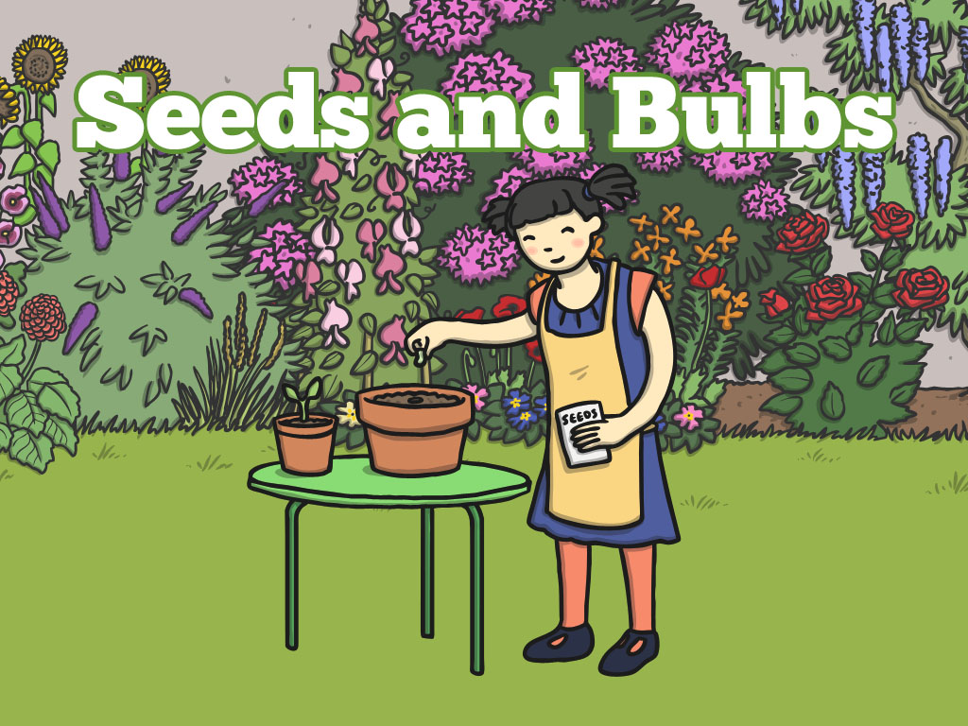


Slide 3
Aim
I can plant seeds and bulbs and suggest how to care for them.
I can make a prediction.
Success Criteria
I can follow instructions to plant a seed and a bulb.
I can suggest how to care for a plant so it grows well.
I can predict which plants will grow well and which will not.

Slide 4
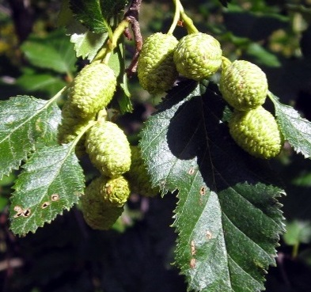
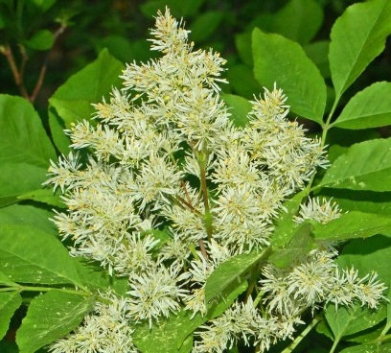
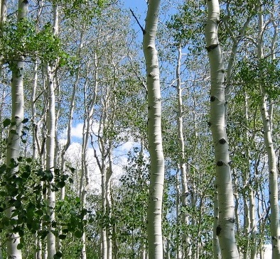
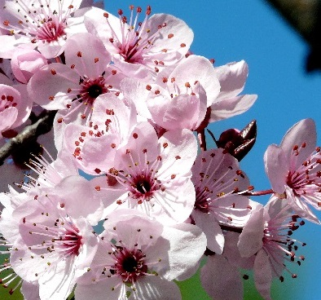
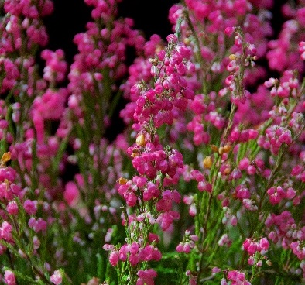
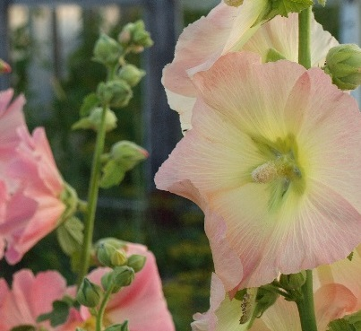
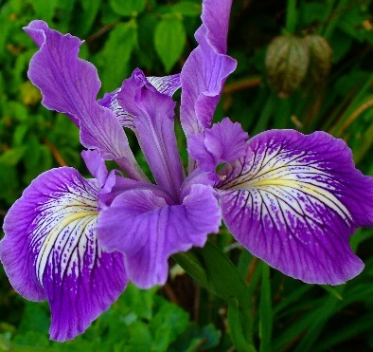
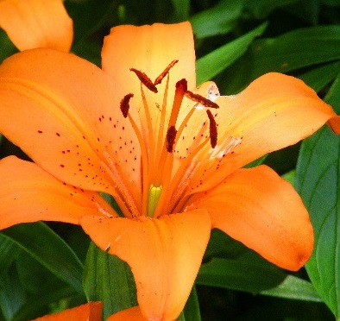
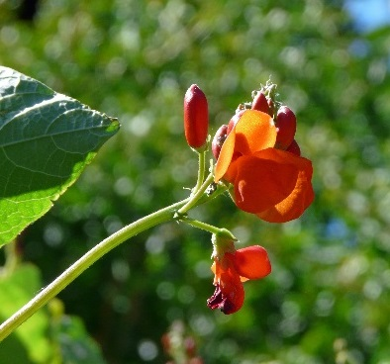
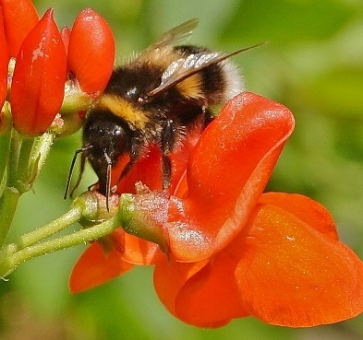
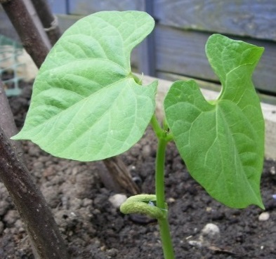
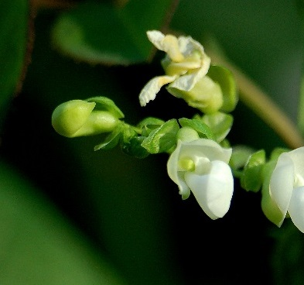
We have been learning about…
Plants.
Photos courtesy of Ruth and Dave, Ettore Balocchi, saaby, .Bambo., flora.cyclam, Dendroica cerulean, Darkroom Daze, Brenda Anderson, Howard Dickins, -adrienne-, free photos for you, rosipaw(@flickr.com) - granted under creative commons licence – attribution

Slide 5
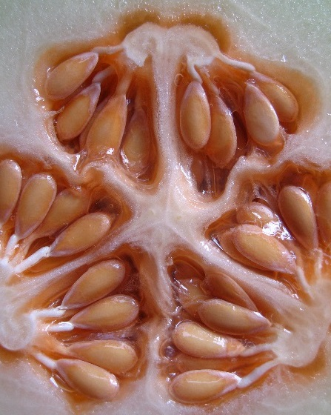
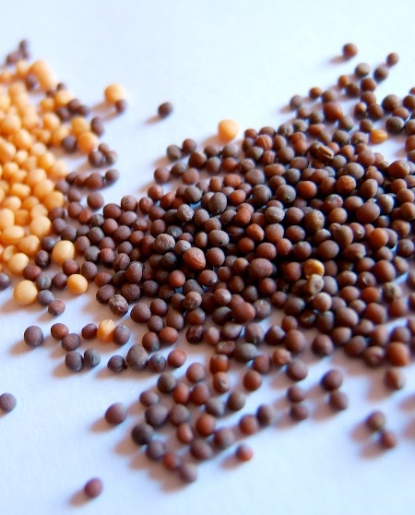
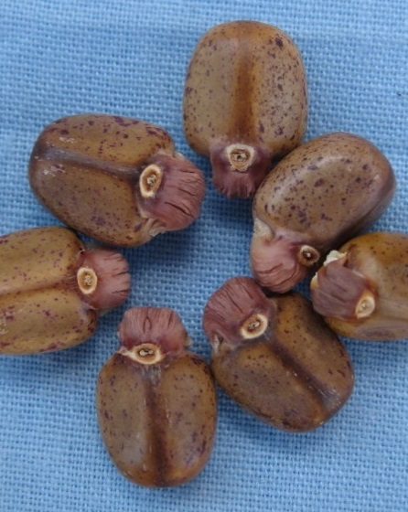
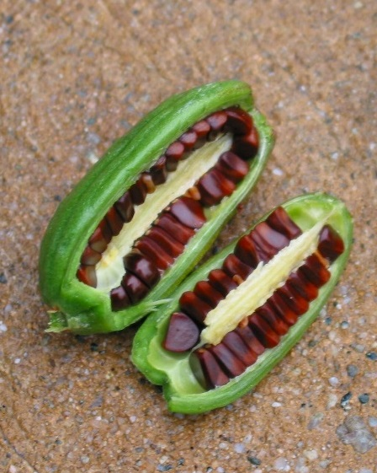
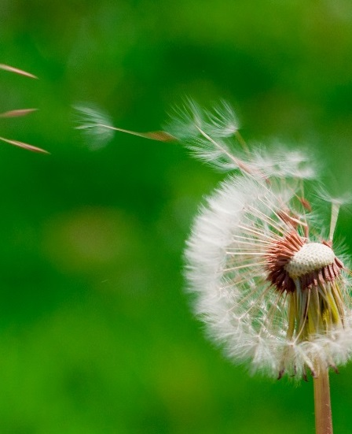
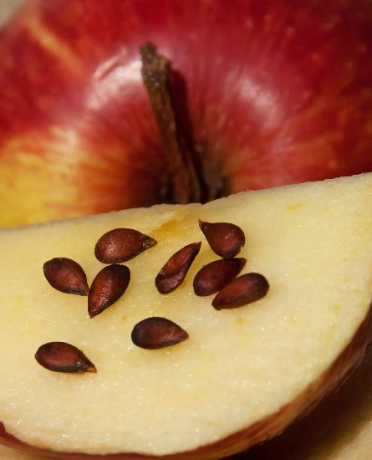
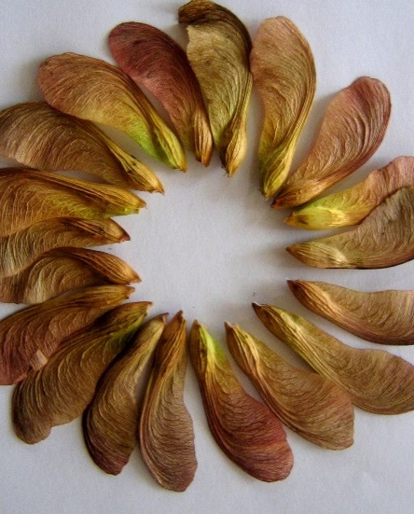
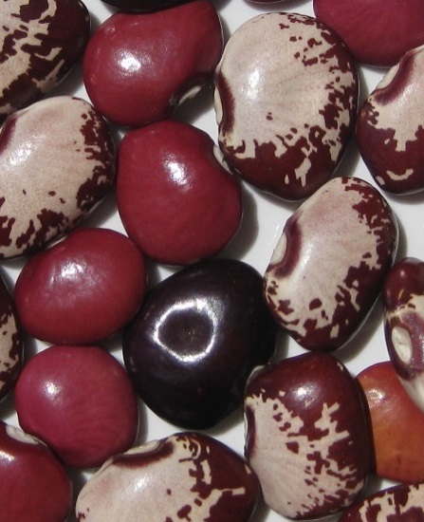
Seeds and Bulbs
The first stage in the life cycle of most plants is a seed.
Seeds come in all shapes and sizes. Every plant has a different seed.
Photos courtesy of Xerones, WordRidden, tonrulkens, Peter Kaminski, LifeSupercharger, Leonard John Matthews, Ctd 2005, tonrulkens (@flickr.com) - granted under creative commons licence – attribution

Slide 6

Seeds and Bulbs
Every single seed has the beginnings of a new plant inside it, along with a little store of food to help it grow.
When the conditions are right, the seed soaks up water and swells, and the tiny new plant bursts out of its shell. This is called germination.
Seed Coat:
A tough outer covering.
Embryo:
The tiny root and shoot which will grow into the adult plant.
Food Store:
A Store of food for the young plant to use until it has grown enough to make its own food.

Slide 7
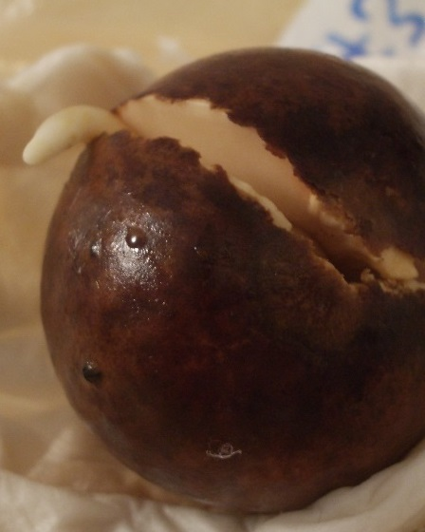
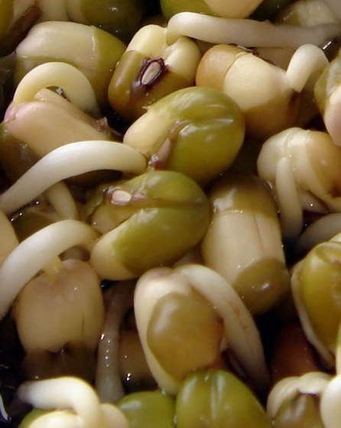
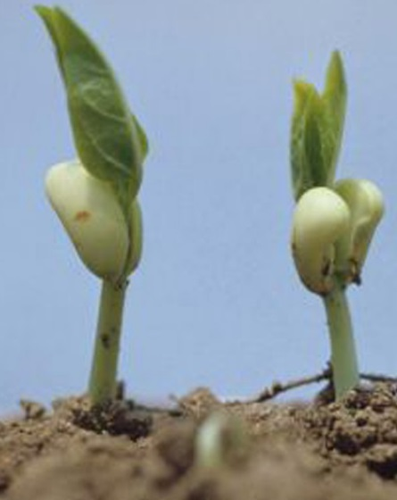
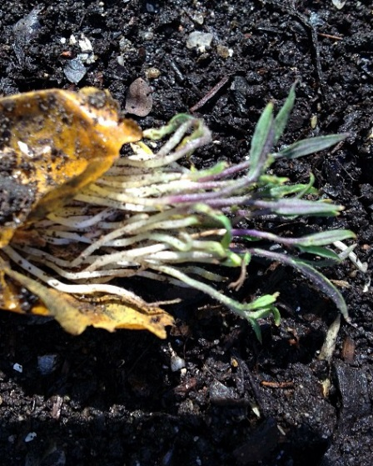
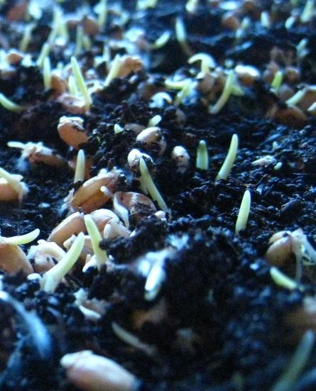
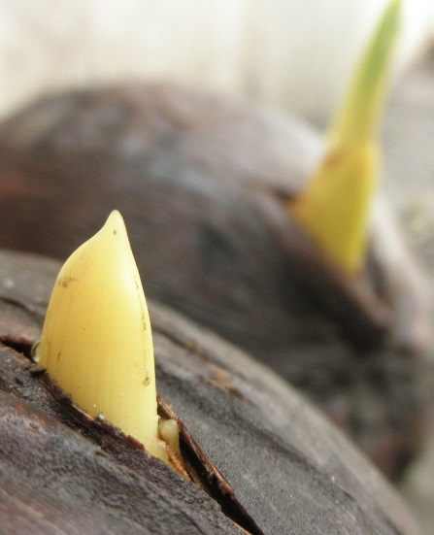
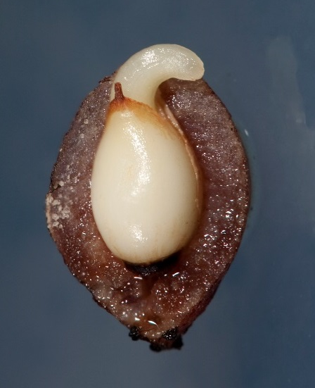
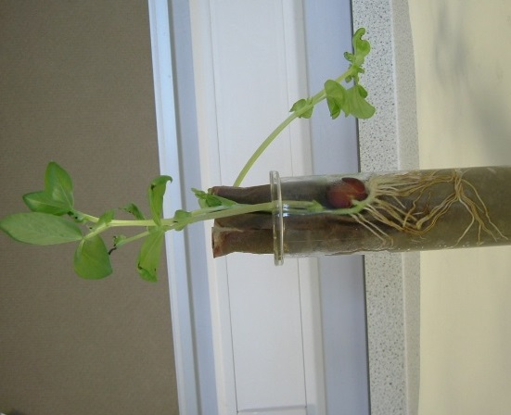

Seeds and Bulbs: Germination
Here are some different plants in the process of germinating.
Click the button below to find out more about germination.
Photos courtesy of Maria Keays, gadl, IITA Image Library, Kristine Paulus, Royal Tasmanian Botanical Gardens, solylunafamilia, thienzieyung, tjmwatson (@flickr.com) - granted under creative commons licence – attribution

Slide 8
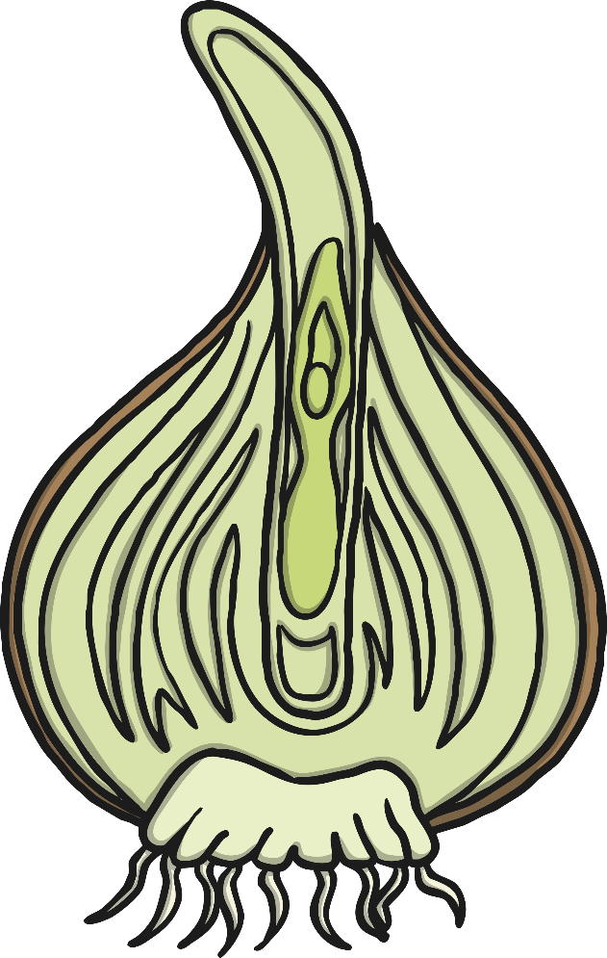
Seeds and Bulbs
Some plants grow first from a seed, and then develop a bulb that helps them to grow back year after year.
A bulb lets the plant rest underground over the winter when it is too cold, then grow back later in the year when conditions are right.
Flower Bud:
Future flower stored inside the bulb for protection.
Tunic:
A papery outer covering.
Scales:
Thick leaves that store the food.
Roots
Stem

Slide 9
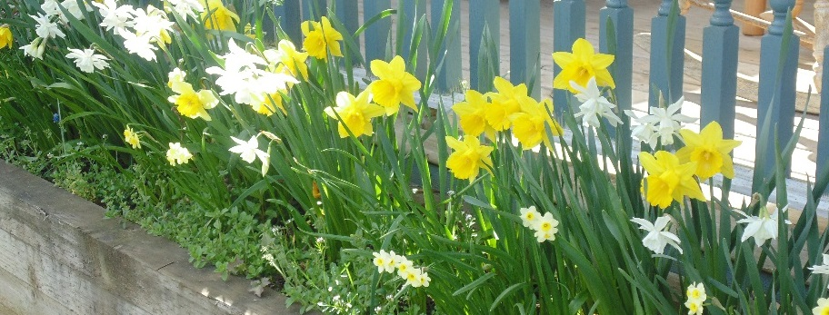
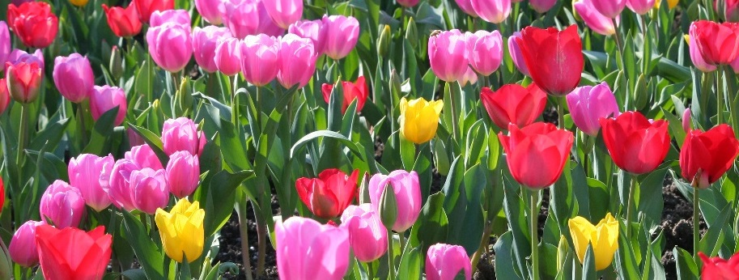
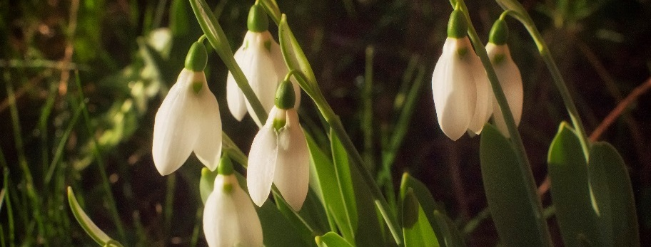
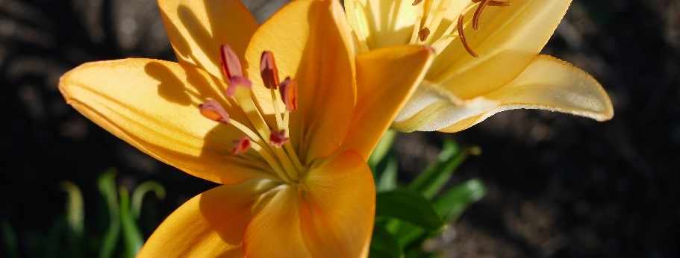
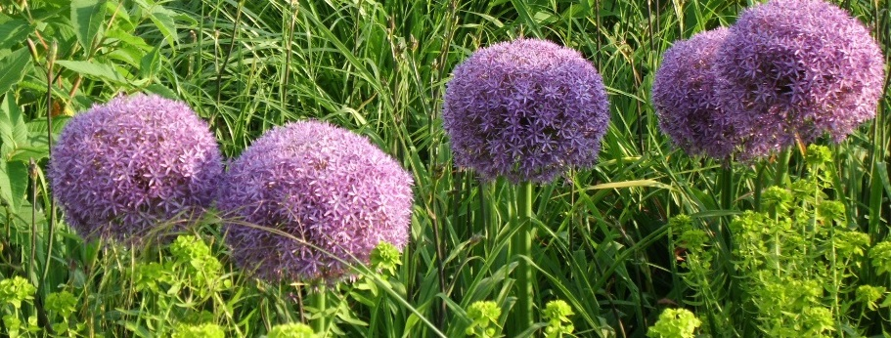
Seeds and Bulbs
Here are some common plants that grow from bulbs.
Daffodils, tulips, snowdrops, lilies and alium.
Photos courtesy of BluebearsLair, John-Morgan, ecstaticist, F. D. Richards, corsi photo (@flickr.com) - granted under creative commons licence – attribution

Slide 10
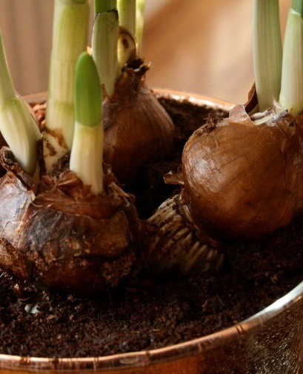
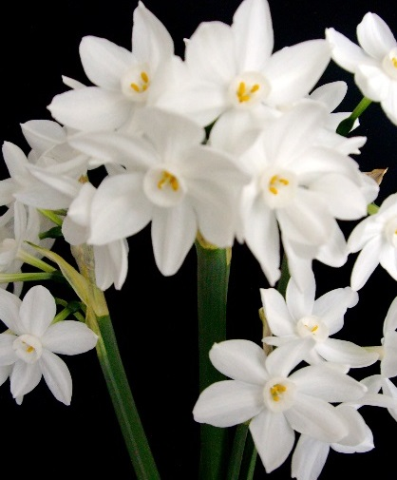
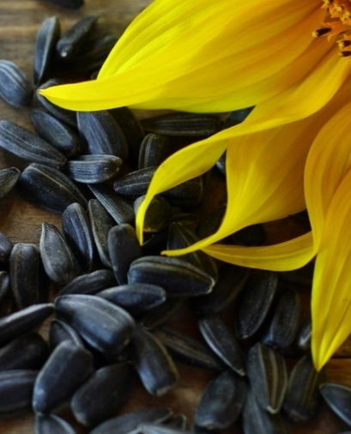
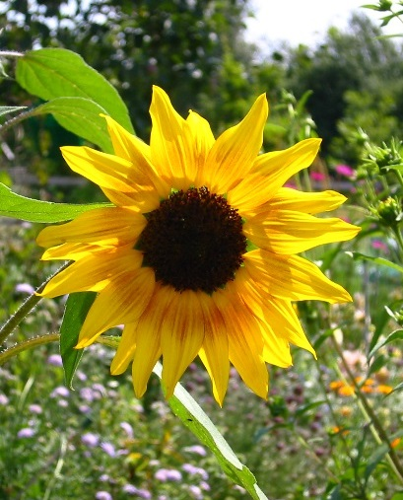
Seeds and Bulbs
We are going to plant a seed and a bulb each,
so we can compare how they grow.
Comparing means looking closely to see what
is similar and what is different.
Paperwhite Narcissus
Dwarf Sunflower
Photos courtesy of BluebearsLair, John-Morgan, ecstaticist, F. D. Richards, corsi photo (@flickr.com) - granted under creative commons licence – attribution

Slide 11


What Do Plants
Need to Grow?
Seeds and bulbs need to wait for conditions to be just right before seeds can germinate and bulbs can sprout new growth.
What do you think that our plants will need so they can sprout and grow well?

Slide 12

What Do Plants
Need to Grow?
How can we find out if
you are right?

Slide 13

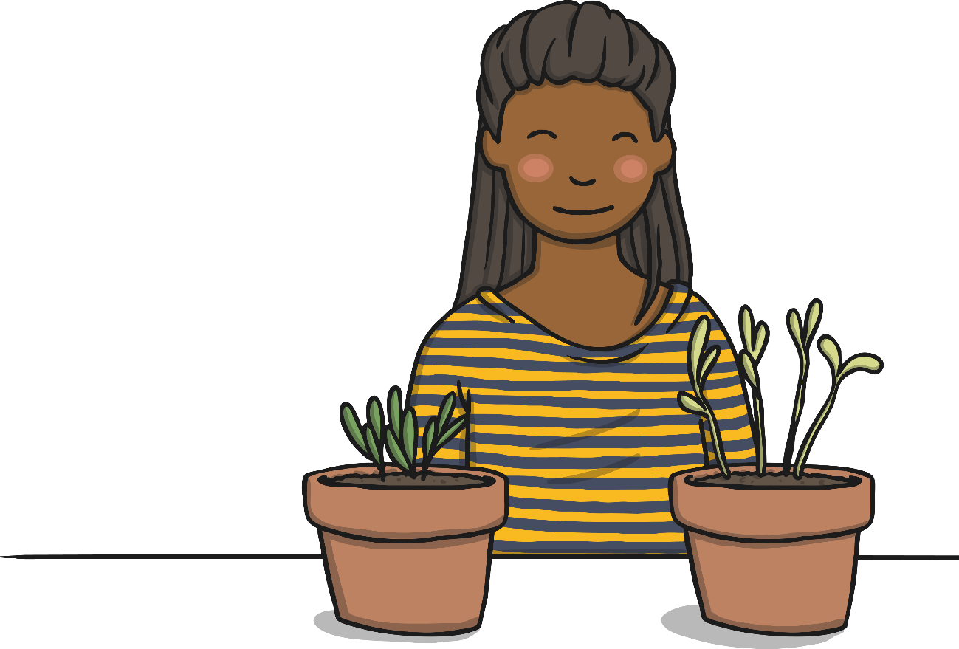
Planting
Josh and Tom are going to plant our seeds and bulbs for us, and are going to plant watermelon seeds and set up a comparative test.
In our comparative test, we are going to plant the same seeds in each pot, and compare how they grow under different conditions.
This will help us to learn what plants need to grow well.

Slide 14
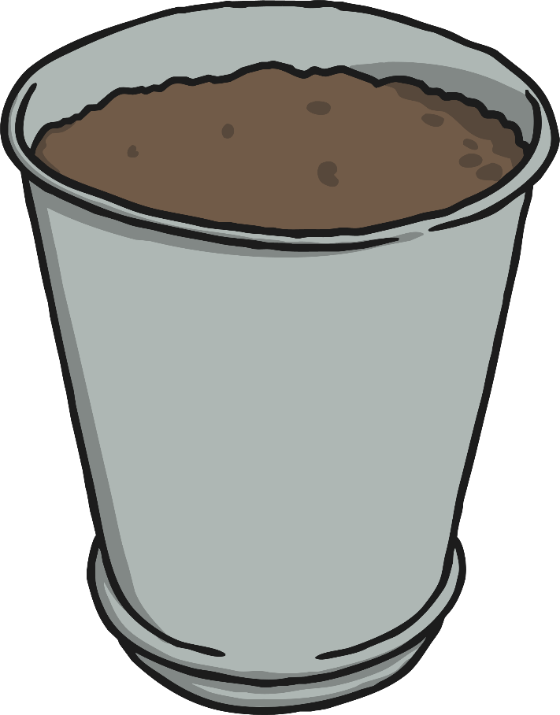
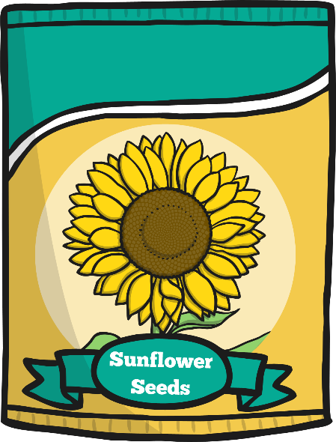
Planting
These are the instructions Josh and Tom Followed to set up your test.
You will need:
4 watermelon test seed
1 dwarf sunflower seed
1 bulb
7 plant pots
Soil

Slide 15
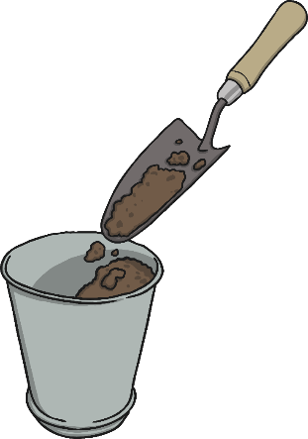
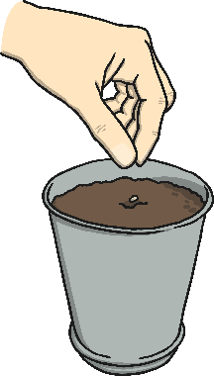
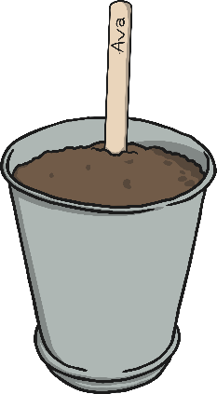

Planting
1
Fill your
pot half
full of soil.
2
Plant the seed or bulb in the soil.
3
Cover the seeds and bulbs with more soil.
4
We put the seeds and bulbs in a warm and sunny spot.

Slide 16

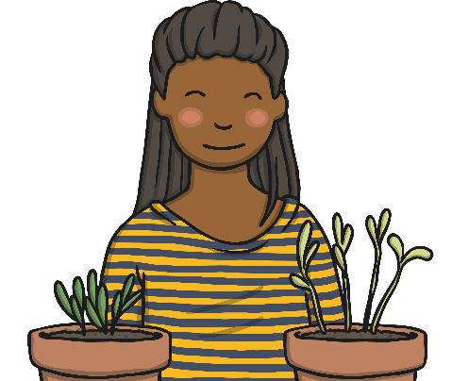
Plant Growth
Comparative Test
We are going to use the 4 watermelon seeds to compare the growth of the seeds under different conditions
One seed will be given water and sunlight.
One seed will be given water but no sunlight.
One seed will be given sunlight and no water.
One seed will be given no sunlight and no water.
What do you think will happen to each of the seeds?

Slide 17

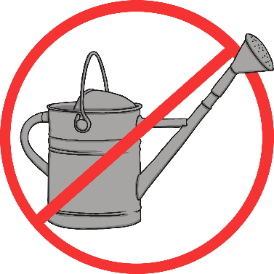
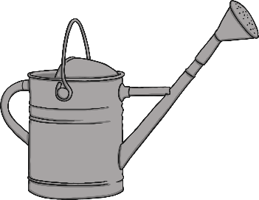

Plant Growth
Comparative Test
What conditions does each plant need? Where should they go?

Slide 18
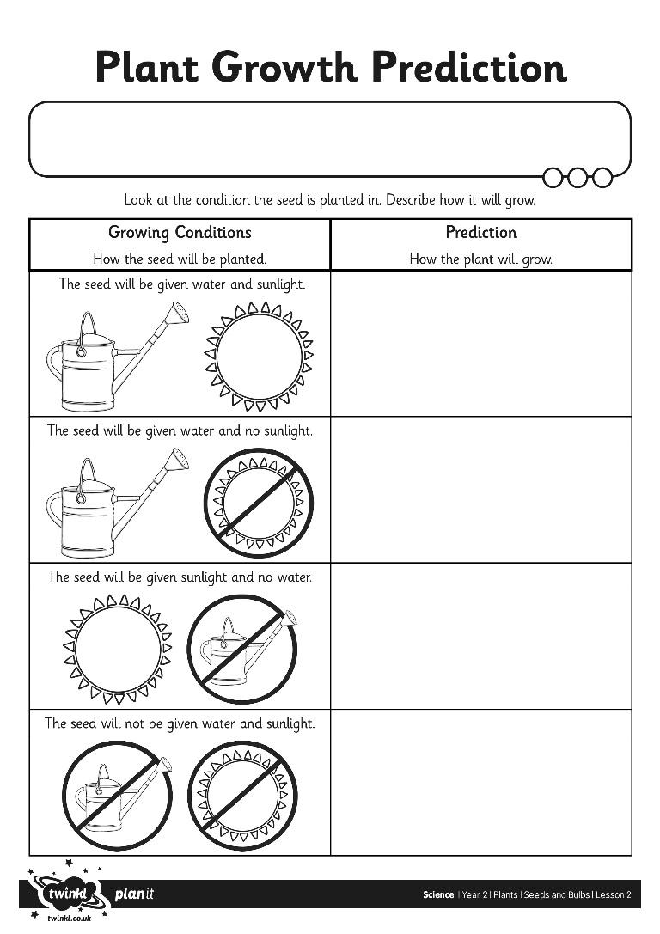
Plant Growth Predictions

Slide 19
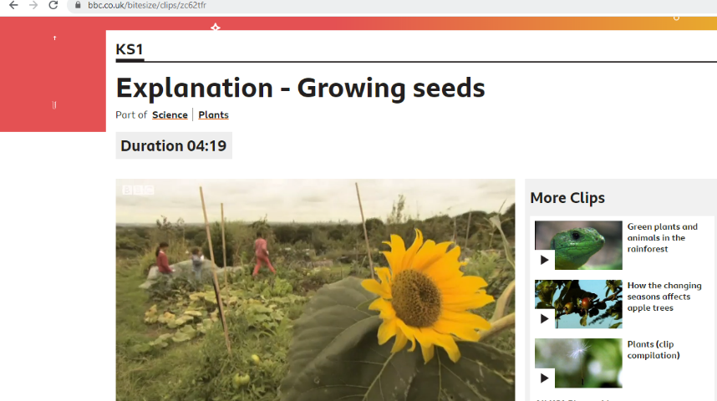

What Plants Need to Grow
What the following clips
https://www.bbc.co.uk/bitesize/clips/zc62tfr
https://www.bbc.co.uk/bitesize/topics/zpxnyrd/articles/zxxsyrd

Slide 20


Plant Growth Predictions
Which seed did we predict would grow the best?
What conditions should we give our sunflower
and plants so that they grow well?

Slide 21


Seed or Bulb? Quiz
On the next slides are
some foods that we eat.
Can you guess if the
food is a seed or a bulb?

Slide 22

Peas
Seed
Bulb
Photos courtesy of Haprog_ (@flickr.com) - granted under creative commons licence – attribution

Slide 23

Correct!
A pea is a seed. Well done!
Photos courtesy of issyeyre (@flickr.com) - granted under creative commons licence – attribution

Slide 24
Bad luck!
A pea is actually a seed.
Photos courtesy of issyeyre (@flickr.com) - granted under creative commons licence – attribution

Slide 25

Onion
Seed
Bulb
Photos courtesy of feesta (@flickr.com) - granted under creative commons licence – attribution

Slide 26

Correct!
An onion is a bulb. Well done!
Photos courtesy of slgckgc (@flickr.com) - granted under creative commons licence – attribution

Slide 27
Bad luck!
An onion is actually a bulb.
Photos courtesy of slgckgc (@flickr.com) - granted under creative commons licence – attribution

Slide 28

Coconut
Seed
Bulb
Photos courtesy of YIM Hafiz (@flickr.com) - granted under creative commons licence – attribution

Slide 29

Correct!
A coconut is a seed. Well done!
Photos courtesy of Koshyk (@flickr.com) - granted under creative commons licence – attribution

Slide 30
Bad luck!
A coconut is actually a seed.
Photos courtesy of Koshyk (@flickr.com) - granted under creative commons licence – attribution

Slide 31

Sweetcorn
Seed
Bulb
Photos courtesy of Aimee Steen (@flickr.com) - granted under creative commons licence – attribution

Slide 32

Correct!
A corn kernel is a seed. Well done!
Photos courtesy of phatcontroller (@flickr.com) - granted under creative commons licence – attribution

Slide 33
Bad luck!
A corn kernel is actually a seed.
Photos courtesy of phatcontroller (@flickr.com) - granted under creative commons licence – attribution

Slide 34

Garlic
Seed
Bulb
Photos courtesy of grongar (@flickr.com) - granted under creative commons licence – attribution

Slide 35

Correct!
Garlic is a bulb. Well done!
Photos courtesy of Tony Austin (@flickr.com) - granted under creative commons licence – attribution

Slide 36
Bad luck!
Garlic is actually a bulb.
Photos courtesy of Tony Austin (@flickr.com) - granted under creative commons licence – attribution

Slide 37

Aim
I can plant seeds and bulbs and suggest how to care for them.
I can make a prediction.
Success Criteria
I can follow instructions to plant a seed and a bulb.
I can suggest how to care for a plant so it grows well.
I can predict which plants will grow well and which will not.

