Slide 1

RE Lesson 3
Which place of worship is sacred for Jewish?
Year One
RE | Year 1 | Places of Worship | Jewish Synagogue | Lesson 2

Slide 2
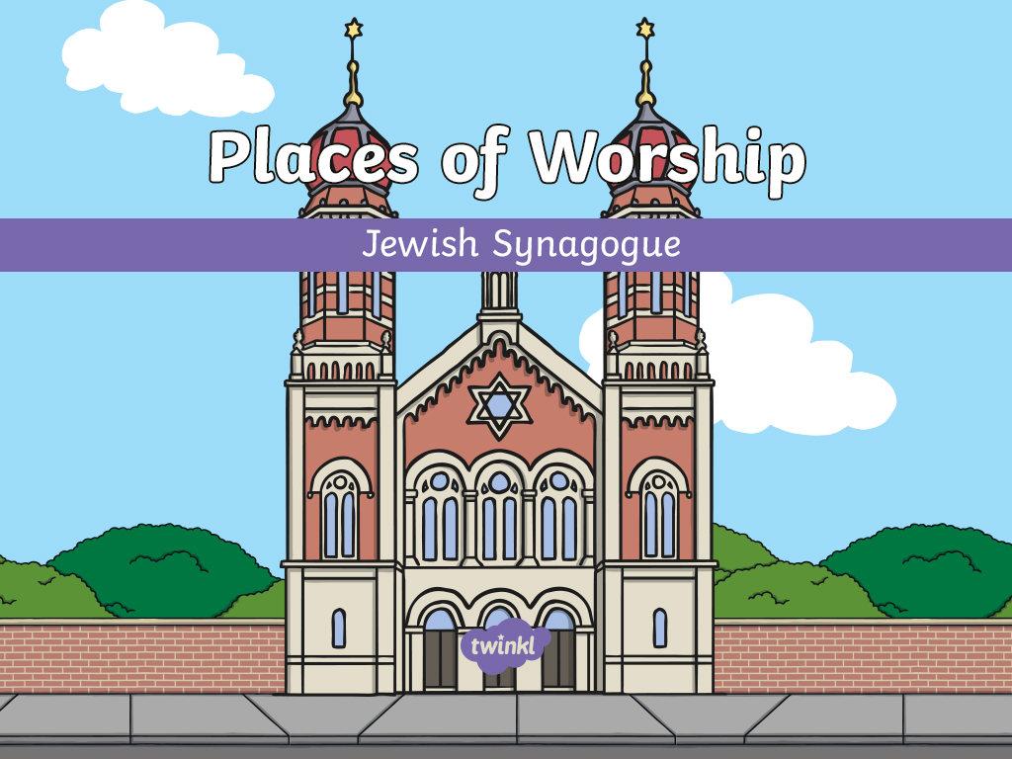

Slide 3
Aim
To discuss key parts of a Jewish synagogue.
Success Criteria
I can explain what a place of worship is.
I can name and talk about some important parts of a Jewish synagogue.
I can talk about some important things that Jewish people believe.
I can identify and name important parts and objects from a synagogue.

Slide 4
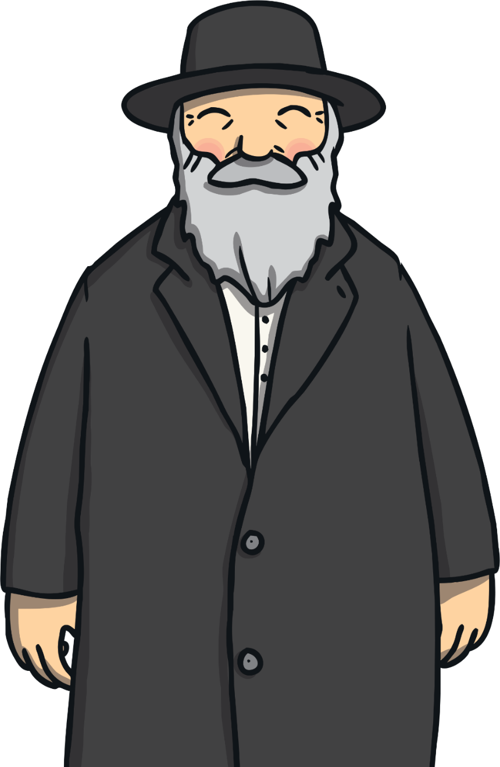

What Is a Place of Worship?
A place of worship is
a special place within a religion where believers go to:
pray;
worship;
learn about their religion;
spend time together as a community.
v
Here’s an idea…

Slide 5
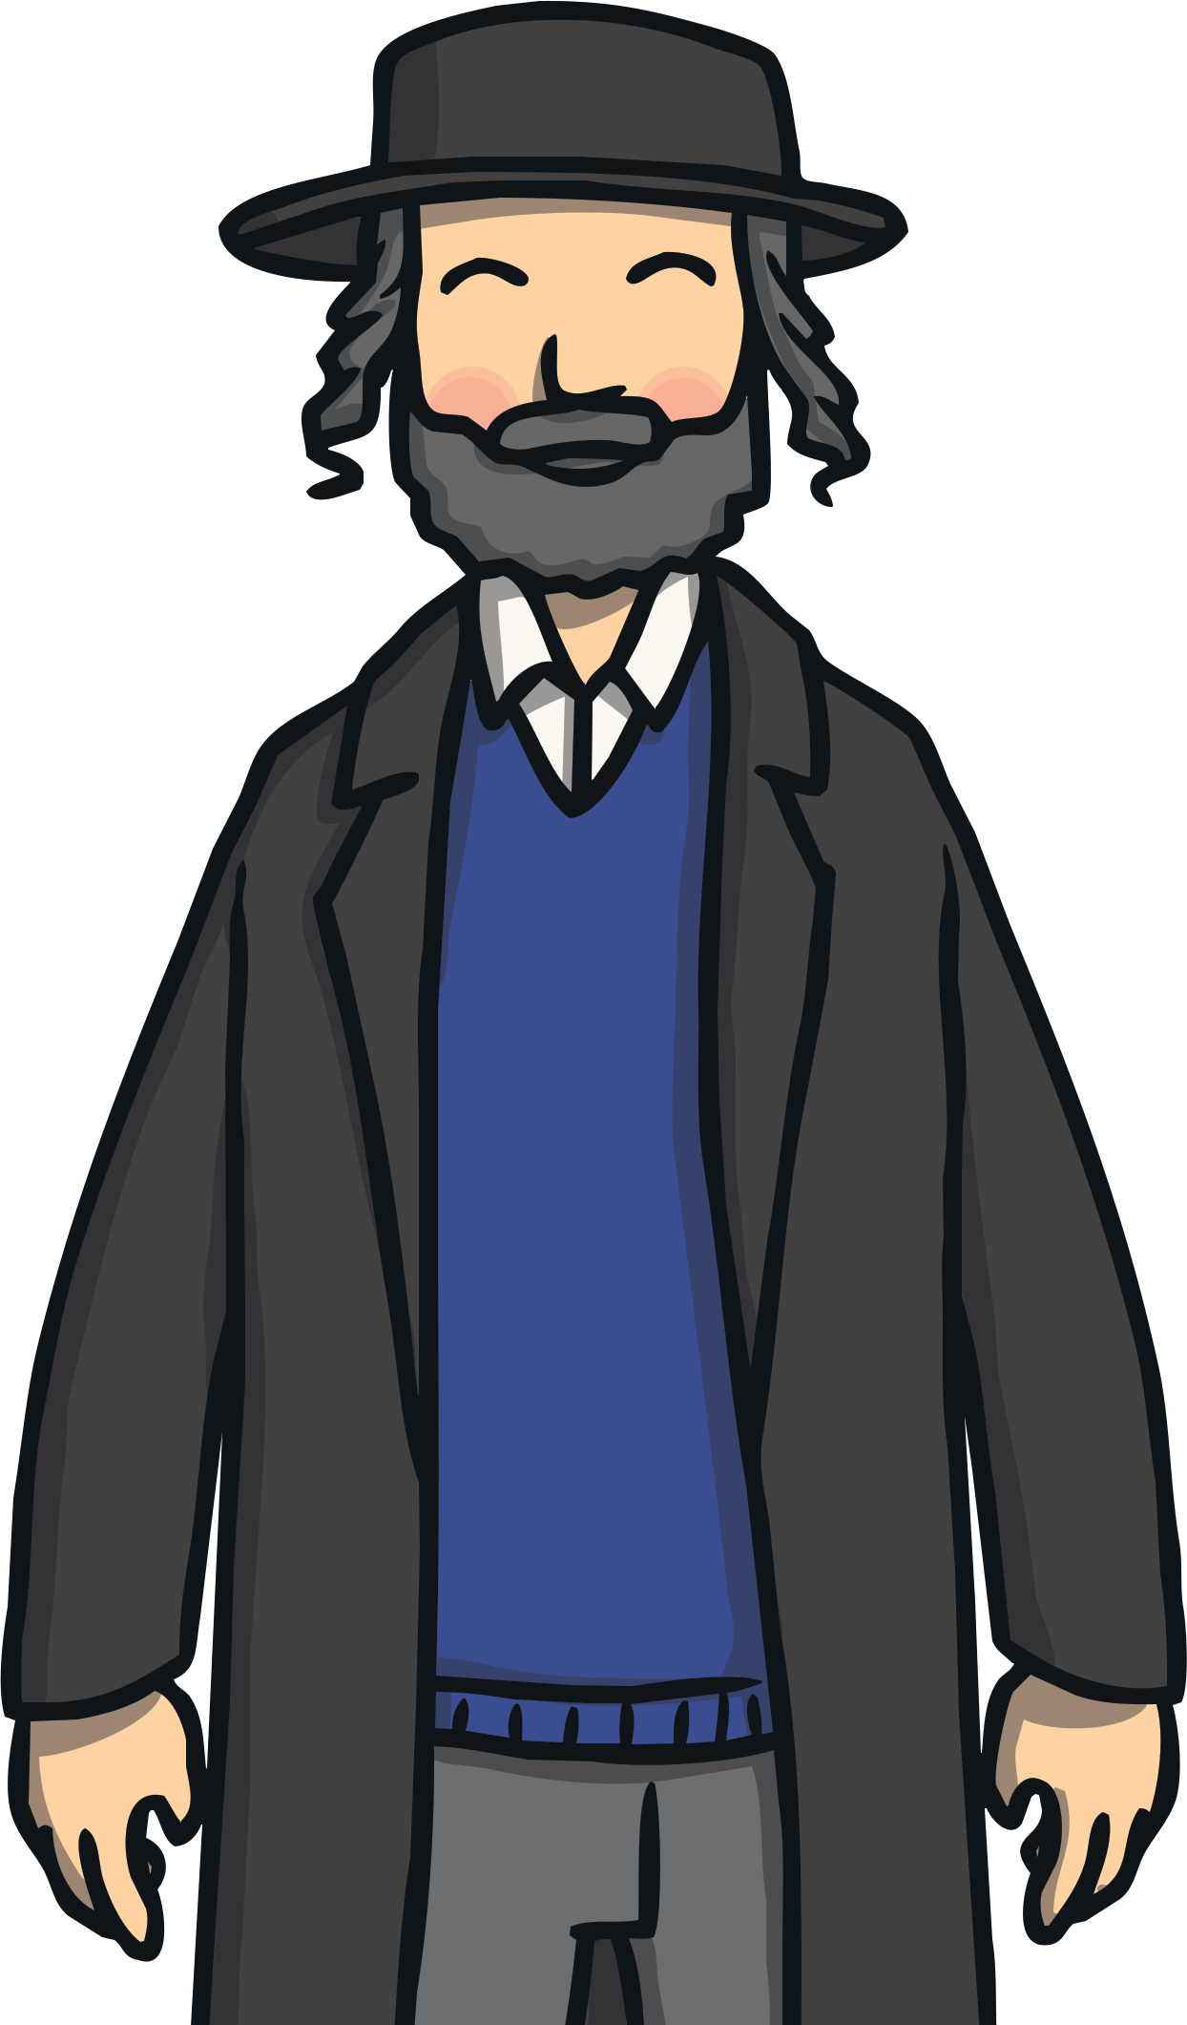
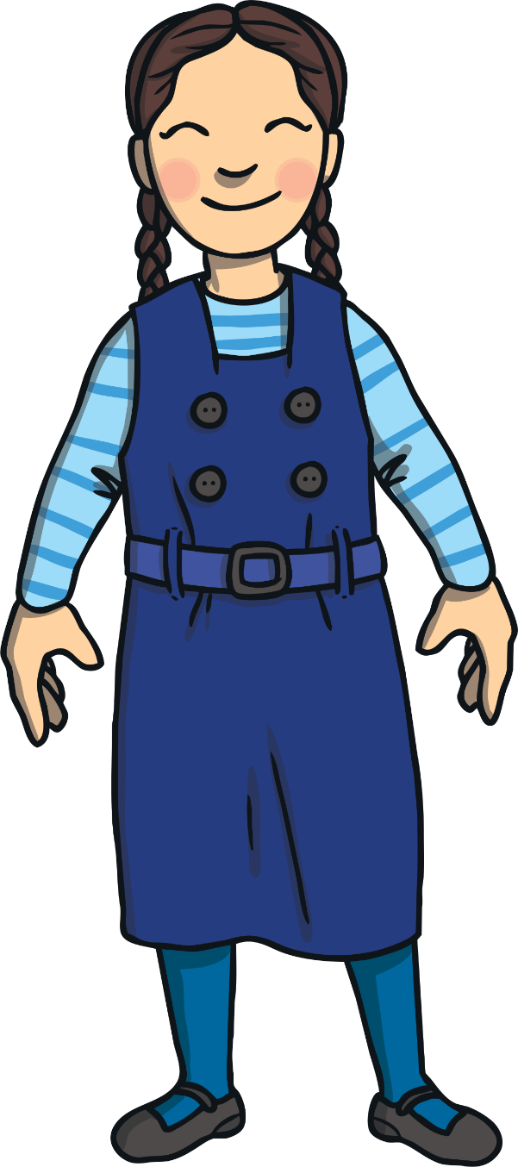

Judaism
Judaism is a religion. People who follow Judaism are called Jews.
v
Did You Know…?
What do you think Jewish people believe?
Jews think God is very holy. They think His name is so holy that it should not be written down. As a sign of respect, Jews write G-d.
Jews believe in one God. They believe God made the world and all people. They believe that God loves them and looks after them.
Jews try to follow important rules to live their lives the way they think God would like them to.

Slide 6
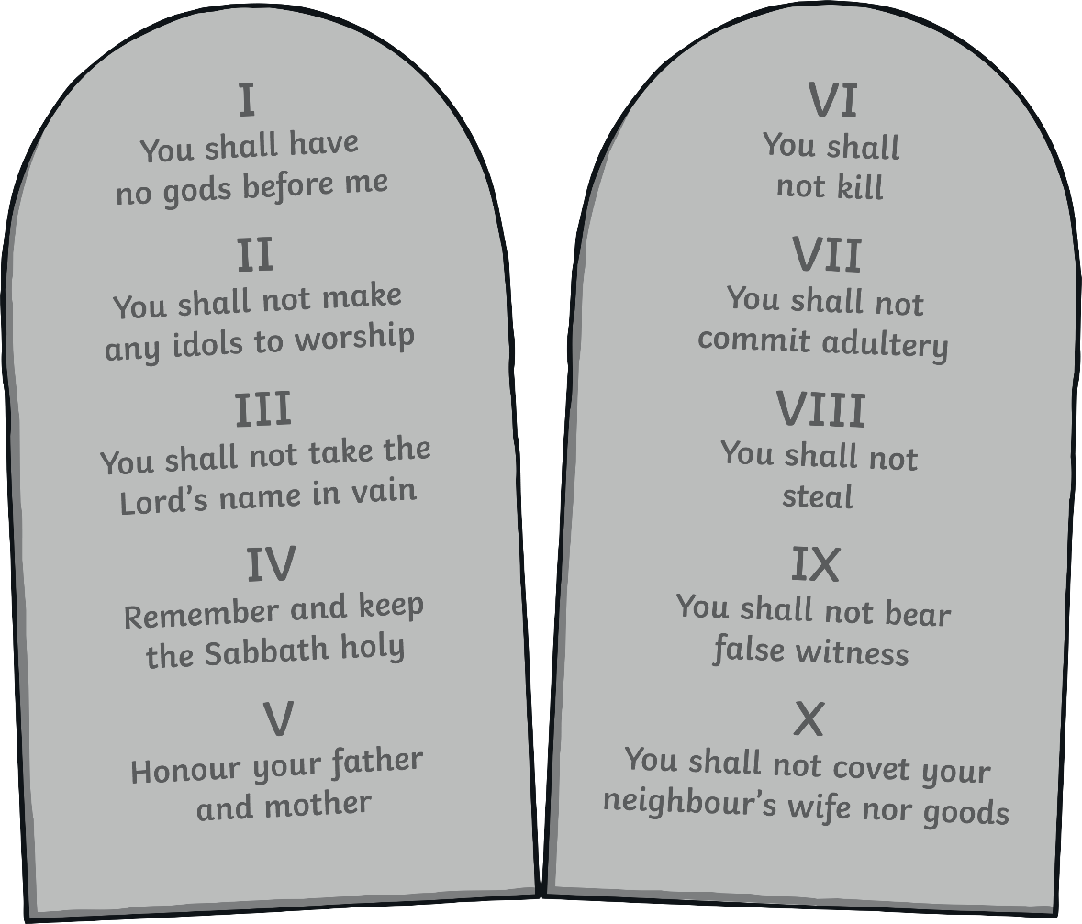
Judaism
What special rules do you think Jews have?
Jews have lots of rules in their special book, the Torah. An important set of rules is the Ten Commandments.
Jews believe God gave the Ten Commandments to Moses. They try to keep all Ten Commandments throughout their lives.

Slide 7
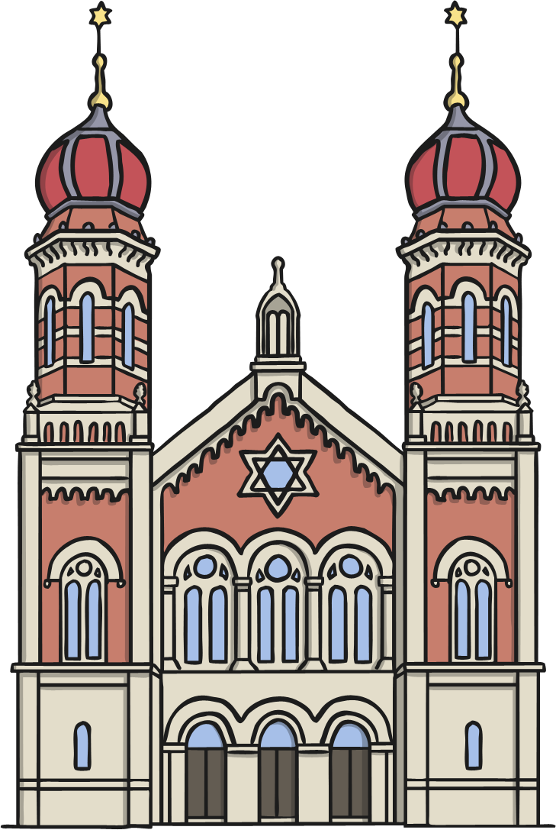
We Might See…
Jews have a special place of worship. They go to this place to pray and worship. They also celebrate special events there.
The Jewish place of worship is called a synagogue.

Slide 8
We Might See…
What kind of things do you think you might see in a synagogue?
Think about some of the things you now know about what Jews believe to help you. Share your ideas with a partner.
v
Use these words to help you:
God
remember
Torah
Ten Commandments
candles
prayer
community
love

Slide 9
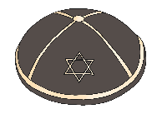
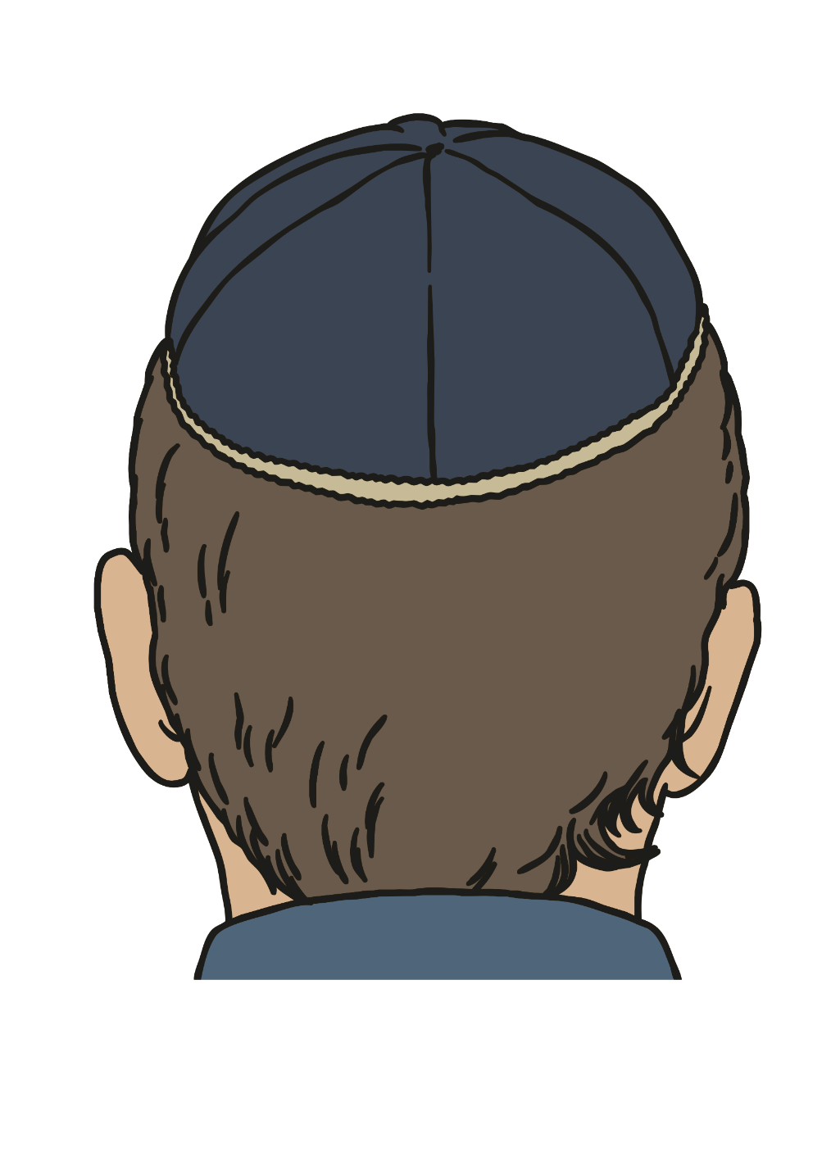
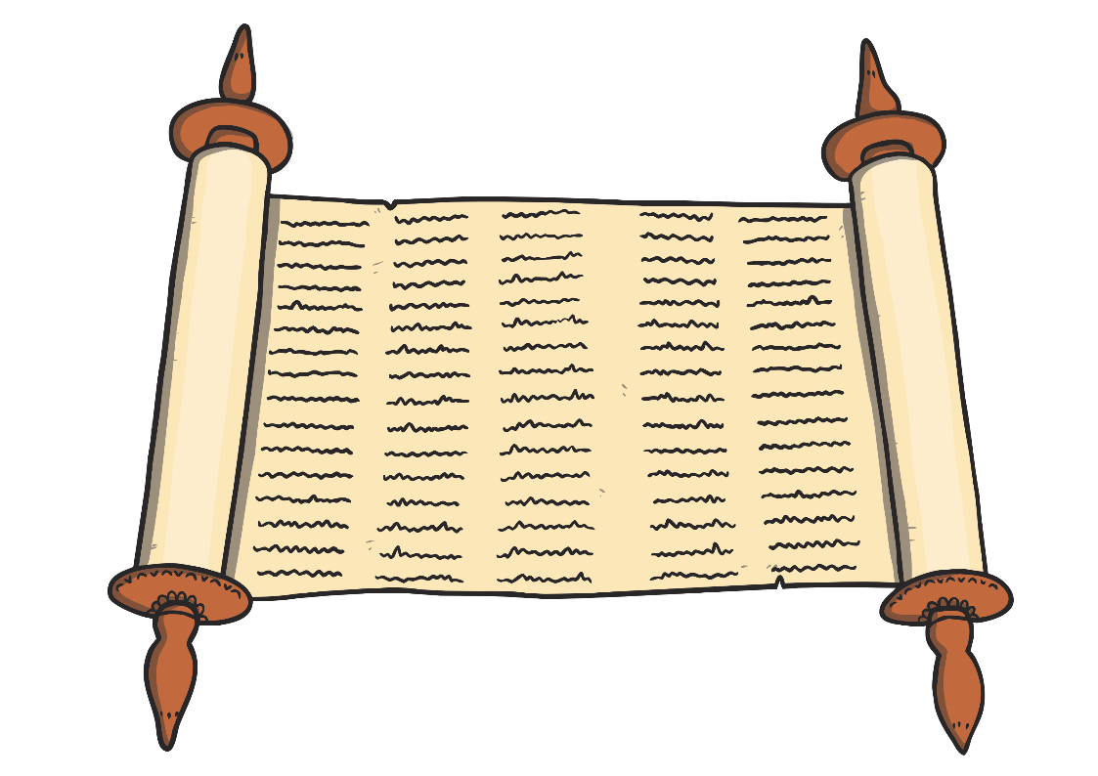
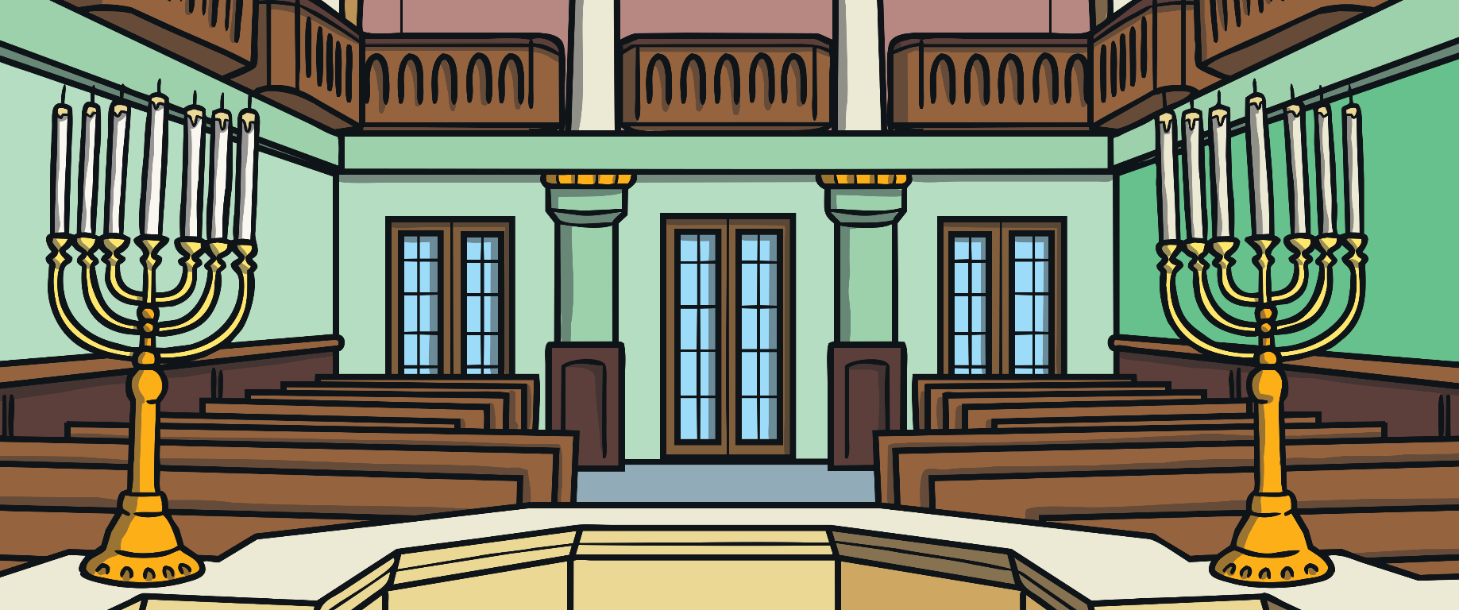
In a Synagogue
v
v
Let’s take a look inside a synagogue. Before we go inside, there are some important rules we must follow. Many places of worship have special rules for people to follow as a way of showing respect.
Be quiet
Cover your head
A synagogue is used for different things. Some of these things, like prayer, are quiet things. It is important to be aware of how quiet things are inside, so that you can be respectful of people who might be thinking in silence.
Most people in a synagogue cover their heads. Men wear a special cap called a kippah. Women also cover their heads. Some children and young people do not have to cover their heads.

Slide 10

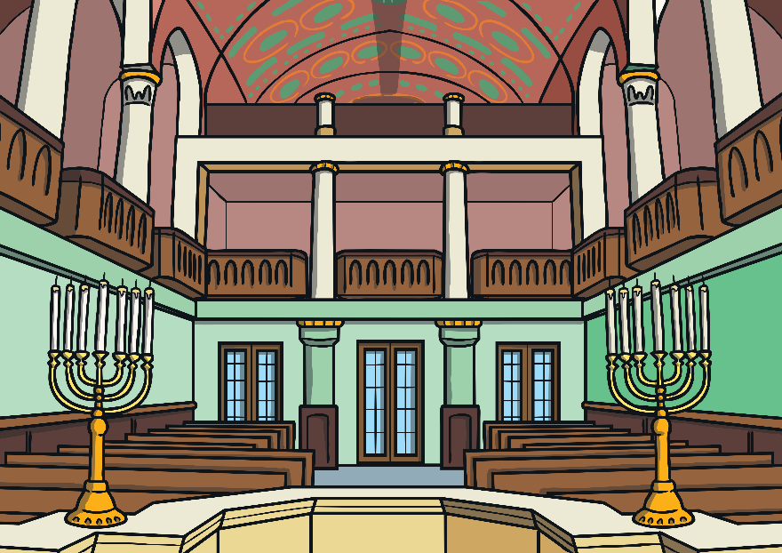
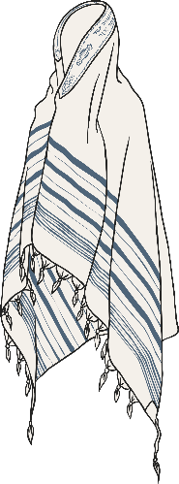
In a Synagogue
v
Prayer Room
This is where Jews gather to pray together. In some synagogues, men sit in a different area to the women. Men wear a special shawl, called a tallit, when they pray.

Slide 11
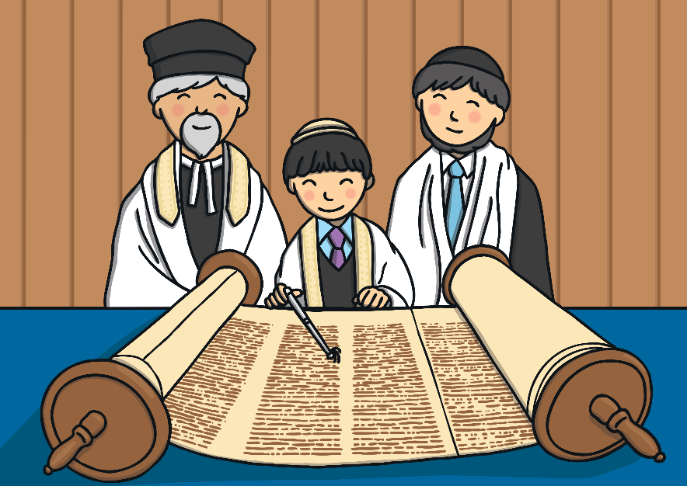
In a Synagogue
v
The Cantor
This person has a special place in the room to stand. They chant prayers for the rest of the people to join in with.

Slide 12
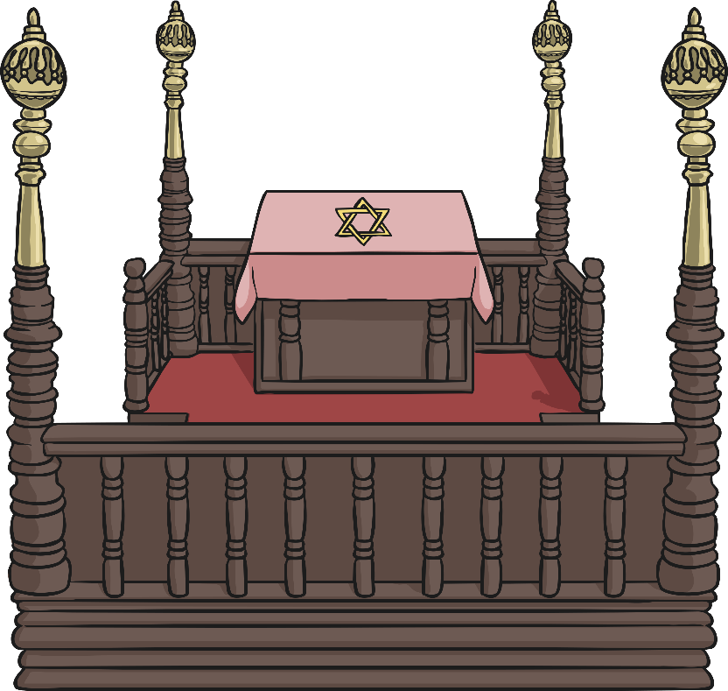
In a Synagogue
v
The Bimah
The Jewish special book is called the Torah. It is sacred to Jewish believers. The bimah is a raised platform where the Torah is placed when it is to be read from. This is often in the middle of the room, or at the end of the room near the ark. The cantor stands here, too.

Slide 13
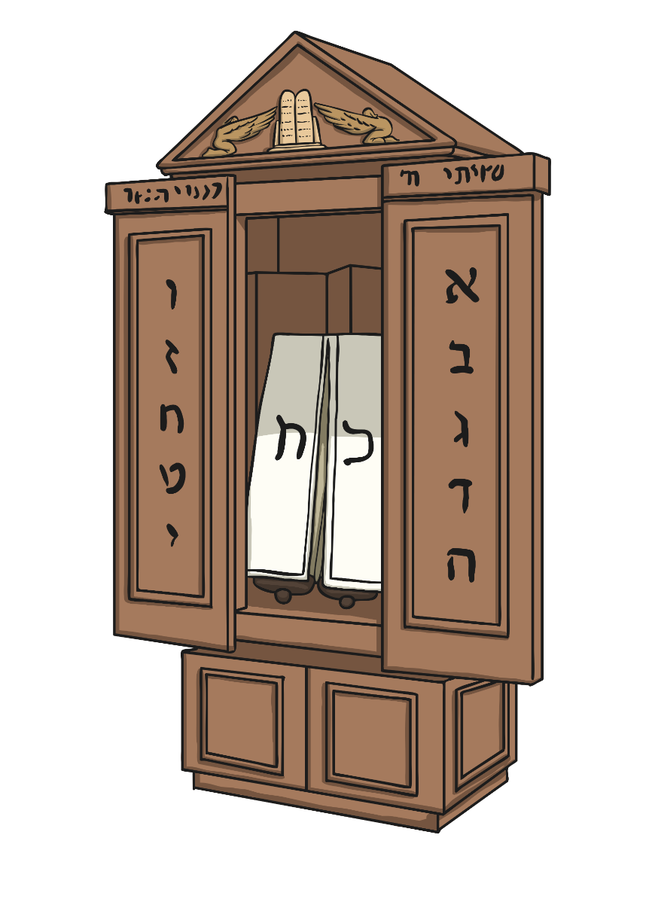
In a Synagogue
v
The Ark
To look after their special book, every synagogue has an ark. This is a special place where the Torah is kept. It is often on the main wall of the synagogue and impressively decorated.

Slide 14
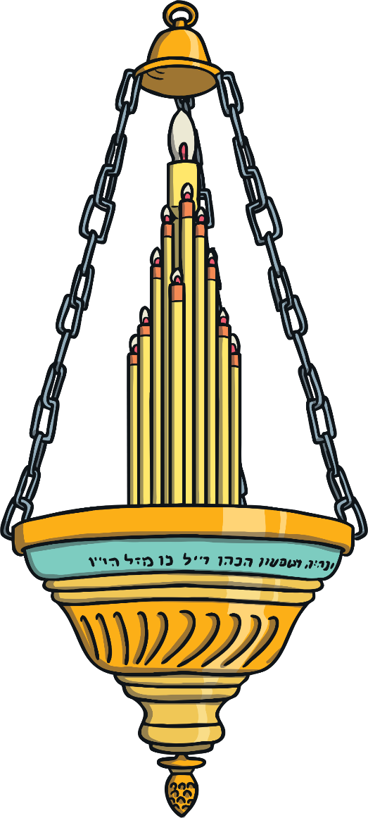
In a Synagogue
v
Eternal Light
In some synagogues, there is a light above the ark. This is called the Eternal Light. Its name comes from a verse in the Torah which says an eternal flame should burn in the temple all the time. It is also a reminder of the candles in the Temple in Jerusalem that stayed lit, which Jews believe was a miracle of God.

Slide 15
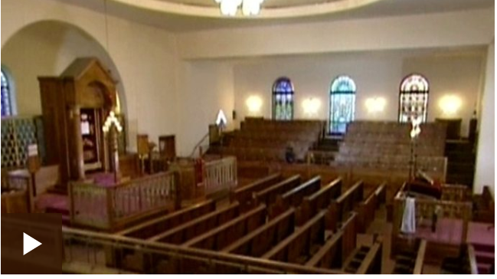
Watch the clip of inside of Synagogue
https://www.bbc.co.uk/bitesize/clips/z834wmn

Slide 16
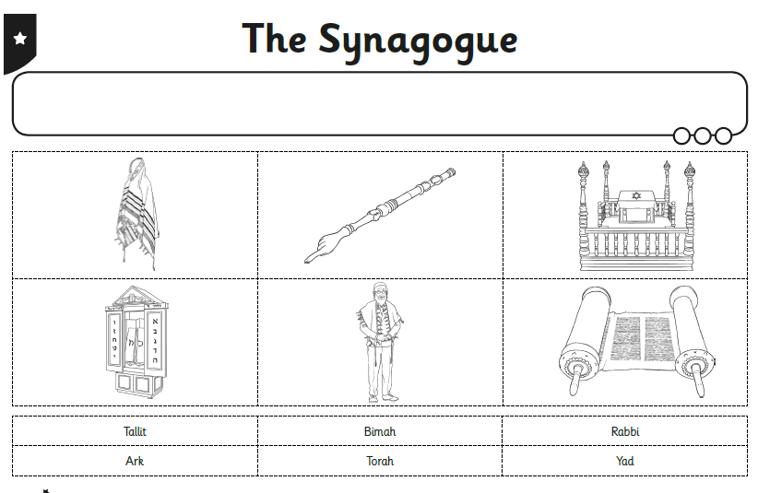
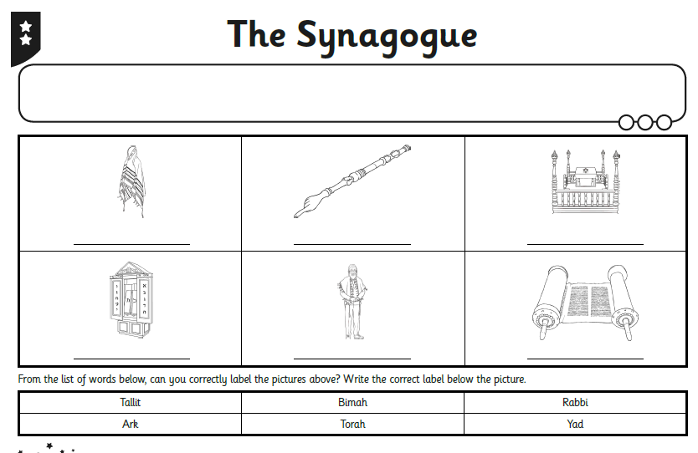
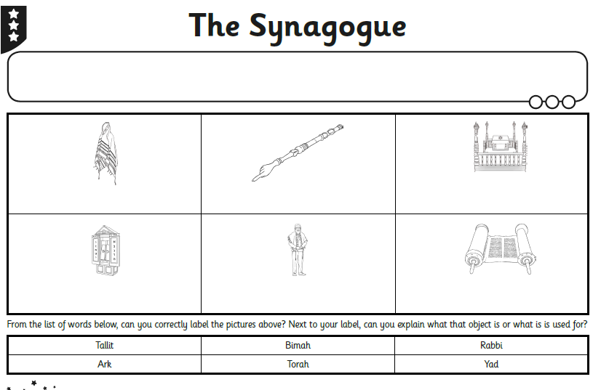
Match It Up!
How much can you remember about the things you might find in a synagogue?
Complete the Parts of a Synagogue Matching Activity Sheet to show much you now know about a synagogue.

Slide 17
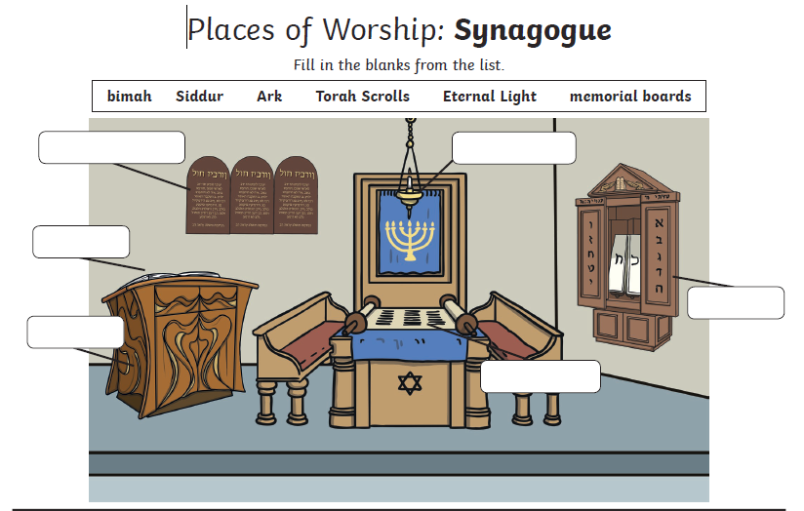

Slide 18
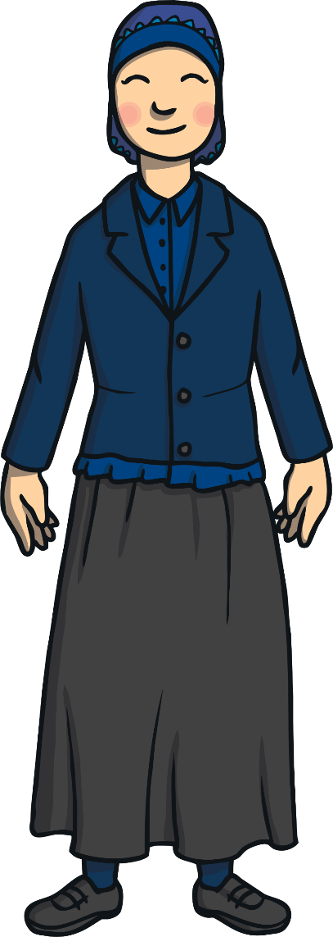
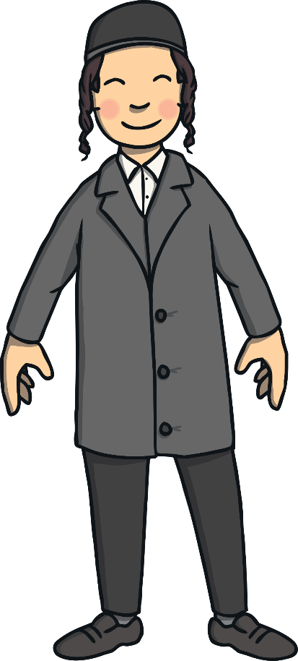

Guess the Object
Can you guess which object from a synagogue this might be?
I am worn by men.
I am blue and white.
I help show respect during prayer.
tallit – a prayer shawl

Slide 19
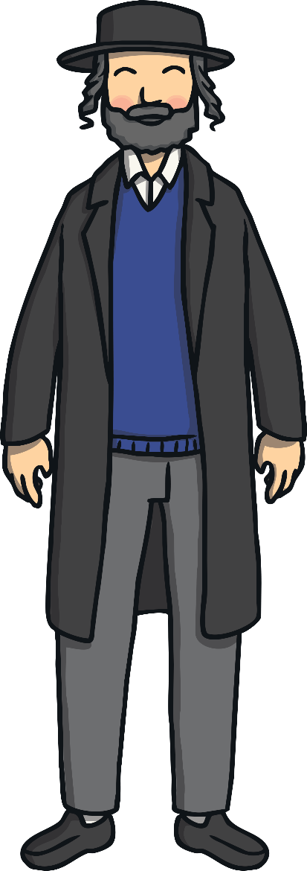


Guess the Object
Can you guess which object from a synagogue this might be?
I am on the main wall of the synagogue.
I look after the Jewish special book.
I am impressive to look at.
ark

Slide 20
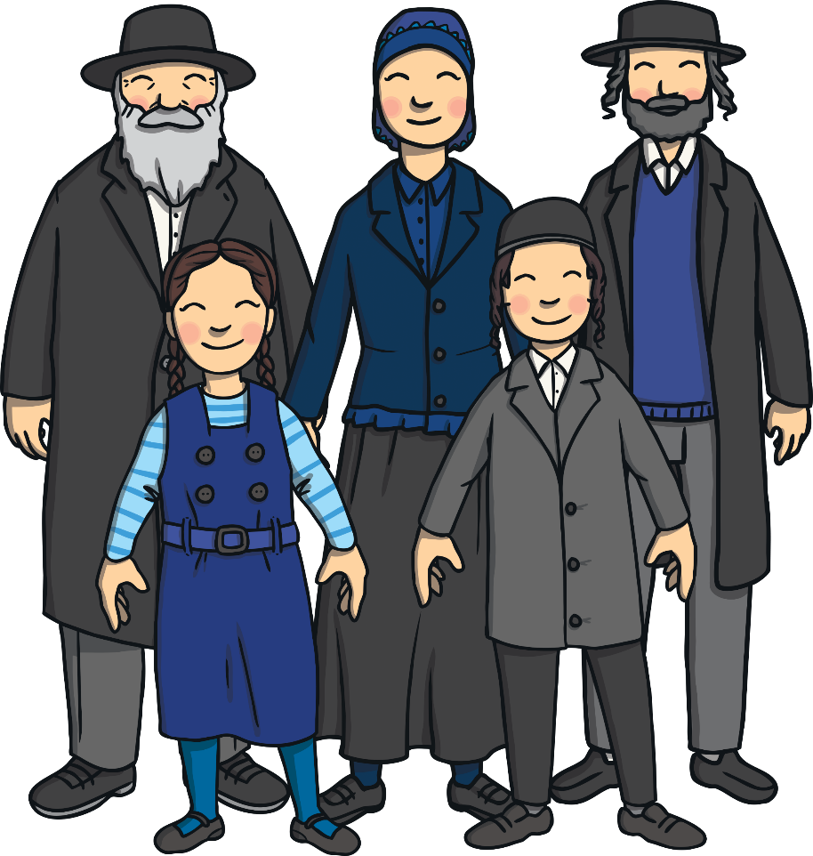
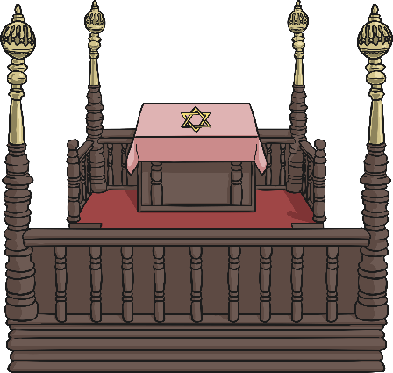
Guess the Object
Can you guess which object from a synagogue this might be?
I am where the cantor stands.
I am where the Torah is placed.
I am in the centre of the room.
bimah

Slide 21

Aim
To discuss key parts of a Jewish synagogue.
Success Criteria
I can explain what a place of worship is.
I can name and talk about some important parts of a Jewish synagogue.
I can talk about some important things that Jewish people believe.
I can identify and name important parts and objects from a synagogue.

