Slide 1

RE lesson 4
Which place of worship is sacred for Muslims?
Year One
RE | Year 2 | Places of Worship | What Is It Like to Visit a Mosque? | Lesson 2

Slide 3
Aim
To explore what it is like to visit a mosque.
Success Criteria
I can identify key features of a mosque.
I can describe what a visitor to a mosque might see.

Slide 4

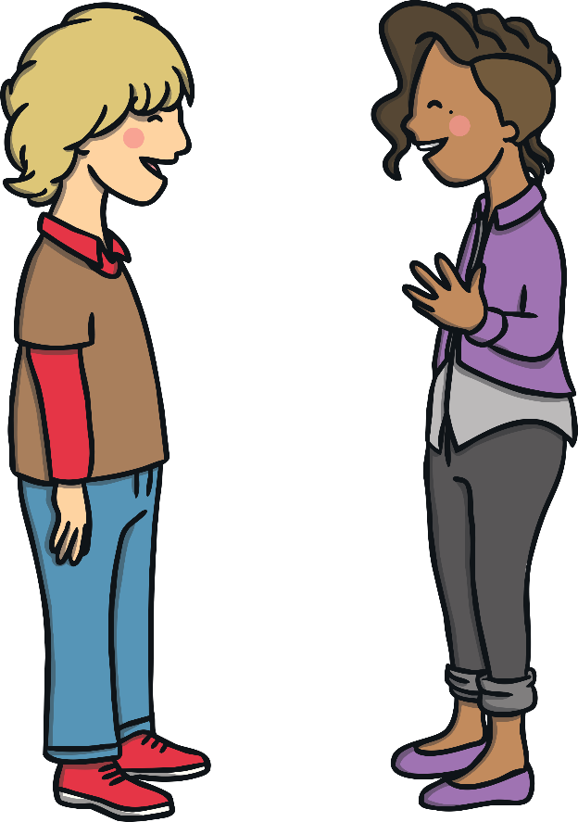
Places of Worship
Discuss these questions with your talk partner:
?
What is a place of worship?
A place of worship is a space or building where people come to pray or worship.
?
Why do people go to a place of worship?
They may go to pray alone or to worship with others. They may go to attend an important ceremony.

Slide 5
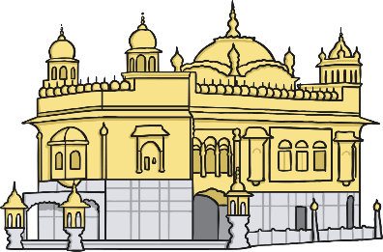
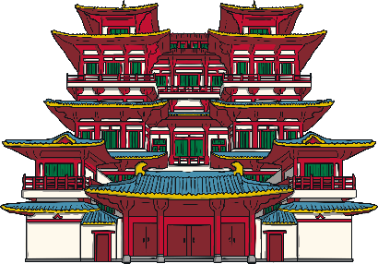
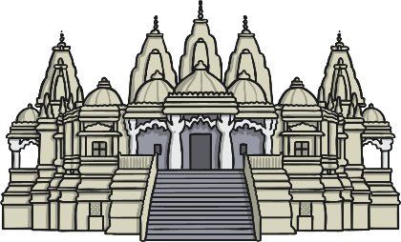
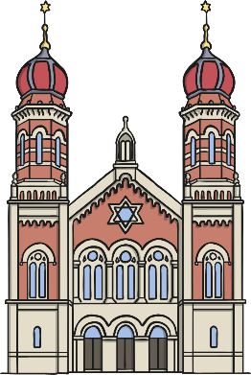

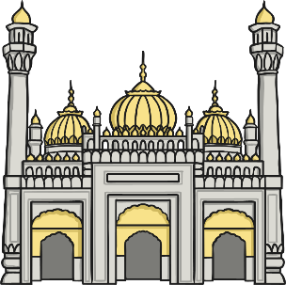
Places of Worship
Do you know what places of worship these images show and what religion they belong to?
Discuss your ideas with your talk partner.
Temple (Buddhism)
Synagogue (Judaism)
Gurdwara (Sikhism)
Mandir (Hinduism)
Mosque (Islam)
Church (Christianity)

Slide 6

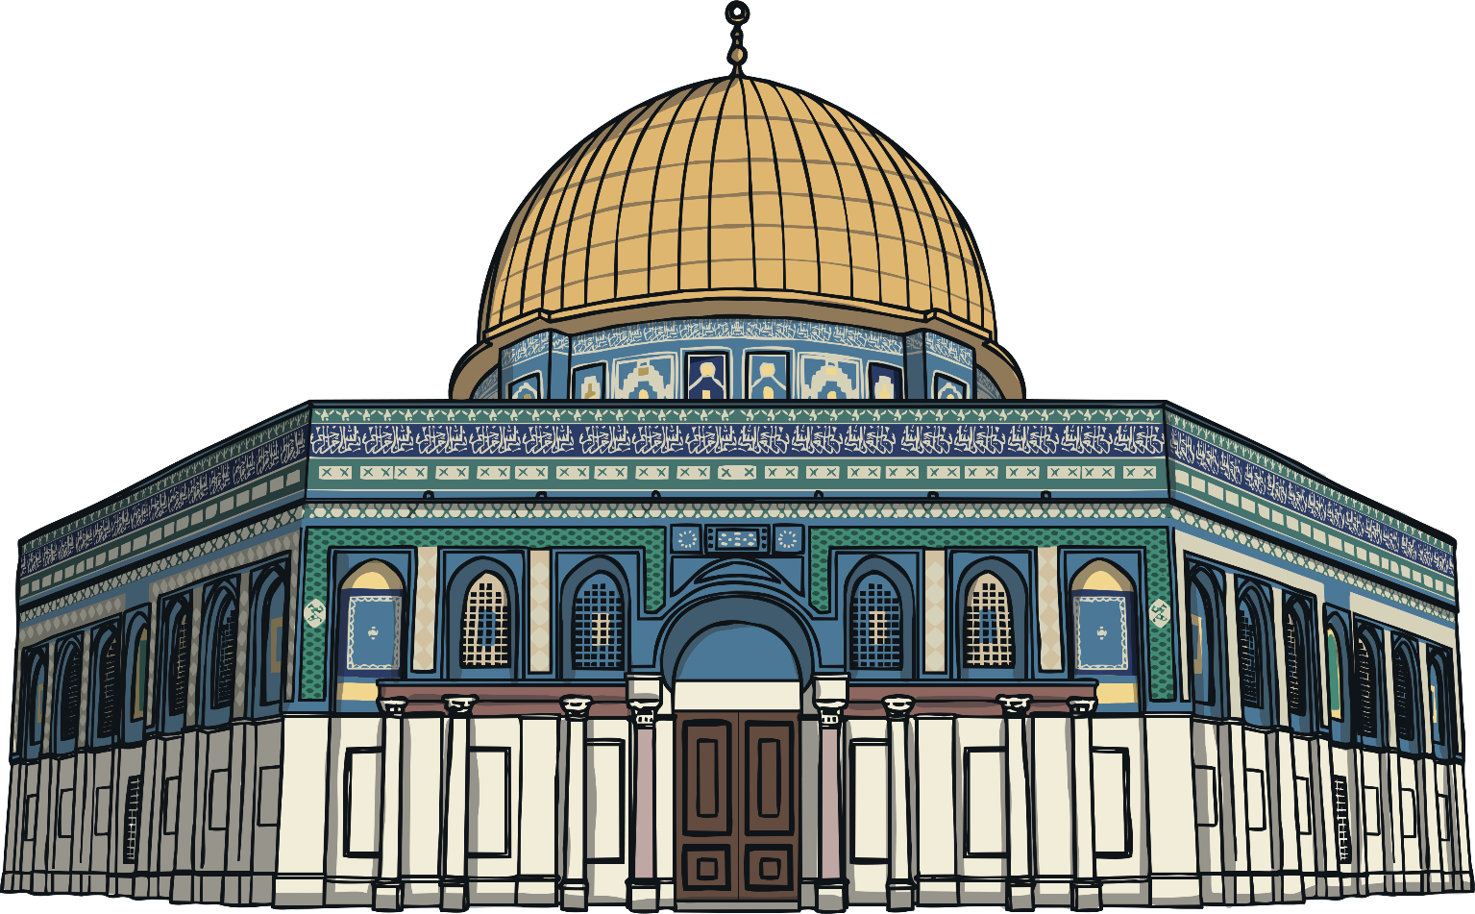
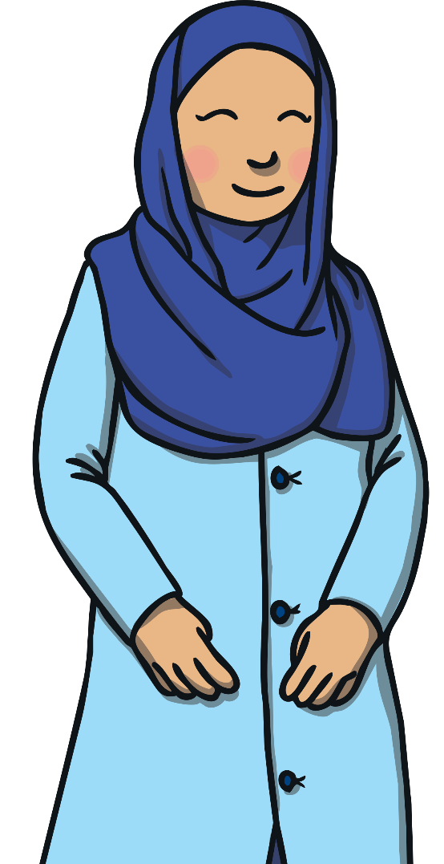
Mosques
Today, we will be learning about the place of worship which is important to Muslims.
A Muslim is someone who follows the religion of Islam.
The place of worship Muslims go to is called a mosque.
The Arabic word for mosque is masjid.

Slide 7
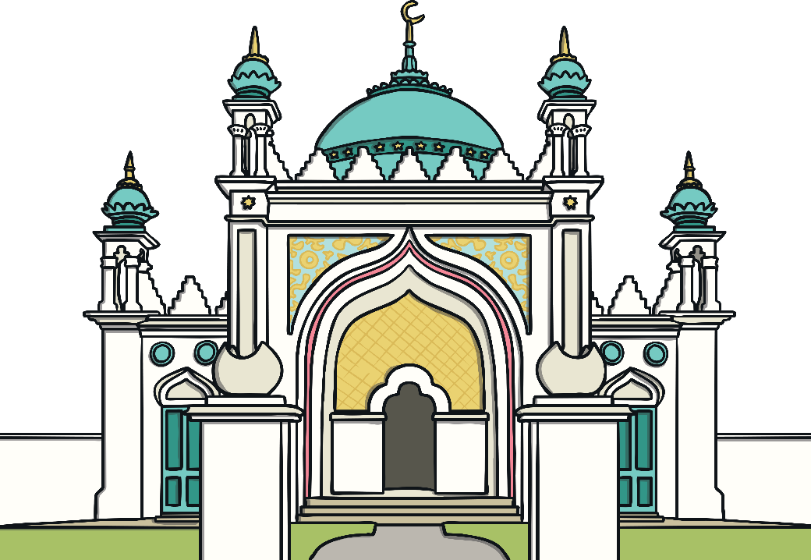
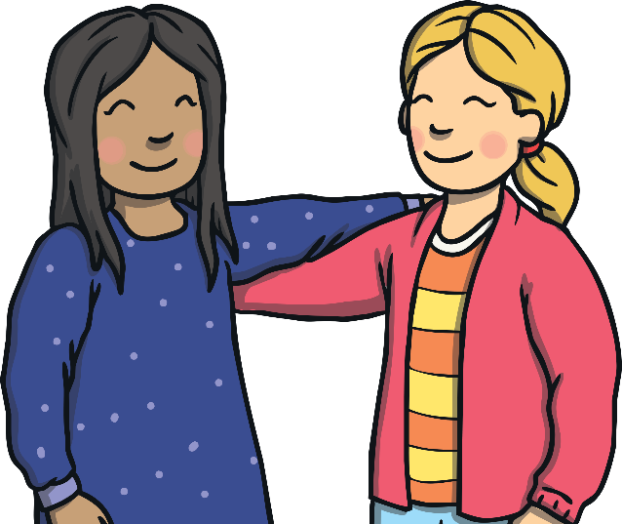
Mosques
There are over 1500 mosques in the United Kingdom.
?
Have you ever been inside one?
?
Have you ever seen one from the outside?
Aisha and Holly are best friends. They go everywhere together. Holly is going to visit Aisha’s special place: the mosque.

Slide 8
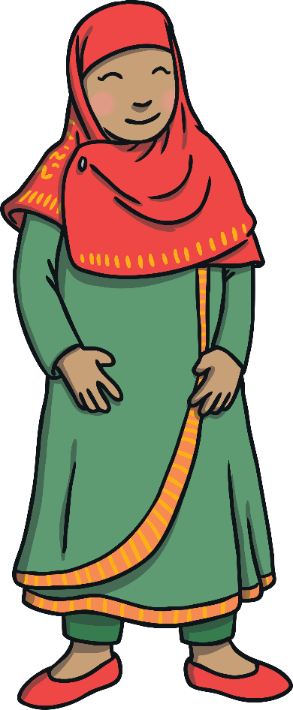
Mosques
Holly asks Aisha if she needs to prepare anything for the visit.
Holly says they should wear clothes that cover up their arms and legs
for when they visit the mosque.
Aisha says that her mosque do not expect visitors to cover their heads in the mosque but they can do if they would like to.
Holly says she would like to cover her head so the girls select headscarves to wear for their visit.

Slide 9
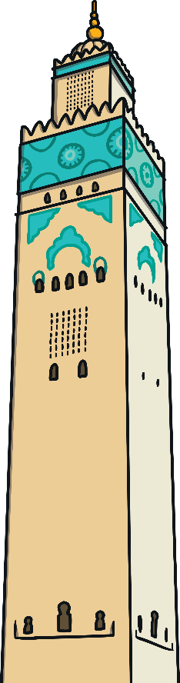
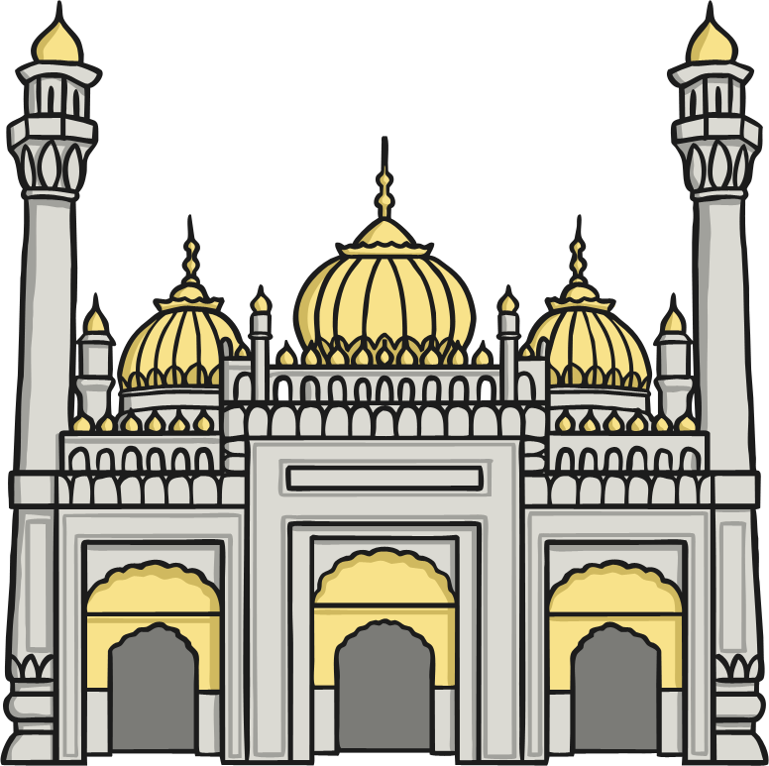
Mosques
Holly has seen the outside of the mosque before but she tells Aisha how beautiful she thinks it is.
Aisha points out some important features.
dome
minaret
Traditionally, the tall, thin tower called a minaret had a large, open window at the top. This would help to cool down the inside of the mosque in hot countries. Someone would also stand on the balcony on the minaret and call people to prayer. In the UK, the call to prayer is done over radio stations.

Slide 10
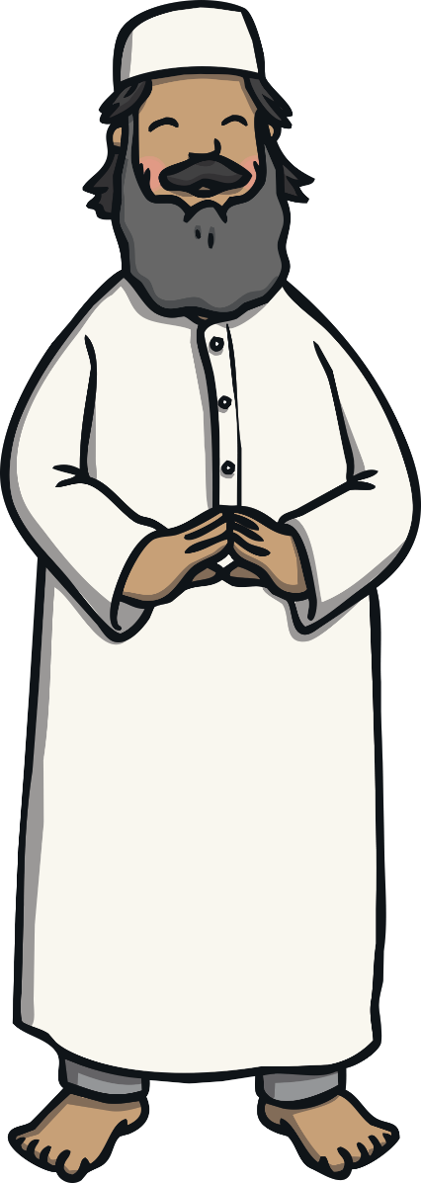
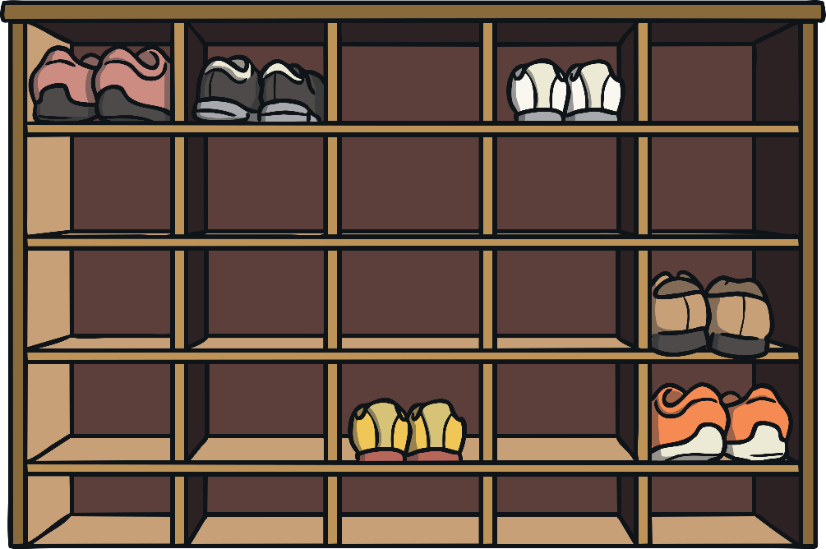

Mosques
Aisha’s parents have told the imam that she is bringing a friend to visit. The imam warmly welcomes them all at the door.
Everyone takes off their shoes after entering the mosque. The shoes are placed on a shoe rack.

Slide 11
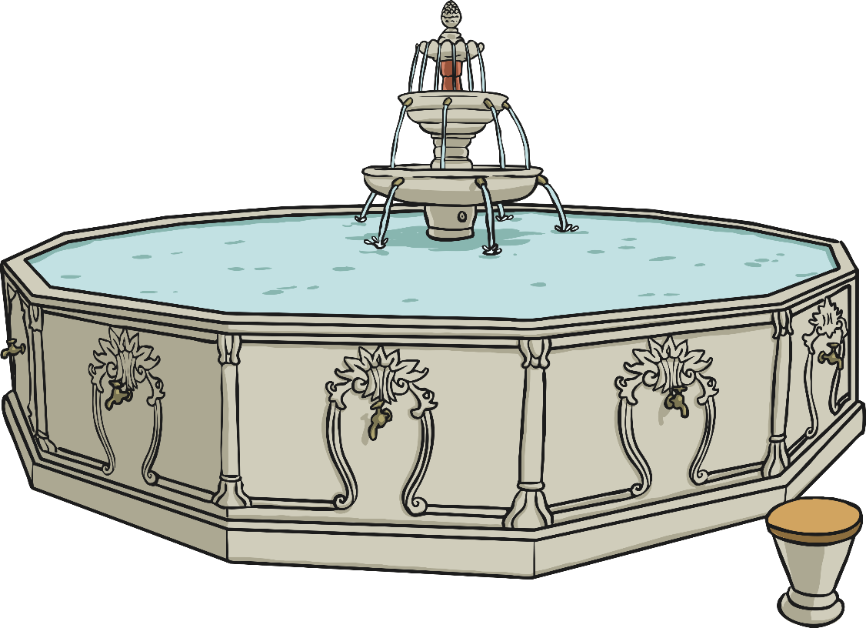
Mosques
The imam shows everyone the ablutions area.
The ablutions area is a room or space where people go to thoroughly wash before praying or touching the holy book, the Qur’an.
Large mosques have a fountain in the ablutions area.

Slide 12

Mosques
Next, they enter the main prayer room. This is called the musallah.
Holly notices straight away that there are no chairs.
The imam explains that everyone sits on the floor here. Traditionally, men and women pray in different spaces.
The carpet is made up of a pattern of prayer mats. The imam shows them an individual prayer mat. Muslims can bring their own prayer mat to a mosque but they often use the carpet provided. A Muslim would use a prayer mat when praying at home or somewhere else.

Slide 13
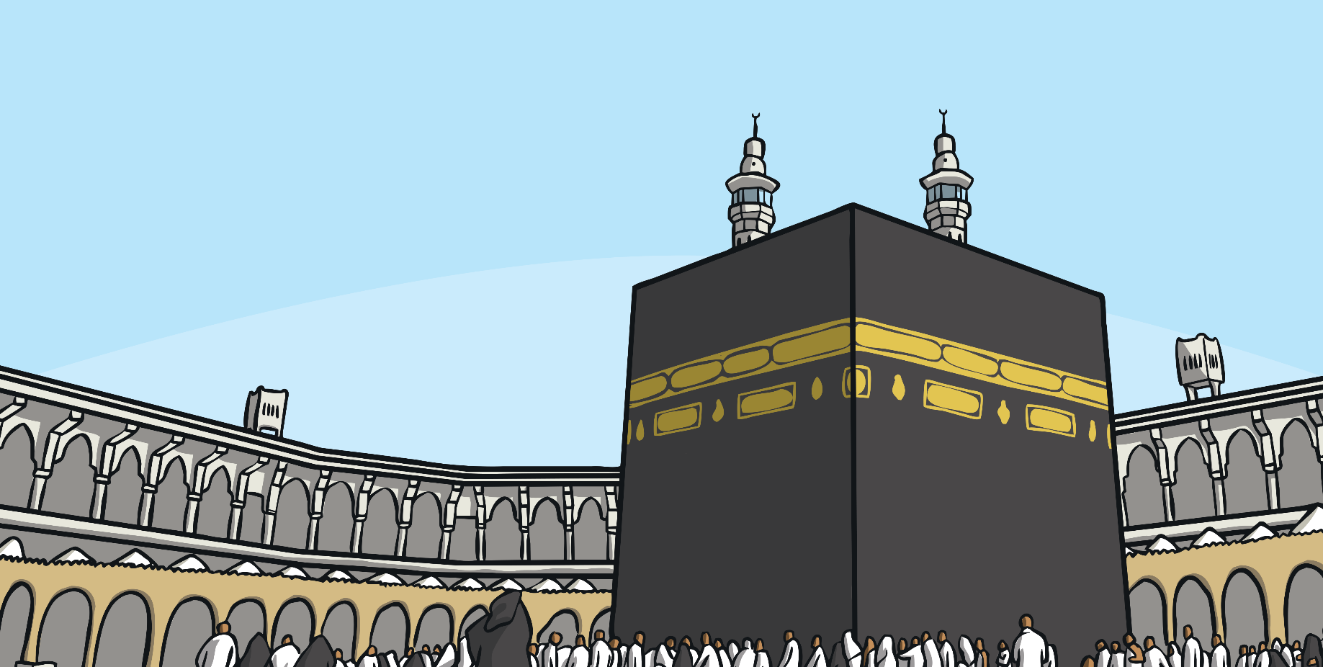
Mosques
When Muslims pray, they face Mecca. Mecca is in Saudi Arabia and is the most holy place in the world for Muslims.
Muslims will know what direction to face in their own house to pray towards Mecca. They will have worked it out as soon as they moved in.
However, when they are somewhere else, they sometimes need to work it out. Some prayer mats even have a compass attached to help.

Slide 14
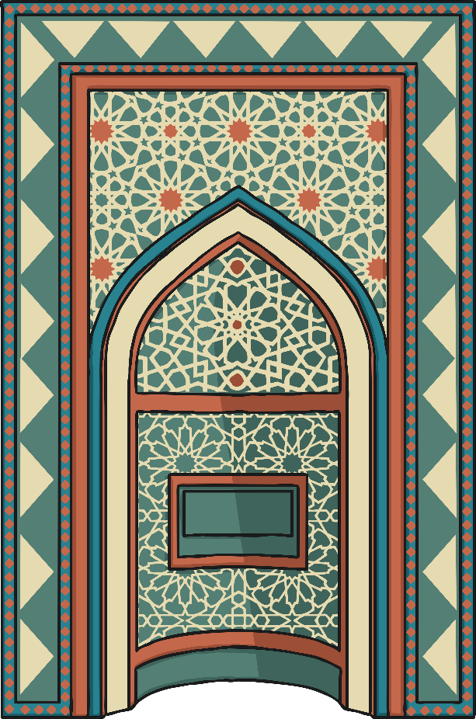
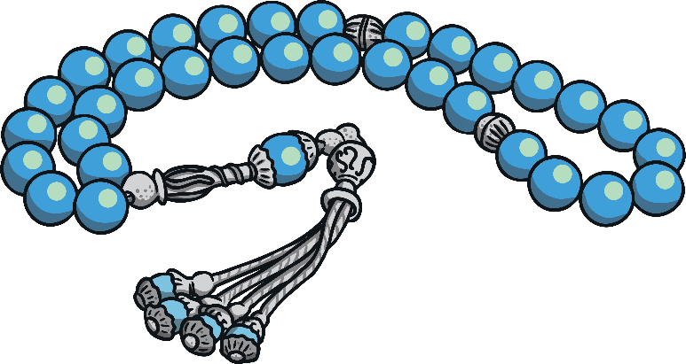
Mosques
The wall of the mosque which faces Mecca is called the qiblah wall.
There is an alcove in this wall called the mihrab.
Holly notices that there are beads hanging up around the mosque.
Aisha explains that these are tasbih beads. They help Muslims to focus when they are praying and thinking about Allah. Allah is the name Muslims give to God.

Slide 15
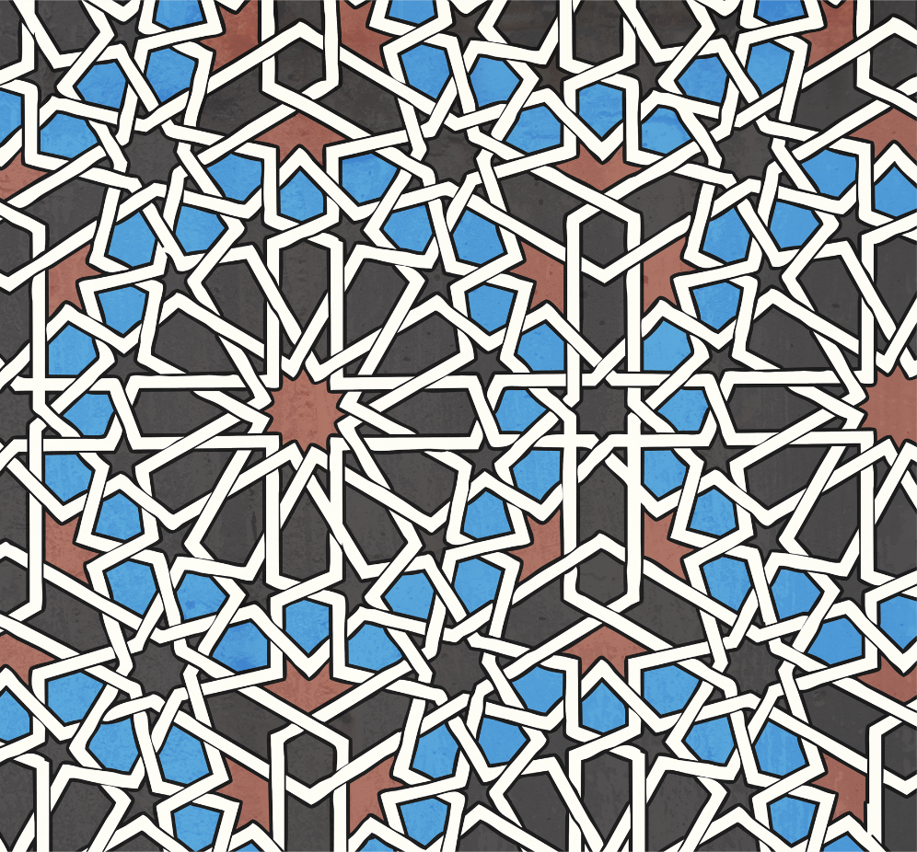
Mosques
The imam answers their questions and then they head out of the prayer hall to collect their shoes.
Holly comments on how pretty the patterns are which decorate the walls of the mosque.
Aisha tells Holly that pictures of animals and humans are not allowed in a mosque. You will only see patterns on the wall, or perhaps photographs of special mosques from around the world.

Slide 16
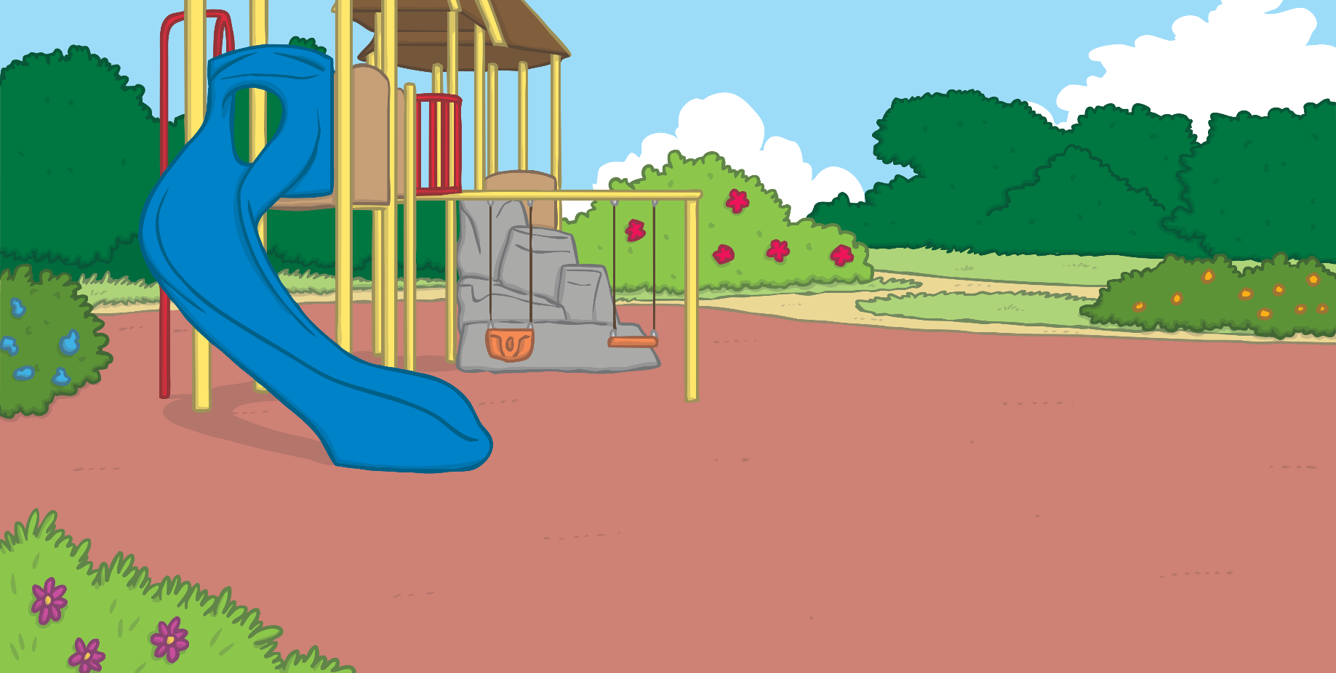

Mosques
The families thank the imam for giving them a tour of the mosque and then they go out to walk in the park together.
Aisha and Holly have lots to talk about.

Slide 17
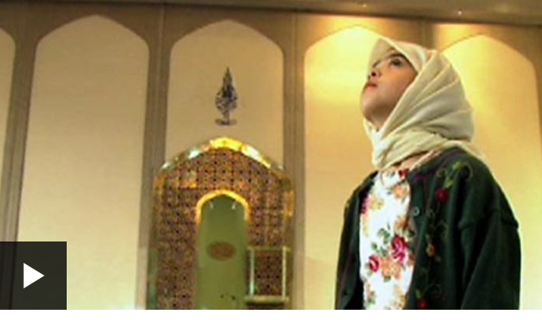
Watch a clip of inside a mosque
https://www.bbc.co.uk/bitesize/clips/z4gkq6f

Slide 18

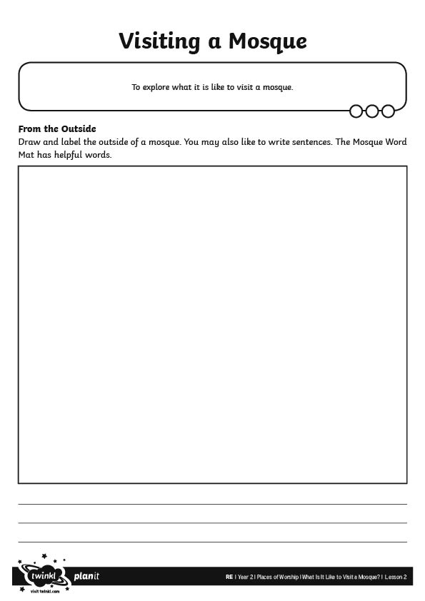
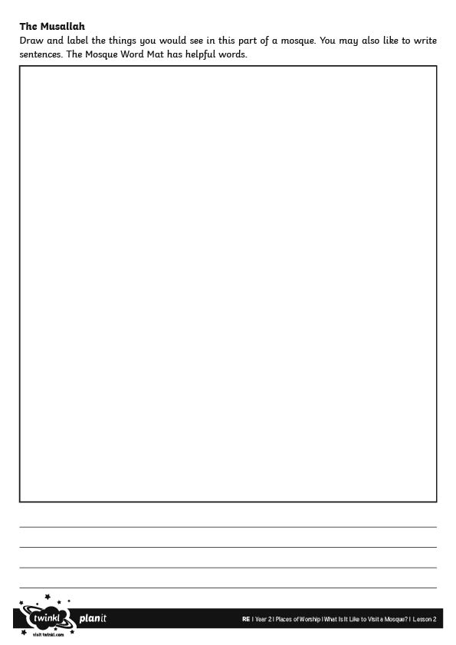
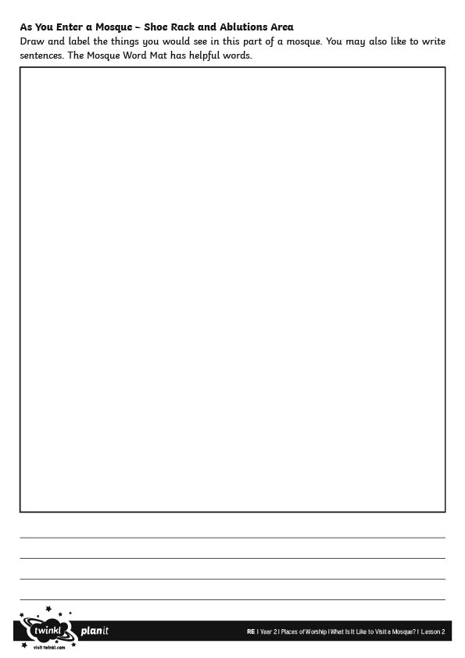
Visiting a Mosque Activities
Year 2s draw and write about the parts of the mosque.
Work on the Visiting a Mosque Activity Sheet.

Slide 19
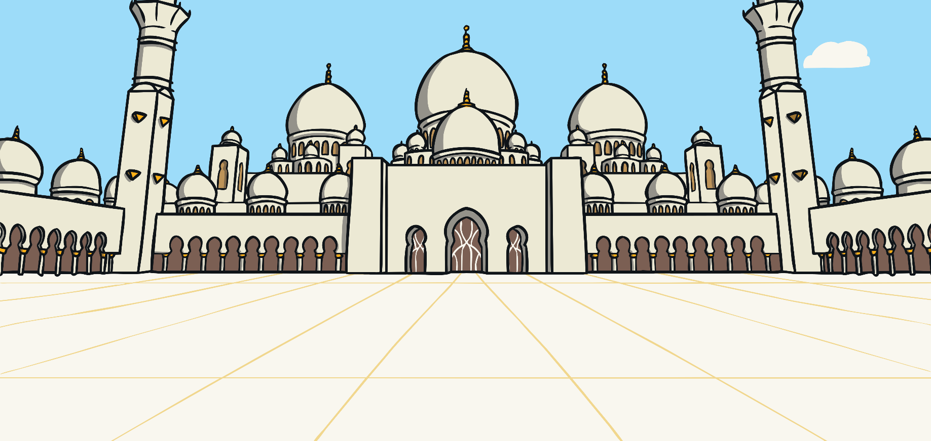
Year 2 Visitors’ Guide
Now you have made your visitor guide books, what could the blurb on the front say? Summarise what a mosque is and why people might like to visit.

Slide 20
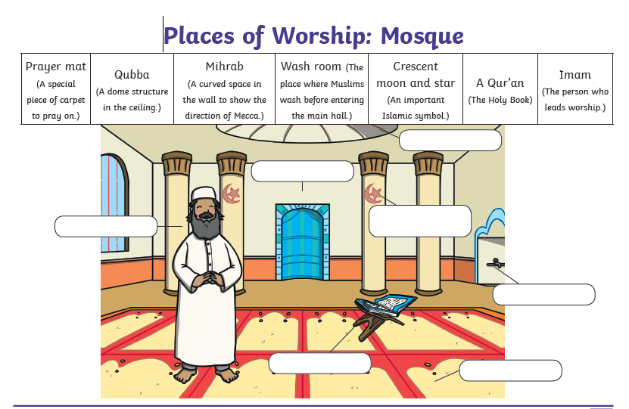
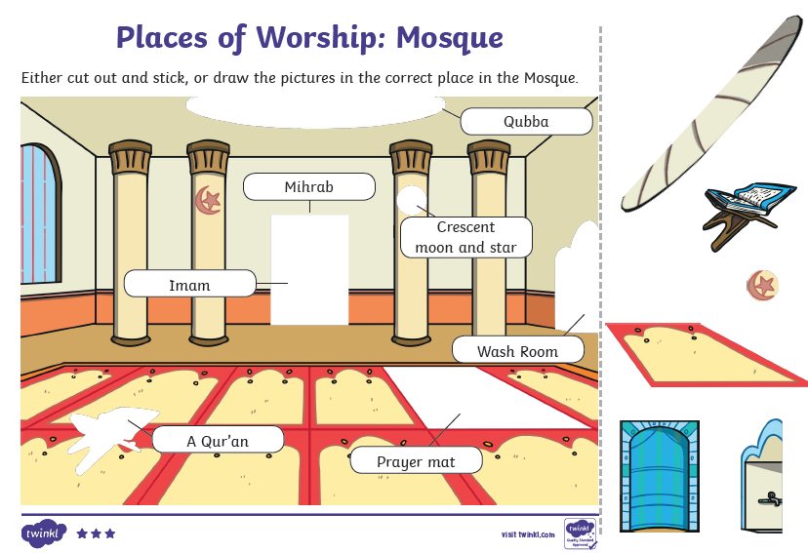
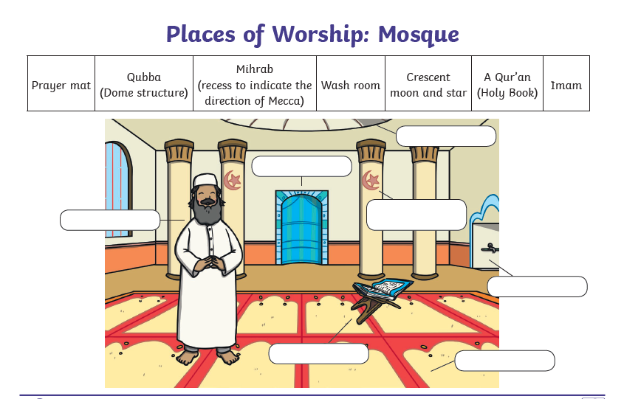
Visiting a Mosque Activities
Year 1 chose one of the Places of Worship sheets and complete the labels.

