Slide 1

RE lesson 5
Designing a Special place
Year One
RE | Year 2 | Places of Worship | Designing a Special Place | Lesson 6

Slide 3
Aim
To apply what I know about places of worship to my own design.
Success Criteria
I can explain what I know about some places of worship.
I can include some features of the places of worship I have learnt about in my design.
I can produce and explain images to help other understand my vision of the special place.

Slide 4

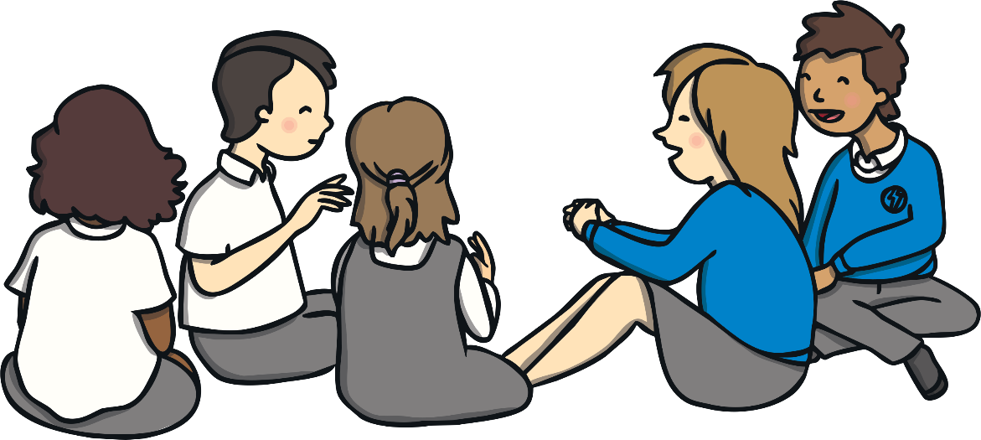
Places of Worship
Think about
?
What is a place of worship?
?
What do they look like?
?
Why do people go to them?
?
How might people feel when they are in their place of worship?

Slide 5


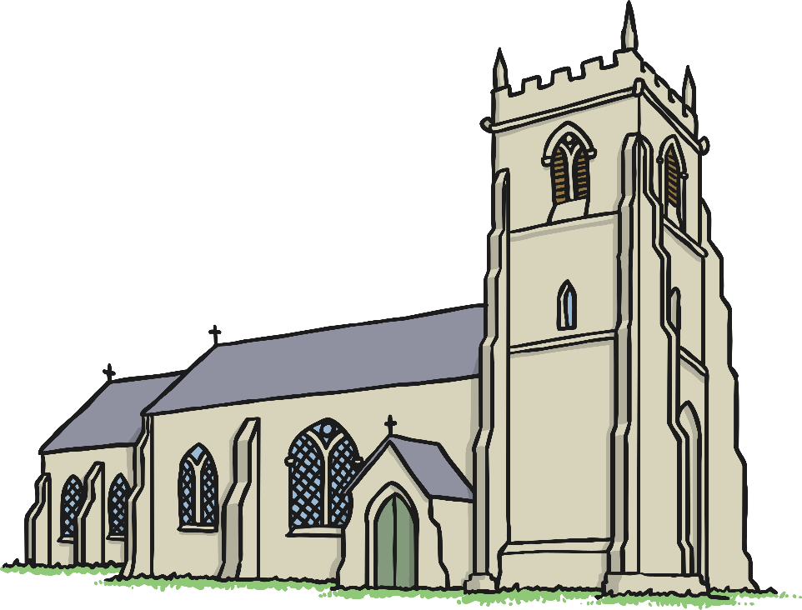
Places of Worship
What is a place of worship?
A place of worship is a space or building where people come to pray or worship.

Slide 6
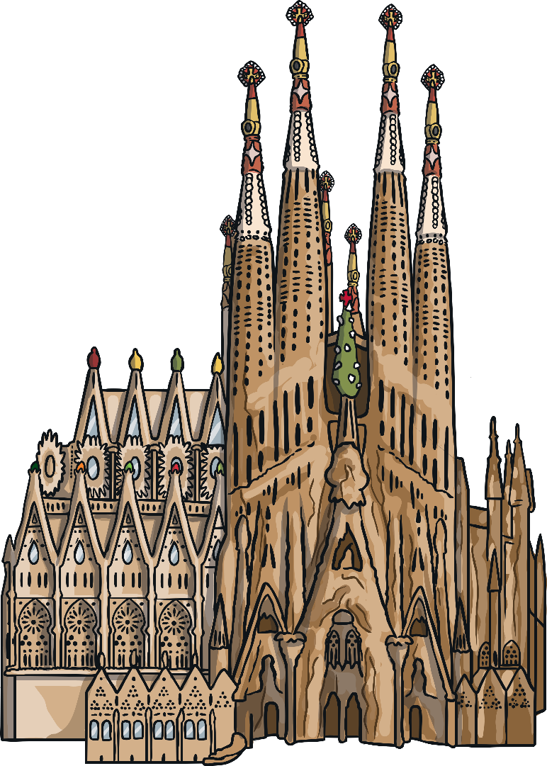
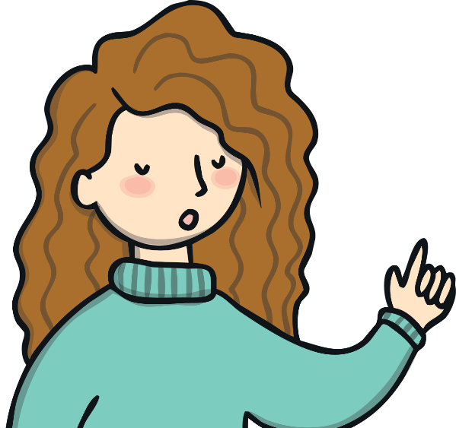
Places of Worship
What do they look like?
They can look very different depending on which religion they are for. Even within the same religion, places can look different. For example, some churches may be very old, while other churches may be in old warehouses.

Slide 7
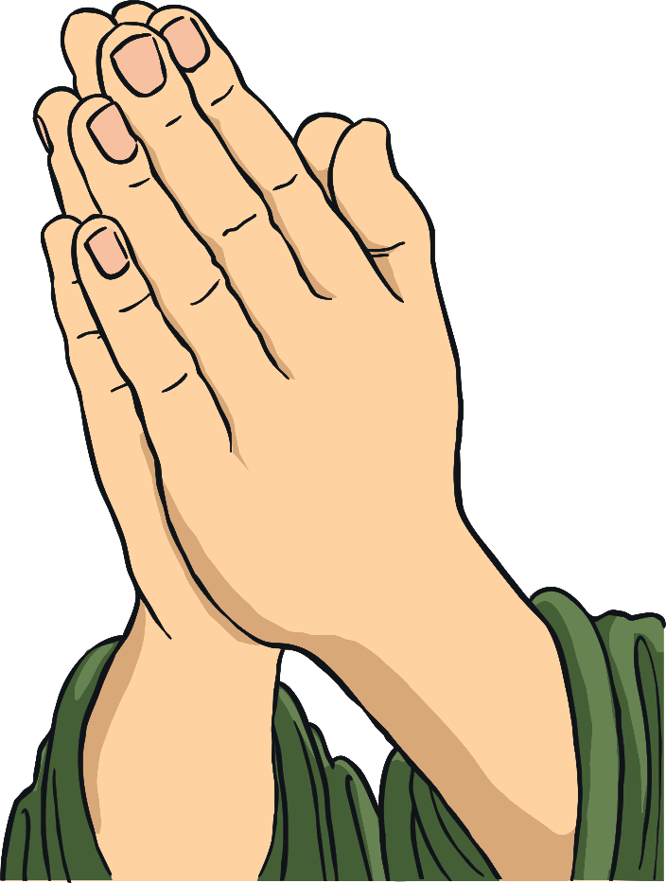
Places of Worship
Why do people go to them?
They may go to pray alone or to worship with others. They may go to attend an important ceremony or to be part of community events. They may go there to study their religion.

Slide 8
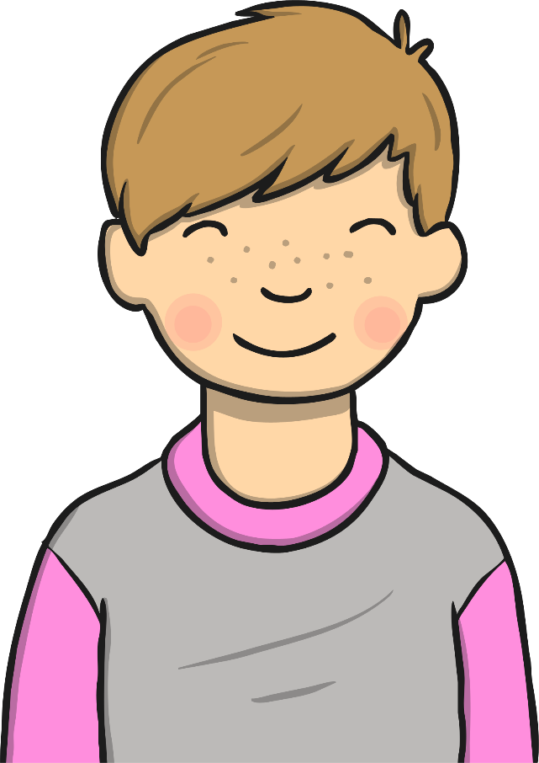
Places of Worship
How might people feel when they are in their place of worship?
They might feel peaceful, relaxed, a sense of belonging, close to God, thoughtful or filled with joy and happiness.

Slide 9


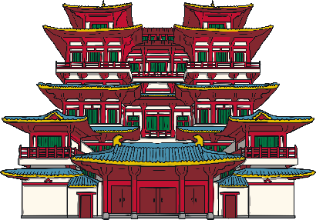


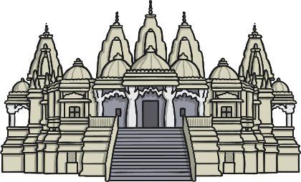
Places of Worship
Can you name any places of worship you have heard of?
Here are some you might have mentioned…
Sikh Gurdwara
Buddhist Temple
Jewish Synagogue
Christian Church
Mosque (Islam)
Hindu Mandir

Slide 10

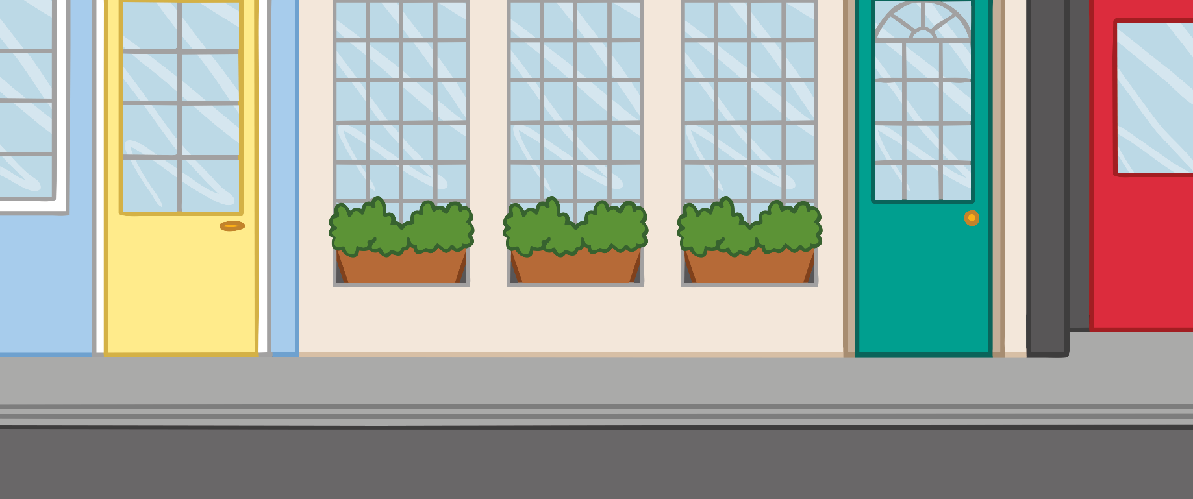
Designing a Special Place
A city called Treefield has decided to build a special place for people to gather. People will not worship God or any special person in this place but it is going to be a place where people celebrate nature and life and spend time being thankful for all they have. It will also be a place where people work together to help others in the city and plan to look after the environment.
They want it to have a special feel and for people to treat the place in a special way.
Treefield Council believe that in designing this very special place, there is much that can be learnt from places of worship.
You will be involved in designing this special place.

Slide 11
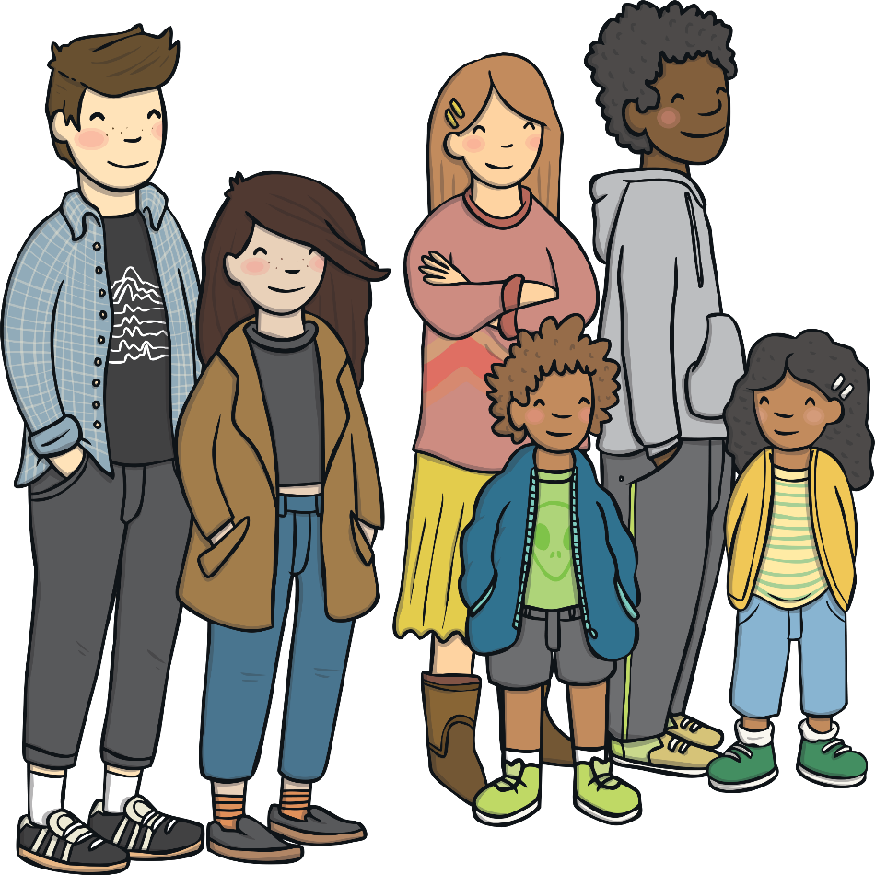
Designing a Special Place
What?
Treefield Council want a special building to be built. It could have a special space outside, too. At this place, the community will be able to come together to celebrate the good things in life and to work together to help others.

Slide 12

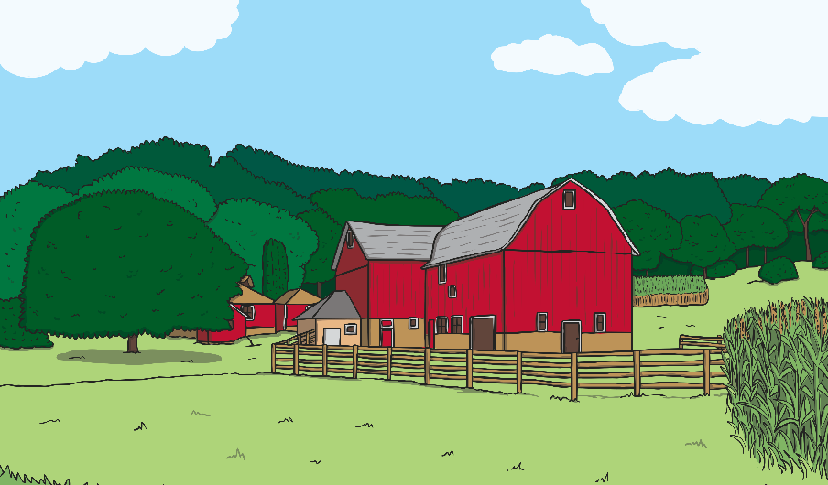
Designing a Special Place
Where?
There is a choice of two plots of land.
1
2
There is a beautiful area next to some parkland near the city centre where there is space to build a new building.
There is a collection of old farm buildings and barns surrounded by fields on the edge of the city that could be converted.

Slide 13
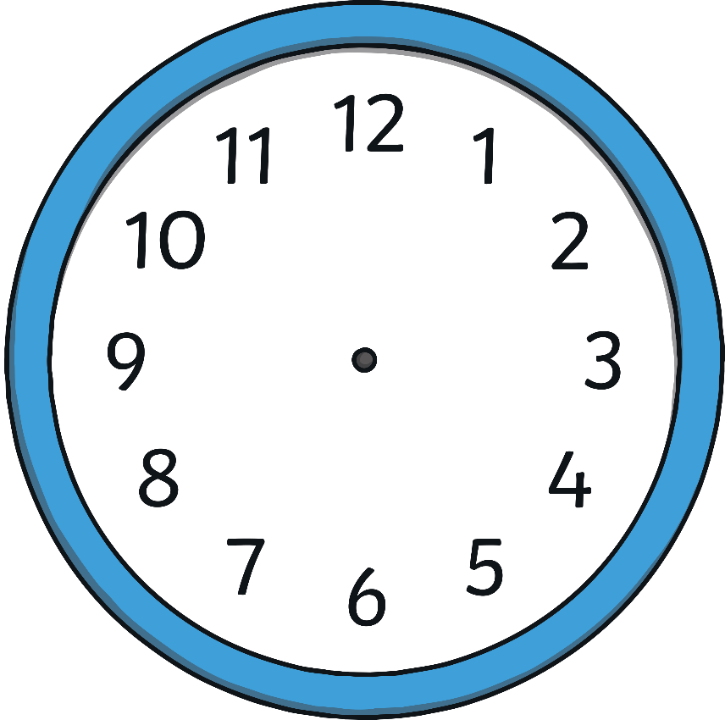

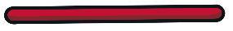
Designing a Special Place
When?
As soon as the plans are in, building can start and this can take as long as needed. Once open, the centre will be open every day of the week between 9am and 7pm.

Slide 14

Designing a Special Place
Who?
This special place is for everyone. People who already attend a place of worship may also wish to come and spend time here. People who do not have a special place might come along, too. Projects involving different religions working together may be based here.

Slide 15
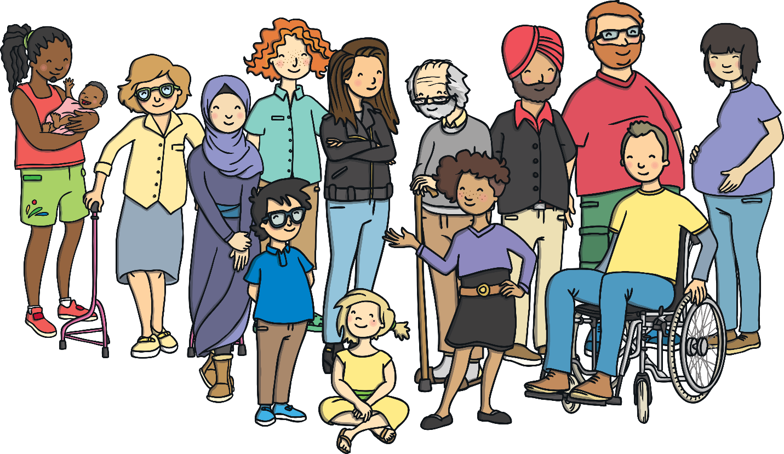
Designing a Special Place
Why?
Treefield City Council want everyone to have a place where they can have time to stop and think about life and be happy. They also think this will be a great place to develop a spirit of community with everyone working together.

Slide 16
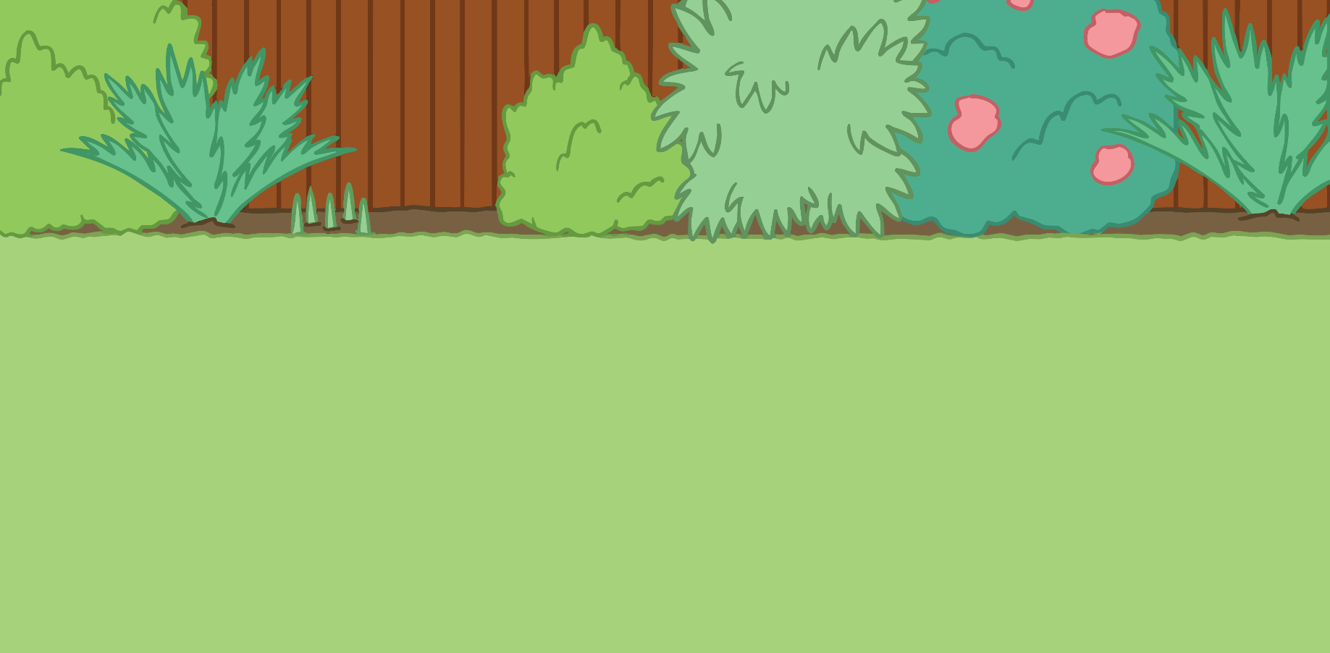
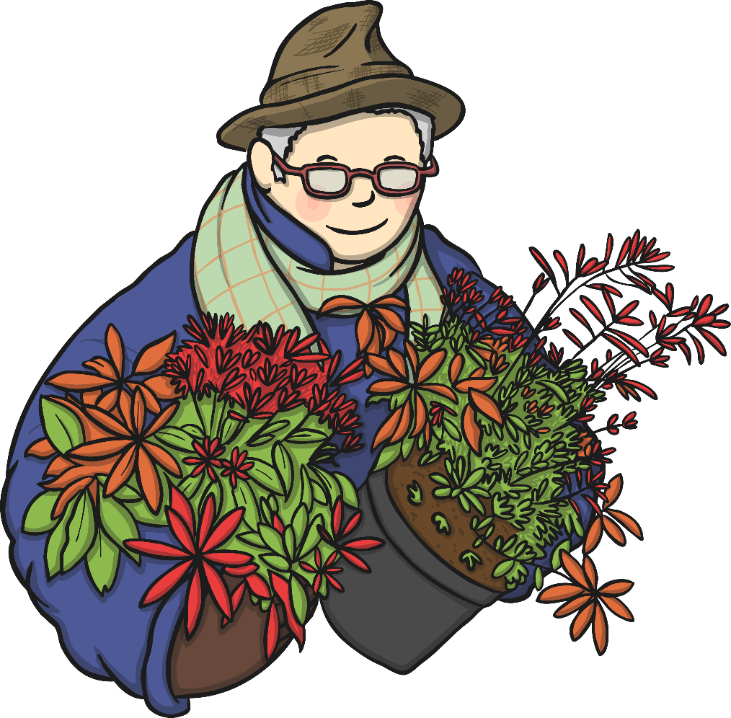
Places of Worship
The team involved in planning this special place have already started asking people in the city what they would like to see in this place.
I’d love it if there were beautiful gardens to sit in and think. I’d be happy to volunteer to help look after the gardens.

Slide 17

Places of Worship
The team involved in planning this special place have already started asking people in the city what they would like to see in this place.
It would be great if the new centre did some courses on how to help you relax. I am always on the go. I find it really hard to just sit still and take a break.

Slide 18

Places of Worship
The team involved in planning this special place have already started asking people in the city what they would like to see in this place.
I’m not religious but I love visiting places of worship as I always feel so peaceful there. It would be amazing to have a beautiful special place where I could sit and think quietly. Maybe we could even take our shoes off before going inside to show that we respect the building itself.

Slide 19

Places of Worship
The team involved in planning this special place have already started asking people in the city what they would like to see in this place.
I think there should be music there. Maybe there should be peaceful music playing all the time but I also think there should be loud and lively music sometimes. Music and dancing bring people together!

Slide 20
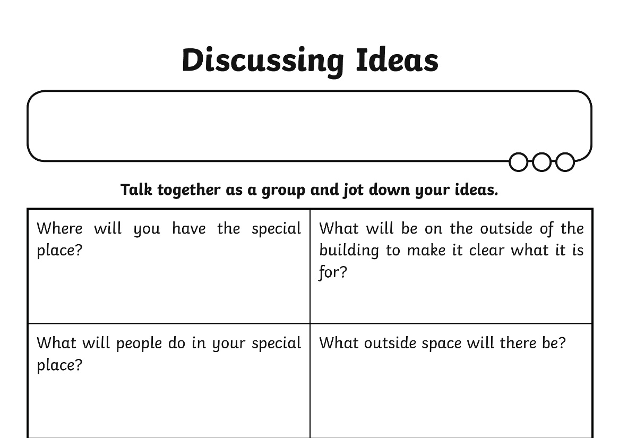
Discussing Ideas
Think about your ideas about this special place. Jot down some of your ideas in response to the questions given on the Discussing Ideas Activity Sheet.

Slide 21

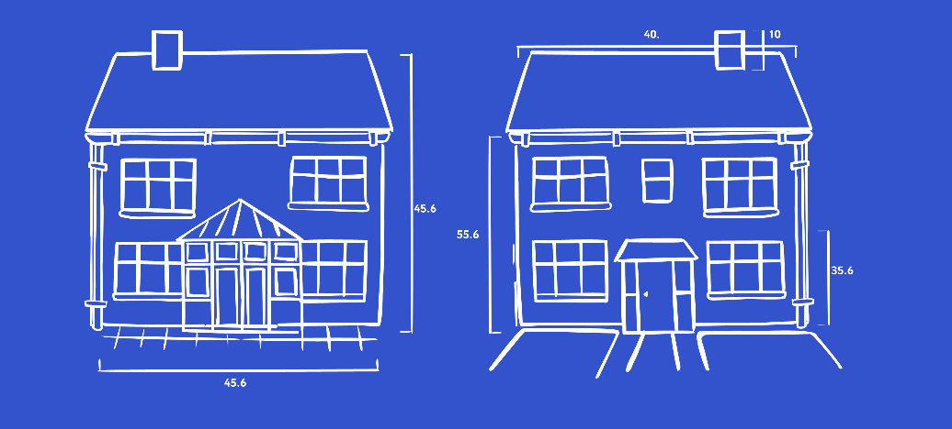
Draw It Out
.
First draw and label the outside of the special place. This should include any gardens or other outside space.
Then draw and label the inside of the special place. You can draw the inside of the building as a plan or you can draw several labelled pictures of things you would see.
You may find the Labelling Word Bank helpful as you work on this activity.

Slide 22
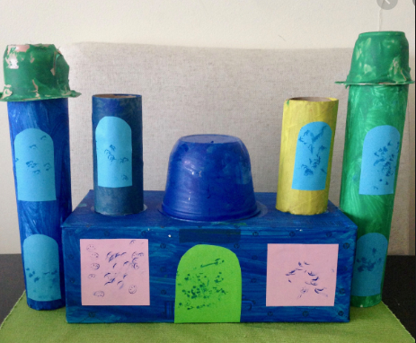
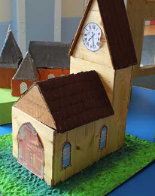
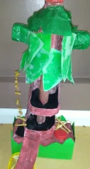
Make a model
.
Can you make a model of either the outside or one of the rooms inside of the special place. You can use lego, junk modelling etc.

