Slide 1

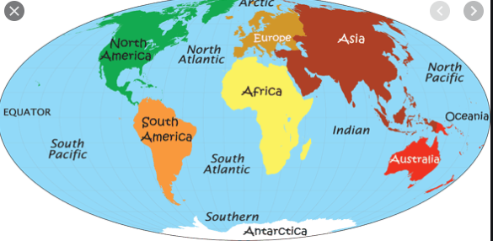
This tale comes from North America.
Can you find it on the world map?

Slide 2



Slide 3


Slide 4
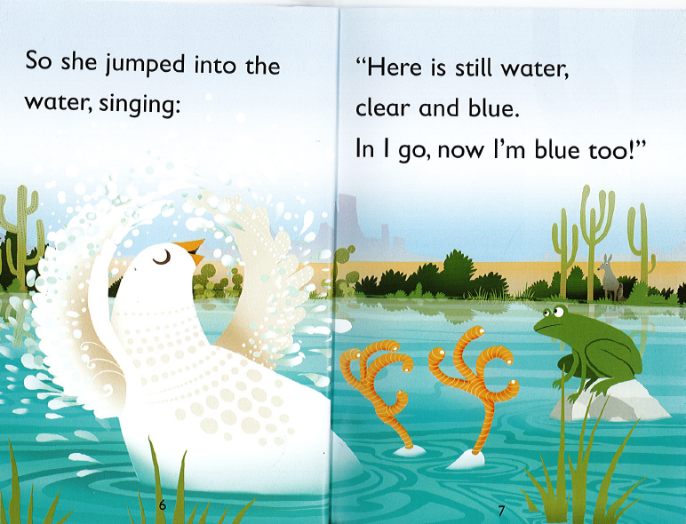

Slide 5
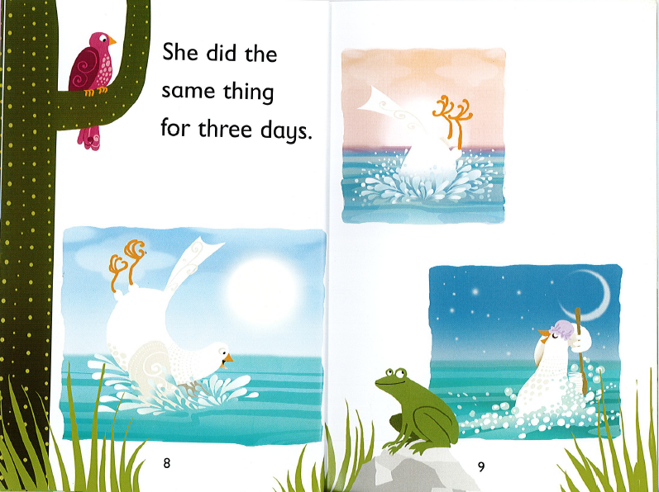

Slide 6


Slide 7
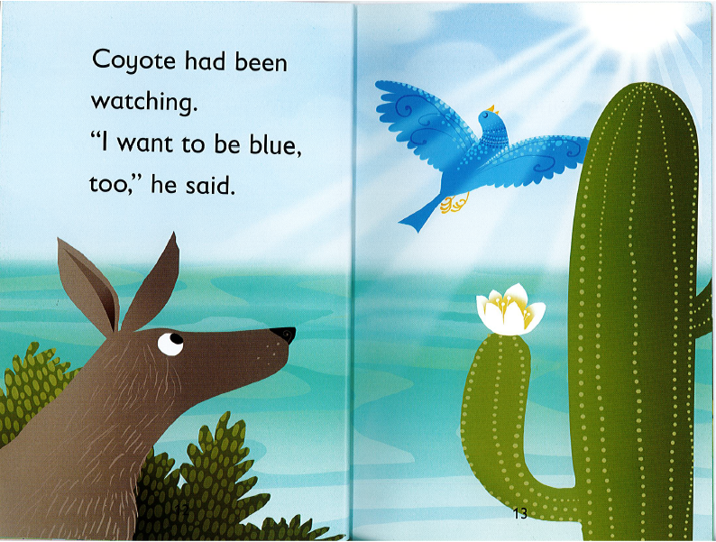

Slide 8
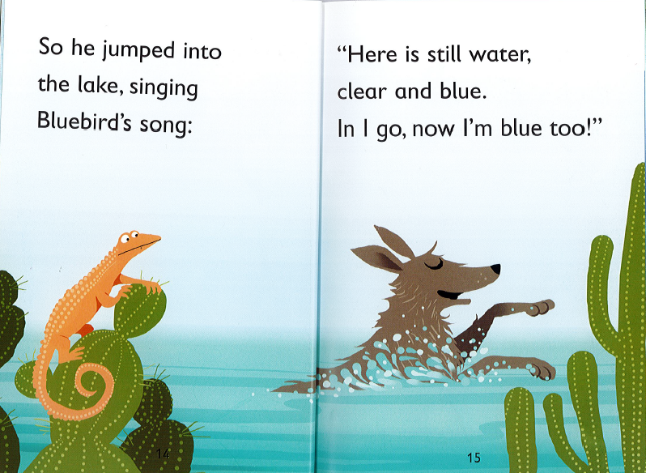

Slide 9
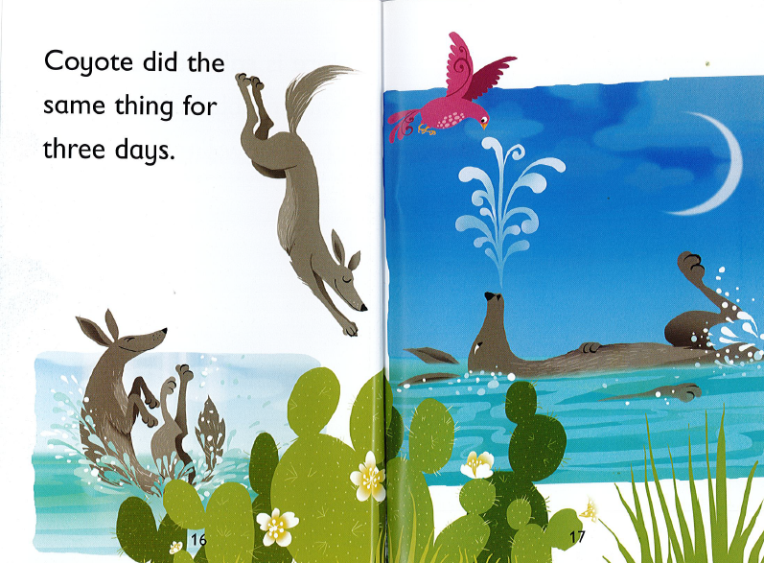

Slide 10


Slide 11
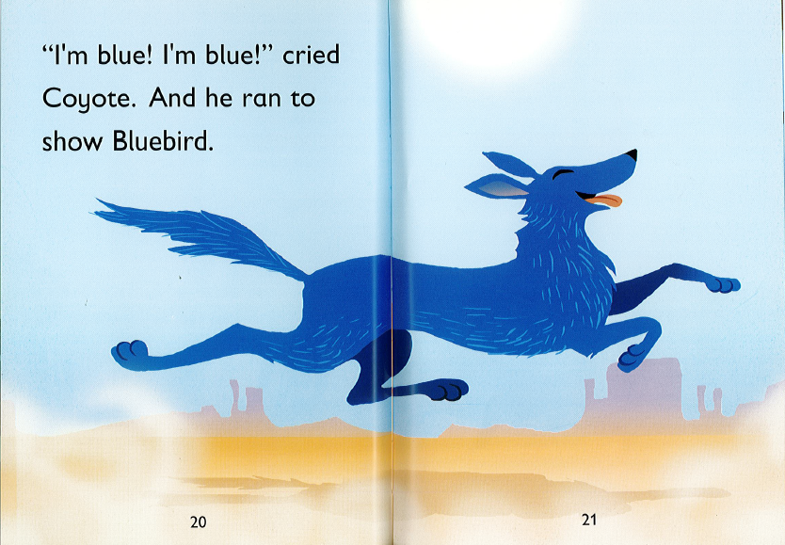

Slide 12


Slide 13


Slide 14
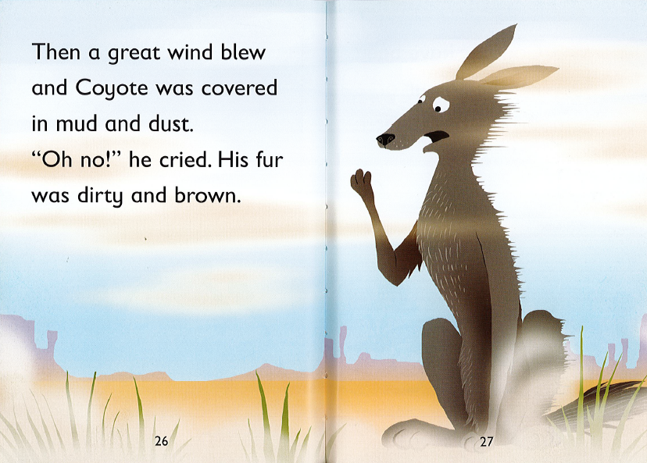

Slide 15


Slide 16

Which is your favourite page and why?

