Slide 1
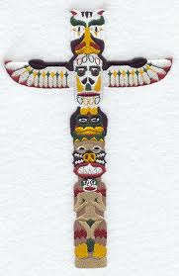
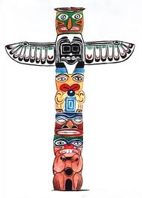
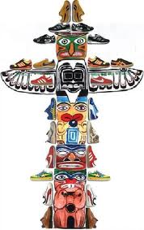
What is a totem pole?

Slide 2
What is a totem pole?
A totem can be the symbol of a tribe, clan, family or individual.
Native American tradition provides that each individual is connected with nine different animals that will accompany each person through life, acting as guides.
Different animal guides come in and out of our lives depending on the direction that we are headed and the tasks that need to be completed along our journey.

Slide 3
Your Animal Guide
Your animal guide will sit on the top of your totem pole.
Select 3 other animals who you identify with in some way.
These animals will make up the rest of your totem pole.

Slide 4
Designing your own totem pole
You are now going to design your own totem pole, using the animals you have selected.
You will now see pictures of Native American totem poles.
Pay close attention to how the animals are drawn and carved.
Take note of the colours used.
You will need to draw your totem pole in the same style as the Native American totem poles.

Slide 5
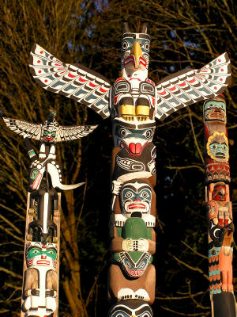
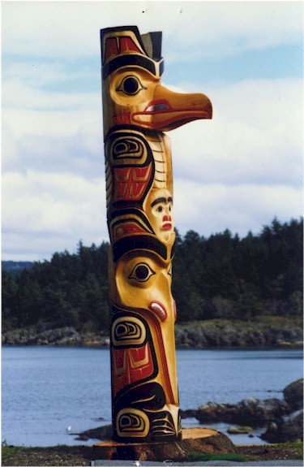

Slide 6
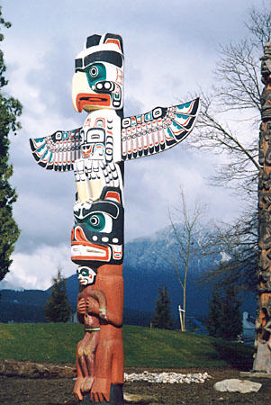
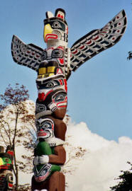

Slide 7
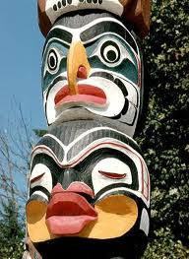
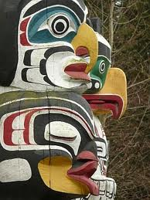

Slide 8
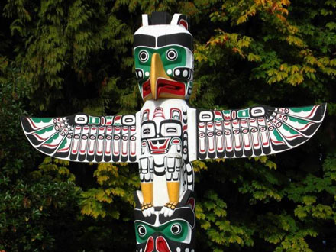

Slide 9
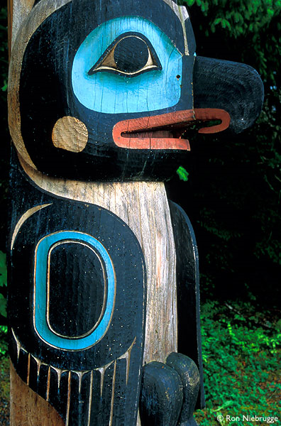
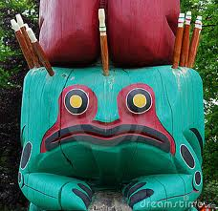
Raven
Frog

Slide 10
Animal Guide Characteristics
What characteristics do your Animal Guides have?
What qualities do they portray?
In what ways do they help and guide you?
Why did you choose that particular animal?

