Slide 2



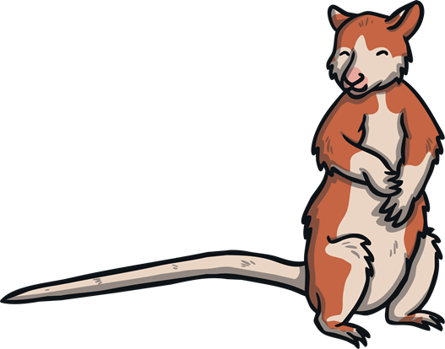
ai
rain
nail
tail

Slide 3

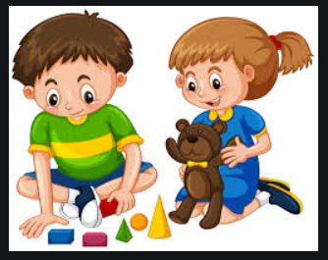

ay
day
play
tray

Slide 4
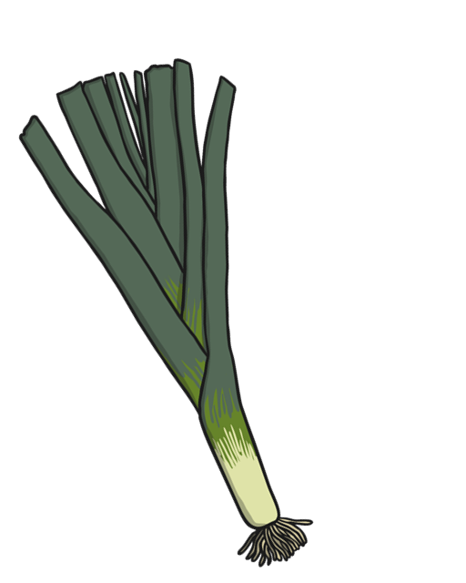
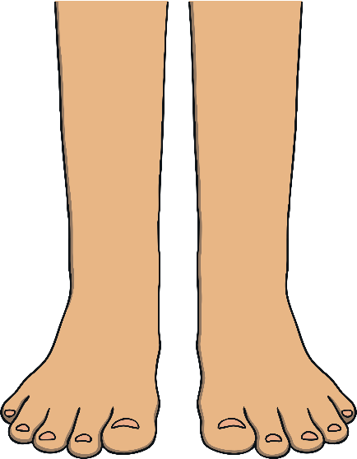
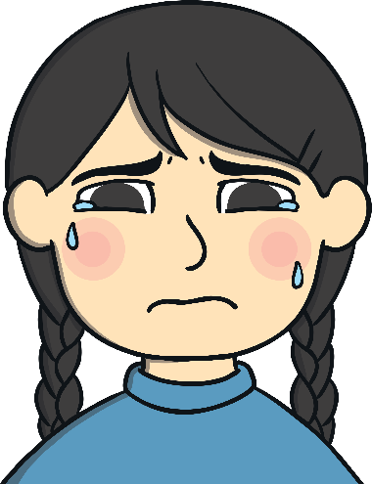
ee
feet
leek
weep

Slide 5


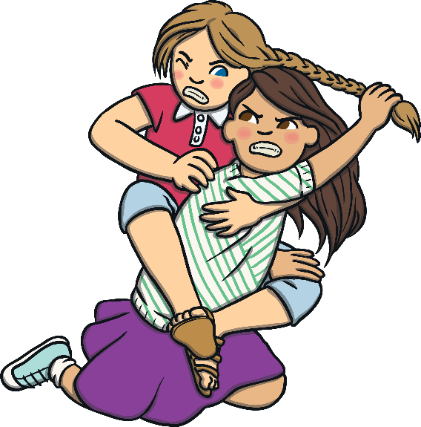
igh
light
night
fight

Slide 6


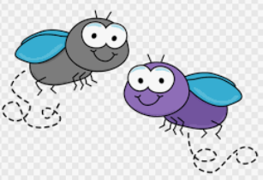
ie
tie
pie
flies

Slide 7



oo
moon
roof
boots

Slide 8


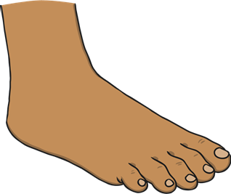
oo
look
book
foot

Slide 9

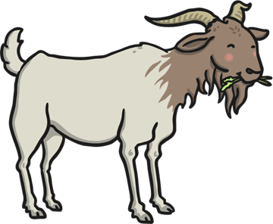
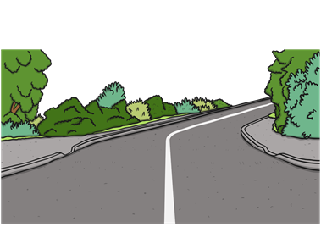
oa
loaf
goat
road

