Slide 1
Lesson 4

Slide 2
Aim
To create a collage in the style of Henri Matisse.
To practise cutting paper and card in different ways.
Success Criteria
I understand what a collage is.
I can identify a picture by Henri Matisse.
I can cut out a range of shapes.
I can plan a simple collage.
I can create a collage using different shapes.

Slide 3
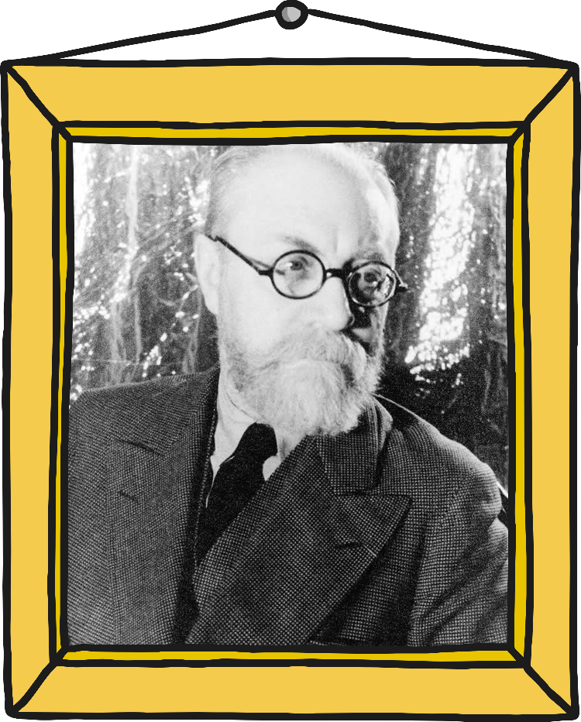
Henri Matisse
Click on the picture for more information about Henri Matisse.
He was born 1869, in France.
He was studying law.
He spent a long time in hospital and started painting.
He changed from studying law to being an artist.
At 72 years old, he was in hospital again and started cutting out shapes to use in his art.
He died 1954, aged 85.
Photo courtesy of Jossifresco (@Wikimedia.org) - granted under creative commons licence – attribution

Slide 4
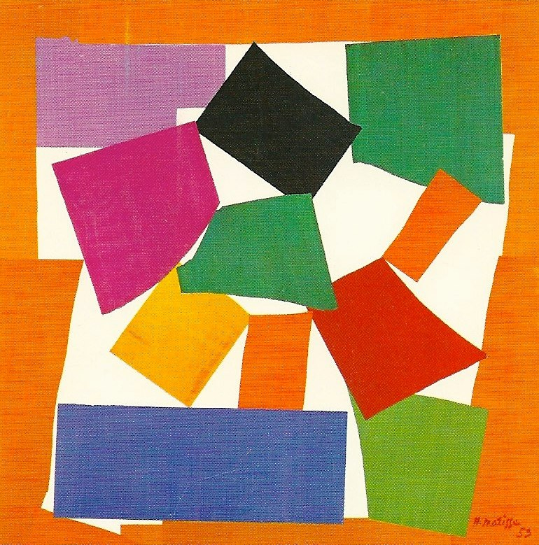
The Snail
Click on the picture for more information.
Matisse created this in 1954.
He cut and tore paper into pieces and then used gouache to stick them together.
Discuss it!
Why do you think it is called
‘The Snail’?
What do you think of this picture?
Photo courtesy of Jossifresco (@Wikimedia.org) - granted under creative commons licence – attribution
Did You Know?
Gouache is thin watery paint which is transparent.

Slide 5
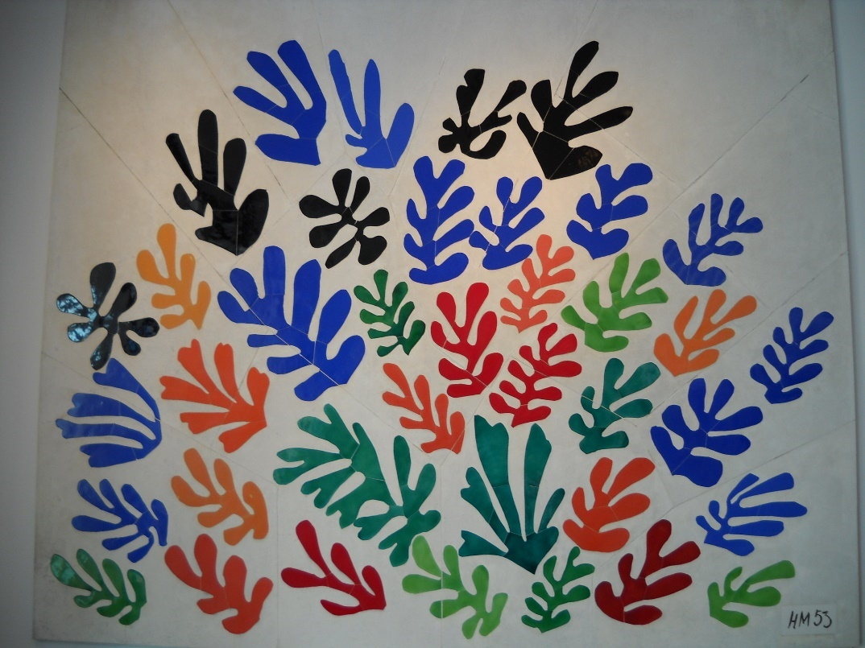
La Gerbe
Discuss it!
What do you think of this picture?
How many colours can you see?
Does it remind you of anything?
Photo courtesy of Tom Ipri (@flickr.com) - granted under creative commons licence – attribution

Slide 6


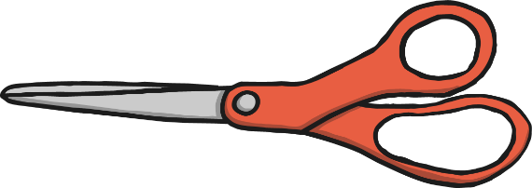

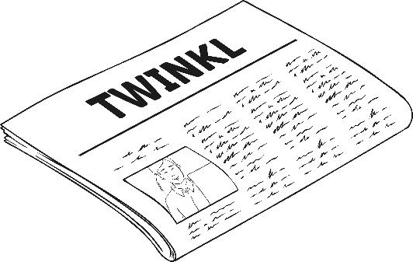
Have a Go!
You will need:
A large sheet of coloured card for the background
Different coloured pieces of paper
Scissors
Glue
Newspaper

Slide 7

Plan Then Do
1
2
3
Choose the colour for your background card.
Choose three other colours from the choice of paper, which you like. These will be for the cut-outs.
Think about the shapes you want to cut out.
Thinking time is planning time.
4
5
6
Keep all the pieces. Sometimes you can use the pieces you think you will throw away.
When you cut out shapes, position them on the background.
Start cutting!

Slide 8
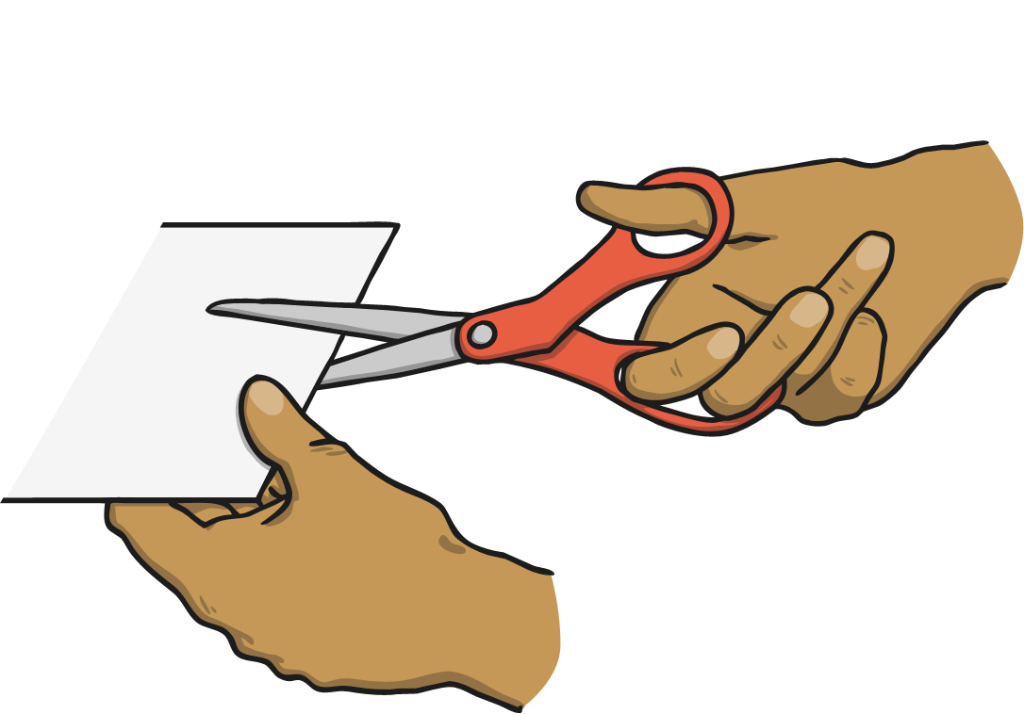
In the Style of Matisse
1
2
Stick your shapes onto the background.
Take your time. You can change your mind before you stick them down.
Look at your piece of artwork, in the style of Henri Matisse!

Slide 9
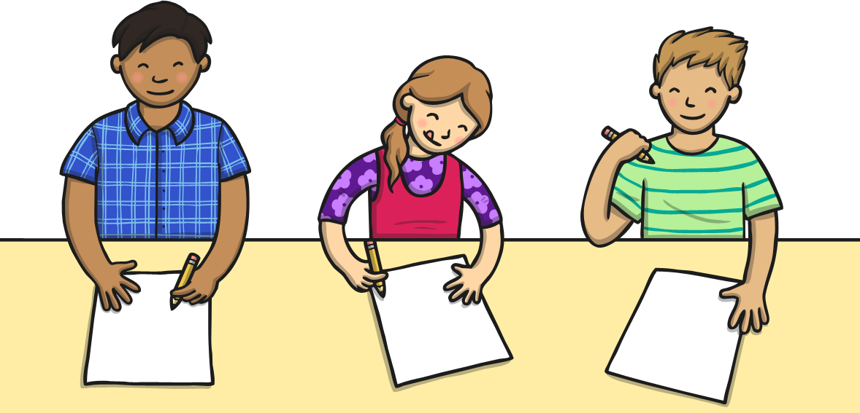
Celebrate Your Work
Display your artwork so that everyone can look at it and celebrate how wonderful it is!
If you are working at home, take a photo of your finished piece and email it to your teacher

