Slide 2
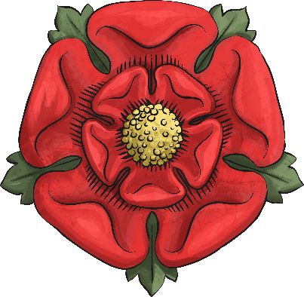

The Wars of the Roses
Civil war had been raging through England for 30 years during the
mid-15th century. This became known as The Wars of Roses because each side of the battle were represented by a rose.
The red rose was the badge of the Lancastrians.
The white rose was the badge of the Yorkists.
Both sides believed they had a right to the throne and crown of England.

Slide 3
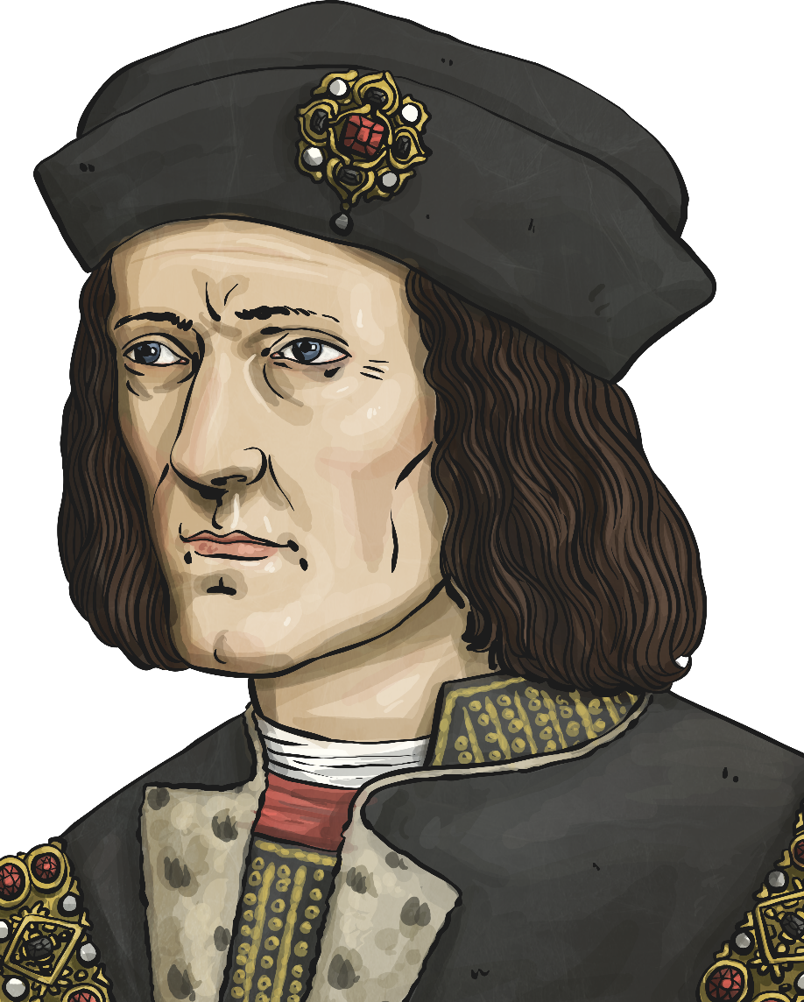
King Richard III
Richard III was a Yorkist king but he was not popular. People were very suspicious of how he had become king.
His brother, Edward IV, was king so when he died it should have been Edward’s eldest son who became king.
The boy, also called Edward, was only 12 years old. Richard was made protector of the realm until the child was old enough to be crowned king.

Slide 4
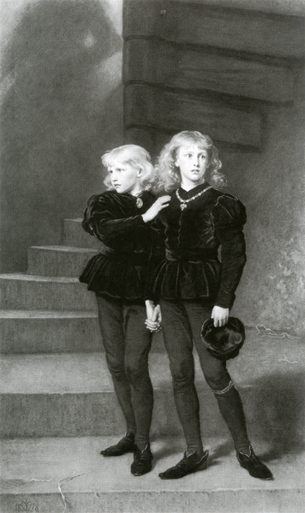
King Richard’s Past
A campaign began to prove the boy could not be king, so Richard was crowned king. His two nephews were imprisoned in the Tower of London.
They were never seen in public again.
It is thought he had them killed, so that they could not become king instead of him.
Samuel Cousins [Public domain], via Wikimedia Commons

Slide 5
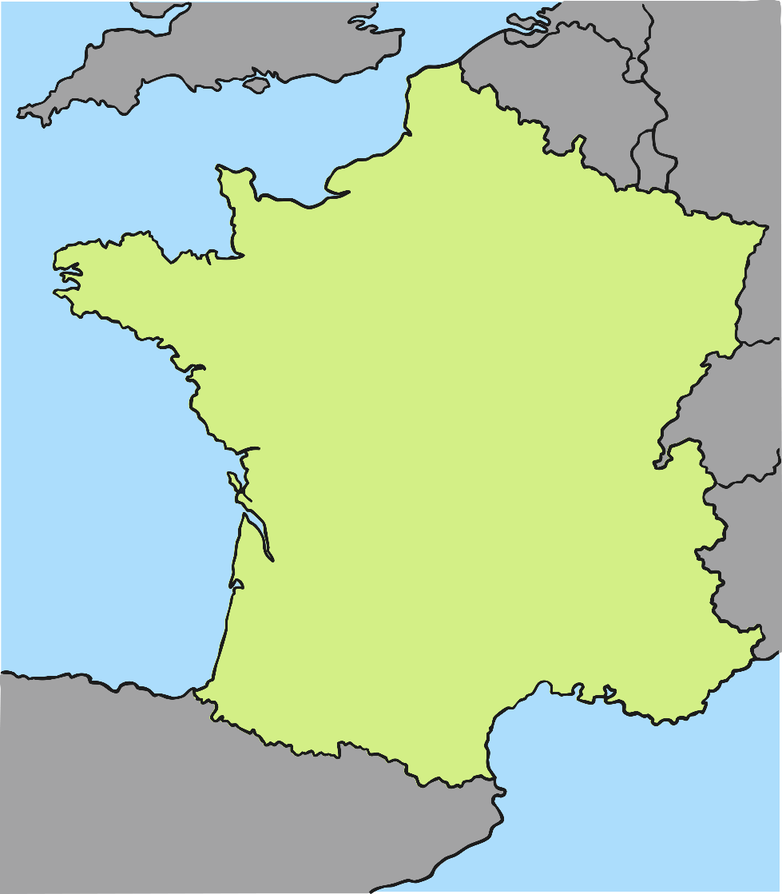
France
Henry Tudor, the leader of the Lancastrian side, got some money from King Charles VIII of France.
Charles had his own mission and wanted to capture Brittany, so he hoped that a battle in England would take the attention away
from his own plans.

Slide 6
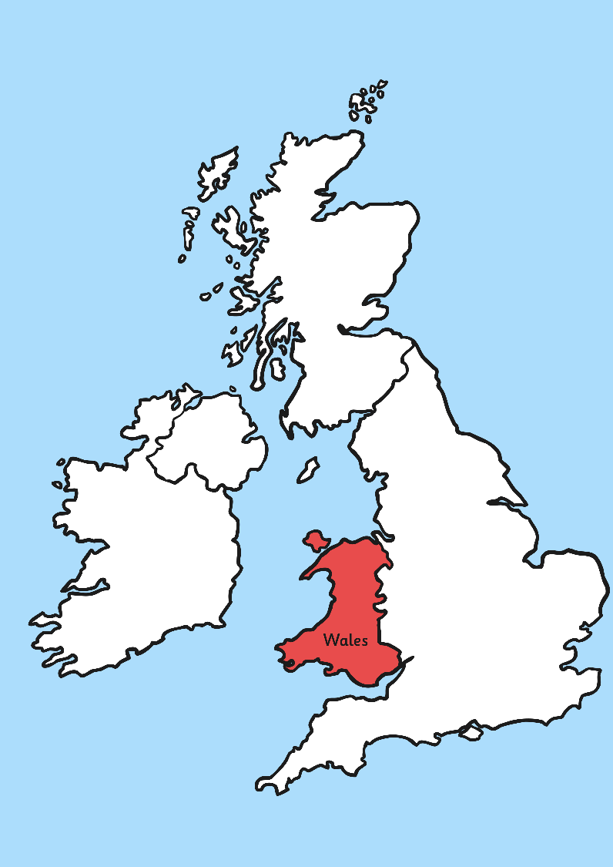
Milford Haven
Henry set sail from France with his supporters.
He landed in Milford Haven in Wales on 7th August and marched along the Cardigan coastline.
Then they followed the River Severn and reached the English border.

Slide 7
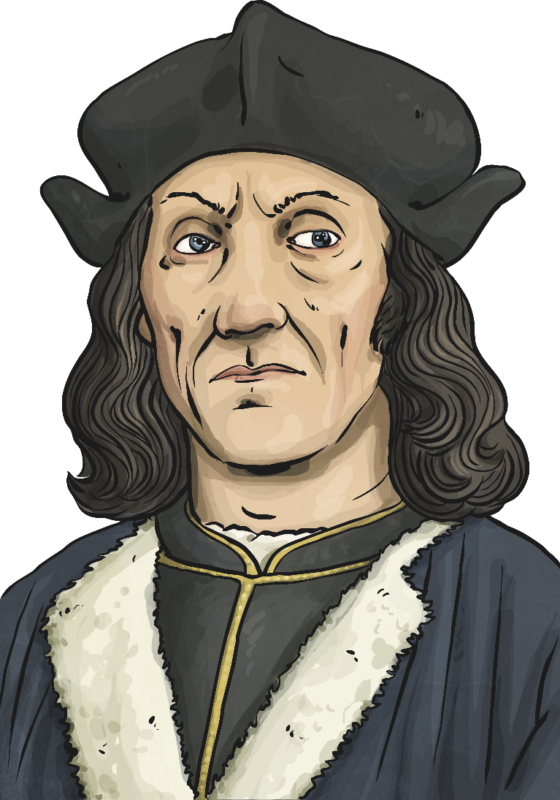
Gaining Support
Henry managed to get the support of the most important landowner in South Wales, Rhys ap Thomas. Henry promised him Lieutenancy of Wales if he won.
Then Henry turned to his step father, Lord Stanley, and his brother Sir William Stanley, for support.

Slide 8
The Stanleys
Both of these men owned land and gave Henry money. At the time, Richard III was keeping Lord Stanley’s eldest son in prison, so he very much wanted Henry to become king.

Slide 9
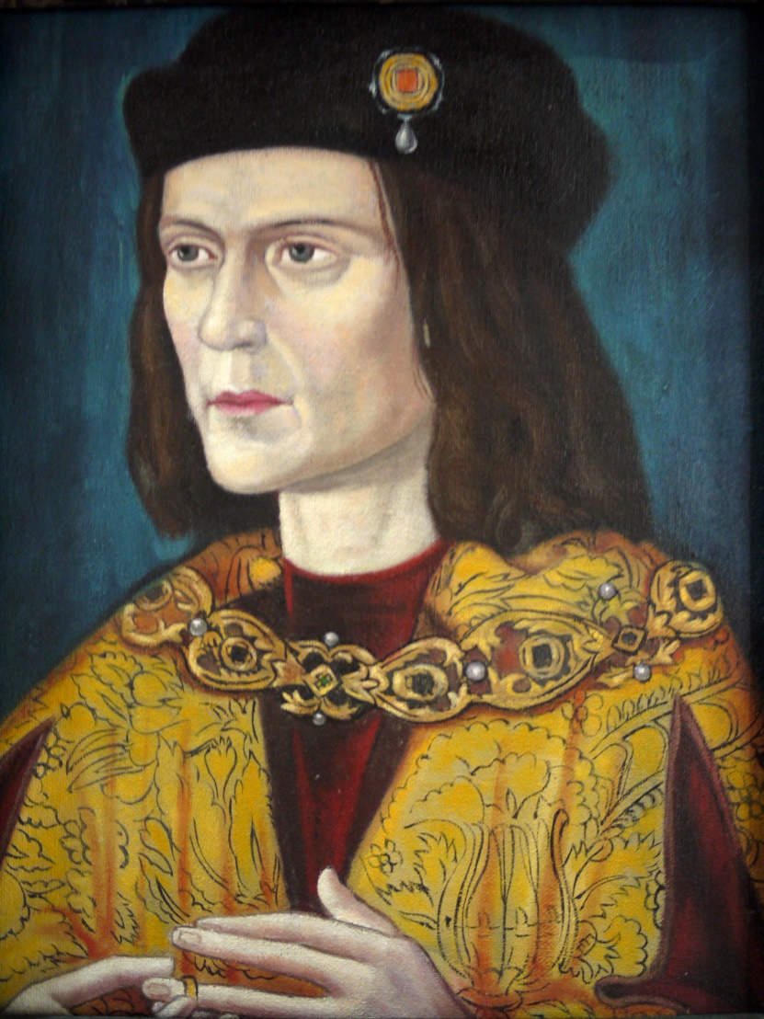
News Travels Fast
Richard was at Nottingham
Castle when he heard about Henry’s invasion.
He did nothing. He thought
that the Welsh landowners
would attack Henry.
He made a big mistake!

Slide 10
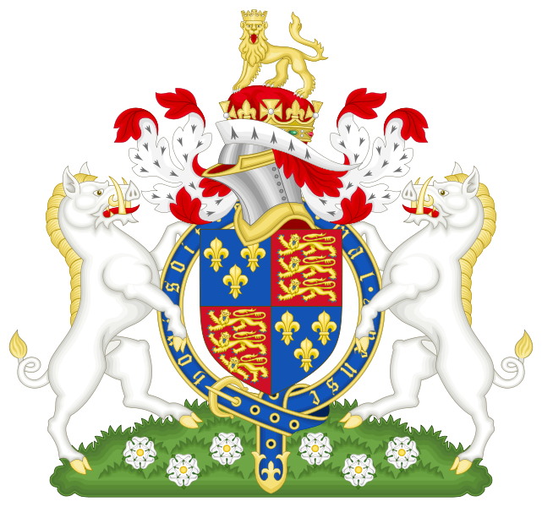
To Leicester
Eventually, Richard realised his mistake. The Welsh landowners were actually helping Henry!
Richard marched his army to Leicester.
Photo courtesy of Sodacan (@wikicommons) - granted under creative commons licence

Slide 11
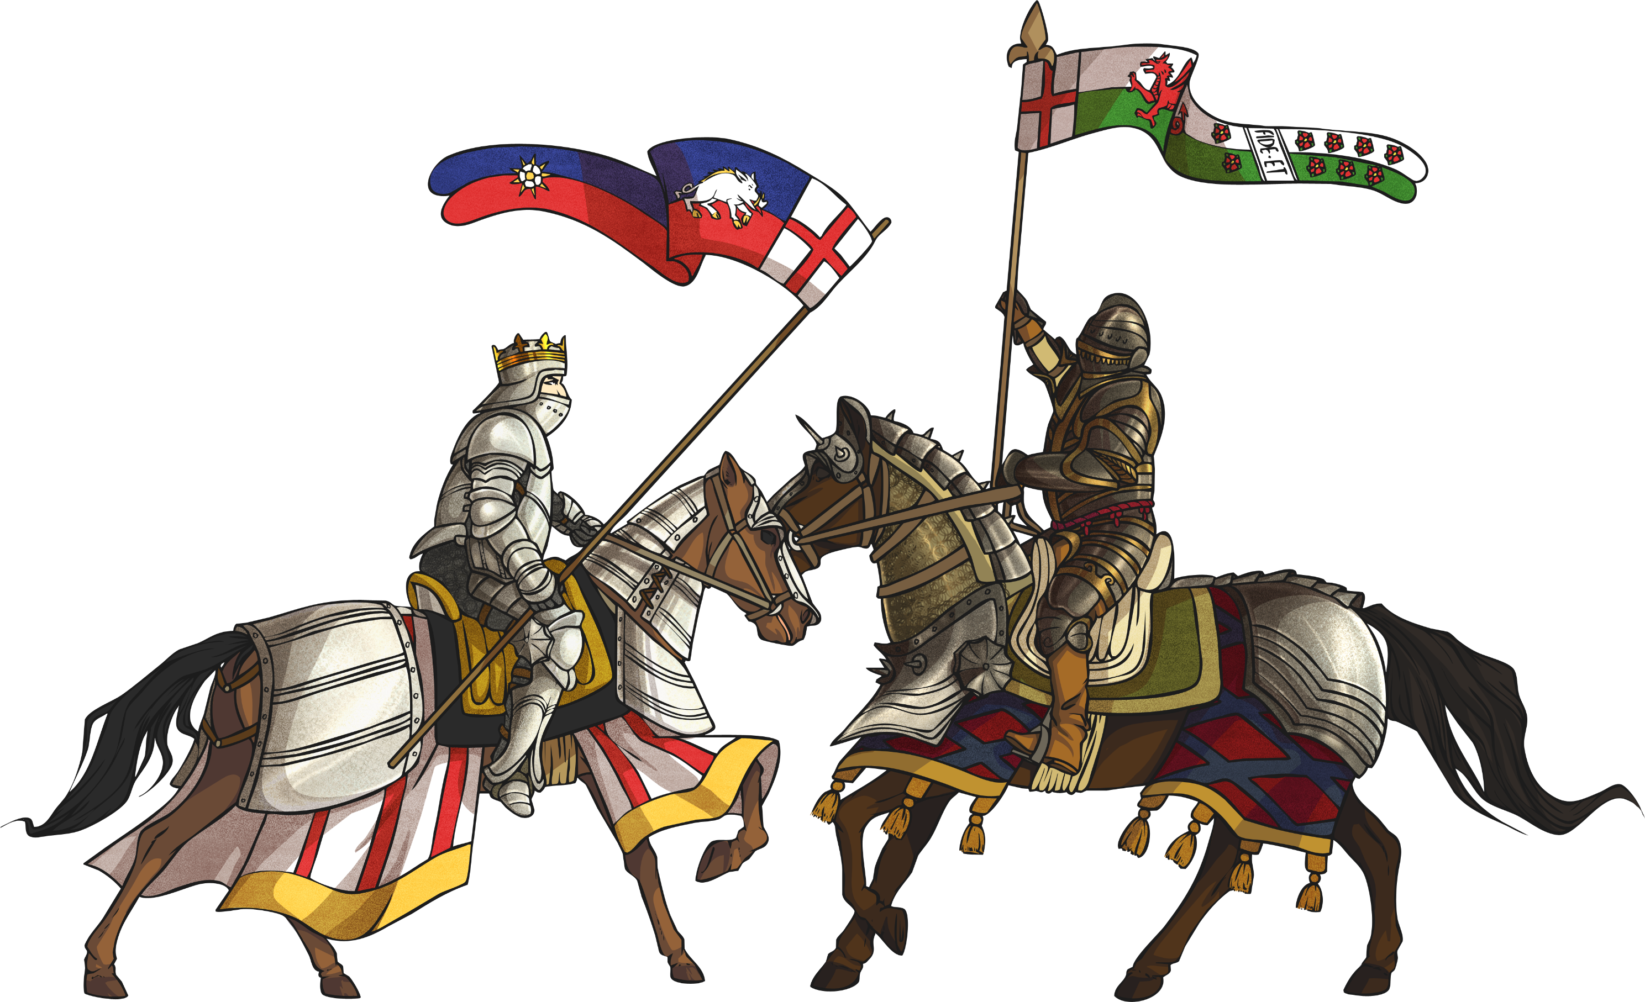
The Battle at Bosworth
Henry had 5000 men.
Richard had 12 000 men. However, 4000 of these
men actually belonged to the Stanley family.
Richard knew that Lord Stanley often fought for
the side he had most to gain from if they won, so the
king did not trust him.

Slide 12

22nd August 1485
The fighting began early in the morning.
The two Stanley armies stayed away at first, whilst they worked out who to support.
Richard’s army was at the top of Ambien Hill.
Henry’s army was at the bottom in marsh land.

Slide 13
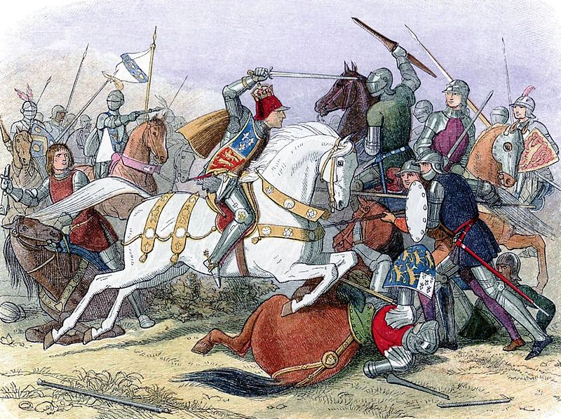
Huge Casualties
Henry’s army charged up the hill, but suffered huge casualties.
However, Henry had recruited long bowmen and their aim inflicted severe wounds on Richard’s army. They had no shelter from the arrows falling on to them.
Photo courtesy of James William Edmund Doyle (@wikicommons) - granted under creative commons licence

Slide 14

The King Charged
King Richard decided to target Henry himself.
He charged at Henry, but Henry’s bodyguards closed ranks and
saved him.
Suddenly, Lord Stanley decided who to support. He attacked Richard, and came to the defence of Henry.

Slide 15
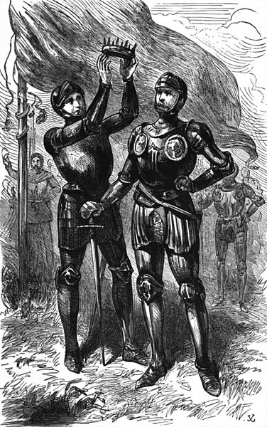
Death of King Richard III
King Richard III of England was killed and his army ran away. The Yorkist
king was dead.
Lord Stanley picked up the crown from Richard and placed it on Henry’s head.
Richard’s naked body was put on the back of a mule and taken to Leicester to be buried.

Slide 16
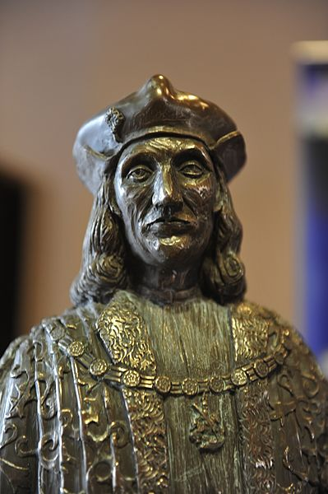
Henry Tudor, King of England
Henry Tudor of the House of Lancaster was now king of England.
He ended the Wars of the Roses by marrying Elizabeth of York in 1486.
Photo courtesy of Thruxton (@wikicommons) - granted under creative commons licence

