Slide 2



oi
boil
coin
foil

Slide 3

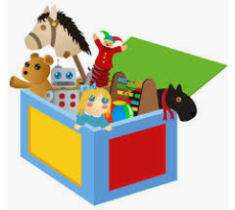

oy
toys
boy
oyster

Slide 4

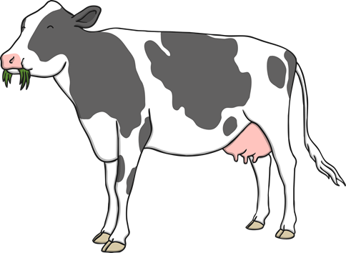
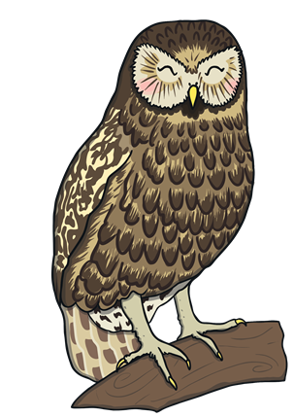
ow
flower
cow
owl

Slide 5


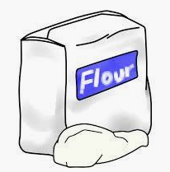
ou
cloud
shout
flour

Slide 6
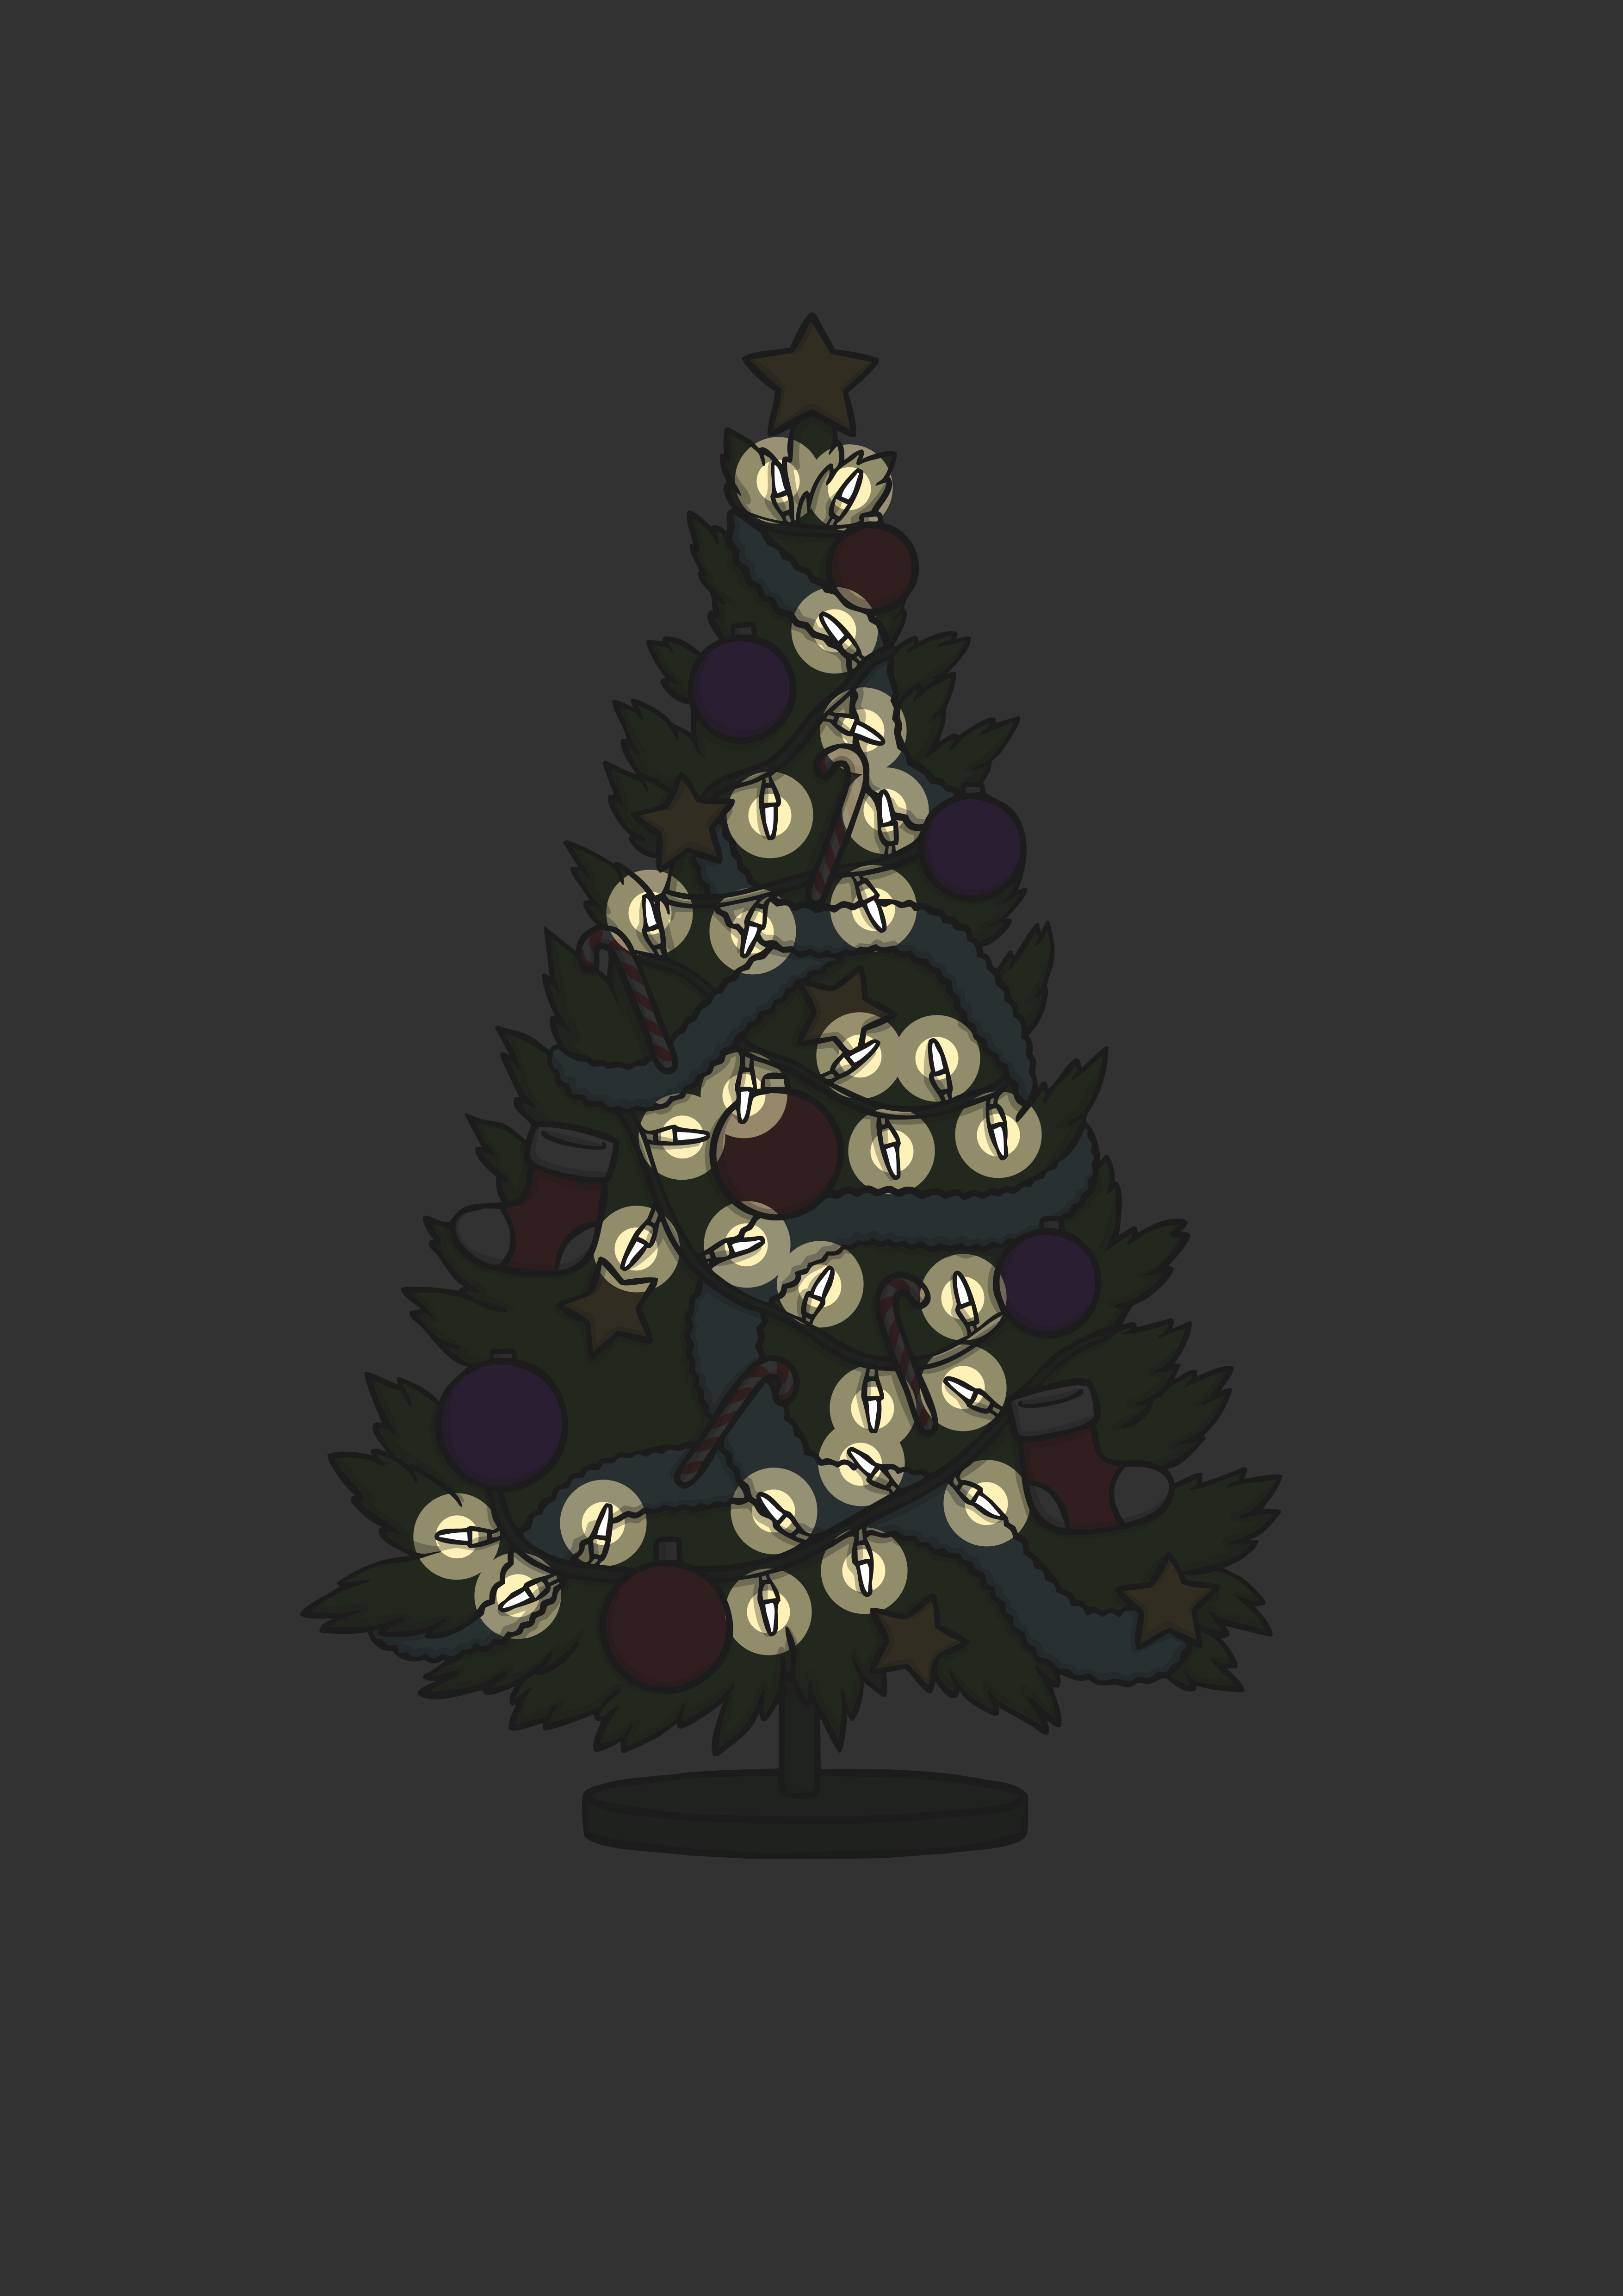
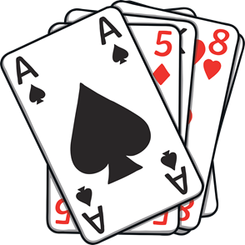

ar
dark
cards
shark

Slide 7



or
corn
fork
torch

Slide 8
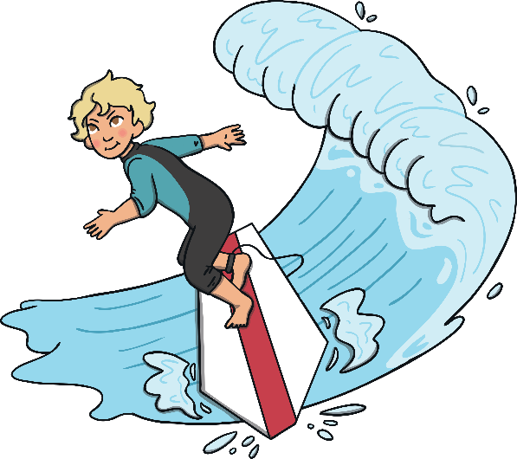
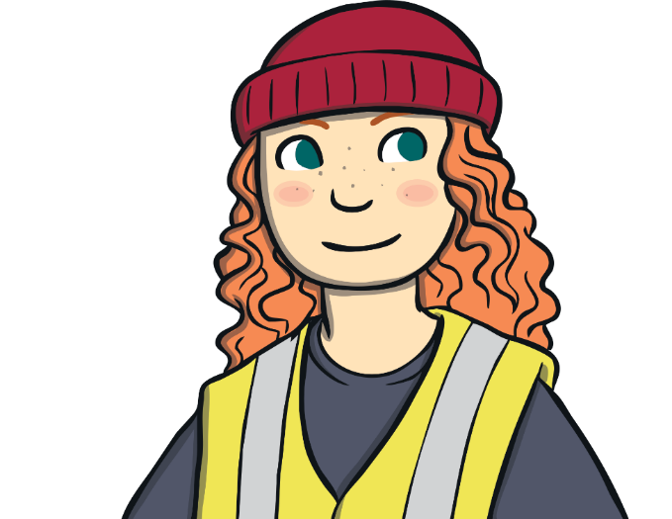
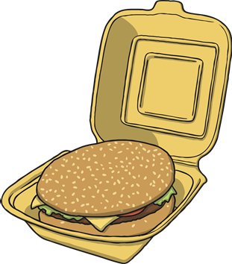
ur
surf
curl
burger

Slide 9
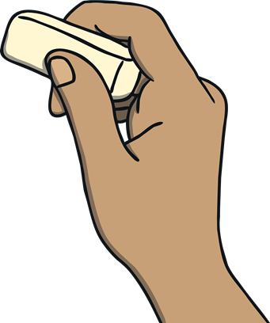


er
rubber
mermaid
waiter

Slide 10



air
hair
chair
pair

Slide 11

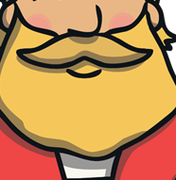
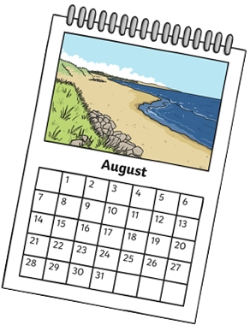
ear
hear
beard
year

