Slide 2
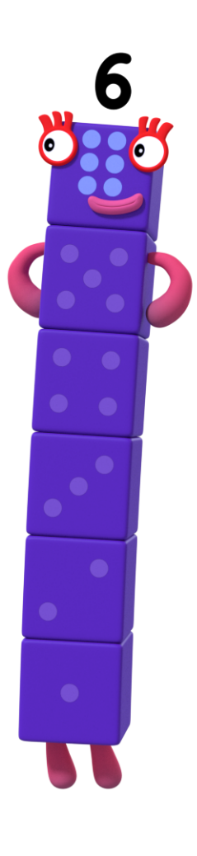
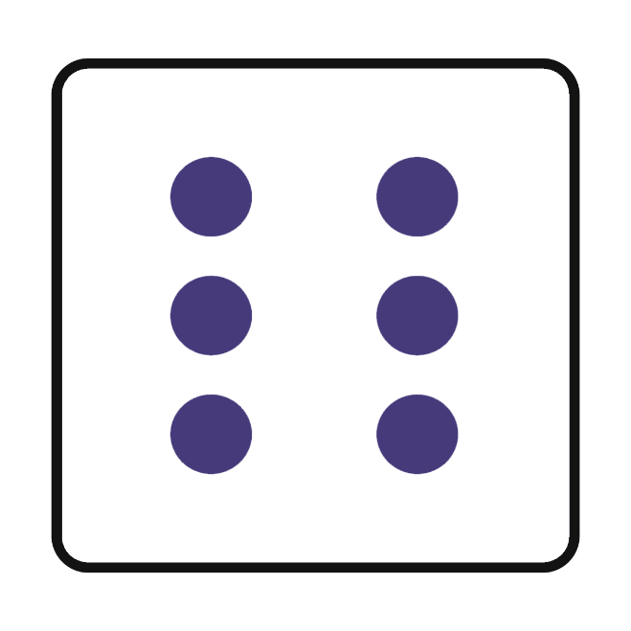
Number Six has something special!
Can you remember what it is?
What can we see on the dice?

Slide 3
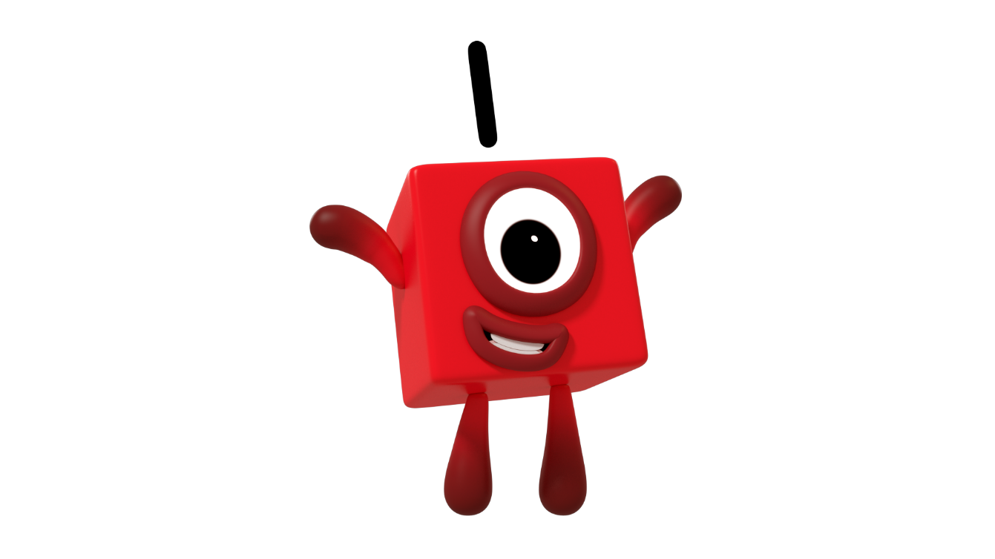
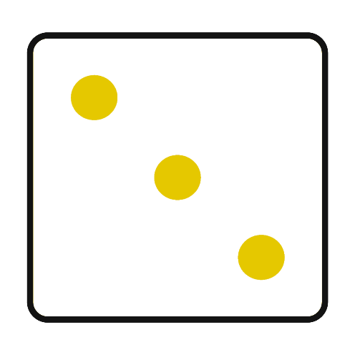

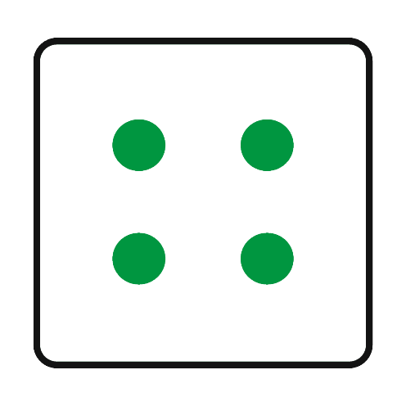
Number One looked at the dice.
Which pattern shows 1 on the dice? How do you know?
Try again.
Try again.

Slide 4

That’s right! It is 1.
Can you count the dots on the dice to check?

Slide 5
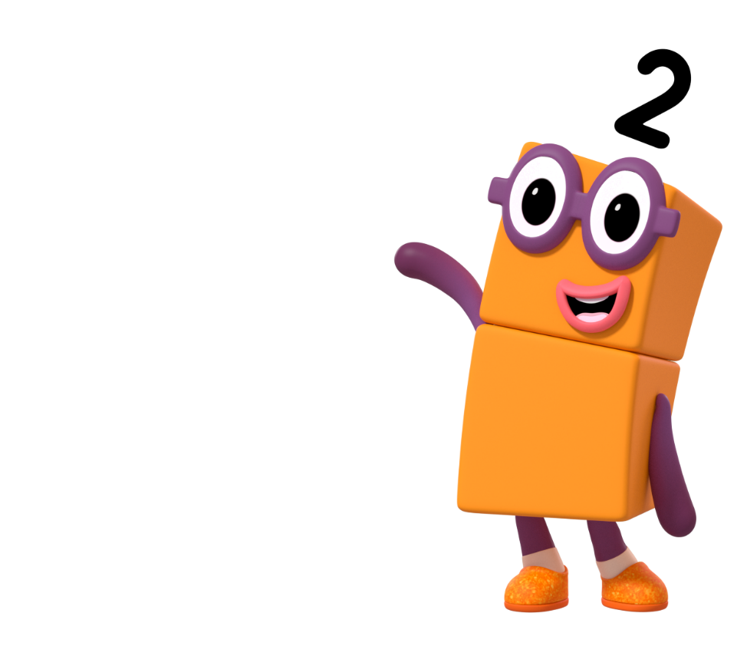
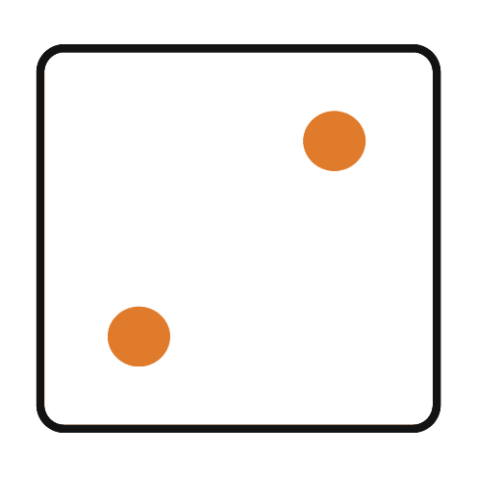
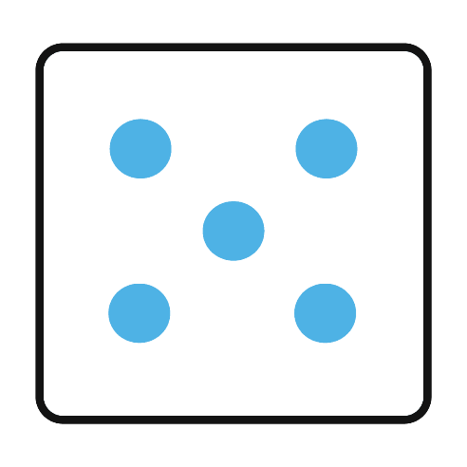
Number Two looked at the dice.
Which pattern shows 2 on the dice? Can you count the dots to check?
Try again.
Try again.

Slide 6

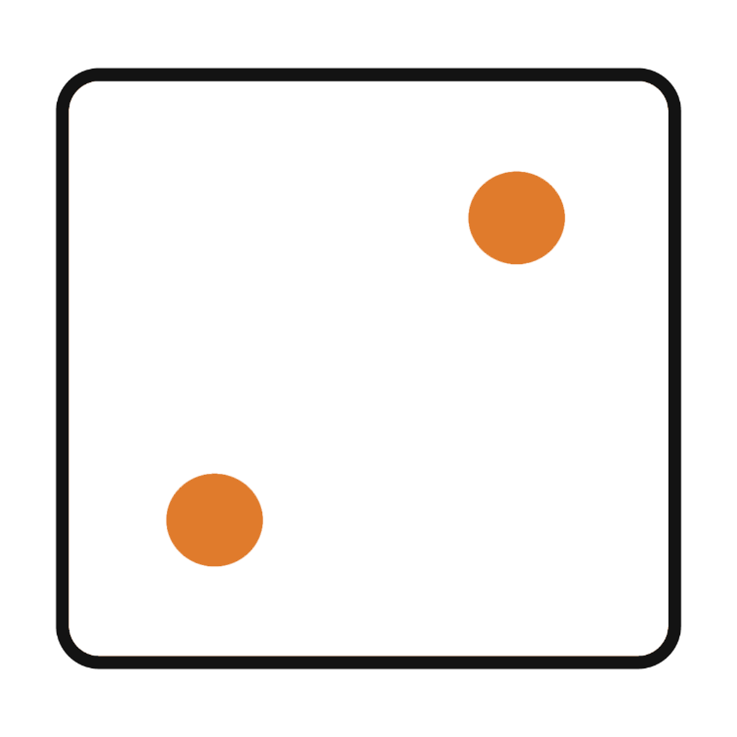
That’s right! It is 2.
Can you do 2 claps?

Slide 7
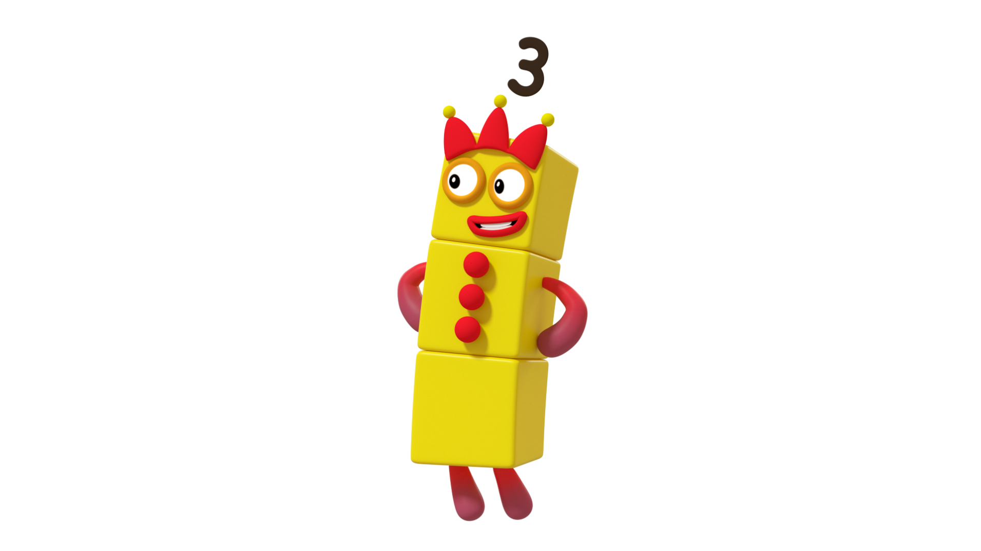
Number Three looked at the dice.
Which pattern shows 3 on the dice? Can you count the dots to check?
Try again.
Try again.

Slide 8
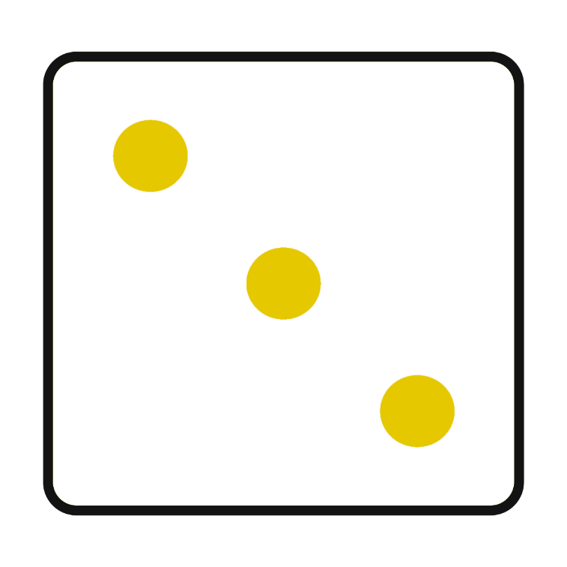
That’s right! It is 3.
Can you show me 3 on your fingers?

Slide 9
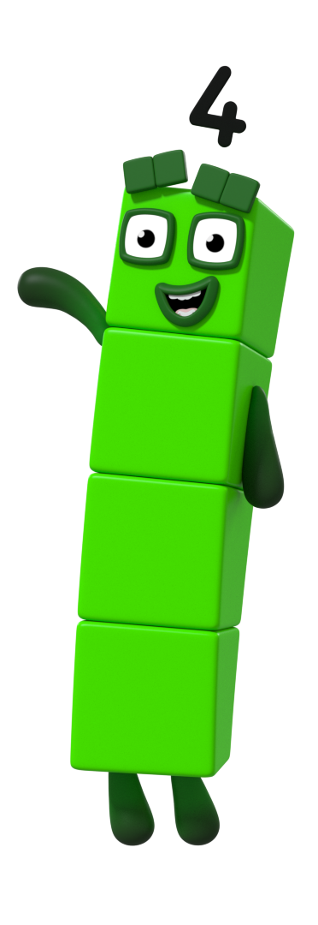
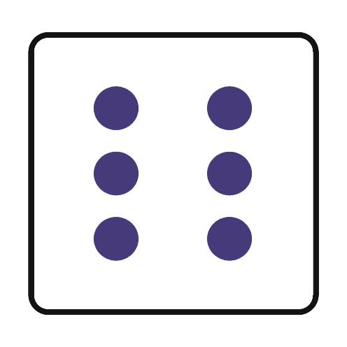
Number Four looked at the dice.
Which pattern shows 4 on the dice? How can you work it out?
Try again.
Try again.

Slide 10
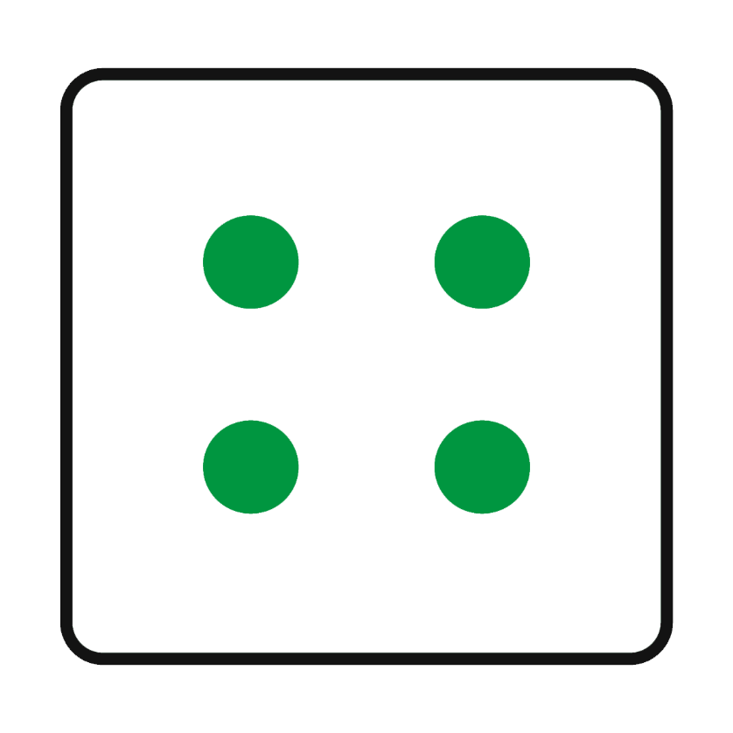
That’s right! It is 4.
How did you know?

Slide 11
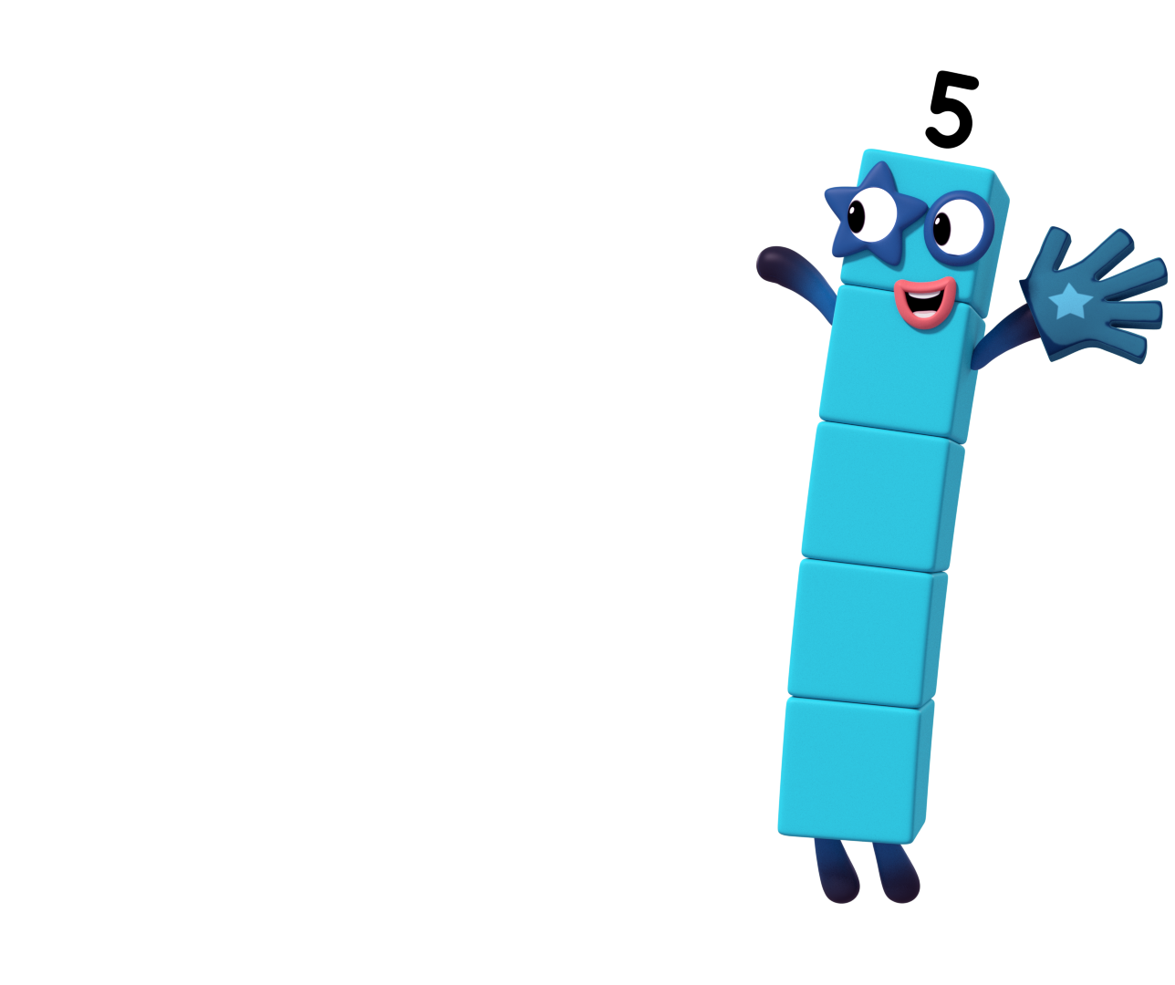
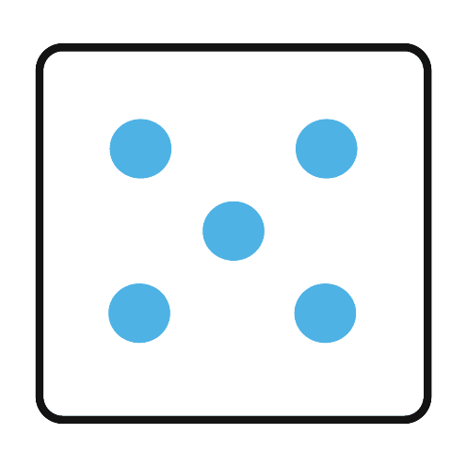
Number Five looked at the dice.
Which pattern shows 5 on the dice? Can you show me 5 on your fingers?
Try again.
Try again.

Slide 12
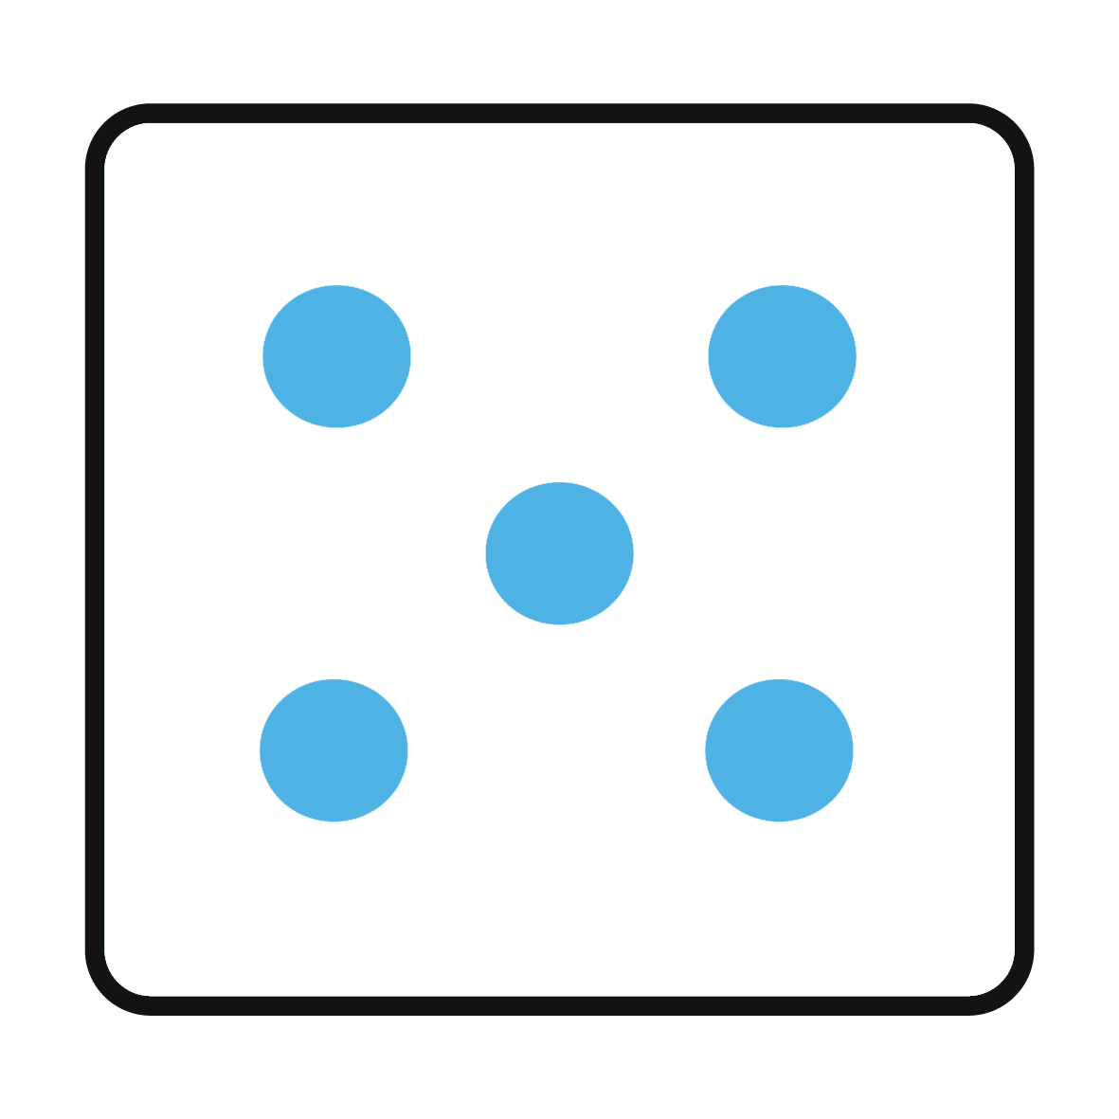
That’s right! It is 5. Can you give your partner a high five?

Slide 13
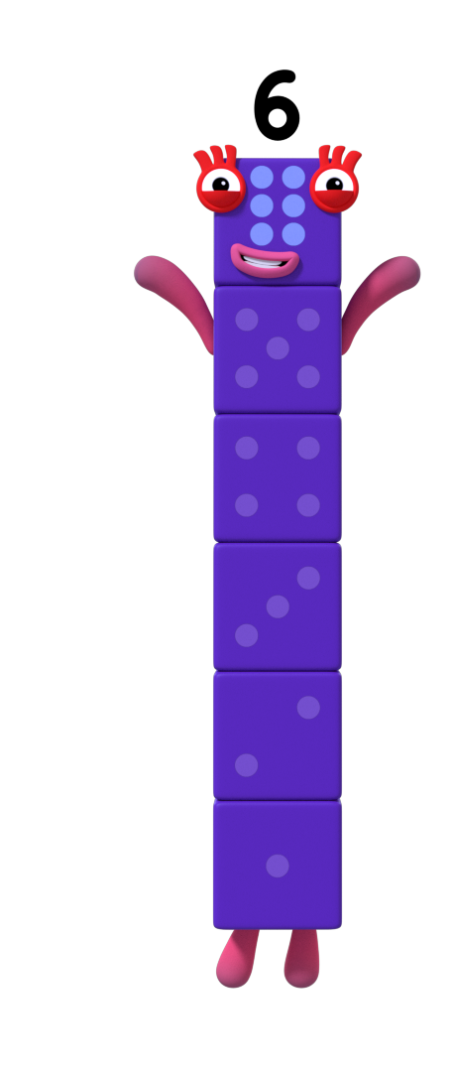
Number Six looked at the dice.
Which pattern shows 6 on the dice? Can you tell a partner how you know it is 6?
Try again.
Try again.

Slide 14
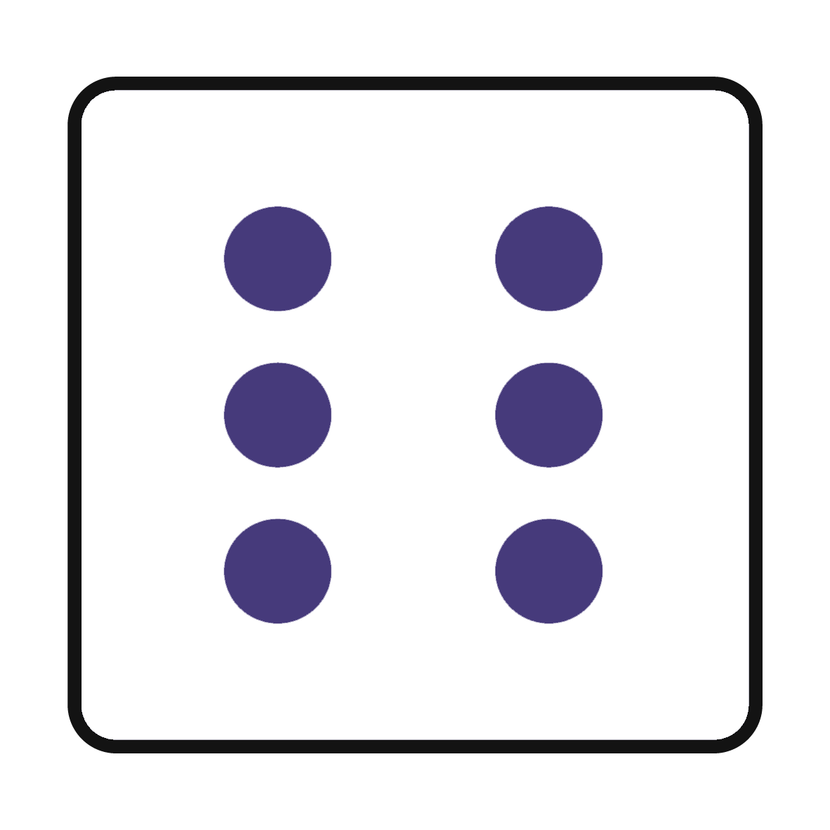
That’s right! It is 6.
Can you count to 6?

Slide 15

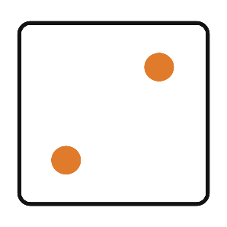
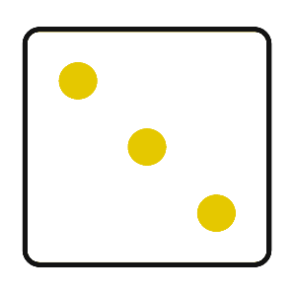
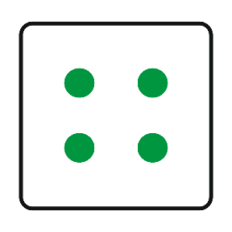
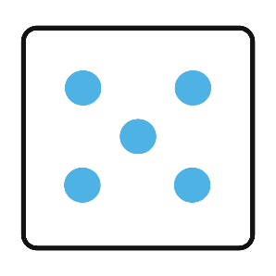
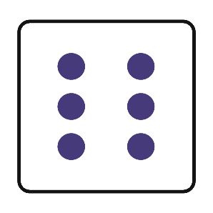
Can you use the dice to help you count to 6?
What do you notice about the dots on the dice?

Slide 16
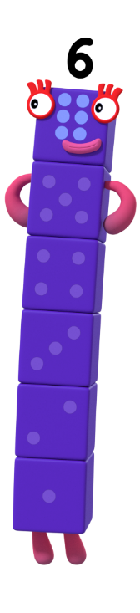
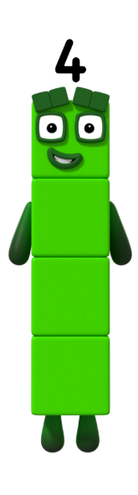


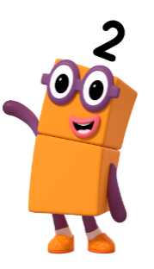

Choose an action for each Numberblock.
Let’s dance!
Decide on a dance move for each of the Numberblocks. It could be 1 hop, 2 jumps, 3 turns, 4 claps, 5 wiggles and 6 taps on your head. Roll the dice, choose the Numberblock and perform the dance moves that you chose.
Remember to count your moves!

Slide 17
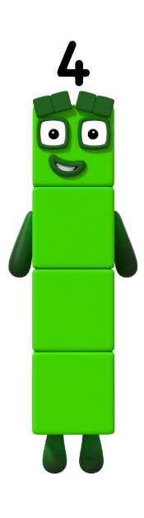


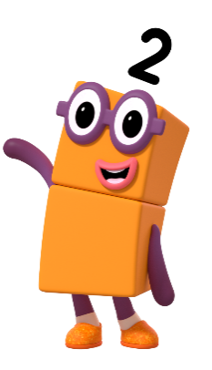



Roll the dice.
Whose turn is it to dance?
Click on the correct Numberblock.
Have another try!
Have another try!
Have another try!
Have another try!
What is my action?
Have another try!

Slide 18
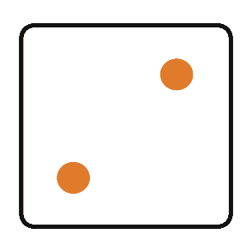
Roll the dice.
Whose turn is it to dance?
Click on the correct Numberblock.
Have another try!
Have another try!
What is my action?
Have another try!
Have another try!
Have another try!

Slide 19
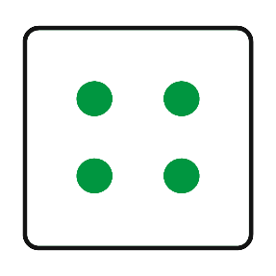
Roll the dice.
Whose turn is it to dance?
Click on the correct Numberblock.
Have another try!
What is my action?
Have another try!
Have another try!
Have another try!
Have another try!

Slide 20
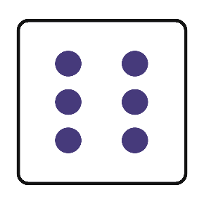
Roll the dice.
Whose turn is it to dance?
Click on the correct Numberblock.
Have another try!
Have another try!
Have another try!
What is my action?
Have another try!
Have another try!

Slide 21
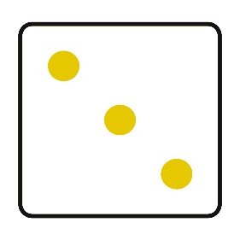
Roll the dice.
Whose turn is it to dance?
Click on the correct Numberblock.
What is my action?
Have another try!
Have another try!
Have another try!
Have another try!
Have another try!

Slide 22
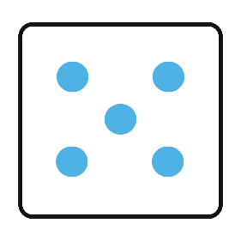
Roll the dice.
Whose turn is it to dance?
Click on the correct Numberblock.
Have another try!
Have another try!
Have another try!
Have another try!
Have another try!
What is my action?

Slide 23
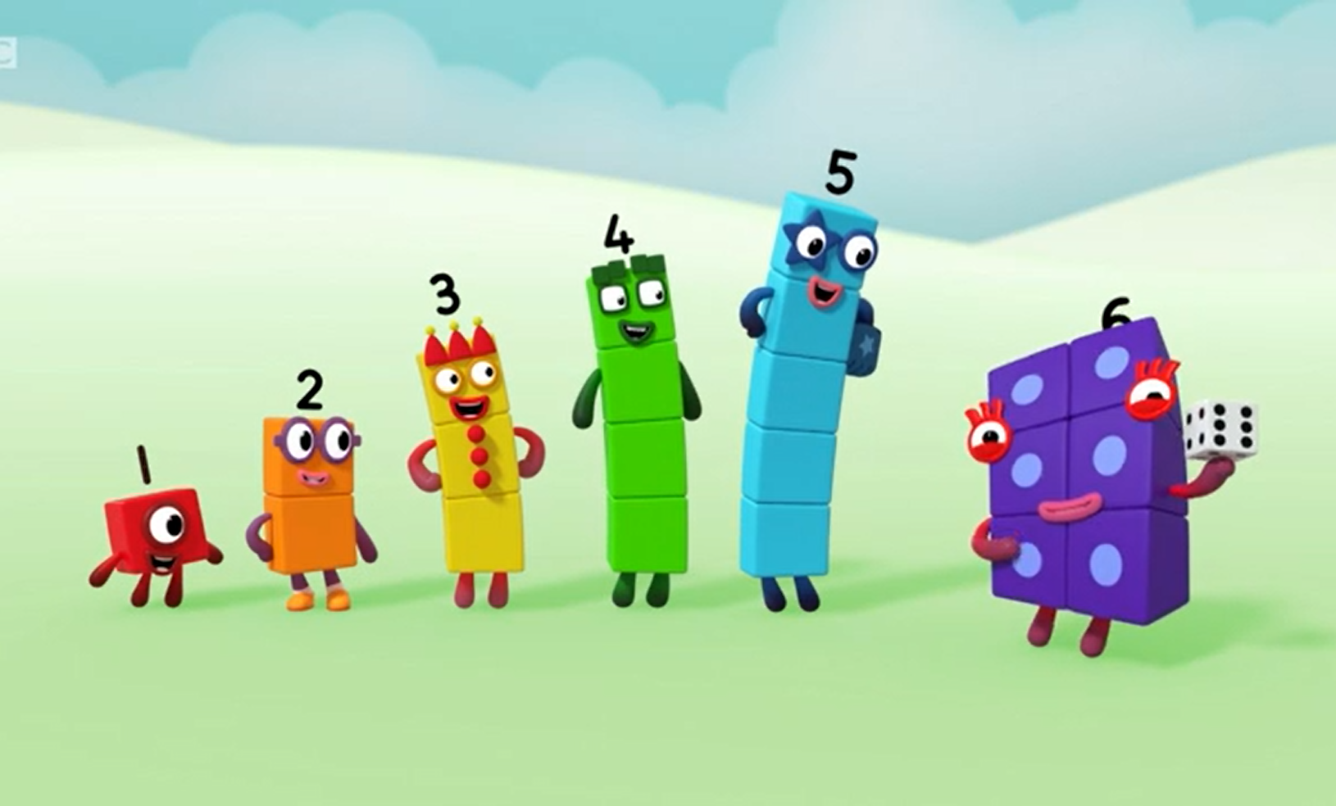
Great dancing!
Can you remember all of our actions?

Slide 24
Goodbye!
For more number fun, head on down to learningblocks.tv!

