Slide 1
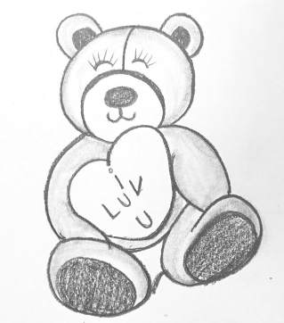
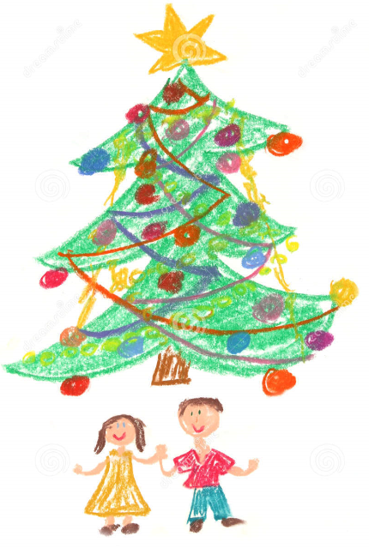
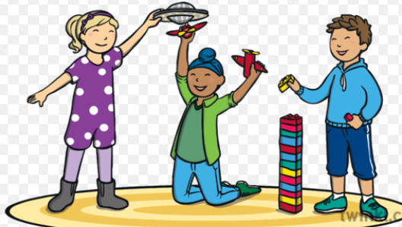
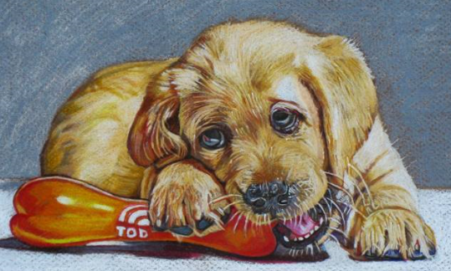
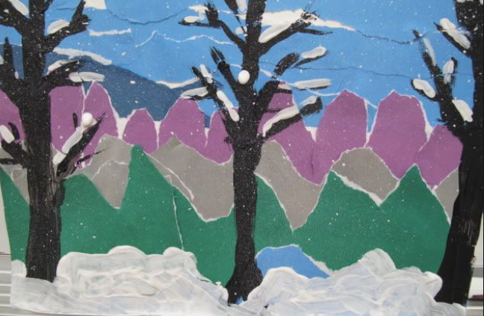
Wednesday 6th January 2021
Afternoon Art Activity
WALT: Make a picture to go with the recount you wrote this morning.
Some suggestions for you …….
Make a pencil drawing of your best present.
Use pencil crayons to draw you and your family by the Christmas tree.
Do a painting of you playing with one of your presents.
Use felt pens to create a picture of your pet at Christmas.
Make a collage of a winter garden scene.

