Slide 1

Hibernation

Slide 2
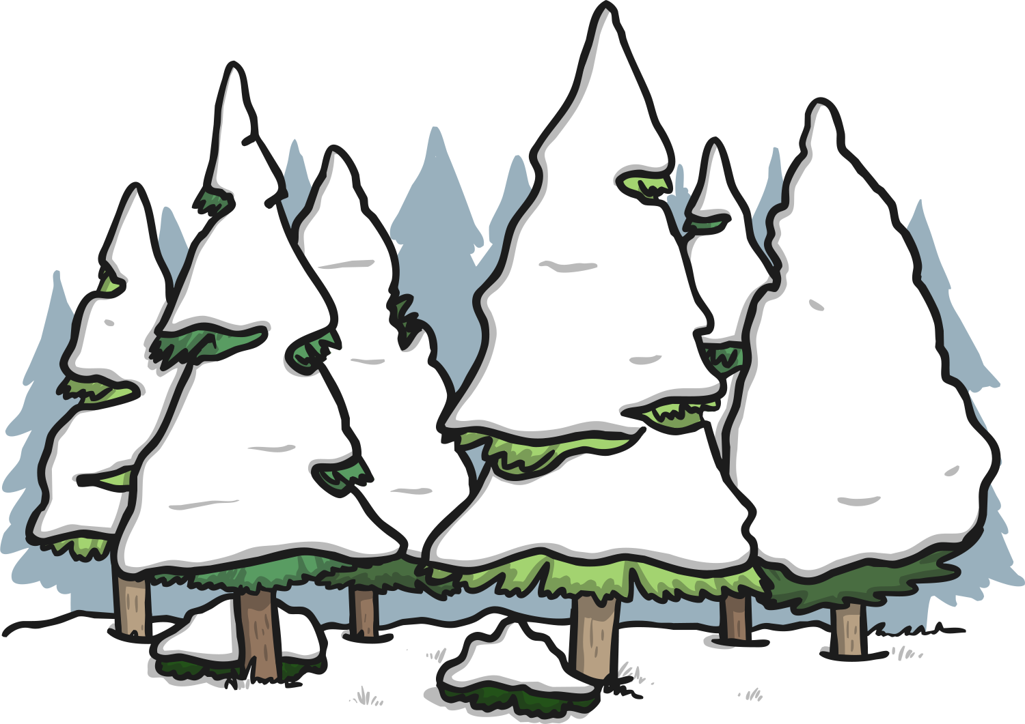
Why Do Some Animals Hibernate?
Some animals hibernate for the winter because the weather is cold and it is hard for them to find food. Hibernation is the way that some animals survive through the winter. They find a safe place and fall into a very deep sleep. When the temperature is warmer, in the spring, they wake up again.

Slide 3
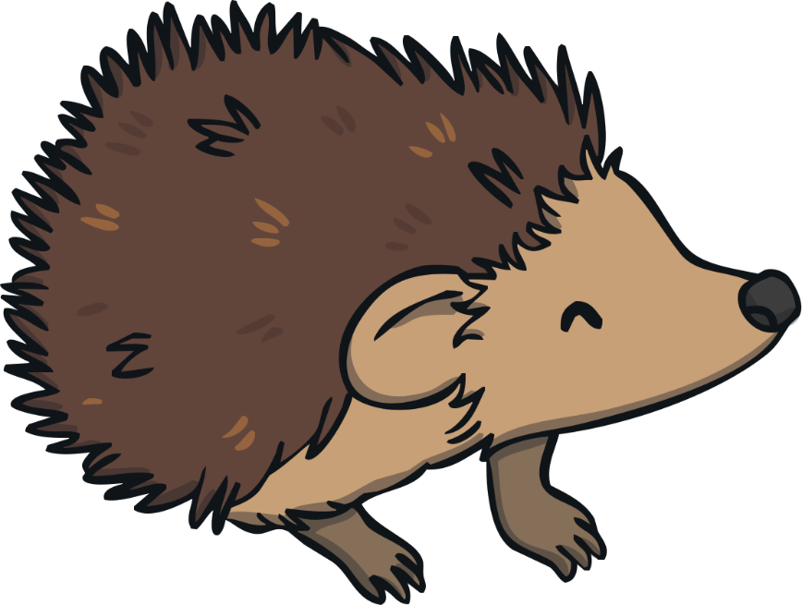

How Do Animals Get Ready To Hibernate?
Before animals go into hibernation, many get ready by eating extra food. They store this as fat in their bodies, which helps to keep them alive during the winter.
Animals usually find a safe, quiet and warm place to hibernate. Some animals go underground and some make their hibernation sites comfortable by lining them with grass and leaves.

Slide 4
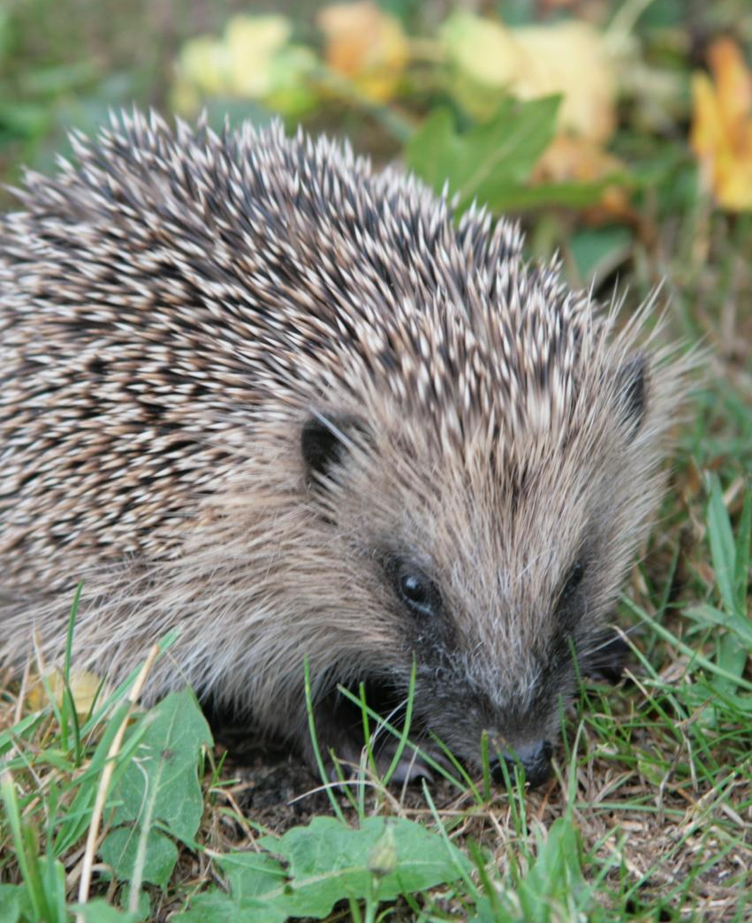
Animals That Hibernate
Hedgehogs
Hedgehogs usually hibernate from November/December to March/April.
Hedgehogs sometimes hibernate under hedges or in old rabbit burrows.
They make their hibernation site comfortable by using old, dry leaves and grass.
Photo courtesy of Karen Roe (@flickr.com) - granted under creative commons licence - attribution

Slide 5
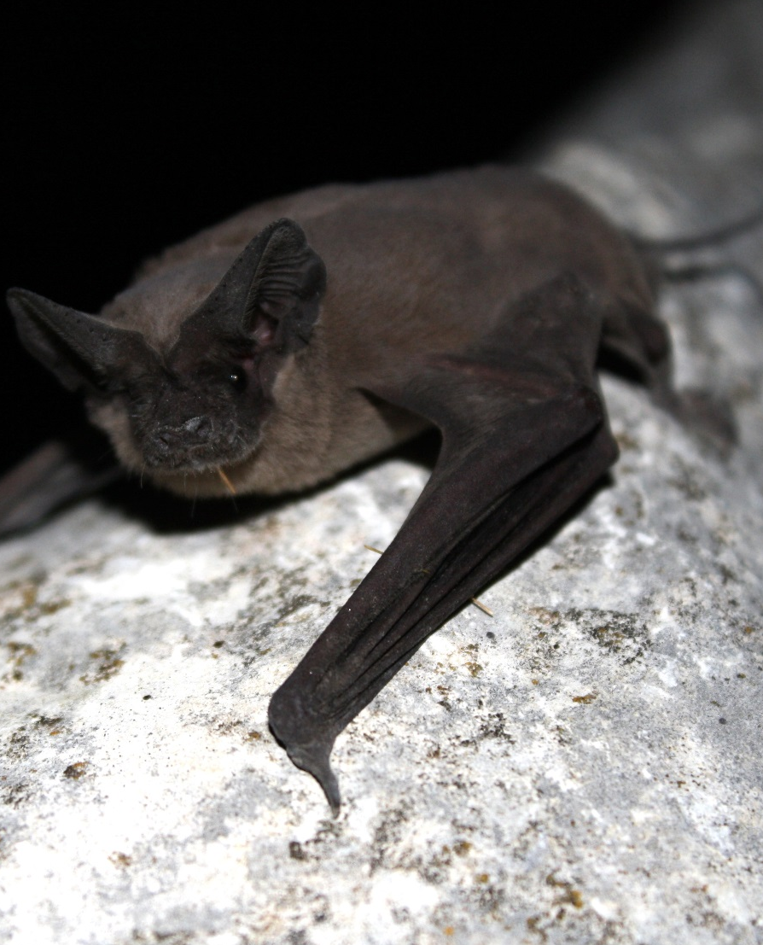
Animals That Hibernate
Bats
Bats usually hibernate from November/December to March/April.
They often hibernate in disused buildings, old trees or caves.
Bats can hibernate on their own or in small groups.
Photo courtesy of USFWS Headquarters. (@flickr.com) - granted under creative commons licence - attribution

Slide 6
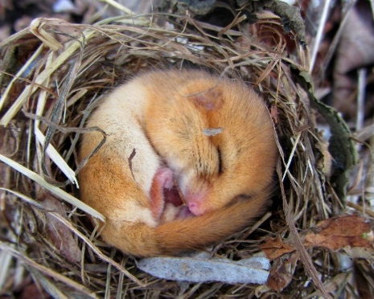
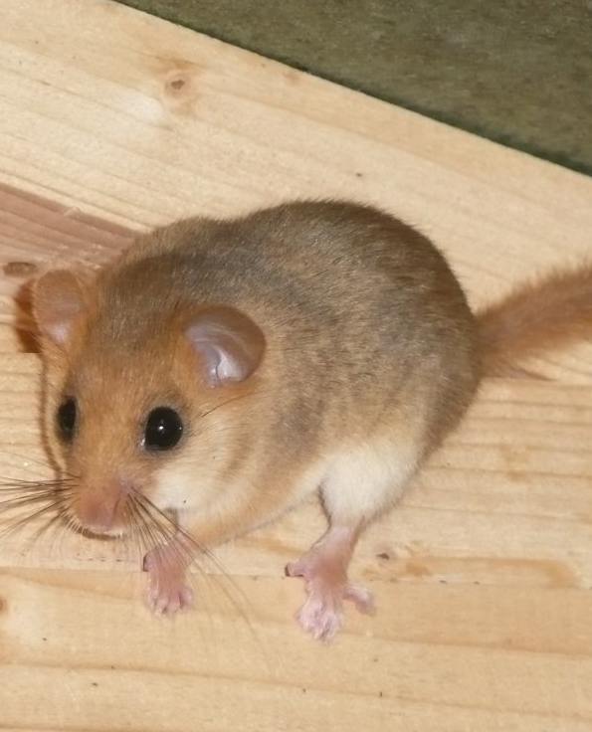
Animals That Hibernate
Dormice
Dormice usually hibernate between October and April, although they can hibernate for up to three quarters of the year.
Dormice hibernate on the ground. They roll themselves into a ball, in a nest of leaves and grass.
Photo courtesy of nociveglia (@flickr.com) - granted under creative commons licence - attribution

Slide 7
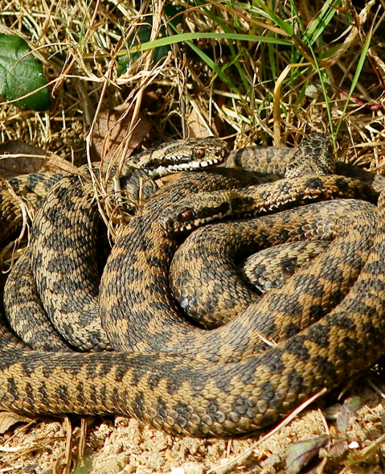
Animals That Hibernate
Adders
Adders hibernate from October each year and come out at different times during the spring, depending on the weather.
Adders follow scent trails left by other adders, to find their way back to their hibernation sites.
Photo courtesy of Peter G Trimming (@flickr.com) - granted under creative commons licence - attribution

Slide 8
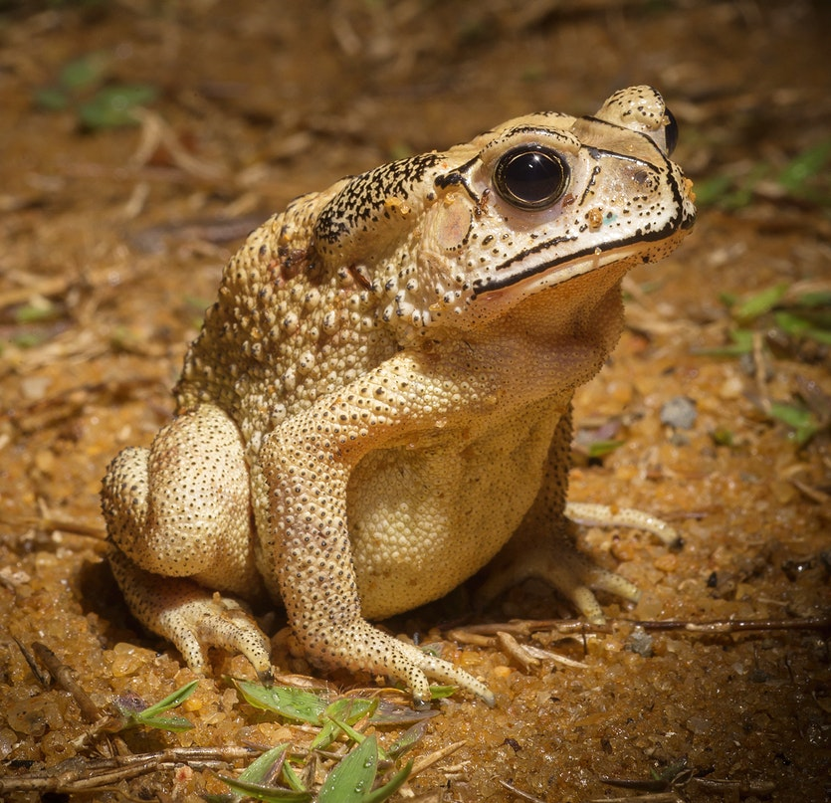
Animals That Hibernate
Toads
Common toads usually hibernate between October and March
They hibernate in damp places, such as the bases of hedgerows, under deep piles of leaves, in logs, burrows or drainpipes.
Photo courtesy of Peter G Trimming (@flickr.com) - granted under creative commons licence - attribution

Slide 9
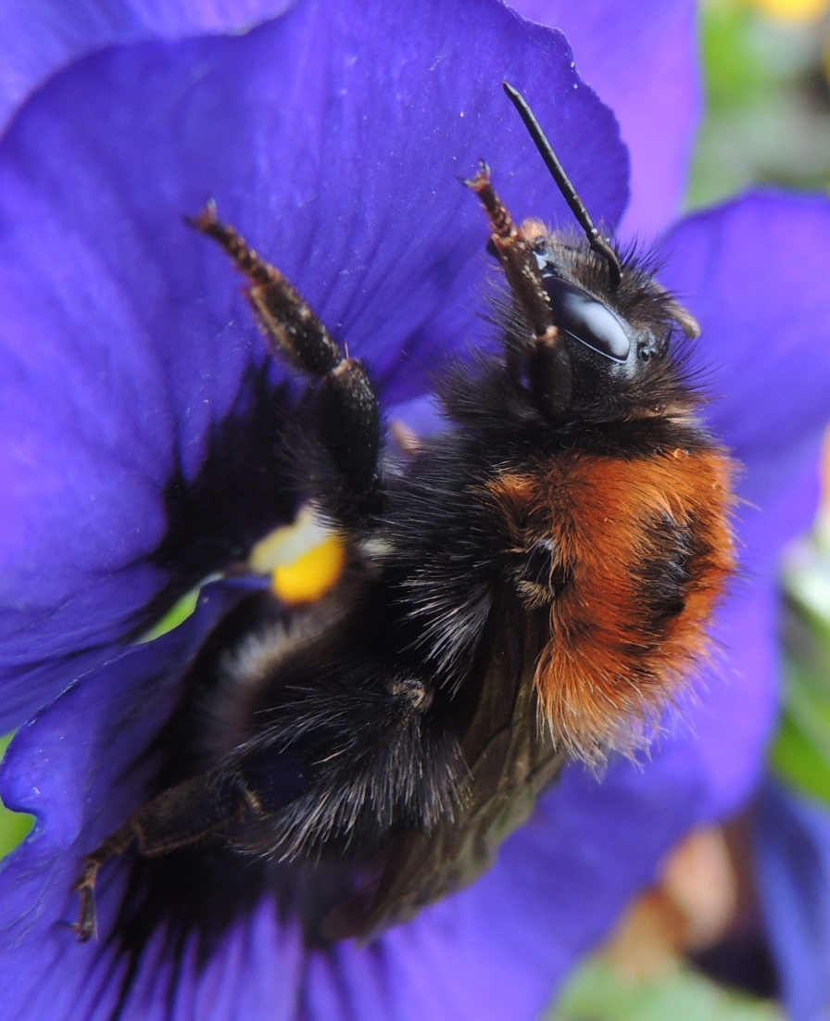
Animals That Hibernate
Queen Bumblebees
Queen bumblebees can hibernate for up to nine months of the year.
They hibernate in a small hole in the soil about 10cm below the ground.
Photo courtesy of orangeaurochs (@flickr.com) - granted under creative commons licence - attribution

Slide 10
Quiz
If an animal hibernates, what does it do?
Correct answer turns green.
1
Goes to sleep for the winter.
2
Keeps very still for a long time.
3
Travels to a warmer place.
4
Goes for a ride in a car.

Slide 11
Quiz
Why do some animals hibernate in winter?
1
Because they are lazy.
2
Because they get very tired.
3
Because they get bored.
4
Because it gets colder and it’s difficult for them to find food.

Slide 12
Quiz
Which 3 mammals hibernate in winter?
1
Dormice, cats and hedgehogs.
2
Dormice, bats and hedgehogs.
3
Dormice, rats and hedgehogs.
4
Dormice, dogs and hedgehogs.

Slide 13
Can you find out about any other animals that hibernate?
At home, draw a picture of some animals that hibernate and label them. Send us your pictures on Evidence Me.

