Slide 1
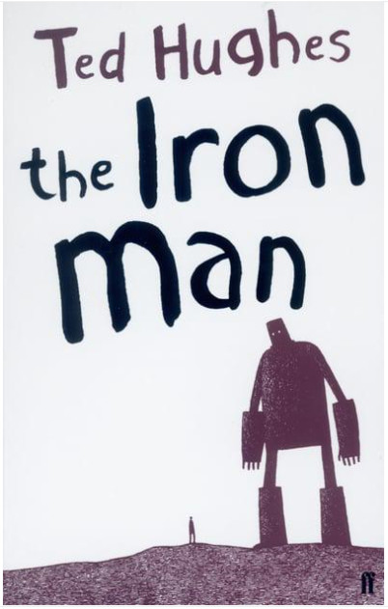
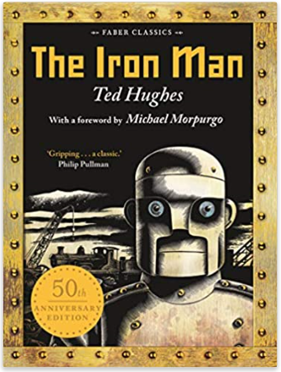
Year 4 English
Thursday 7th January
WALT: Predict what will happen in the Iron Man

Slide 2
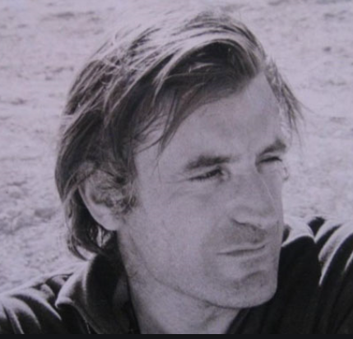
The Iron Man is a classic book by Ted Hughes.
In August 1930 Ted Hughes was born in Yorkshire. He went to Cambridge University and became a famous poet and writer of children’s books.
Between 1984 and 1998 (when he died) he was the Poet Laureate in the UK.

Slide 3
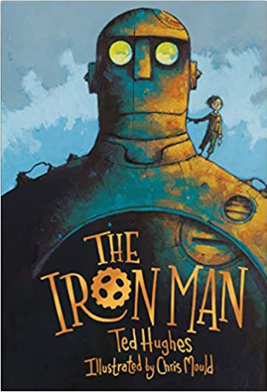
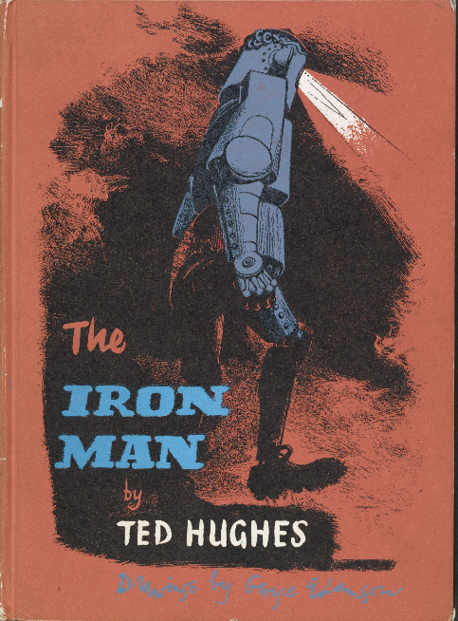
The Iron Man was written in 1968. It has been republished many times and sold millions of copies all around the world.

Slide 4
What do you think the story will be about?
What clues can you see on the covers?
What genre do you think the story will be from?

Slide 5
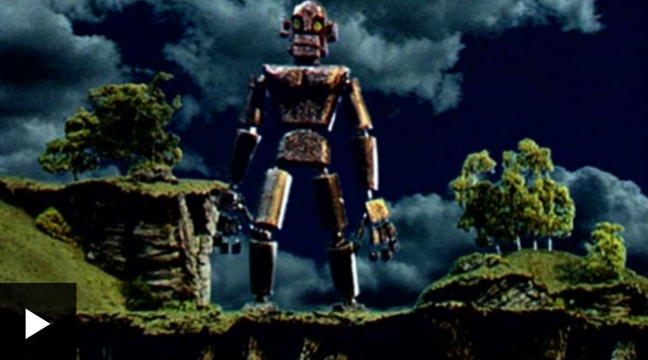
Watch this clip of the beginning of the story …
https://www.bbc.co.uk/bitesize/clips/z878q6f

Slide 6
The Coming of the Iron Man
The Iron Man came to the top of the cliff.
How far had he walked? Nobody knows. Where did he come from? Nobody
knows. How was he made? Nobody knows.
Taller than a house, the Iron Man stood at the top of the cliff, on the very
brink, in the darkness.
The wind sang through his iron fingers. His great iron head, shaped like a
dustbin but as big as a bedroom, slowly turned to the right, slowly turned to the left.
His iron ears turned, this way, that way. He was hearing the sea. His eyes, like
headlamps, glowed white, then red, then infrared, searching the sea. Never before had
the Iron Man seen the sea.
He swayed in the strong wind that pressed against his back. He swayed
forward, on the brink of the high cliff.
And his right foot, his enormous iron right foot, lifted - up, out into space, and
the Iron Man stepped forward, off the cliff, into nothingness.
CRRRAAAASSSSSSH!
Down the cliff the Iron Man came toppling, head over heels.
CRASH!
CRASH!
CRASH!

Slide 7
From rock to rock, snag to snag, tumbling slowly. And as he crashed and
crashed and crashed.
His iron legs fell off.
His iron arms broke off, and the hands broke off the arms.
His great iron ears fell off and his eyes fell out.
His great iron head fell off.
All the separate pieces tumbled, scattered, crashing, bumping, clanging, down
on to the rocky beach far below.
A few rocks tumbled with him.
Then
Silence.
Only the sound of the sea, chewing away at the edge of the rocky beach,
where the bits and pieces of the Iron Man lay scattered far and wide, silent and
unmoving.
Only one of the iron hands, lying beside an old, sand-logged washed-up
seaman’s boot, waved its fingers for a minute, like a crab on its back. Then it lay still.
While the stars went on wheeling through the sky and the wind went on
tugging at the grass on the cliff top and the sea went on boiling and booming.
Nobody knew the Iron Man had fallen.

Slide 8
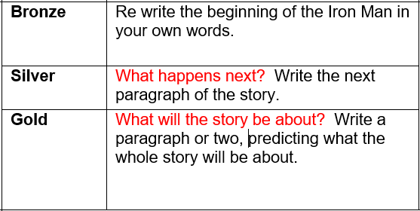
Choose your challenge ….

