Slide 1

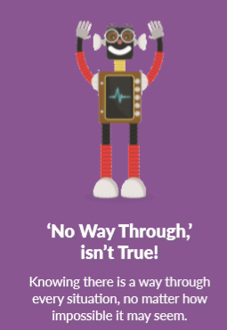
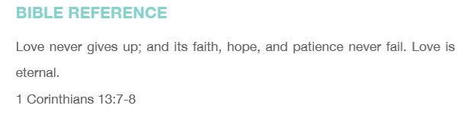


Assembly 1 – No way through isn’t true
Boris asks, “Can you think of some situations where you get stuck and feel there is no way through?”

Slide 2

Assembly 1
Boris says, ”Discuss with a partner or in a group how you might work through some of these problems.”
Boris says, “When we don’t believe there is a way through we give up and stay stuck. But when we believe there is an answer for every problem, we keep working at it until we find it!”
Being Heartsmart means knowing
NO WAY THROUGH ISN’T TRUE!

Slide 3
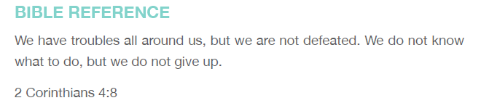
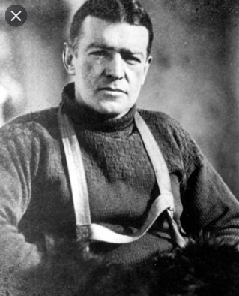
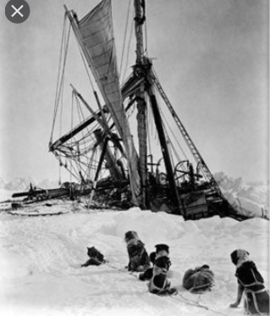

Assembly 2 – Endurance Expedition
Listen to the true story of Ernest Shackleton

Slide 4
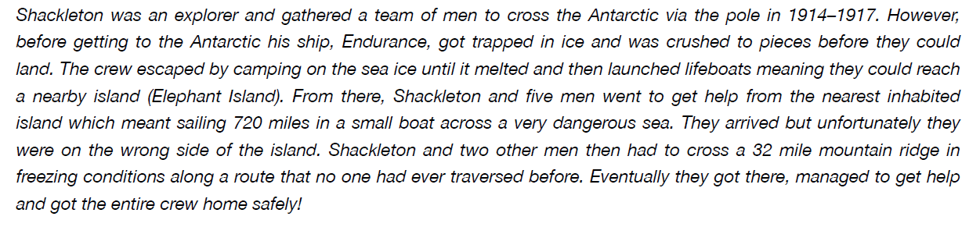
Assembly 2 – Endurance Expedition
Here is the true story of Ernest Shackleton

Slide 5
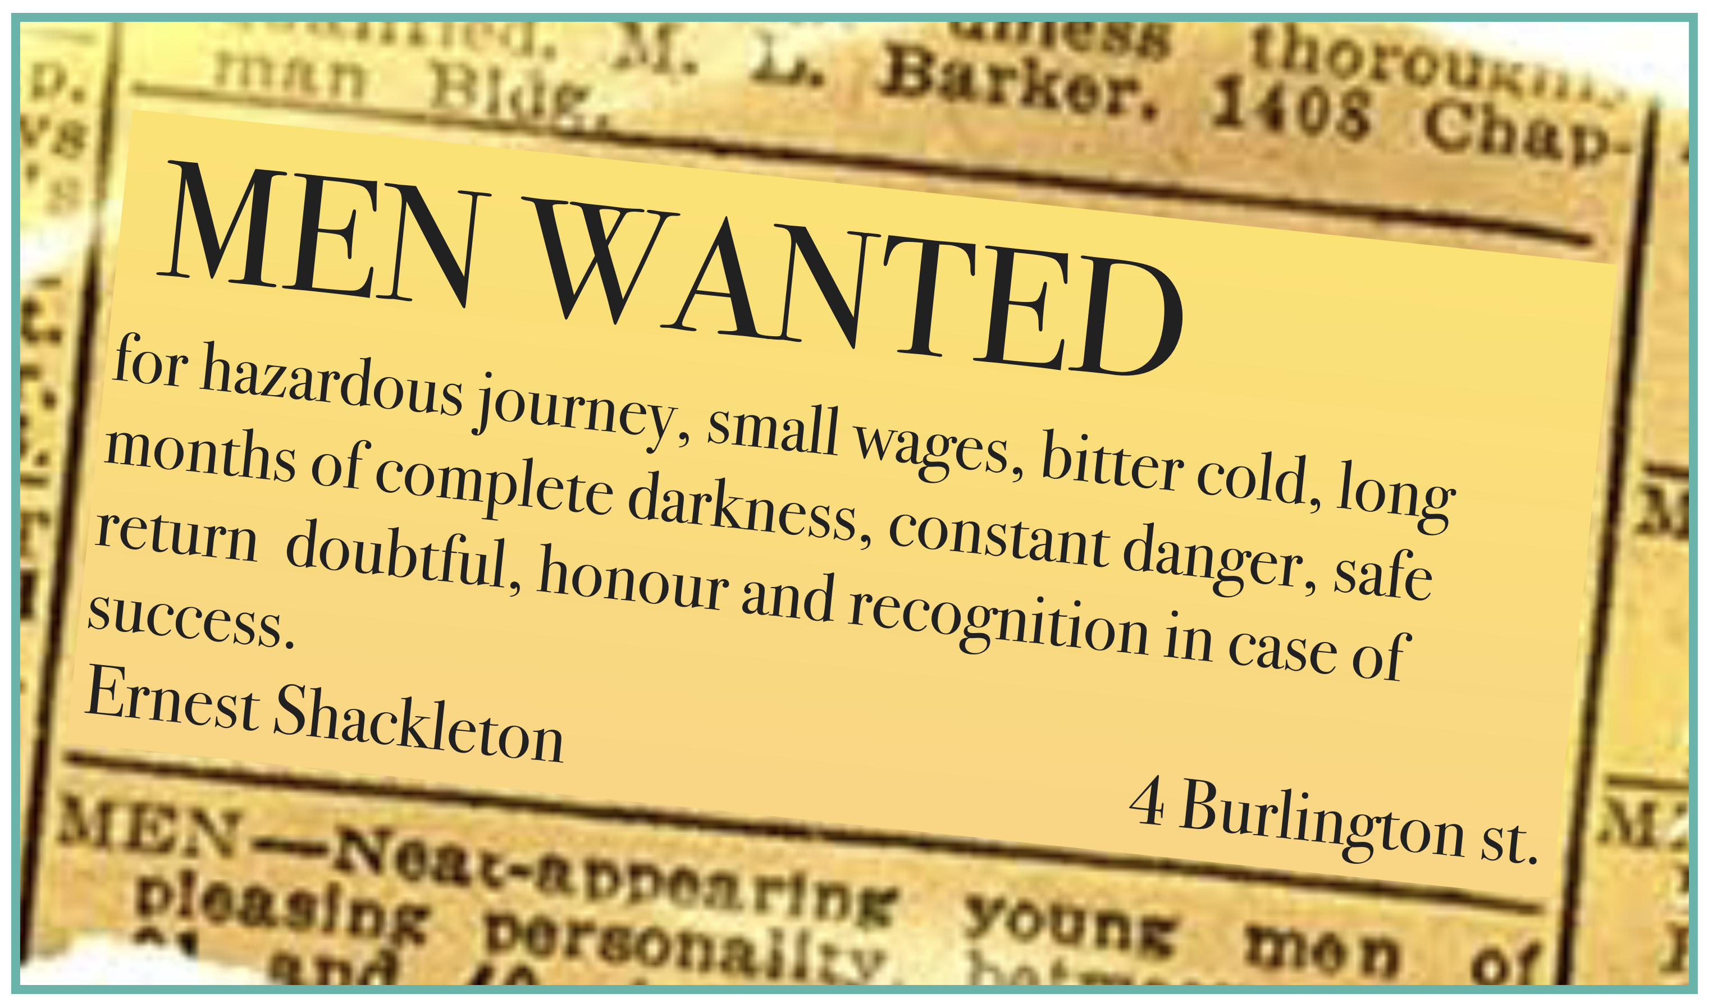
Assembly 2: Endurance Expedition
Imagine you are setting out on a dangerous
expedition. You need a team to take with you.
What kind of qualities will your team need?
Here is the real advert.
Why do you think people answered the advert?
Would it make you want to go?
Why do you think the story of the Endurance is so famous?

Slide 6
Assembly 2: Endurance Expedition
Activity
Imagine you are the leader of an exciting expedition. Create a poster advertising for members of your team.
Think about ….
where you plan to go – will it be hot, cold, mountainous, wet?
how you plan to get there – hot air balloon, ship, bicycle?
what qualities and skills you are looking for – courage, resilience,
humour, good organisation?

Slide 7
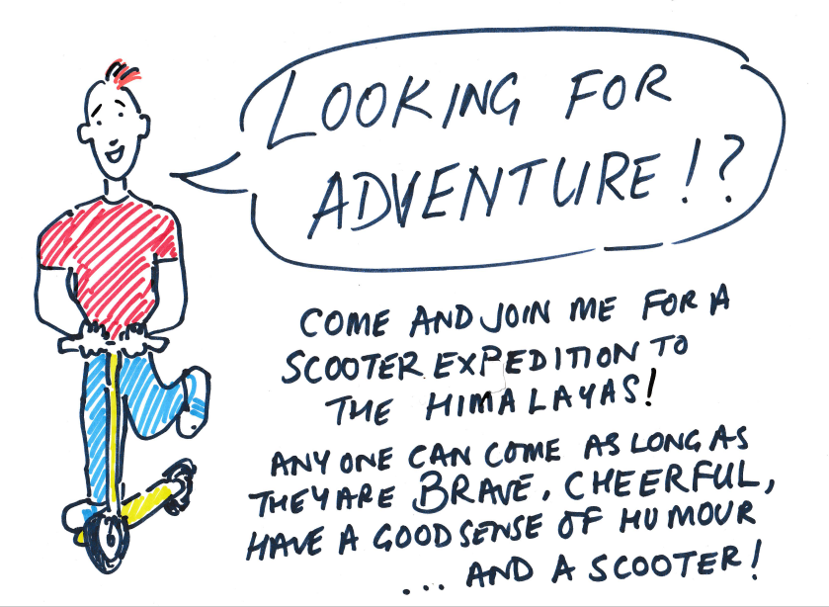
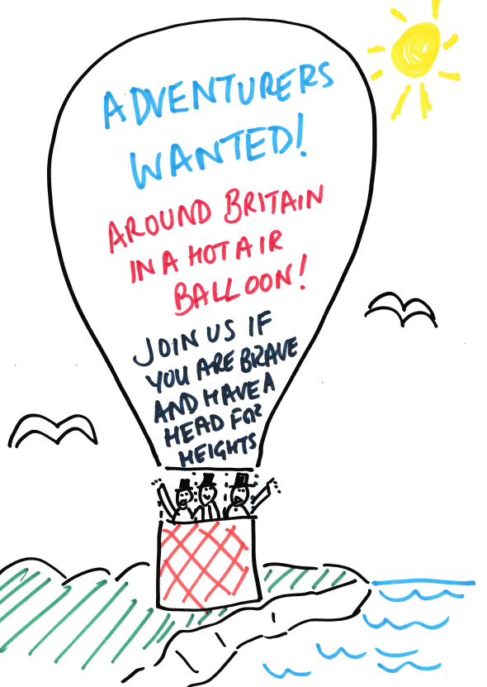
Assembly 2: Endurance Expedition
Activity
Imagine you are the leader of an exciting expedition. Create a poster advertising for members of your team.

