Slide 1
Properties of Materials
© www.SaveTeachersSundays.com 2013

Slide 2
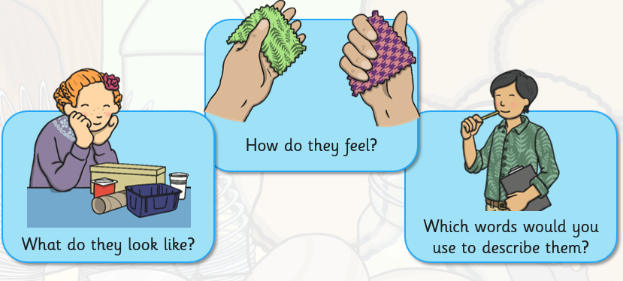
Describing Materials

Slide 3
Properties of Materials
Can you think of some words to describe materials?
hard soft bendy stiff rough
smooth strong shiny dull
Did you think of those words?
Did you think of any other words?
© www.SaveTeachersSundays.com 2013

Slide 4
Properties of Materials
The words that we use to describe a material are called its properties.
Lets find out about some more properties of materials …
© www.SaveTeachersSundays.com 2013

Slide 5
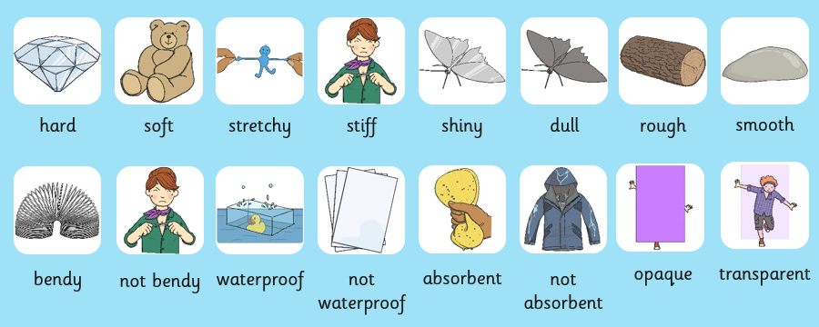

Slide 6
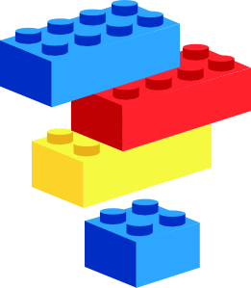


Hard
If something is hard, it is difficult to scratch or squash
Can you think of some things that are hard?
© www.SaveTeachersSundays.com 2013
Images © www.clker.com and www.clipart.com 2013

Slide 7
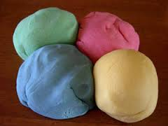
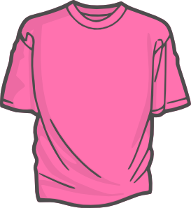

Soft
If something is soft, it is easy to squash, cut or bend
Can you think of some things that are soft?
© www.SaveTeachersSundays.com 2013
Images © www.clker.com and www.clipart.com 2013

Slide 8
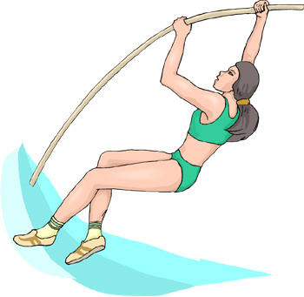
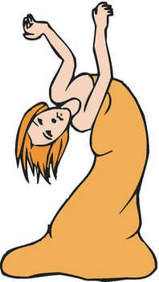

Bendy / flexible
If something is bendy, it can be bent without breaking
Can you think of some things that are bendy?
© www.SaveTeachersSundays.com 2013
Images © www.clker.com and www.clipart.com 2013

Slide 9

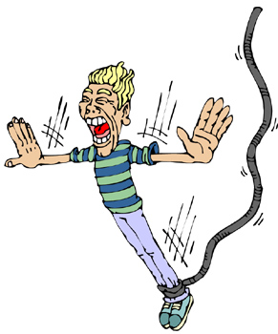
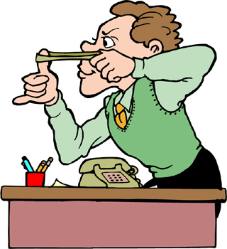
Stretchy
If something is stretchy, it can be stretched without breaking
Can you think of some things that are stretchy?
© www.SaveTeachersSundays.com 2013
Images © www.clker.com and www.clipart.com 2013

Slide 10

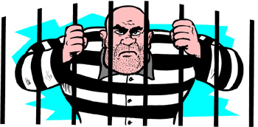
Stiff
If something is stiff, it is difficult to bend or else it may break if it is bent
Can you think of some things that are stiff?
© www.SaveTeachersSundays.com 2013
Images © www.clker.com and www.clipart.com 2013

Slide 11
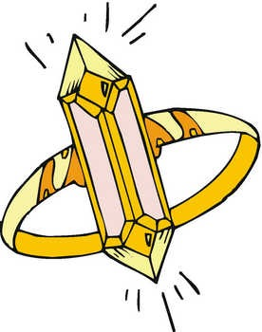


Shiny
If something is shiny, it reflects light
Can you think of some things that are shiny?
© www.SaveTeachersSundays.com 2013
Images © www.clker.com and www.clipart.com 2013

Slide 12

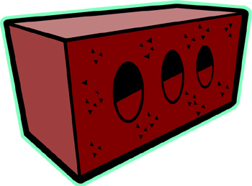
Dull
If something is dull, it does not reflect light
Can you think of some things that are dull?
© www.SaveTeachersSundays.com 2013
Images © www.clker.com and www.clipart.com 2013

Slide 13

Rough
If something is rough, it feels bumpy, uneven and hard
Can you think of some things that are rough?
© www.SaveTeachersSundays.com 2013
Images © www.clker.com and www.clipart.com 2013

Slide 14



Smooth
If something is smooth, it does NOT feel uneven or bumpy
Can you think of some things that are smooth?
© www.SaveTeachersSundays.com 2013
Images © www.clker.com and www.clipart.com 2013

Slide 15
Properties of Materials
Remember …
The words that we use to describe a material are called its properties.
Different materials and objects have different properties.
© www.SaveTeachersSundays.com 2013
Images © www.clker.com and www.clipart.com 2013

Slide 16
Properties of Materials
Hard
Soft
Bendy / Stretchy
Stiff
Shiny
Dull
Rough
Smooth
© www.SaveTeachersSundays.com 2013
Images © www.clker.com and www.clipart.com 2013

Slide 17


