Slide 1
RE Online Lesson 15/01/21
Our new RE topic poses the question –
“What do different people believe about God?

Slide 2

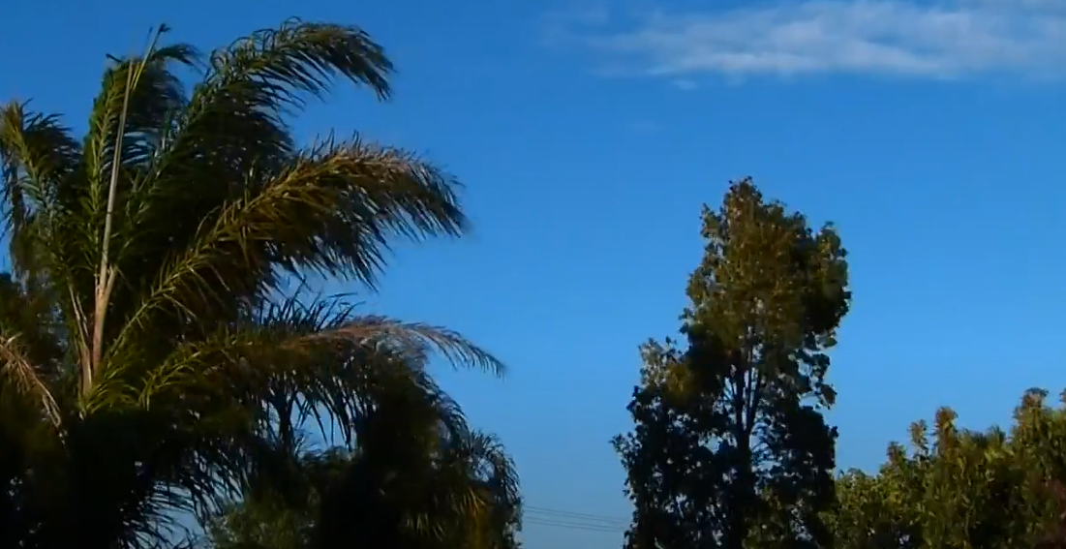
What is inside the balloon?
How do we know what is inside if we cannot see it?
Watch this video clip …..
https://www.youtube.com/watch?v=7QEzjnVkKls

Slide 3
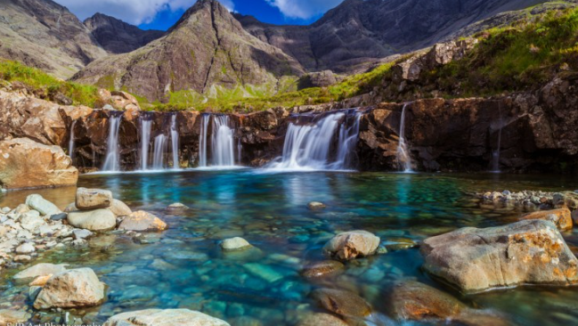
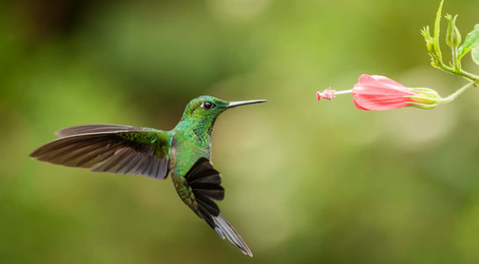
Sometimes we believe things are happening even though we cannot see them.
This can help us to think about the way people believe in God – even though they cannot see God they still believe that God is there.

Slide 4
Activity 1: Visualisation exercise.
Have a piece of paper and a pencil ready
Listen to what I am describing
Imagine it in your head
Draw it on your piece of paper

Slide 5
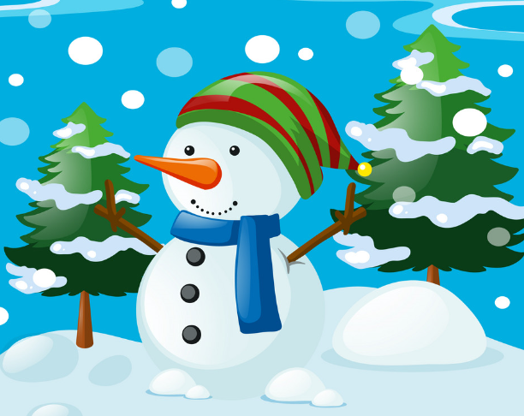
This is the scene I was describing – how does your picture look?
This shows us that sometimes, although we cannot see something with our eyes, we can still see it or understand it in our minds.

Slide 6
Activity 2:
If God were a …………what would God be?

Slide 7
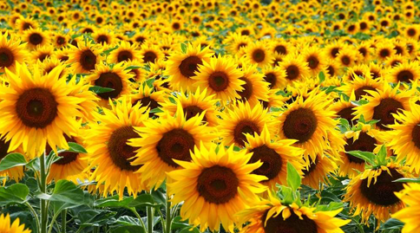
If God were a flower, what kind of flower would God be?
If God were a flower, God would be a bunch of sunflowers because I think God helps me look on the bright side of life, just like sunflowers face the sun when they grow.

Slide 8
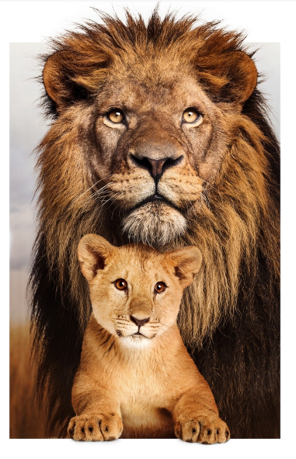
If God were an animal, what kind of animal would God be?
If God were an animal, God would be a lion, because I think God is powerful and strong, but can also be gentle and loving, like a father lion looking after his cub.

Slide 9
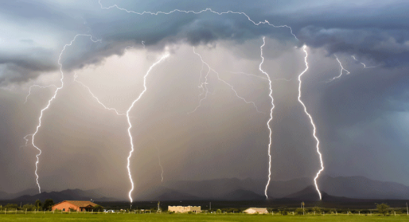
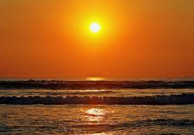
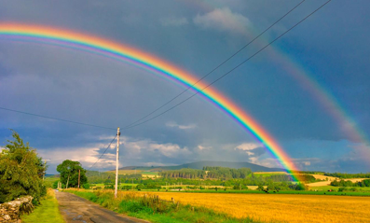
If God were weather, what kind of weather would God be?

Slide 10
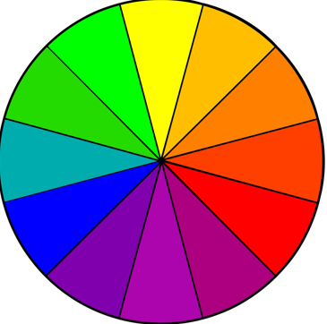
If God were a colour, what colour would God be?

Slide 11
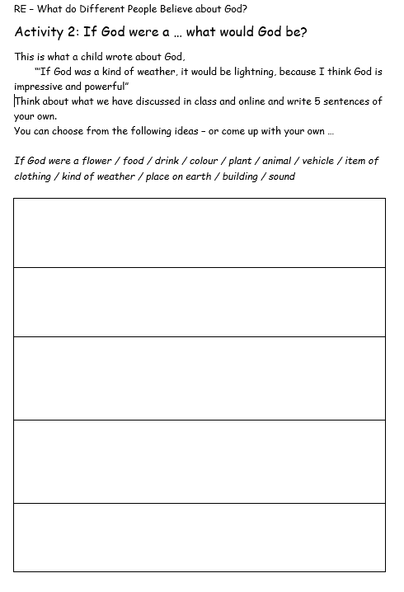
Now have a go of your own!
Create five sentences of your own to describe what you think about God …
Choose from these ideas - flower / food / drink / colour / plant / animal / vehicle / item of clothing / kind of weather / place on earth / building / sound /

