Slide 1
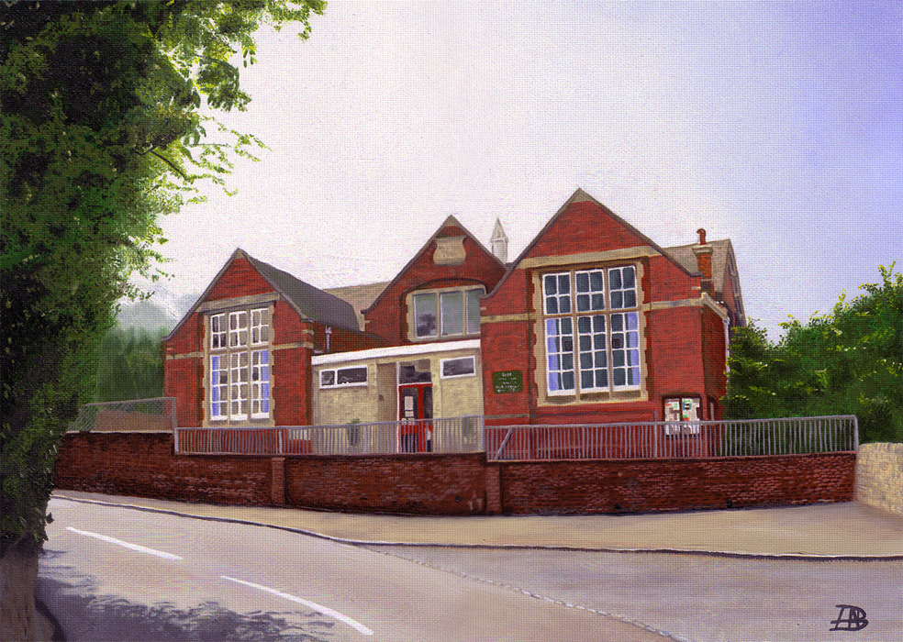
Welcome to Year 2
Almondsbury C of E Primary School
Mr Garcia’s Class

Slide 2
Timings
Start of School: 8.55am
End of School: 3.30pm
Children will enter and exit the school through the white hall door leading onto the KS1 playground.

Slide 3
Who’s who?
Our TA is Mrs Greenland on Mondays and Mrs Bryant on Wednesdays, Thursdays and Fridays
We also have Mrs Liang working as a 1:1 TA
Thursday afternoons: Mrs Williams and Mr Wallace will have the children and they will do Music and P.E.
We will have Forest School later on in the year.

Slide 4


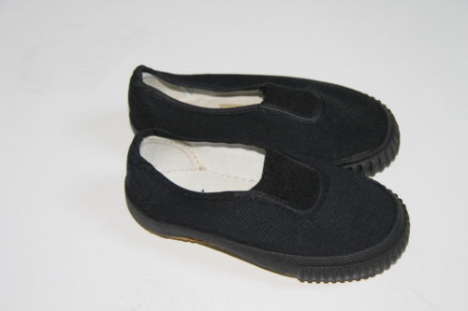

PE is on a Tuesday and a Thursday this year.
Children need to come into school in their PE kit on these days.
Jewellery is not permitted. Stud earrings need to be removed before school or taped over.

Slide 5
Reading Books
The children will only be required to bring their book bags on their allotted day for book changing. This should include their Reading Record and school reading books.
Children can also read books from home and record this but we encourage the use of the school reading books as they allow the children
to apply the phonics they are learning in school.
We ask that children try and read at least 4x a week at home.

Slide 6

This term’s topic: Autumn 2022
“Let’s Explore London”

Slide 7
Online safety is a shared responsibility!
At School:
At home:
We need you to reinforce what is being taught at school, know what applications are age appropriate and closely monitor your child’s use of the internet.
We teach the children how to be safe online, how to use the internet responsibly and closely monitor their use.

Slide 8







Instagram
Facebook
Snapchat
Musical.ly
All of these applications have age limits!
Children must be 13 years old to use them!
Whatsapp
YouTube
Fortnite

Slide 9

School Policy
There is a clear section in our Computing policy that addresses use of the internet.

Slide 10

Mastery Maths Attack
As a school we are moving to the Mastery of Mathematics approach following a successful trial last year.
Mastering maths means pupils of all ages acquiring a deep, long-term, secure and adaptable understanding of the subject. The phrase ‘teaching for mastery’ describes the elements of classroom practice and school organisation that combine to give pupils the best chances of mastering maths. Achieving mastery means acquiring a solid enough understanding of the maths that’s been taught to enable pupils to move on to more advanced material.
We have also decided to change the Maths Attack system so that it is in line with our new approach.
Mastery Maths Attack
Each year group will have a set of Maths Attack levels that are focused on the curriculum objectives for their year
The children will benefit from input on these levels during maths lessons
The children will be able to bring home their attempted level to practise with your support
Each level will be studied for three weeks (two weeks in Year 6)
Each week the children can attempt the level in class and try and better their score or time
Following the three weeks, every child will move onto the next level and practise a new skill

Slide 11

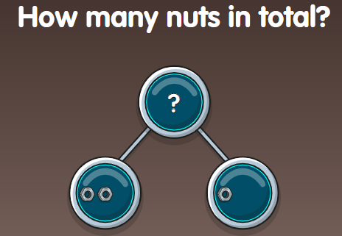
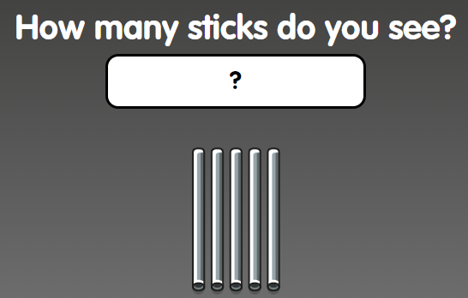
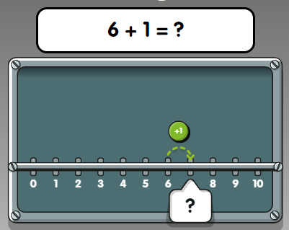
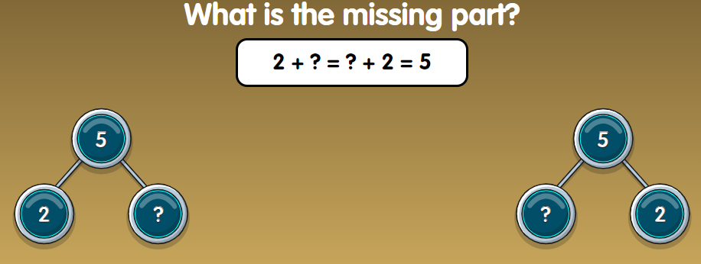
Numbots is a great, fun way for children to learn number facts. When children are fluent in number facts, they find it much easier to apply maths using different methods and contexts.
Please ask your child’s class teacher if you do not have your child’s log on details. They are the same details to access Times Table Rockstars.

Slide 12
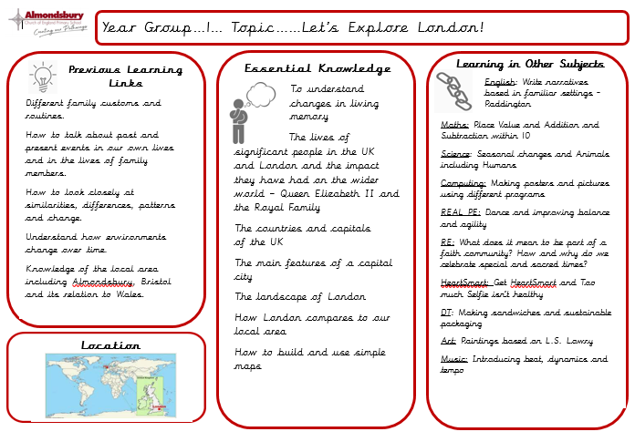
Knowledge Organisers

Slide 13
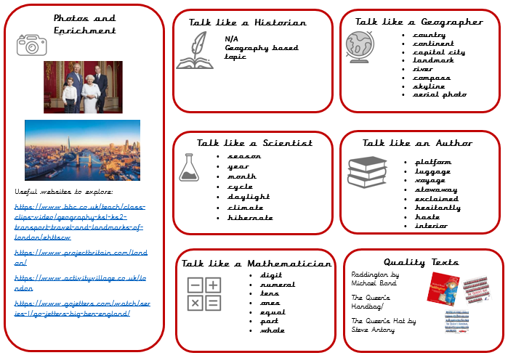

Slide 14



Homework
Weekly Maths Attack test (mental maths calculation) on Fridays.
Reading at home (4 times per week)
to be recorded in Reading Diary.
Homework projects throughout the year (1 per long term).
Computer skills and staying safe.

Slide 16

We use our vision as the main tool to drive our quality of education. We believe that everyone has the potential to do their very best and create their own pathways through life to take them any where and do anything they want to.

Slide 17

Thank you for coming.
Please ask if you have
any other queries
Mr Garcia

