Slide 1

Meet the Teacher
Welcome to Year 5
Miss Abraham

Slide 2

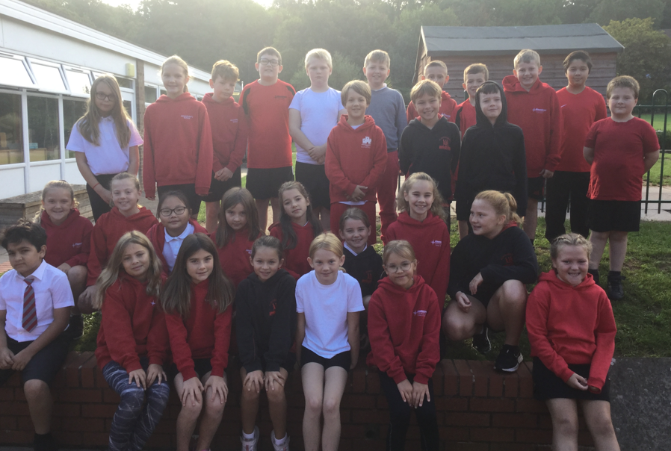
Miss Abraham’s Class

Slide 3
Timetable (for start of the year)
TIMETABLE 2022 – 2023 Y5
 |  | Assembly
MON | Maths | Collective Worship | B | Spelling | English |  | L | Arithmetic | Art/RE |  | Reading
TUES | Maths | Heartsmart | R | Comprehension | English |  | U | Arithmetic | Spelling | Science | Reading
WED | Maths | Singing | E | GR | English |  | N | PPA |  | PPA
THUR | Maths | Key Stage | A | GR |  | English | C | Arithmetic | Spelling | Computing
FRI | Maths | Celebration | K | PE |  | GR | H | Arithmetic |  | Topic

Slide 4
Class Teacher – Miss Abraham
Teaching Assistant – Mrs Bailey (Tuesday & Wednesday morning)

Slide 5
PE
Wednesday & Friday for Term 1 and 2.
Children must wear their PE kits to school on PE days.

Slide 6
The School Day
Children can enter the Key Stage playground from 8.45 am.
The children will finish at 3.30pm and will be taken to the side of the school.
Please inform the school if the children are walking home.

Slide 7
Snacks and Water
To ensure hydration, children must bring water bottles to school. These can be refilled in school. The children should bring a healthy snack to eat at break time. Toast will also be available from 26th September for 10p a slice.
Remember we are a nut free school.

Slide 8

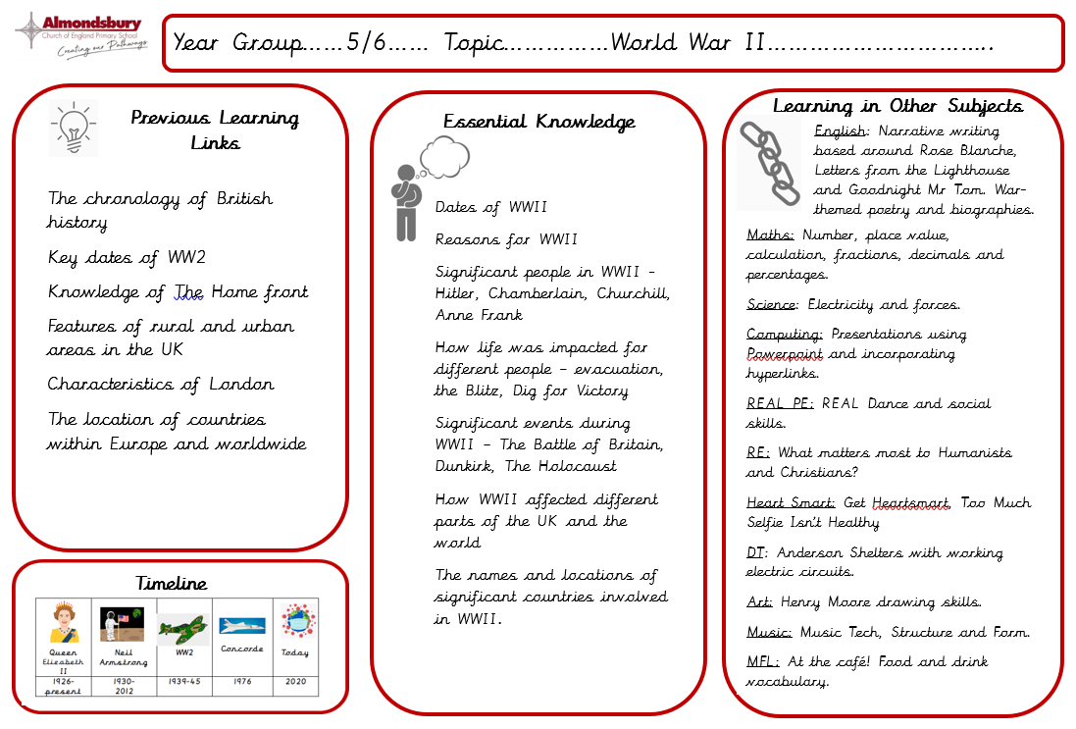
Curriculum overview – Term 1 & 2

Slide 9
Curriculum overview – Term 1 & 2
This side is information for parents. It gives you a breakdown of the key facts the children will learn during the topic, shows linked learning from topics in previous year groups and also allows you to see what will be taught in other subjects across the term.

Slide 10
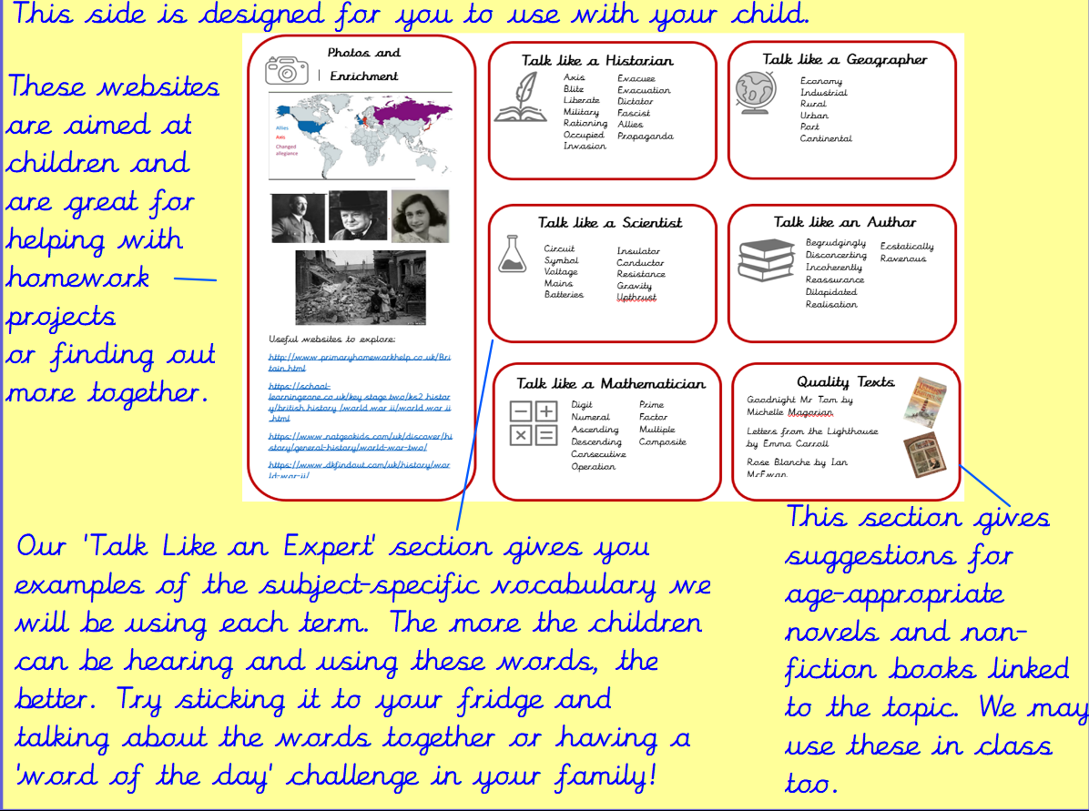

Slide 11
Homework
Homework will be given out every Friday and is expected to be handed in the following Wednesday.
The homework given will alternate between English and Maths.
Children will also receive Guided Reading ‘prep work’ every Friday to be completed over the weekend. This will involve reading a short extract and completing a quick vocabulary discussion activity ready to be used in class the following Wednesday.
Children are expected to read regularly and practise their times tables (or prepare for the Maths Attack tests). Children have Times Tables Rockstars logins and this is a fun and easy way to practise online.

Slide 12

Mastery Maths Attack
As a school we are moving to the Mastery of Mathematics approach following a successful trial last year.
Mastering maths means pupils of all ages acquiring a deep, long-term, secure and adaptable understanding of the subject. The phrase ‘teaching for mastery’ describes the elements of classroom practice and school organisation that combine to give pupils the best chances of mastering maths. Achieving mastery means acquiring a solid enough understanding of the maths that’s been taught to enable pupils to move on to more advanced material.
We have also decided to change the Maths Attack system so that it is in line with our new approach.
Mastery Maths Attack
Each year group will have a set of Maths Attack levels that are focused on the curriculum objectives for their year
The children will benefit from input on these levels during maths lessons
The children will be able to bring home their attempted level to practise with your support
Each level will be studied for three weeks
Each week the children can attempt the level in class and try and better their score or time
Following the three weeks, every child will move onto the next level and practise a new skill

Slide 13
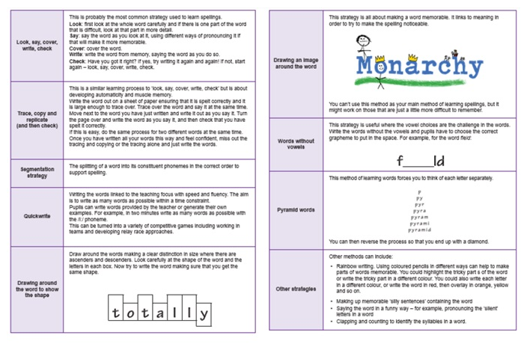
Spelling
Spelling patterns for each week will be added to our class page termly.
We will be using the Essential Spelling scheme of work, which builds on the spelling strategies and patterns that the children have used for the last two years.
We will not have weekly spelling tests but will instead complete regular application tasks that focus on spelling rules and patterns. Please support your children with this at home.

Slide 14
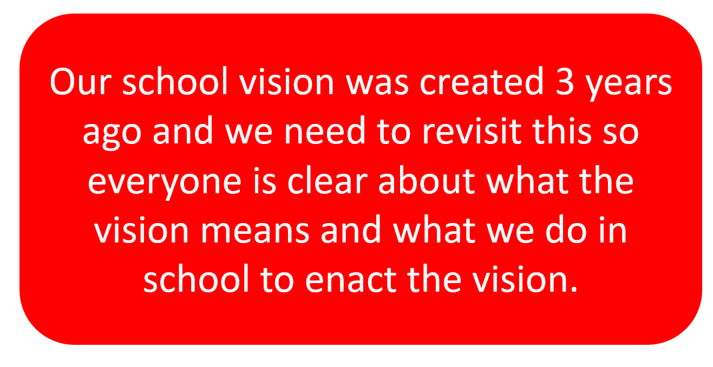


Slide 15

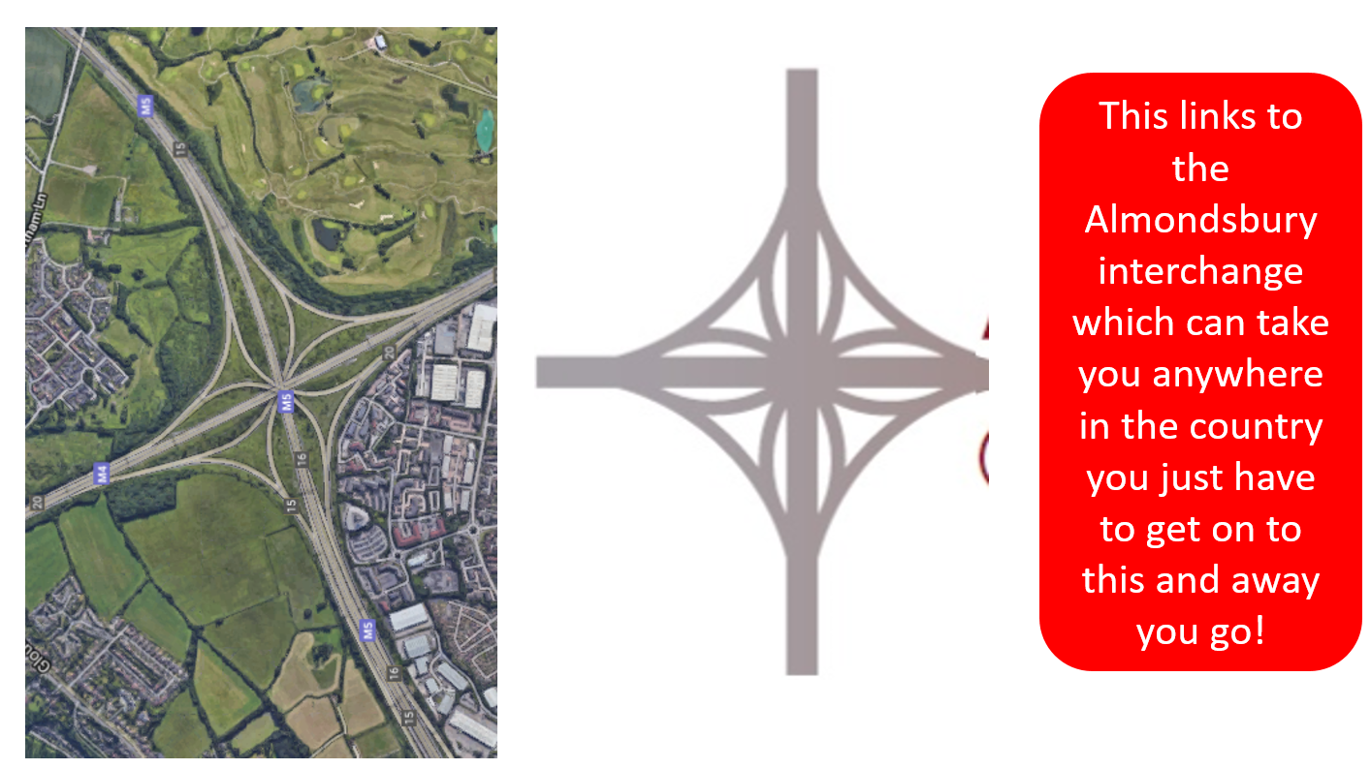

Slide 16


Slide 17

School News App
Website and School News App
Please regularly check our class page on the school website for any important information and news. Most information is also available through the School News app which can be downloaded onto both Apple and Android phones.

Slide 18
Online safety is a shared responsibility!
At School:
At home:
We need you to reinforce what is being taught at school, know what applications are age appropriate and closely monitor your child’s use of the internet.
We teach the children how to be safe online, how to use the internet responsibly and closely monitor their use.

Slide 19







Instagram
Tik Tok
Snapchat
Musical.ly
All of these applications have age limits!
Children must be 13 years old to use them!
WhatsApp
YouTube
Fortnite

Slide 20


School Policy
There is a clear section in our Computing policy that addresses use of the internet.

Slide 21
Please feel free to email me directly:
anna.abraham@almondsburyprimary.co.uk

Slide 22
Questions?

