Slide 1
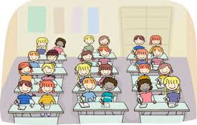
Welcome to Year 4

Slide 2
Who’s who?
Monday | Tuesday | Wednesday AM | Wednesday PM | Thursday | Friday
Mr Ramshaw | Mr Ramshaw PPA - Both | Mrs Williams | Mr Ramshaw | Mrs Williams | Mrs Williams

Slide 3

Behaviour – Golden Rules

Slide 4
Year 4
Year 3, 3&4 and 4 work closely together and plan lessons as a team to ensure that all children receive the same curriculum.
We work on a two year cycle so all topics will be covered at some point during the two years.

Slide 5
Year 4
Current Procedures – Entry/Exit
Children can enter the Key Stage playground from 8.45 am.
The children will finish at 3.30pm and will be taken to the side of the school.
Children are encouraged to wait and let us know when they see who is picking them up.
Children can walk to the KS1 playground if their sibling is being picked up. They must come back if they do not see you.

Slide 6
Year 4
Current Procedures - Hygiene
We encourage regular handwashing, particularly before/after snacks/meals.
Current Procedures - Playground
Currently the children are allowed to mix on the playground.

Slide 7
Year 4
Current Procedures – Snacks and Water
To ensure hydration, children must bring water bottles to school. These can be refilled in school
Healthy snacks can be eaten during break time.
Remember we are a nut free school.

Slide 8
Our school vision was created 3 years ago and we need to revisit this so everyone is clear about what the vision means and what we do in school to enact the vision.

Slide 10

We use our vision as the main tool to drive our quality of education. We believe that everyone has the potential to do their very best and create their own pathways through life to take them any where and do anything they want to.

Slide 11

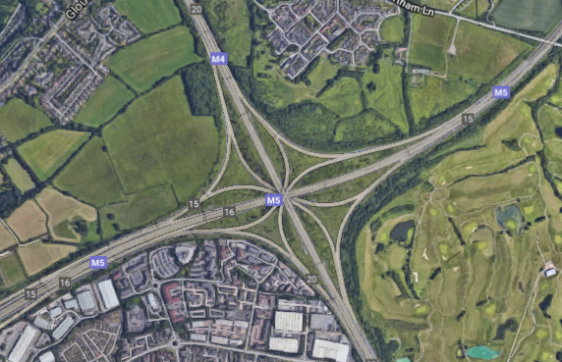
This links to the Almondsbury interchange which can take you anywhere in the country you just have to get on to this and away you go!

Slide 12
Our vision Bible verse – this links to our status as a Church school, gaining inspiration from the Bible and from our ives to use the Lord’s examples to show us the way to live, behave, work and play.
We use Bible stories to illustrate the ways of how to do this to believe, persevere and develop the children as rounded individuals, be themselves and do their very best.

Slide 13
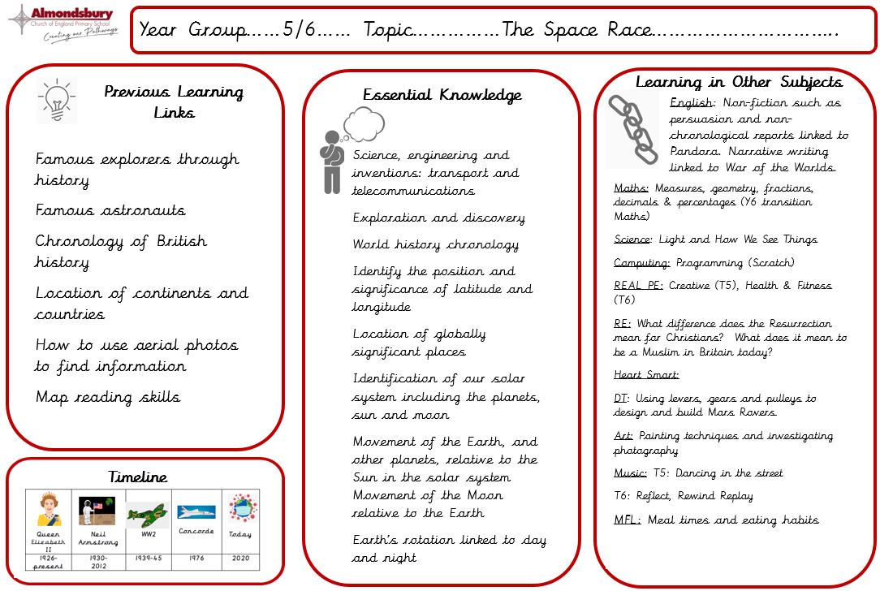
Knowledge Organisers
This side is information for parents. It gives you a breakdown of the key facts the children will learn during the topic, shows links learning from topics in previous year groups and also allows you to see what will be taught in other subjects across the term.

Slide 14
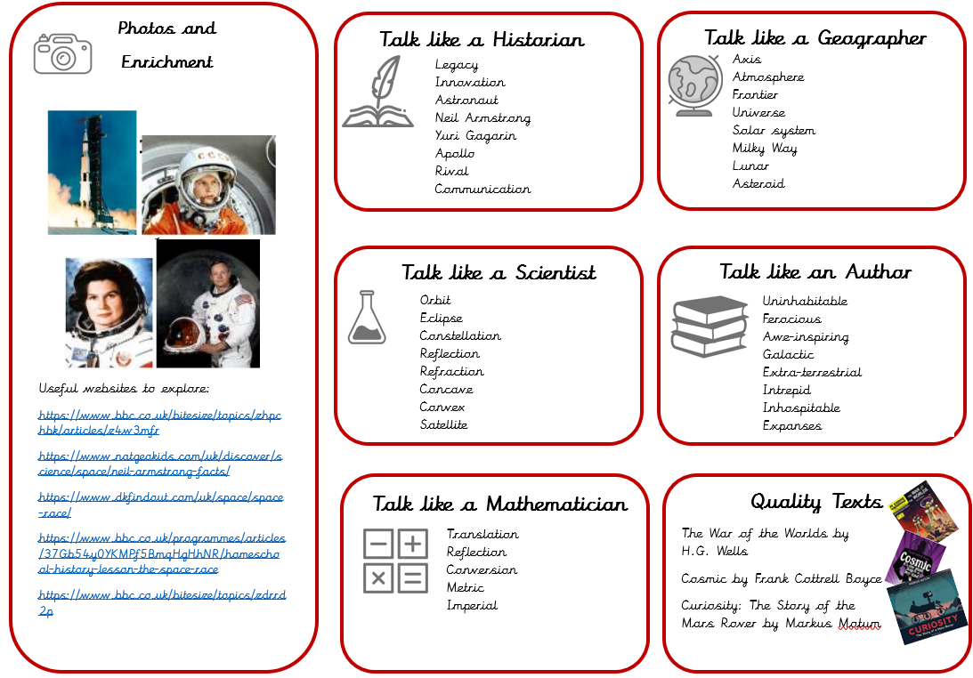
Knowledge Organisers
This side is designed for you to use with your child.
These websites are aimed at
children and are great for helping with homework projects or finding out more together.
Our 'Talk Like an Expert' section gives you examples of the subject-specific vocabulary we will be using each term. The more the children can be hearing and using these words, the better. Try sticking it to your fridge and talking about the words together or having a 'word of the day' challenge in your family!
This section gives suggestions for age-appropriate novels and non-fiction books linked to the topic. We may use these in class too.

Slide 15
Homework
Reading and developing a love of reading has now been recognised by the DFE as a priority. Please continue to support and inspire your children to read at home.
Reading scheme books: All children will need to bring in their reading record books on a MONDAY with any books that they need to change so that new books can then be distributed.
Guided Reading homework is given out every Friday to read over the weekend. Please bring the text back by the following MONDAY as we will be using this in class.
Children will also have the opportunity to bring home a copy of our class book to read and share at home.

Slide 16
Homework
Maths Mastery: Every MondayTimes Tables Rockstars
TTRS Launch: Wednesday 27th September
Telling the Time
There will be a creative piece of homework to link in with each topic that we do.

Slide 17
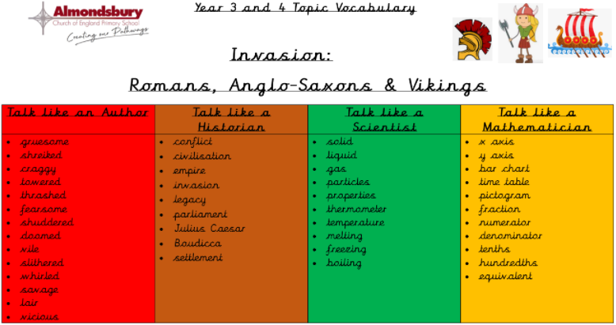
Homework

Slide 18

Mastery Maths Attack
As a school we are moving to the Mastery of Mathematics approach following a successful trial last year.
Mastering maths means pupils of all ages acquiring a deep, long-term, secure and adaptable understanding of the subject. The phrase ‘teaching for mastery’ describes the elements of classroom practice and school organisation that combine to give pupils the best chances of mastering maths. Achieving mastery means acquiring a solid enough understanding of the maths that’s been taught to enable pupils to move on to more advanced material.
We have also decided to change the Maths Attack system so that it is in line with our new approach.
Mastery Maths Attack
Each year group will have a set of Maths Attack levels that are focused on the curriculum objectives for their year
The children will benefit from input on these levels during maths lessons
The children will be able to bring home their attempted level to practise with your support
Each level will be studied for three weeks (two weeks in Year 6)
Each week the children can attempt the level in class and try and better their score or time
Following the three weeks, every child will move onto the next level and practise a new skill

Slide 19
PE
PE for Term 1 and 2 will be on a Tuesday and Friday (swimming). Like last term, please ensure the children come into school in their PE kit on these days.

Slide 20
Medical Issues
Although we have spoken to your child’s previous teachers, if there are any medical issues that you feel we should know about please email us with the information.

Slide 21
Website
Please regularly check our class page on the school website for any important information and news. Most information is also available through the School News app which can be downloaded onto both Apple and Android phones.
Also, on the website we will place any letters that are specifically for Years 3 and 4.

Slide 22
Online safety is a shared responsibility!
At School:
At home:
We need you to reinforce what is being taught at school, know what applications are age appropriate and closely monitor your child’s use of the internet.
We teach the children how to be safe online, how to use the internet responsibly and closely monitor their use.

Slide 23








Instagram
Facebook
Snapchat
Musical.ly
All of these applications have age limits!
Children must be 13 years old to use them!
Whatsapp
YouTube
Fortnite
Tik Tok

Slide 24

School Policy
There is a clear section in our Computing policy that addresses use of the internet.

Slide 25

Any questions?
We are very happy to answer general questions now. However, if you have any personal queries that you would prefer to ask privately, please email us.
Stuart.Ramshaw@almondsburyprimary.co.uk
Jennifer.Williams@almondsburyprimary.co.uk

