Slide 1
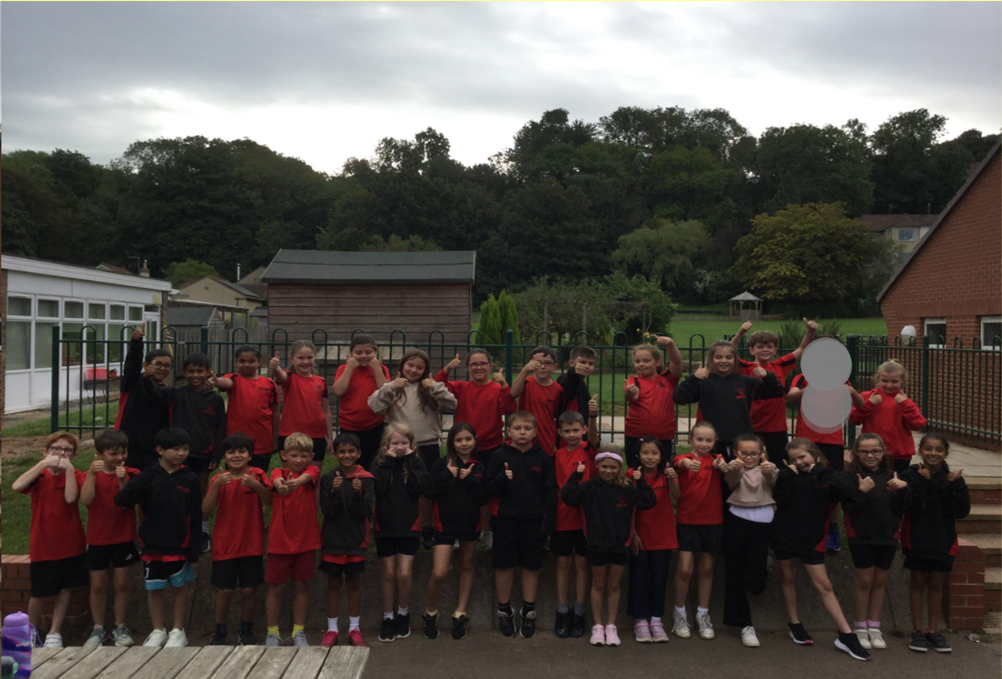
Meet the Teacher
Welcome to Year 5
Miss Whittingham

Slide 2

Class Teacher – Miss Whittingham
Teaching Assistants – Mr Evans and
Mrs Davis – Jones (Thursday PM)

Slide 3
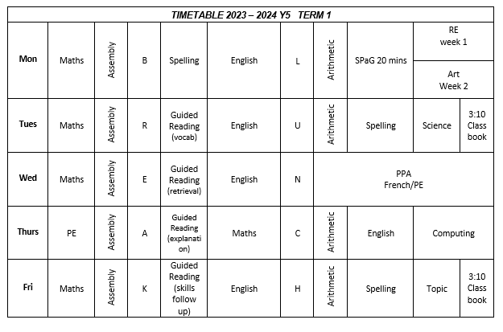
Timetable (for start of the year)

Slide 4
PE
Wednesday & Thursday for Term 1 and 2.
Children must wear their PE kits to school on PE days.

Slide 5
The School Day
Children can enter the Key Stage playground from 8.45 am.
The children will finish at 3.30pm and will be taken to the side of the school.
Please inform the school if the children are walking home.

Slide 6
Snacks and Water
To ensure hydration, children must bring water bottles to school. These can be refilled in school. The children should bring a healthy snack to eat at break time.
Remember we are a nut free school.

Slide 7

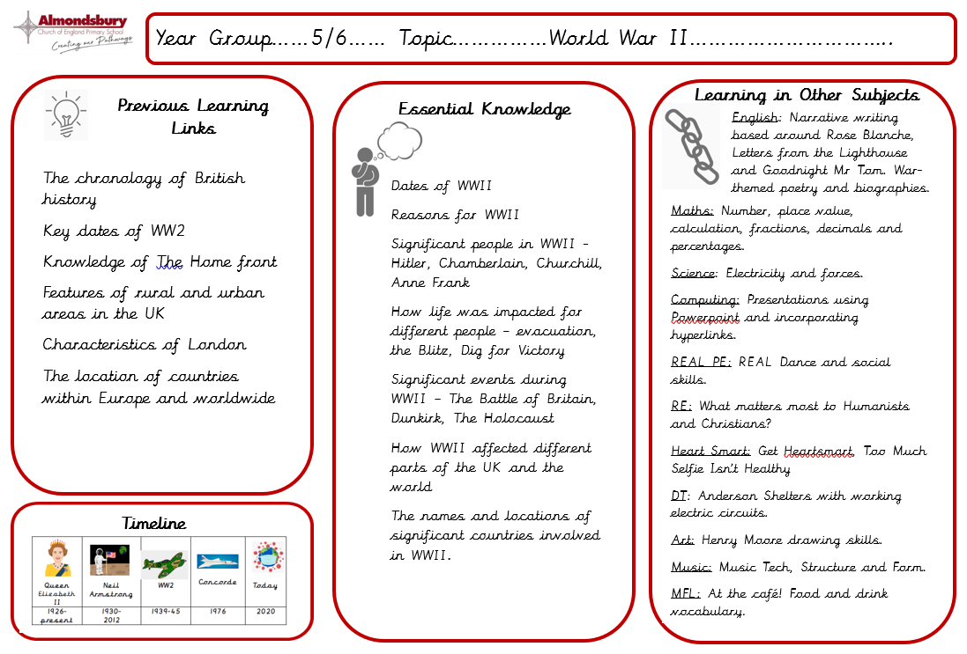
Curriculum overview – Term 1 & 2

Slide 8


Slide 9
Homework
Homework will be given out every Friday and is expected to be handed in the following Tuesday.
The homework given will alternate between English and Maths.
Children will also receive Guided Reading ‘prep work’ every Friday to be completed over the weekend. This will involve reading a short extract and completing a quick vocabulary discussion activity ready to be used in class the following Tuesday.
Children are expected to read regularly and practise their times tables (or prepare for the Maths Attack tests). Children have Times Tables Rockstars logins and this is a fun and easy way to practise online.

Slide 10
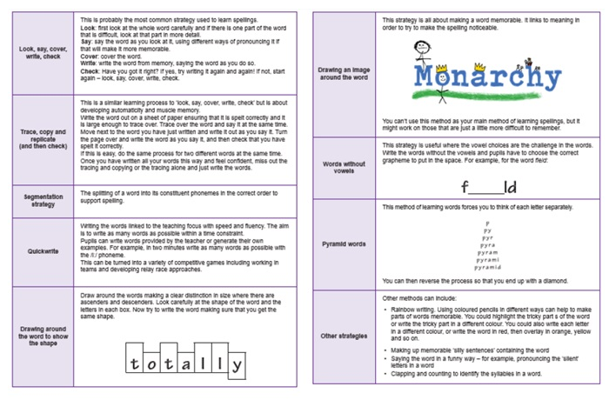

Spelling
Spelling patterns for each week will be added to our class page termly.
We will be using the Essential Spelling scheme of work, which builds on the spelling strategies and patterns that the children have used for the last two years.
We will not have weekly spelling tests but will instead complete regular application tasks that focus on spelling rules and patterns. Please support your children with this at home.

Slide 11


Slide 12


Slide 13


Slide 14
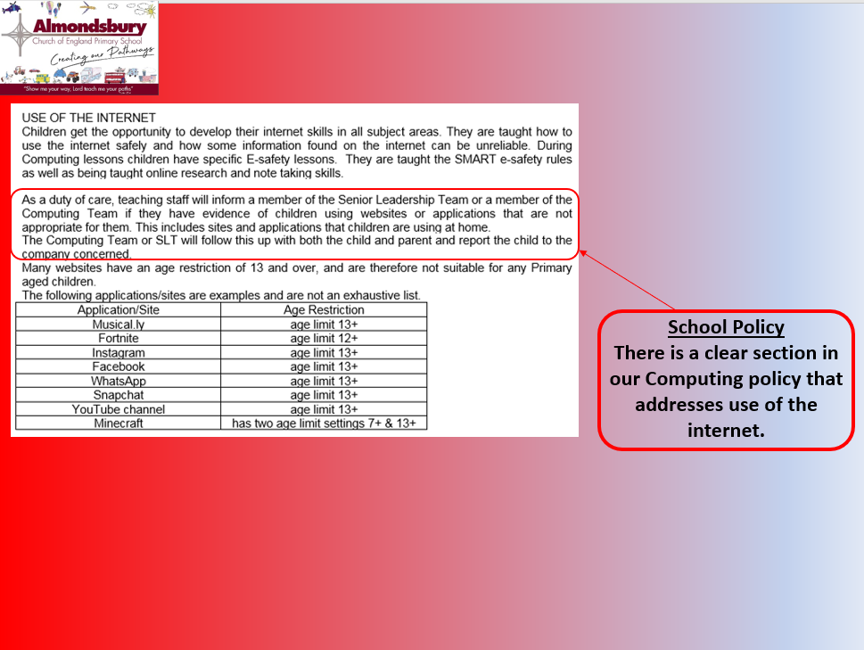

Slide 15
Questions molly.whittingham@almondsburyprimary.co.uk

