Slide 1
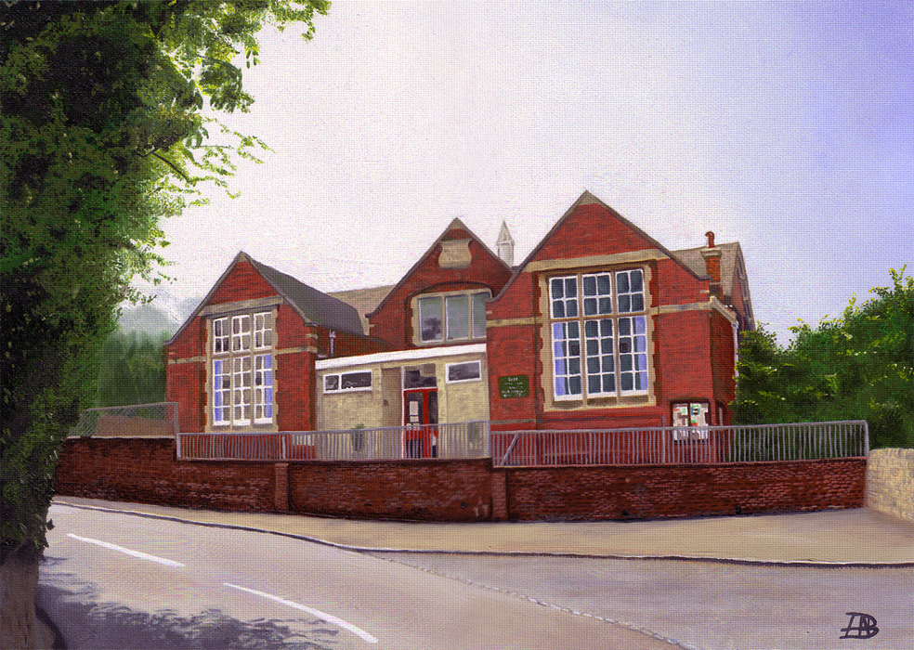
Welcome to Year 2
Almondsbury C of E Primary School
Mr Garcia’s Class

Slide 2
Who’s who?
TAs working in our class this year are Mrs Brooks, Mrs Greenland and Mrs Moore.
We also have Miss Byrne working as a 1:1 TA in the class.
Thursday afternoons: Mrs Bowen and Jacob from Future Stars will take the children for Music and P.E.
We will have Forest School in Term 2 and Term 5.

Slide 3


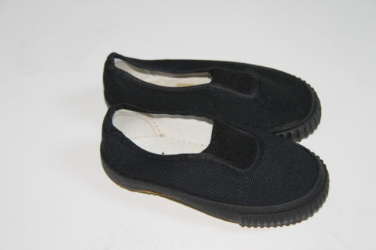
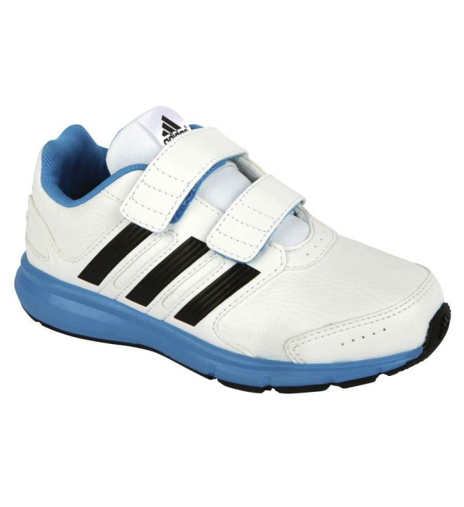
PE is on a Tuesday and a Thursday this year.
Children need to come into school in their PE kit on these days.
Jewellery is not permitted. Stud earrings need to be removed before school or taped over.

Slide 4
Reading Books
The children will only be required to bring their book bags on Fridays for book changing. This should include their Reading Record and school reading books.
Children can also read books from home and record this but we encourage the use of the school reading books as they allow the children
to apply the phonics they are learning in school.
We ask that children try and read at least 4x a week at home.

Slide 5
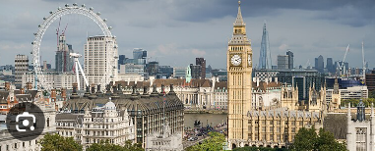
This term’s topic: Autumn 2024
“Let’s Explore London”

Slide 6
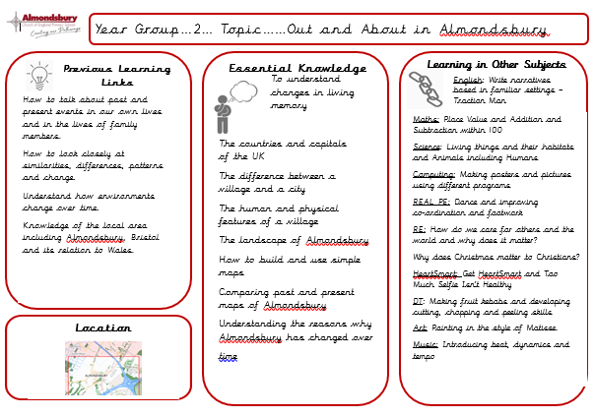
Knowledge Organisers

Slide 7
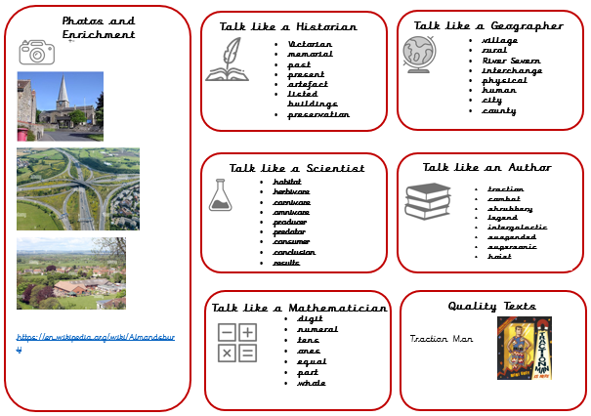

Slide 8
Online safety is a shared responsibility!
At School:
At home:
We need you to reinforce what is being taught at school, know what applications are age appropriate and closely monitor your child’s use of the internet.
We teach the children how to be safe online, how to use the internet responsibly and closely monitor their use.

Slide 9







Instagram
Facebook
Snapchat
Musical.ly
All of these applications have age limits!
Children must be 13 years old to use them!
Whatsapp
YouTube
Fortnite

Slide 10

School Policy
There is a clear section in our Computing policy that addresses use of the internet.

Slide 11
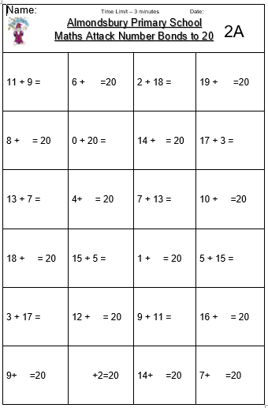

Mastery Maths Attack
Mastery Maths Attack
Each year group will have a set of Maths Attack levels that are focused on the curriculum objectives for their year
The children will benefit from input on these levels during maths lessons
The children will be able to bring home their attempted level to practise with your support
Each level will be studied for three weeks
Each week the children can attempt the level in class and try and better their score or time
We will do Maths Attack every Monday in this class

Slide 12

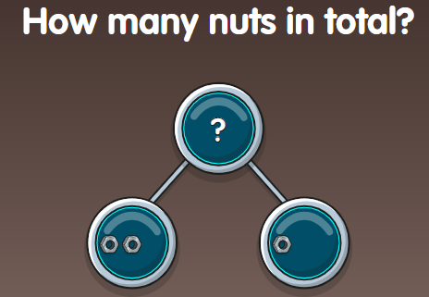
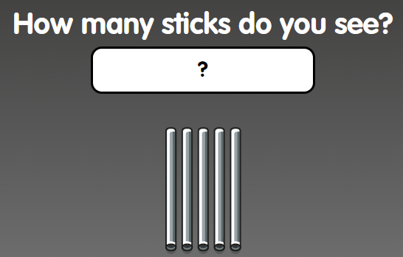
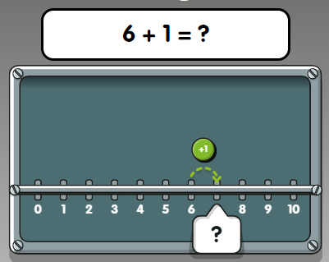
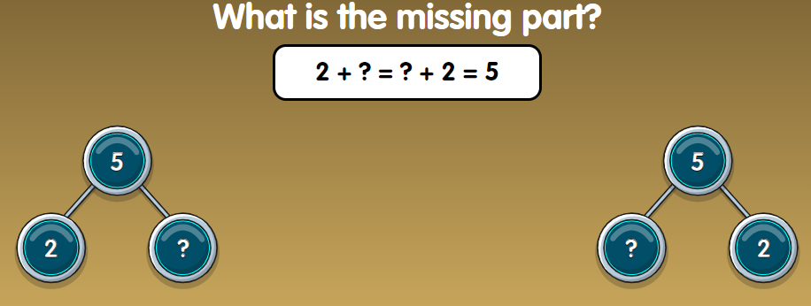
Numbots is a great, fun way for children to learn number facts. When children are fluent in number facts, they find it much easier to apply maths using different methods and contexts.
Please ask your child’s class teacher if you do not have your child’s log on details. They are the same details to access Times Table Rockstars.

Slide 13



Homework
Weekly Maths Attack test (mental maths calculation) on Mondays.
Reading at home (4 times per week)
to be recorded in Reading Diary.
Homework projects throughout the year (1 per long term).
Computer skills and staying safe.

Slide 15

We use our vision as the main tool to drive our quality of education. We believe that everyone has the potential to do their very best and create their own pathways through life to take them any where and do anything they want to.

Slide 16
Attendance
Attendance is most important to ensure that all children achieve their full potential and make the most of their time at school.
Punctuality is also crucial to ensure children have the maximum time in school and do not miss vital starts to lessons each day.

Slide 17
Attendance
From 19 August new DFE government attendance guidance and policy came into force. Once governors have approved the new policy for the school this will be shared with parents.
However, the main points are these:
- new rules regarding term time absence and fines for term time holidays.
new rules regarding expectations on attendance by parents and engagement with school processes.
new procedures by school to begin discussions regarding attendance straight away.

Slide 18
Attendance
Parents should expect to be prepared to discuss any attendance issues with their child’s class teacher whenever necessary, at parents evenings and informal meetings.
Either Mr Smith, Mrs Goode or Mr Dean will meet with parents and children when attendance falls below 95% informally initially and then formally when attendance falls below 90%.
ATTENDANCE MEANS ACHIEVEMENT

Slide 19

Thank you for coming.
Please ask if you have
any other queries
Mr Garcia

