Slide 1

Meet the Teacher
Welcome to Year 5/6
Mrs Goode & Mrs Barrett

Slide 2


Mrs Goode and Mrs Barrett’s Class
​
​
​

Slide 3
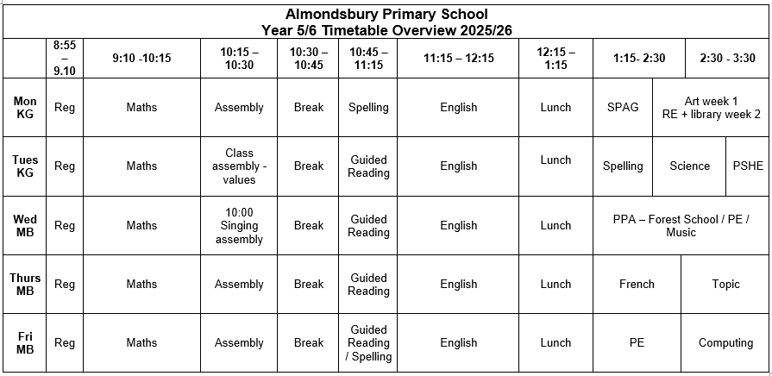
Timetable (for start of the year)

Slide 4
Class Teachers
Mrs Goode (Monday-Tuesday)
Mrs Barrett (Wednesday-Friday)
Teaching Assistants
Ms Jamieson
Mrs Davis-Jones

Slide 5
PE
Wednesday & Friday for Term 1 and 2.
Children must wear their PE kits to school on PE days.

Slide 6
The School Day
Children can enter the Key Stage playground from 8.45 am.
The children will finish at 3.30pm and will be taken to the side of the school.
Please inform the school if the children are walking home.

Slide 7
Snacks and Water
To ensure hydration, children must bring water bottles to school. These can be refilled in school. The children should bring a healthy snack to eat at break time.
Remember we are a nut free school.

Slide 8
Homework
Homework will be given out every Friday and is expected to be handed in the following Tuesday.
The homework given will alternate between English and Maths.
Children will also receive Guided Reading ‘prep work’ every other Friday to be completed over the weekend. This will involve reading a short extract and completing a quick vocabulary discussion activity ready to be used in class the following Tuesday.
Children are also expected to read regularly and practise their times tables and spellings.

Slide 9
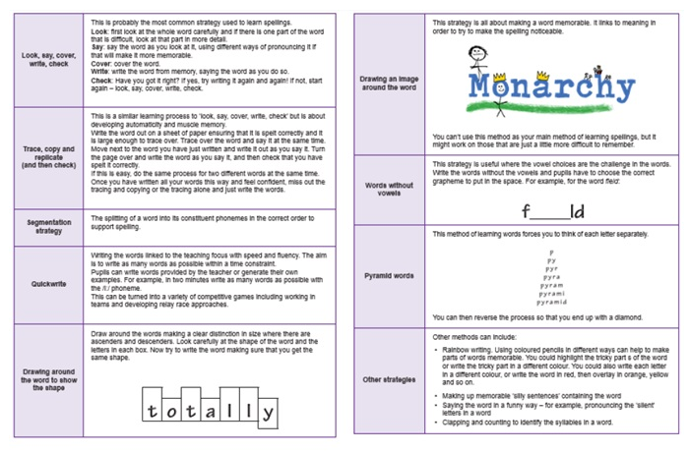
Spelling
Spelling patterns for each week will be added to our class page termly.
We will be using the Essential Spelling and Word Knowledge scheme of work, which builds on the spelling strategies and patterns that the children have used for the last two years.
We will not have weekly spelling tests but will instead complete regular application tasks that focus on spelling rules and patterns. Please support your children with this at home.

Slide 10
Our Year at a Glance
Autumn | Spring | Summer
Greece Yesterday and Today Y6 France Trip Y5 Singing at The Mall Carol Service | Our Changing World Houses of Parliament Trip Young Voices concert Forest School | Space Race Y6 SATs Y6 Legoland Production

Slide 11
Online safety is a shared responsibility!
At School:
At home:
We need you to reinforce what is being taught at school, know what applications are age appropriate and closely monitor your child’s use of the internet, especially phones and group chats.
We teach the children how to be safe online, how to use the internet responsibly and closely monitor their use.

Slide 12







Instagram
Tik Tok
Snapchat
Musical.ly
All of these applications have age limits!
Children must be 13 years old to use them!
WhatsApp
YouTube
Fortnite

Slide 13


School Policy
There is a clear section in our Computing policy that addresses use of the internet.

Slide 14

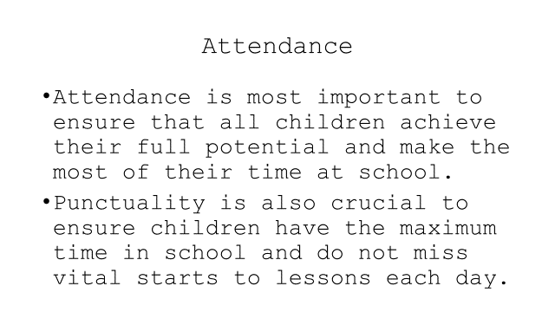

Slide 15
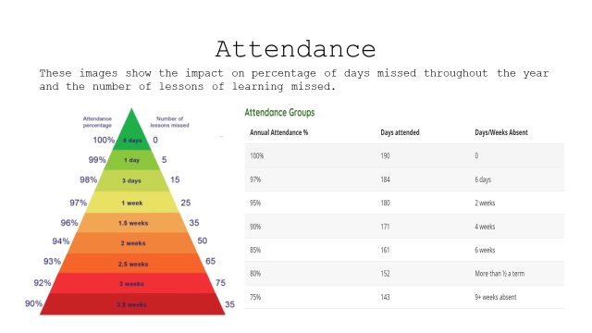

Slide 16
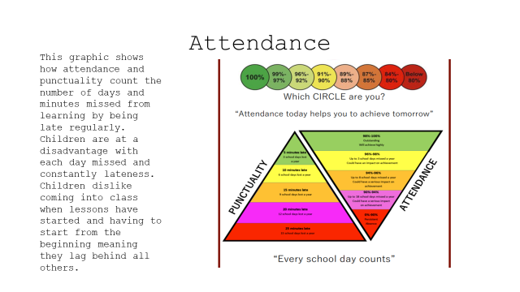

Slide 17
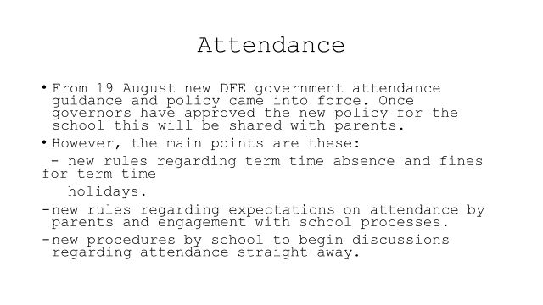

Slide 18
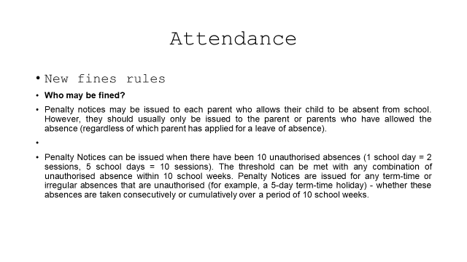

Slide 19
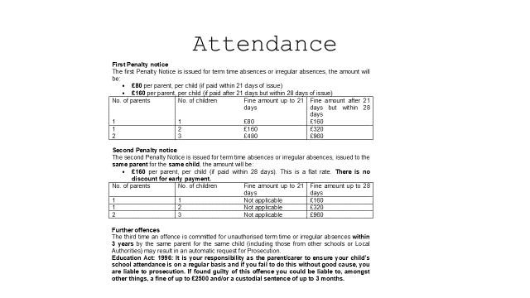

Slide 20
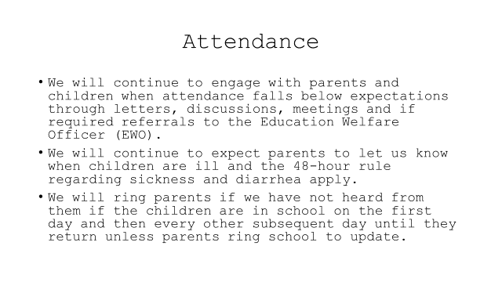

Slide 21
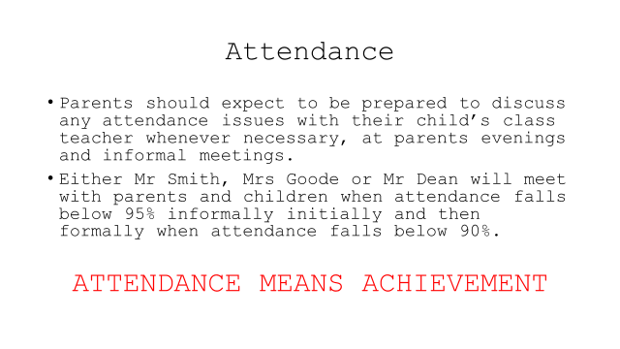

Slide 22
Please feel free to email us directly:
katie.goode@almondsburyprimary.co.uk
marie.barrett@almondsburyprimary.co.uk

Slide 23
Questions?

