Slide 1

Meet the Teacher
Welcome to Year 6
Miss Ramli

Slide 2

Class Teacher – Miss Ramli
Teaching Assistants – Ms Jamieson, Mrs Challis and Mrs Davis Jones

Slide 3
The School Day
Children can enter the Key Stage playground from 8.45 am.
The children will finish at 3.30pm and will be taken to the side of the school.
Please inform the school if the children are walking home.

Slide 4
Snacks and Water
To ensure hydration, children must bring water bottles to school. These can be refilled in school. The children should bring a healthy snack to eat at break time.
Please remember we are a nut free school.

Slide 5
PE
Our PE days are Wednesday and Friday.
Forest School will take place on a Wednesday in Terms 2 and 5. Children can wear PE kit. Please ensure they have wellies and appropriate outer wear.

Slide 6
Our Year at a Glance
Autumn | Spring | Summer
Greece Yesterday and Today Y6 France Trip Carols by Candlelight | Our Changing World Houses of Parliament Trip Young Voices concert | Space Race Y6 SATs Y6 Legoland Y5/6 Production

Slide 7
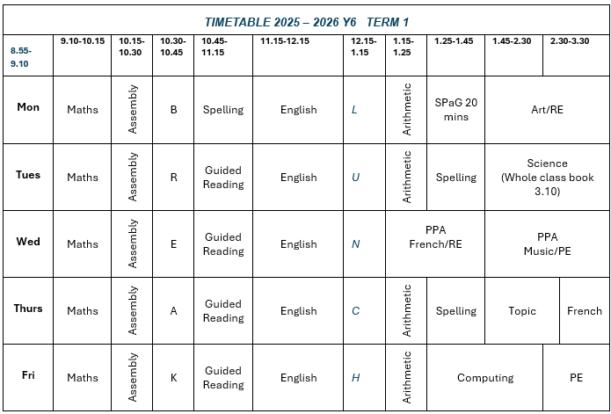

Slide 8
Homework
Homework will be given out every Friday and is expected to be handed in by the following Friday
The homework given will alternate between English and Maths.
The children will also receive a Guided Reading text every other Friday to read over the weekend. They will need to bring this back into school by the following Tuesday.
Children are also expected to read regularly and practise their times tables and spellings.
They all have a Times Tables Rockstars login to support their learning. I have a copy of their username and password if you need it.

Slide 9
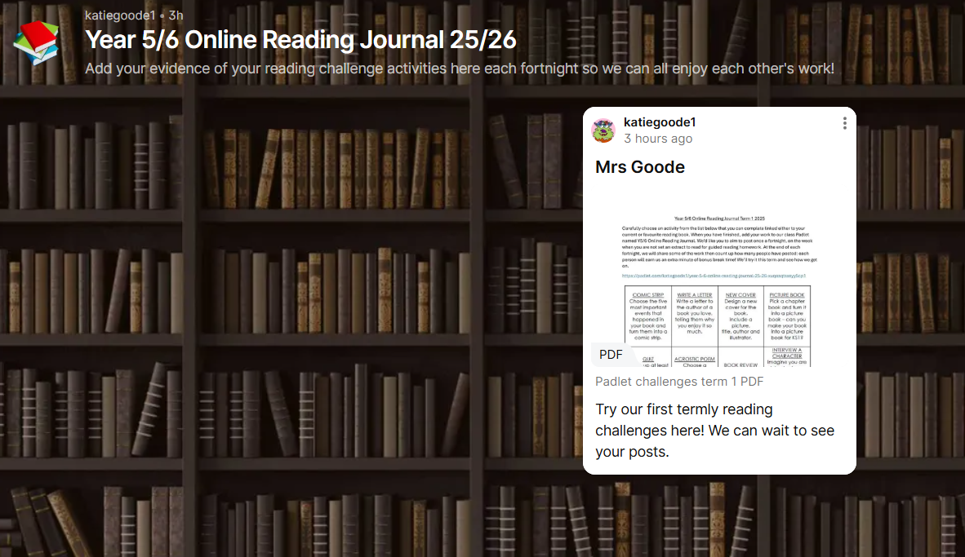
Reading for Pleasure
On the weeks the children do not have guided reading homework, they will be encouraged to engage with our Reading Journal Padlet. This will be an opportunity for them to share and celebrate their reading with the class.
More details will follow shortly in an email with a link to the website.

Slide 10
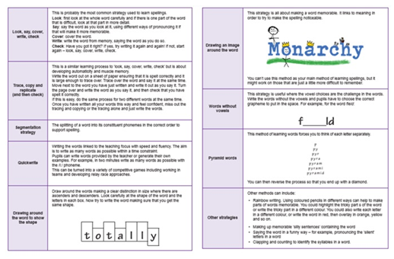
Spelling
Spelling patterns will be added to our class page termly. We will be using the Essential Spelling and Word Knowledge scheme to support learning this year, which builds on the spelling strategies and patterns that the children have used for the last two years.
We will not have weekly spelling tests but will instead complete regular application tasks that focus on spelling rules and patterns. Please support your children with this at home.

Slide 11

Online safety is a shared responsibility!
At School:
At home:
We need you to reinforce what is being taught at school, know what applications are age appropriate and closely monitor your child’s use of the internet.
We teach the children how to be safe online, how to use the internet responsibly and closely monitor their use.

Slide 12






Instagram
Tik Tok
Snapchat
All of these applications have age limits!
Children must be 13 years old to use them!
WhatsApp
YouTube
Fortnite

Slide 13

School Policy
There is a clear section in our Computing policy that addresses use of the internet.

Slide 14
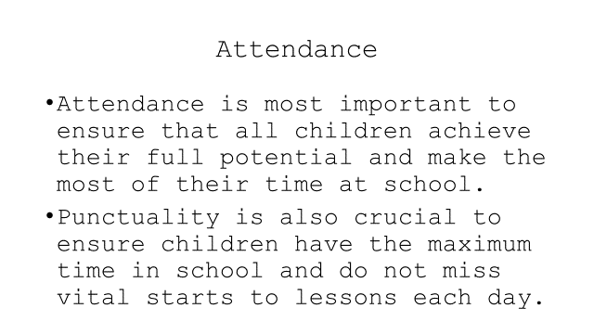

Slide 15
Questions?
yasmin.ramli@almondsburyprimary.co.uk

