Slide 1

Welcome to Year 3

Slide 2
Year 3
Year 3, 3&4 and 4 work closely together and plan lessons as a team to ensure that all children receive the same curriculum.
We work on a two year cycle so all topics will be covered at some point during the two years.

Slide 3
Year 3
Current Procedures – Entry/Exit
Children can enter the Key Stage playground from 8.45 am.
The children will finish at 3.30pm and will be taken to the side of the school.
Children are encouraged to wait and let us know when they see who is picking them up.
Children can walk to the KS1 playground if their sibling is being picked up. They must come back if they do not see you.

Slide 4
Year 3
Current Procedures – Snacks and Water
To ensure hydration, children must bring water bottles to school. These can be refilled in school
Healthy snacks can be eaten during break time.
Remember we are a nut free school.

Slide 5

We use our vision as the main tool to drive our quality of education. We believe that everyone has the potential to do their very best and create their own pathways through life to take them any where and do anything they want to.

Slide 6
Our vision Bible verse – this links to our status as a Church school, gaining inspiration from the Bible and from our ives to use the Lord’s examples to show us the way to live, behave, work and play.
We use Bible stories to illustrate the ways of how to do this to believe, persevere and develop the children as rounded individuals, be themselves and do their very best.

Slide 7
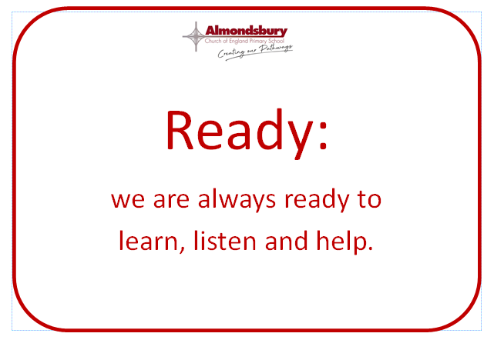

Slide 8


Slide 9


Slide 10
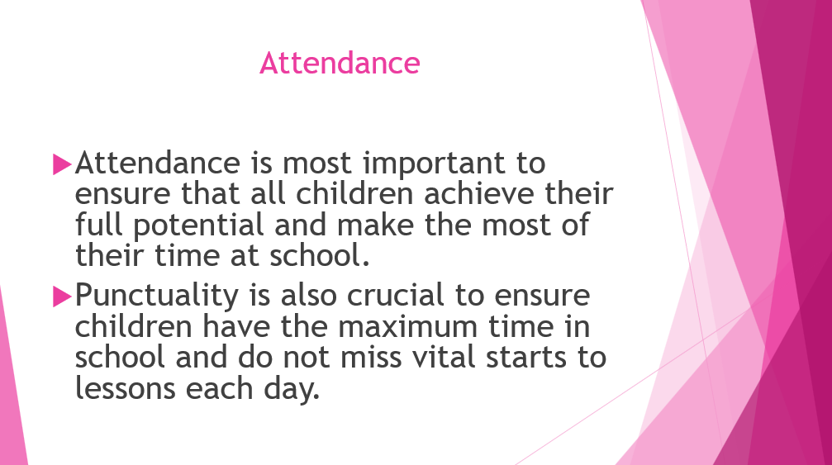

Slide 11
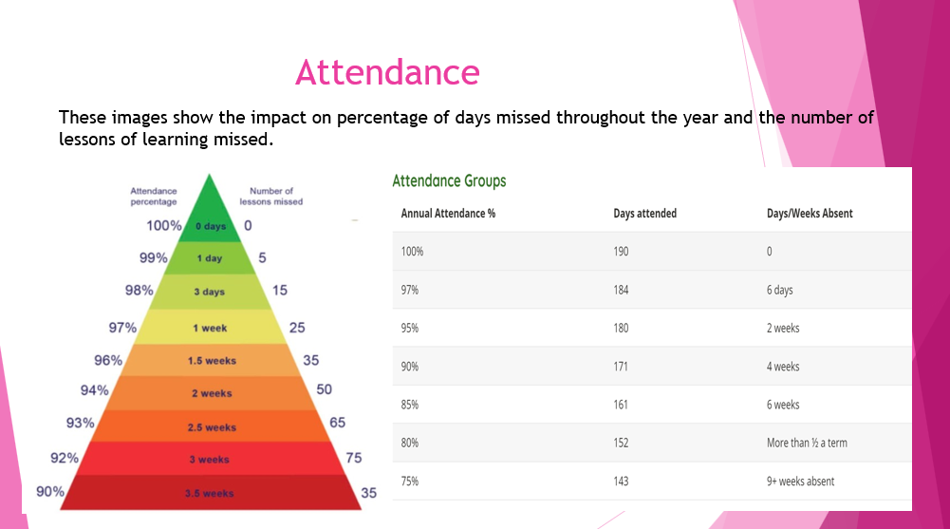

Slide 12
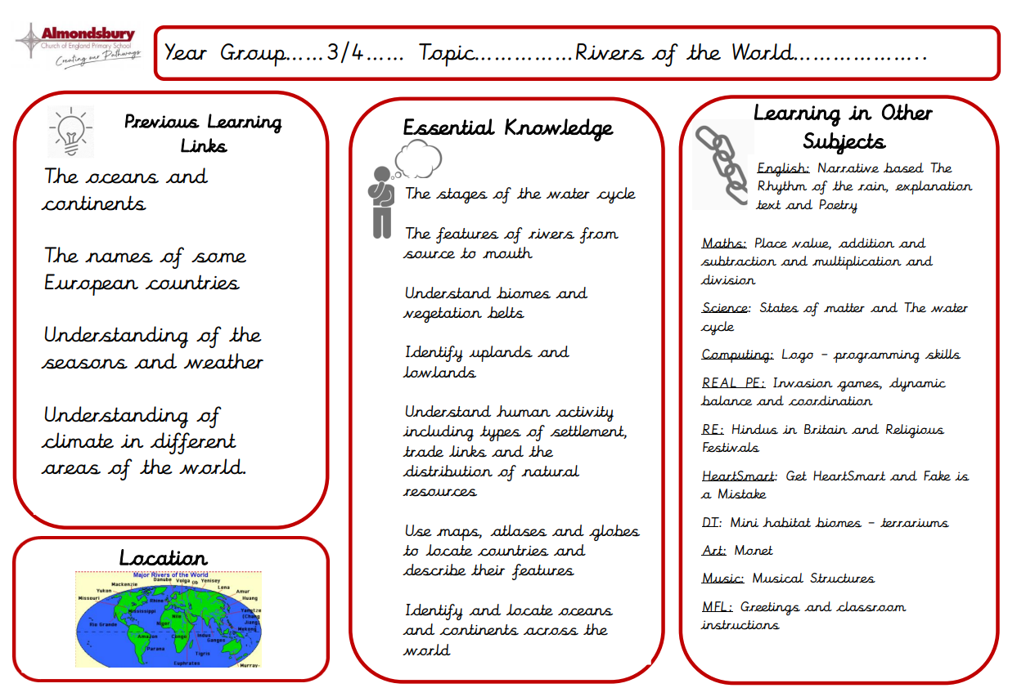
Knowledge Organisers
​ ​​
This side is information for parents. It gives you a breakdown of the key facts the children will learn during the topic, shows links learning from topics in previous year groups and also allows you to see what will be taught in other subjects across the term.

Slide 13
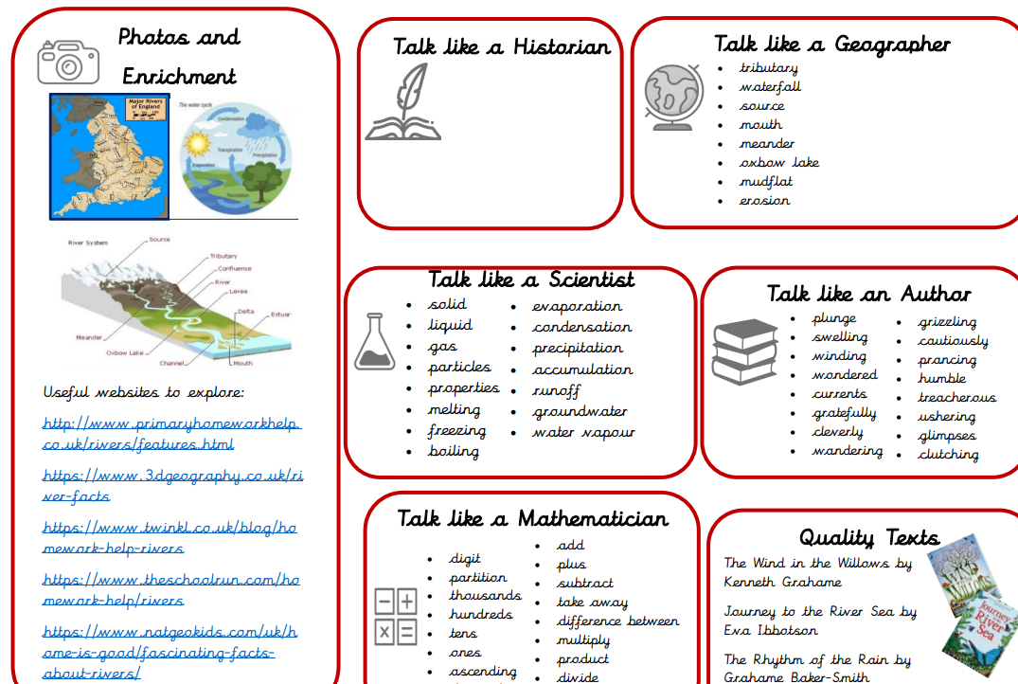
Knowledge Organisers
This side is designed for you to use with your child.
These websites are aimed at
children and are great for helping with homework projects or finding out more together.
Our 'Talk Like an Expert' section gives you examples of the subject-specific vocabulary we will be using each term. The more the children can be hearing and using these words, the better. Try sticking it to your fridge and talking about the words together or having a 'word of the day' challenge in your family!

Slide 14
Homework
Reading and developing a love of reading has now been recognised by the DFE as a priority. Please continue to support and inspire your children to read at home.
Reading scheme books: All children will need to bring in their reading record books on their designated day (next slide) with any books that they need to change so that new books can then be distributed. The expectation is that children will read with you at least 3 times per week and recorded in their reading record.
Guided Reading homework is given out every other Friday to read over the weekend. Please bring the text back by the following Tuesday as we will be using this in class.
Children will also have the opportunity to bring home a copy of our class book to read and share at home.

Slide 15
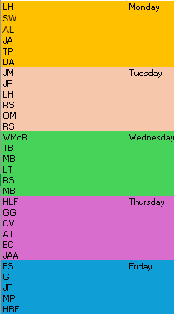

Slide 16
Homework
Spelling: Patterns we will be learning are on our class page. There’s a new sound each week.
Maths Attack: Every Monday
Times Tables Rockstars
TTRS Launch: Monday 6th October
Telling the Time – ongoing practise
There will be a creative piece of homework to link in with each topic that we do each long term.

Slide 17
PE
PE for Term 1 will be on a Monday so children can wear their PE kit to school.
Forest School will be on a Tuesday, please ensure children come in with their PE kits, wellington boots and a rain coat.
We will be swimming week beginning 22nd September. Children should come in their PE kits each day and bring their swim kit in a bag. The second week of swimming will take place week beginning 1st December.
WE NEED PARENT HELPERS PLEASE FOR THE SWIMMING DATES!

Slide 18
Swimming Helpers needed
Monday 22nd September 1.30pm-3.30pm
Tuesday 23rd September 1.30pm-3.30pm
Friday 26th September 1.30pm-3.30pm
Monday 1st December 1.30pm-3.30pm
Tuesday 2nd December 1.30pm-3.30pm
Friday 5th December 1.30pm-3.30pm

Slide 19
Medical Issues
Although we have spoken to your child’s previous teachers, if there are any medical issues that you feel we should know about please email us with the information.
Please bring in any medications and check they are in date, that the children may require e.g. inhalers

Slide 20

Website
Please regularly check our class page on the school website for any important information and news and updates.

Slide 21
Online safety is a shared responsibility!
At School:
At home:
We need you to reinforce what is being taught at school, know what applications are age appropriate and closely monitor your child’s use of the internet.
We teach the children how to be safe online, how to use the internet responsibly and closely monitor their use.

Slide 22








Instagram
Facebook
Snapchat
Musical.ly
All of these applications have age limits!
Children must be 13 years old to use them!
Whatsapp
YouTube
Fortnite
Tik Tok

Slide 23

School Policy
There is a clear section in our Computing policy that addresses use of the internet.

Slide 24
Any Questions?
We are very happy to answer general questions now, but if you have any personal queries that you would prefer to ask privately please email us or catch us at the end of the day.
The best time to catch us during the week is after school.
Please feel free to email us directly:
jennifer.williams@almondsburyprimary.co.uk
Tim.Dean@almondsburyprimary.co.uk

