Slide 1

Meet the Teacher
Welcome to Year 5
Miss Whittingham

Slide 2
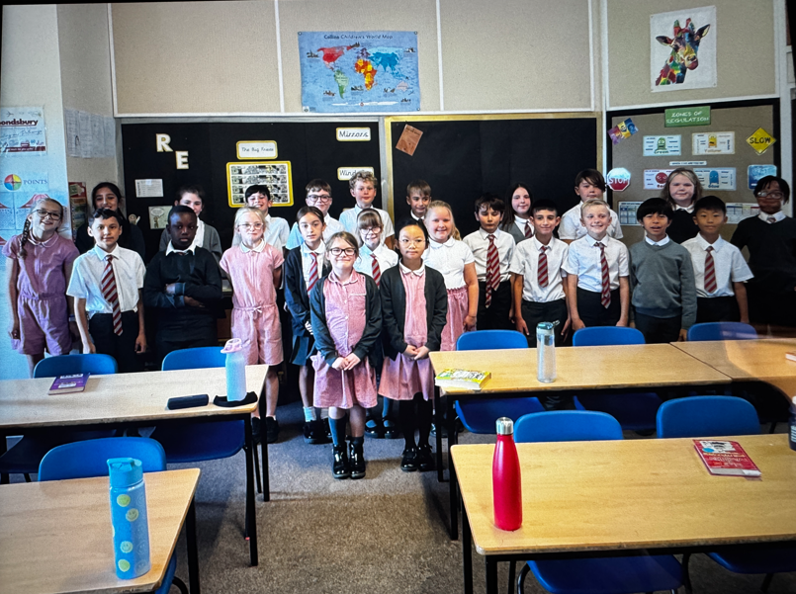
Miss Whittingham’s class!

Slide 3
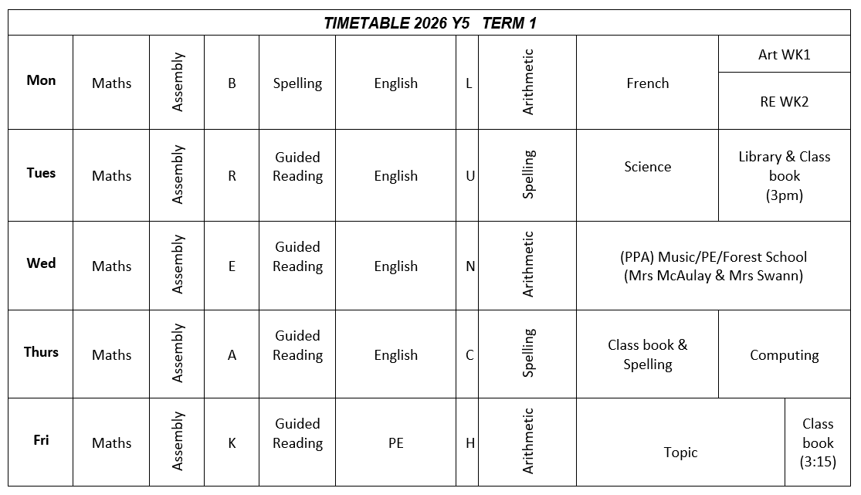
Year 5 Timetable
Subject to change over terms 3 & 5. Check our class webpage for more details.

Slide 4
Class teacher and support staff:
Miss Whittingham – class teacher
Miss Maddocks – support staff (Weds & Thurs morning)

Slide 5
PE & Forest School
Wednesday & Friday.
Children must wear their PE kits to school on PE and Forest School days. It is recommended that children also wear wellie boots and waterproof clothing for Forest School.

Slide 6
The School Day
Children can enter the Key Stage playground from 8.45 am.
The children will finish at 3.30pm and will be taken to the side of the school.
Children cannot walk home alone until they are in year 6.

Slide 7
Snacks and Water
To ensure hydration, children must bring water bottles to school.
These can be refilled in school. The children should bring a healthy snack to eat at break time.
Remember we are a nut free school.

Slide 8
Homework
Homework will be given out every Thursday or Friday and is expected to be handed in the following Tuesday.
The homework given will alternate between an English or Maths task, along with a Guided Reading text.
We have a library slot scheduled weekly, during our visit the children will have the opportunity to ‘borrow’ books which they can take home to read or keep in their drawer to read during reading time.

Slide 9
Spelling and Guided Reading
We will have a weekly spelling focus.
We will be using the Oxford Owl spelling scheme of work, which builds on the spelling strategies and patterns. We will progress with this scheme throughout the year.
We will not have weekly spelling tests but will instead complete regular application tasks that focus on spelling rules and patterns.
Guided Reading will take place on a Tuesday, Wednesday and Thursday. Children are expected to return their Guided Reading homework on a Tuesday.
Please support your children with this at home.

Slide 10

Online safety is a shared responsibility!
At School:
At home:
We need you to reinforce what is being taught at school, know what applications are age appropriate and closely monitor your child’s use of the internet.
We teach the children how to be safe online, how to use the internet responsibly and closely monitor their use.

Slide 11







Instagram
Tik Tok
Snapchat
Musical.ly
All of these applications have age limits!
Children must be 13 years old to use them!
WhatsApp
YouTube
Fortnite

Slide 12


School Policy
There is a clear section in our Computing policy that addresses use of the internet.

Slide 13

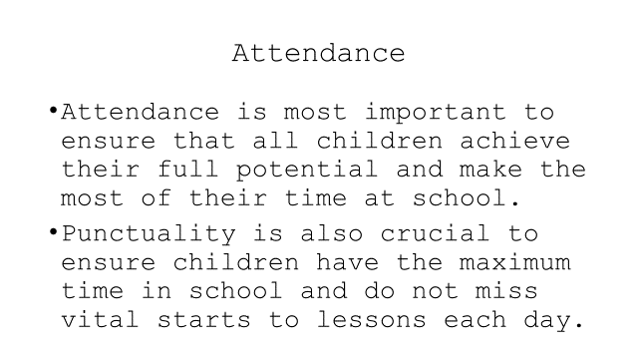

Slide 14
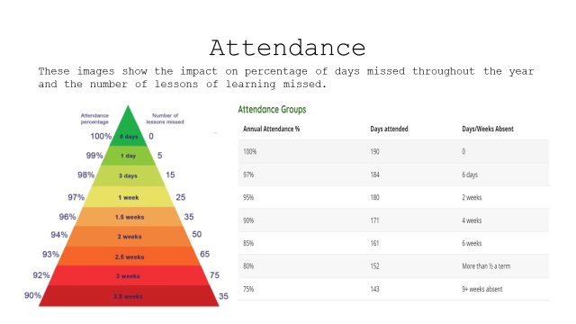

Slide 15
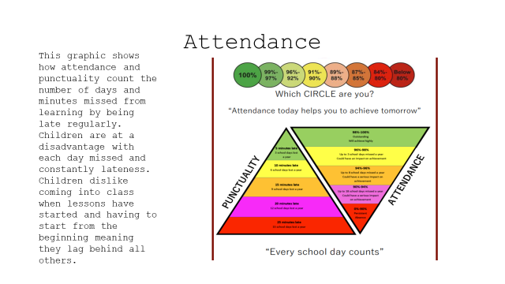

Slide 16
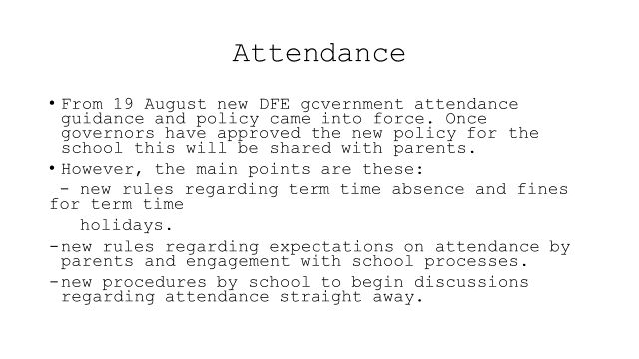

Slide 17
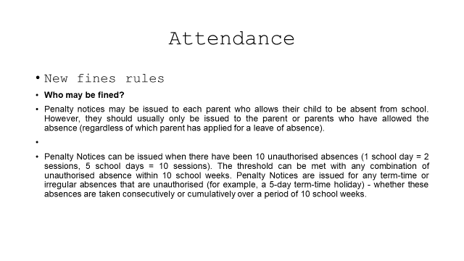

Slide 18
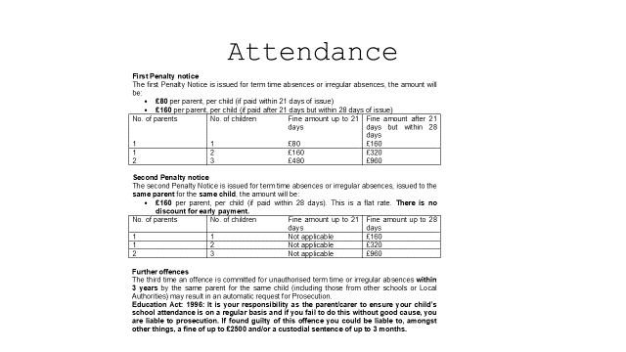

Slide 19
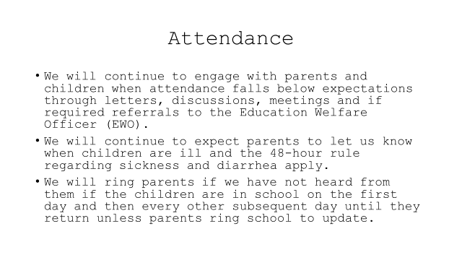

Slide 20
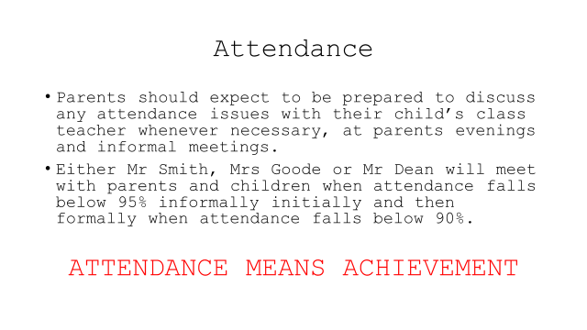

Slide 21
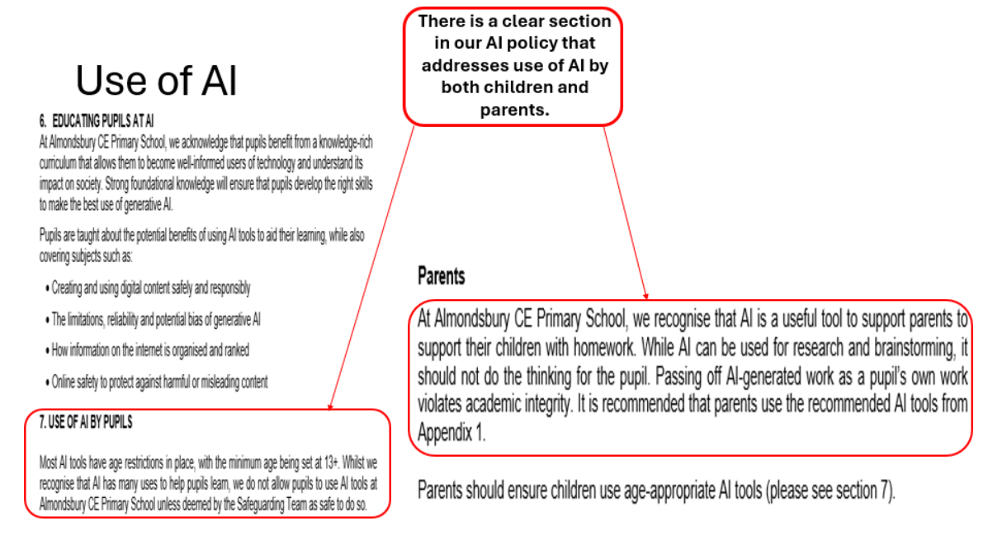

Slide 22


Slide 23
Questions?

Slide 24
Please feel free to email me directly:
Molly.Whittingham@almondsburyprimary.co.uk

