Slide 1

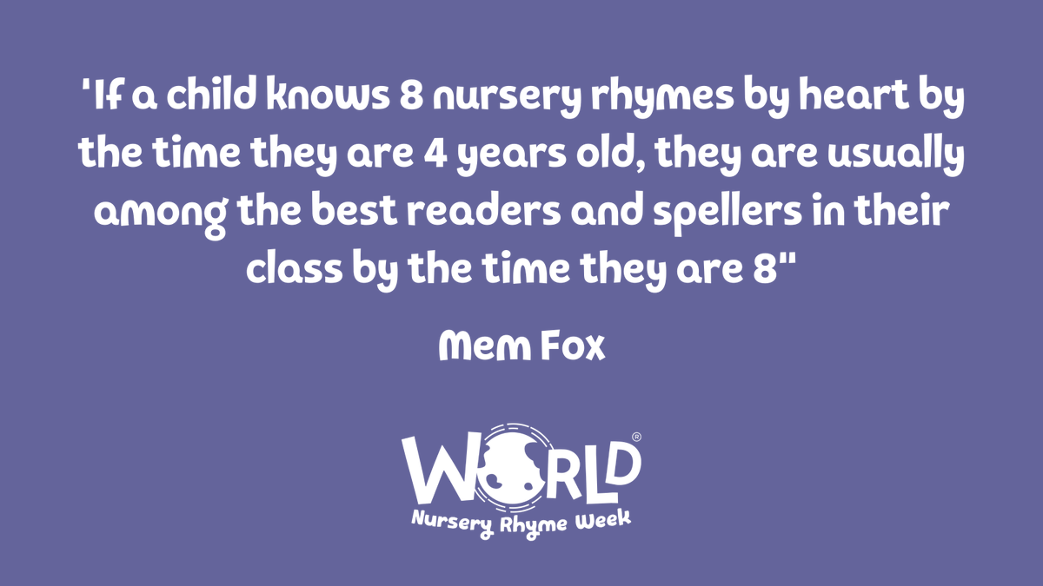


Slide 2

Welcome to …
Early Reading & Writing in Reception

Slide 3
What are we going to cover?
Phonics ~ Funky Fingers ~ Drawing Club
What is Phonics?
How we teach phonics
Supporting Phonics at home
Importance of Fine & Gross motor skill development for early writing
Mark making & emergent writing
How we teach children to write
Drawing Club

Slide 4
Phonics

Slide 5
What is Phonics and why do we teach it?
Method of teaching beginners to read and pronounce words by learning to associate letters or letter groups with the sounds they represent.
There are 26 letters in the alphabet but there are 44 main sounds in the English Language. Each sound is represented by a grapheme (the written representation of a sound).
English is one of the most challenging languages to learn as there are so many ways to spell the sounds of our language.

Slide 6
The /ai/ sound…
… has many different spellings
a – acorn
ai – rain
ay – play
a-e – name
eigh – eight
ey – they
ea – great
aigh – straight

Slide 7
The technical bit!
A phoneme is the smallest single identifiable of sound in a word. For example, in the word 'cat' there are three phonemes c/a/t.
A grapheme is a way of writing down a phoneme. It can be made up of…
1 letter - p
2 letters - sh
3 letters - igh
4 letters - ough
Digraph: two letters making one sound. For example, /sh/ in the word 'shop'.
Trigraph: three letters making one sound. For example, /igh/ in the word 'night'.
Split digraph: two vowel letters split by one or more consonants. For example, /a-e/ in the word 'cake'.

Slide 8
Pronouncing pure sounds
We only use pure sounds when decoding words (no ‘uh’ after the sound)
We must use pure sounds when we are pronouncing the sounds and supporting children in reading words.
If we mispronounce these sounds we will make reading harder for our children.
Phase 2 sounds ELS

Slide 9
Harder to read and spell words
Some words, we cannot decode (sound out phonetically) these are called ‘Harder to Read and Spell Words’.
These words the children have to learn to read by sight.
They will learn approximately 3 per week. e.g. the no pull there
The children will be issued with a ‘Harder to Read and Spell Word’ bookmark at the start of each term.

Slide 10

Essential Letters and Sounds (ELS)
Phonics is taught as a whole class. Your child will experience the same classroom routines within each lesson which reduces cognitive load and maximises the chances of success.
20 – 30 minutes everyday starting right from the beginning of Reception
Harder to Read and Spell words
Lots of opportunities for oral blending and robot arms - c/oa/t
Opportunities for writing - new grapheme, words and sentences

Slide 11

ELS
Robot arms
When sound-talking a word (orally segmenting it into the phonemes within the word), we use robot arms to physically make the link between the separating of the sounds. This assists children in hearing the separate sounds within the word. The word is said in ‘robot talk’ and then blending hands are used to blend the word.
Me, then you…
m-a-t mat, sh-i-p ship, s-p-oo-n spoon

Slide 12
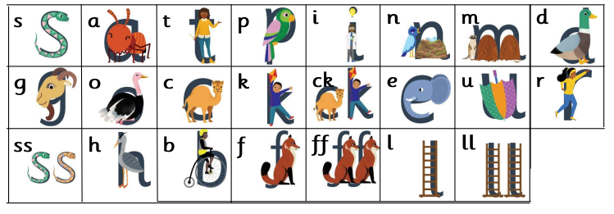
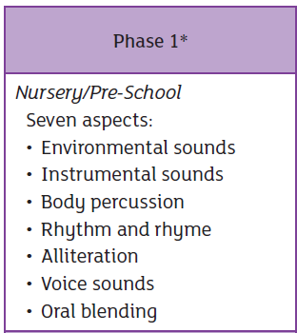
ELS progression
By October half term, the children will have learnt these Phase 2 sounds

Slide 13

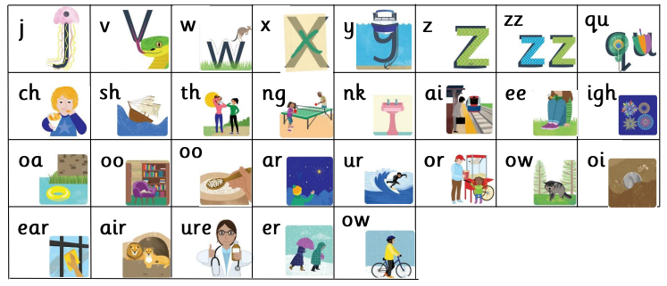
ELS progression
Phase 2
Phase 3

Slide 14
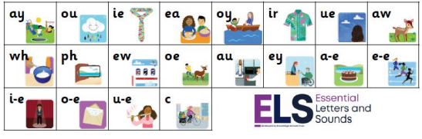
ELS progression
Phase 5

Slide 15
Reading at home
We want all our children to leave primary school able to read well and confidently – you can support us in this journey.
Only 1 in 3 children are read a bedtime story
Reading a bedtime story every night to your child improves their outcomes
If your child views themselves as a ‘good reader’ when they leave Primary School they are more likely to earn a higher salary in their 40s

Slide 16
Supporting your child to read at home
As per the scheme, initially, we will be sending home two books a week and change these each Friday
One is a wordless book to develop storytelling and vocabulary (please support your child in retelling a story as opposed to just describing what they can see on the page) and one matched to the phonics being taught in school
After the October half term, the children will bring home only one book per week, directly linked to the ELS scheme
Please ensure your child’s bookbag and reading folder is brought into school every day.

Slide 17
Supporting your child to read at home
Re-reading words and sentences until fluent is a key part of learning to read.
To best support us in teaching your child to read, we ask that you read the decodable text provided by the school four times across the week.
This will allow your child to re-read each text several times, building their confidence and fluency. This is especially important as they begin to learn that the sounds within our language can be spelled in different ways.
We want the children to practise reading their book 4 times across the week working on these skills:
Decoding
Fluency - reading with ease and precision
Expression/ comprehension of the text

Slide 18
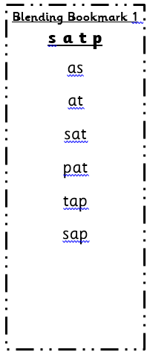
Supporting your child to read at home
Children are only reading from books that are entirely decodable. The texts sent home are carefully matched to the teaching taking place in school. Your child will be practising what they have been taught in school with you at home.
Blending Bookmarks
You can also support your child’s reading by practising robot arms at home.
Spending 5 -10 minutes a day reading with your child will hugely support them on their journey to becoming an independent reader.
Children who read regularly at home really do make more progress with their reading than those who do not.

Slide 19
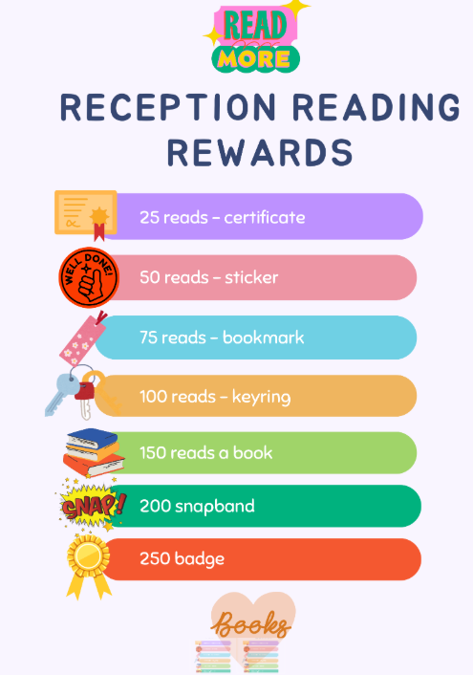

Slide 20
Funky Fingers

Slide 21
What are motor skills?
Gross Motor Skill Activities (Big Movements using large muscles) | Fine Motor Skill Activities (Small Movements using smaller muscles)
Running Climbing Throwing and catching a ball Scooting Pushing dolls prams/wheelbarrows Pouring sand and water Mixing cake ingredients Large chalks outside Sweeping Hopscotch Obstacle course/ going to the park Swimming | Fastening buttons/ zips Cutting Drawing Writing Threading Using cutlery Playdough Washing line & pegs Finger painting Sewing kits Small construction – Lego, Meccano, K-Nex Weaving

Slide 22
Why is the development of motor skills so important?
If we want children to grow up to be enabled and successful writers, we need to understand the stages of physical development in a child’s body and how these link to emergent writing.
If our children do not master these skills in The Early Years, they will not have the stamina or dexterity to form letters and begin to write.
It may not always be obvious at first glance that the activities and resources available to support children’s play and development are so important to their journey.

Slide 23
Motor skills
For motor skills to develop children must have opportunities to be physically active and be able to move and explore their environment.
If there are no opportunities given to move and be active then the co-ordination of motor skills cannot be developed.

Slide 24

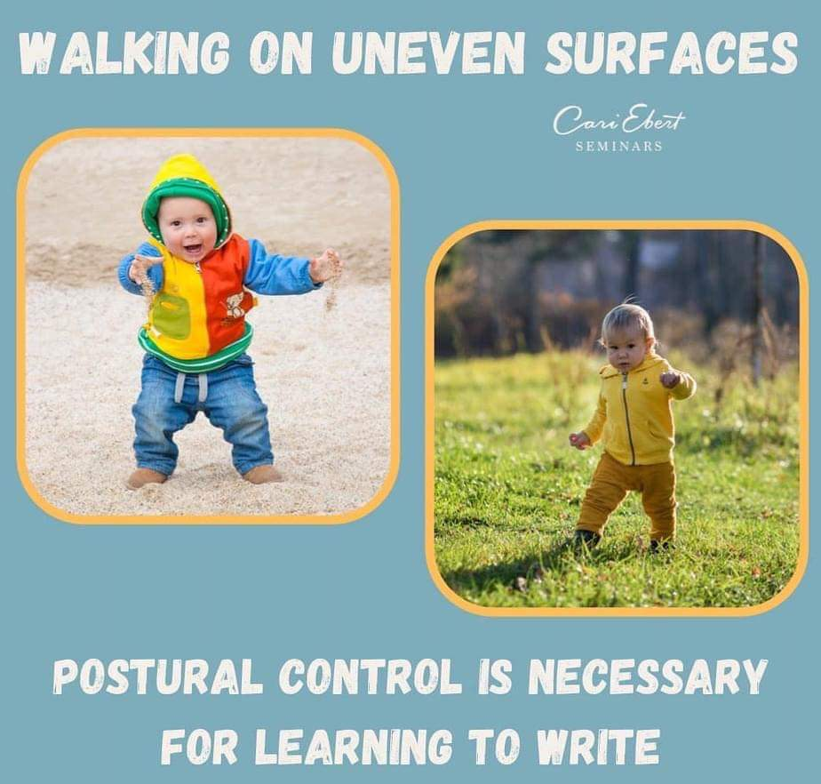
Shoulder pivot
During the early stages of development, when children are learning to support their head, reach, grasp and walk they are using a group of muscles in their pelvis, back, shoulders, arms and neck.
It is these upper body muscle groups that they use in the very emergent stages of mark making.

Slide 25
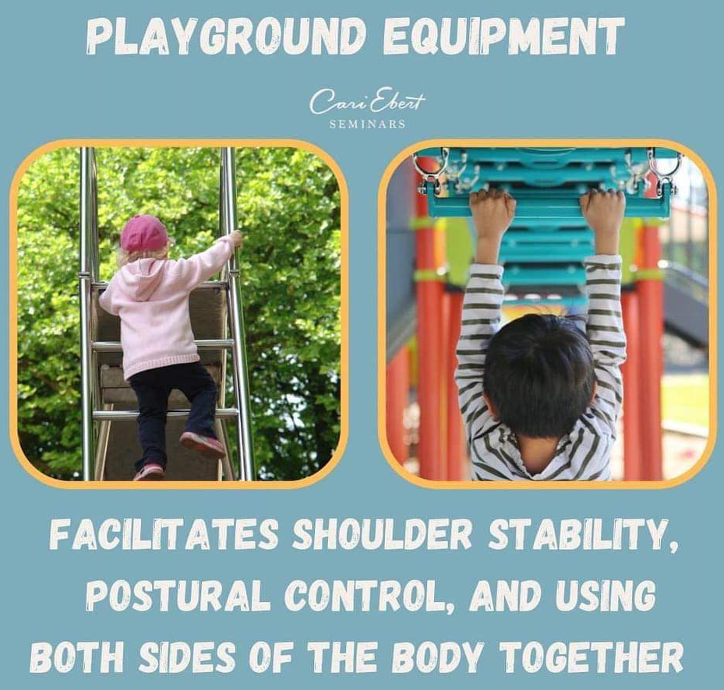
Activities to support shoulder pivot strength
Painting with big brushes (fences, walls, floors)
Trains in paint or shaving foam
Sweeping with brushes
Pushing buggies or wheelbarrows
Pouring water or sand
Scooter play
Mixing mud kitchen ingredients

Slide 26
Activities to support elbow pivot strength
Chalking on the floor
Water and sand play
Hammering nails
Climbing and pulling bodies up on ropes and climbing frames
Scarf and ribbon twirling
Stick/wand writing in the air
Construction materials like large wooden blocks
Elbow pivot
Once the muscles in the back, upper arms and shoulders begin to strengthen, there usually starts to be more movement further down the arm at the next point of pivot: the elbow.

Slide 27
Activities to support wrist pivot strength
Nuts and bolts
Threading beads
Sewing
Lacing pictures
Water and sand play
Finger football
Construction toys like Lego
Wrist pivot
As the arm muscles and sense of balance develop further then the pivot changes again, this time to allow an even smaller range of movement. The pivot moves to their wrist.

Slide 28
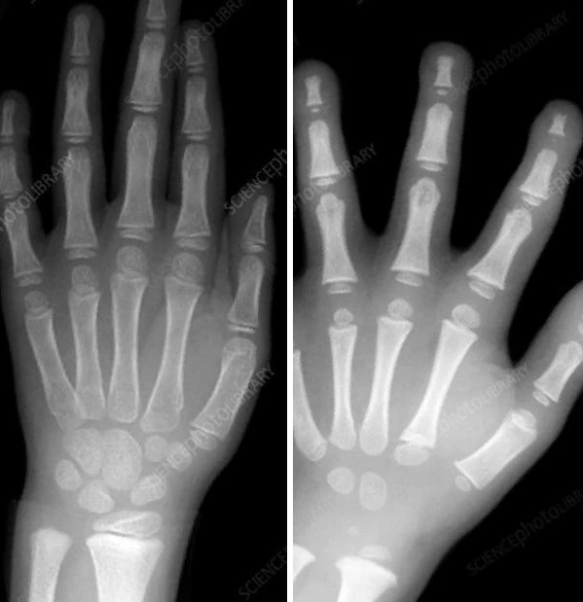
Fine motor strength
The hand is quite a complex piece of machinery and is made up of lots of different joints and muscle groups that interconnect and work together to provide maximum dexterity.
A 7 year old hand and an EYFS child’s hand.
The hand is physically underdeveloped

Slide 29
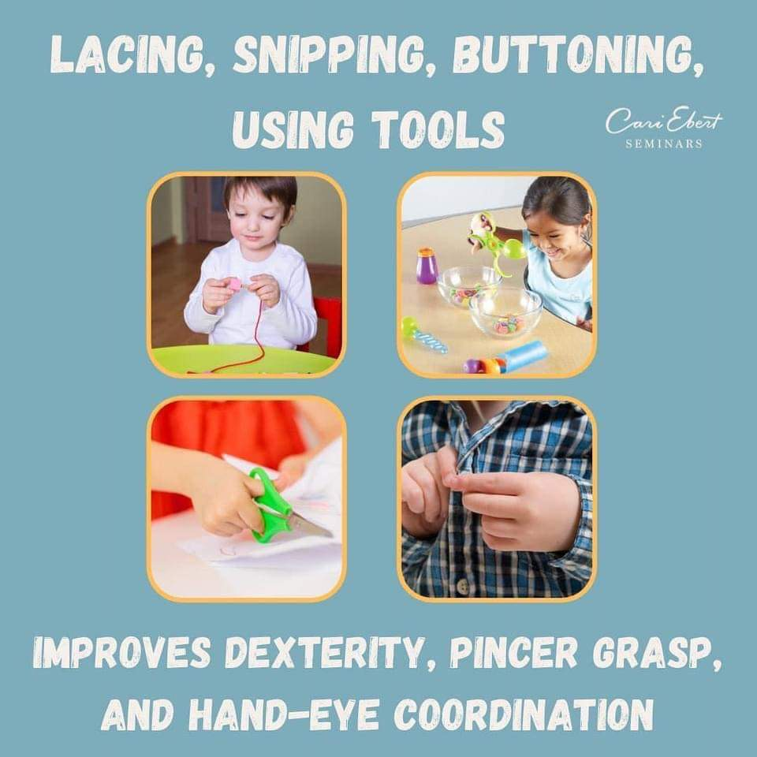
Activities to support fine motor strength
Washing lines and pegs
Dressing and undressing toys
Using cutlery
Dressing up clothes with a range of fastenings
Peg boards
Malleable materials (dough, clay, jelly, wet sand)
Tweezers to pick up small objects
Cutting with scissors
Construction materials

Slide 30
How you can help at home
Teach your child to use a knife and fork.
Encourage your child to dress themselves.
Get creative with your mark making – use paint, chalk, sticks in mud/sand, paint with water, bath crayons.
Allow your child to be as independent as possible with all tasks and allow them to take risks
Less screen time, more time being physical!

Slide 31
Drawing Club

Slide 32
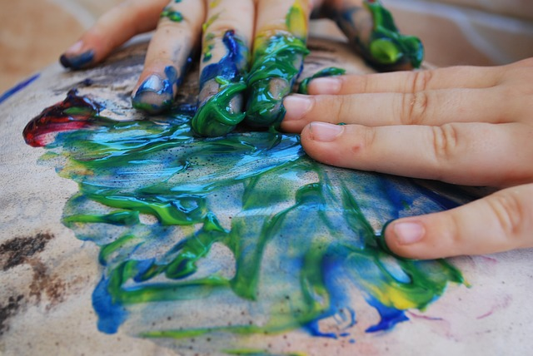
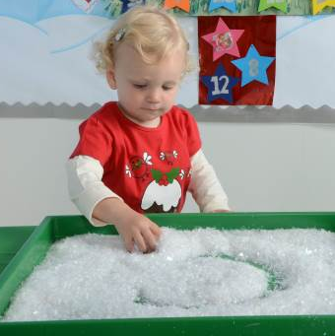
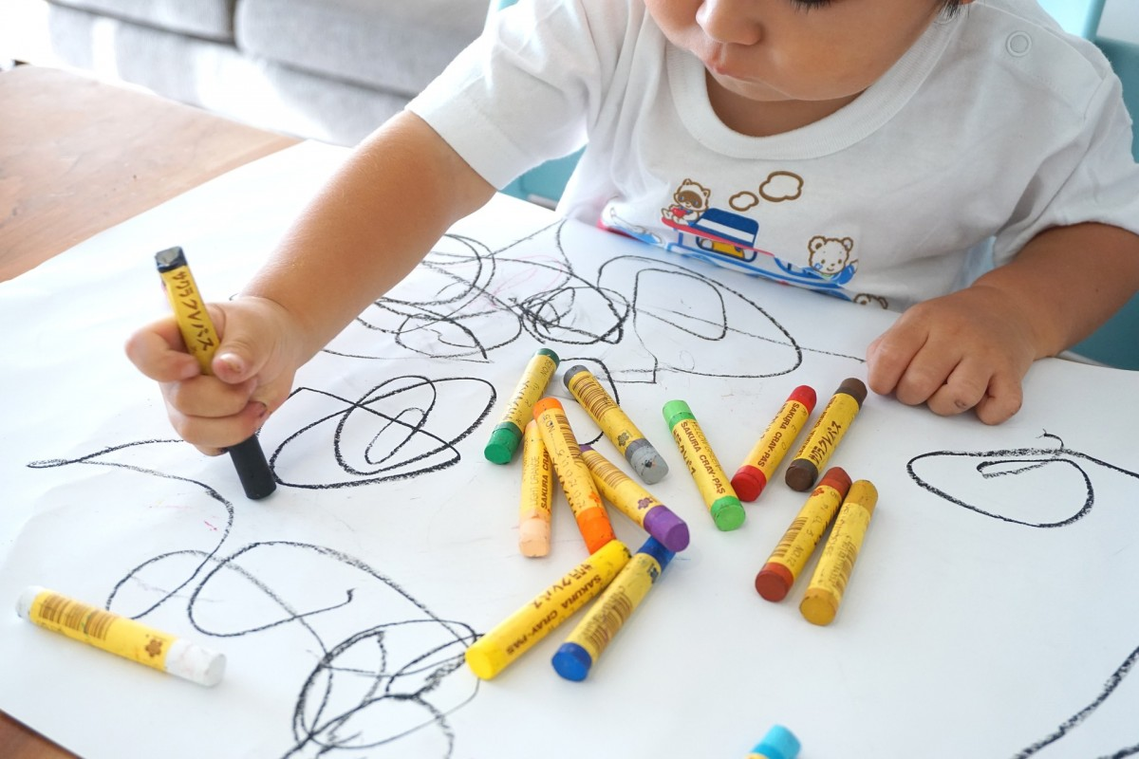
What is mark making?
Mark making in the Early Years is when children start to intentionally create their own lines, patterns, or shapes using their bodies or tools. It's the first step in a child's developmental journey towards writing and drawing, and is usually first seen in babies and toddlers.

Slide 33
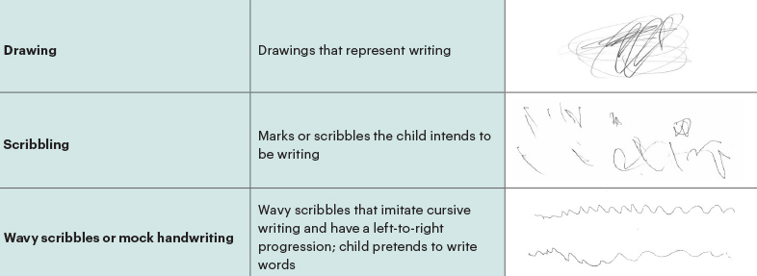
What is emergent writing?
Emergent writing is young children’s first attempts at the writing process. Children as young as 2 years old begin to imitate the act of writing by creating drawings and symbolic markings that represent their thoughts and ideas.

Slide 34



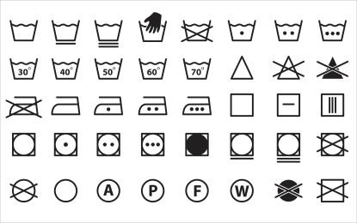

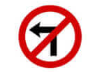
Symbols
Symbols are all around us and are something we use as part of our everyday lives.
Symbols communicate a message or an instruction. Do you recognise these?

Slide 35
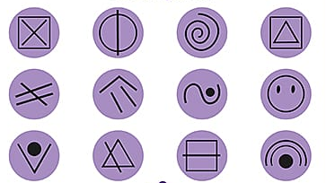
Secret symbols
To children, letters are symbols, until they learn what they are, they are just a series of lines, curves and dots.
In Reception, we introduce ‘Secret Symbols’, these are any symbols which the children can draw/write, which can mean whatever their imaginations want them to be!
“Young children need to feel 3 things when they write and mark make: joy, purpose and magic.” Greg Bottrill

Slide 36

The Message Monster
The Message Monster visited Reception today!
The Message Monster communicates using ‘Secret Symbols’! The purpose of this is to encourage the children to mark-make and give meaning to what they have ‘written’.
Using ‘Secret Symbols’ gives children the confidence to start mark making.
Writing can and should be a positive experience. Children can so quickly become ‘reluctant writers’ so we need to make it fun, inviting and engaging.
When ‘messaging’ takes off, the phrase ‘reluctant writers’ goes out the window!

Slide 37

Drawing Club
Each week in Reception we have a focus book.
We introduce key vocabulary words linked to the story. Each word has an action to help us remember the word.
We complete Drawing Club twice a week:
Day 1 – draw the character or a setting
Day 2 – I wonder … question

Slide 38
Drawing Club
The children are encouraged to add detail to their drawings and explain to the adults what they have drawn.
By the end of the year, they will be drawing pictures and writing sentences.
Words do not have to be spelled correctly, just phonetically plausible.

Slide 39
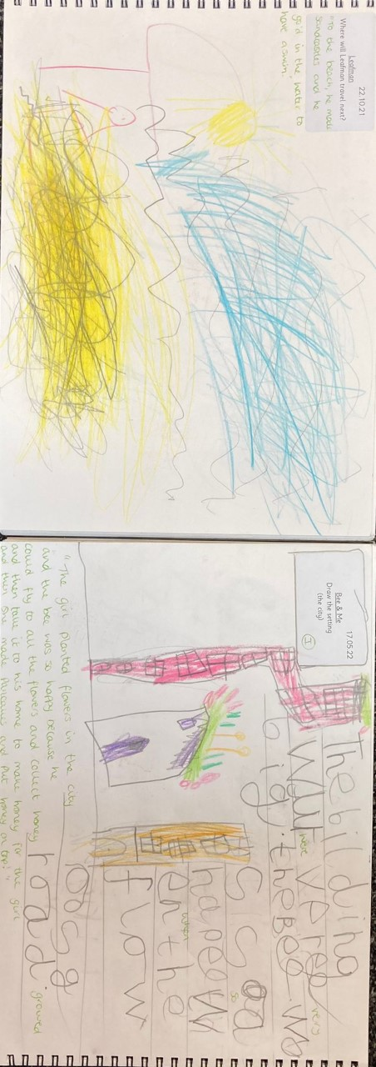
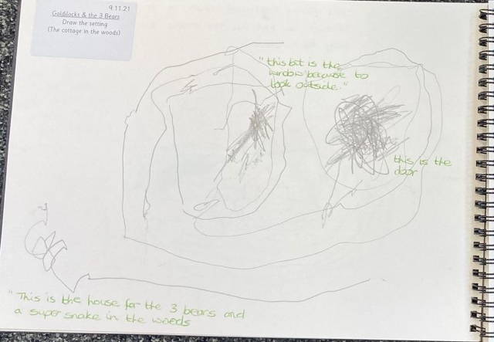
Drawing Club

Slide 40
Drawing Club

Slide 41
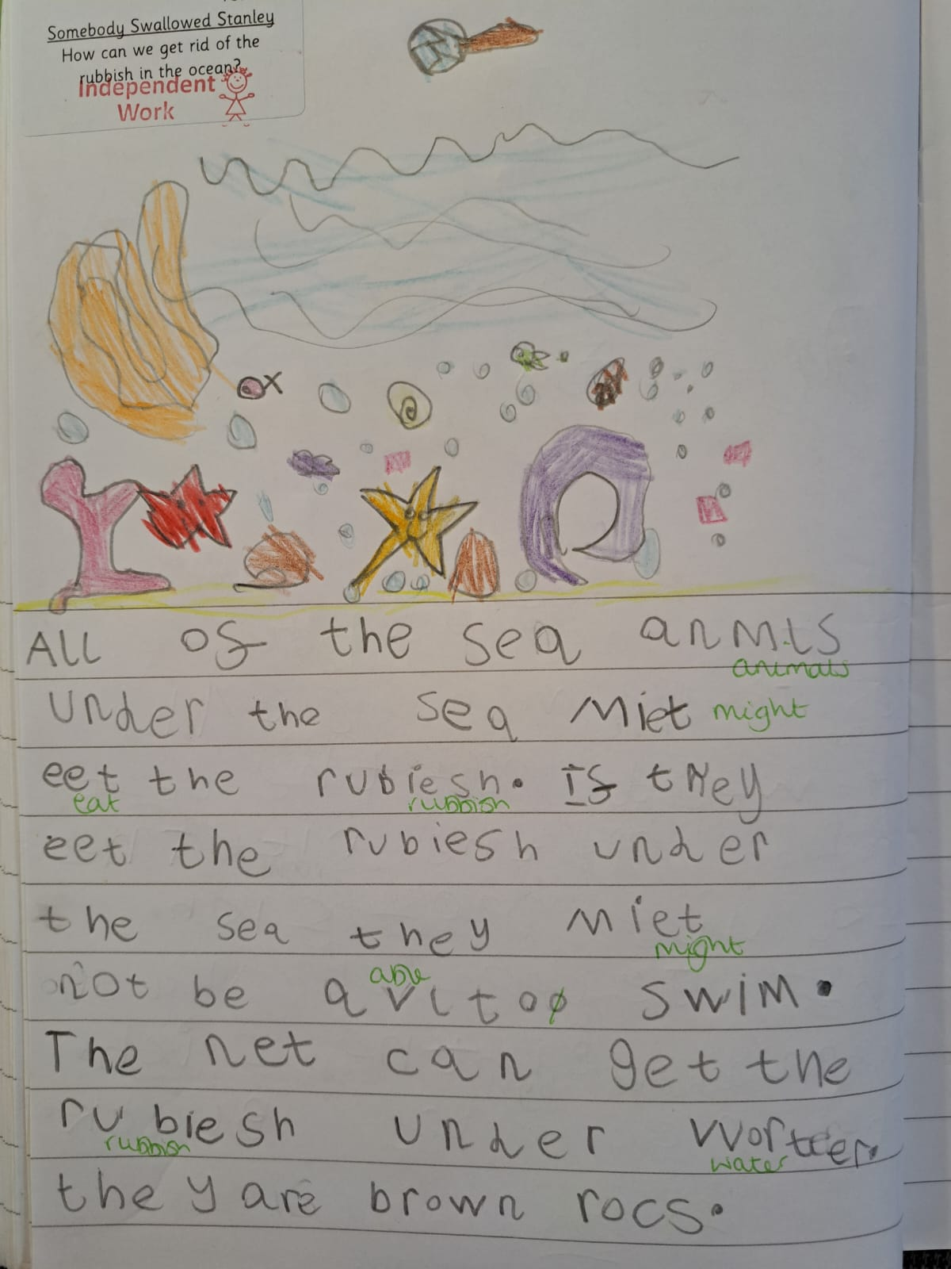
Drawing Club

Slide 42
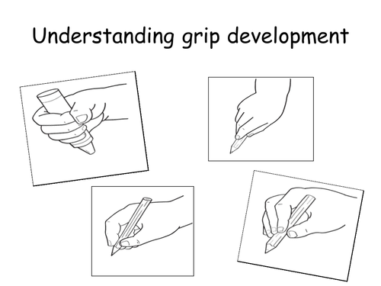
Pencil grips
According to their stage of development, children progress through stages of pencil grips. They will only be ready to grip a pencil in the most efficient grip (image 4) once they have developed the fine motor strength to do so.
By the end of Reception, most children will be using a tripod grip.

Slide 43
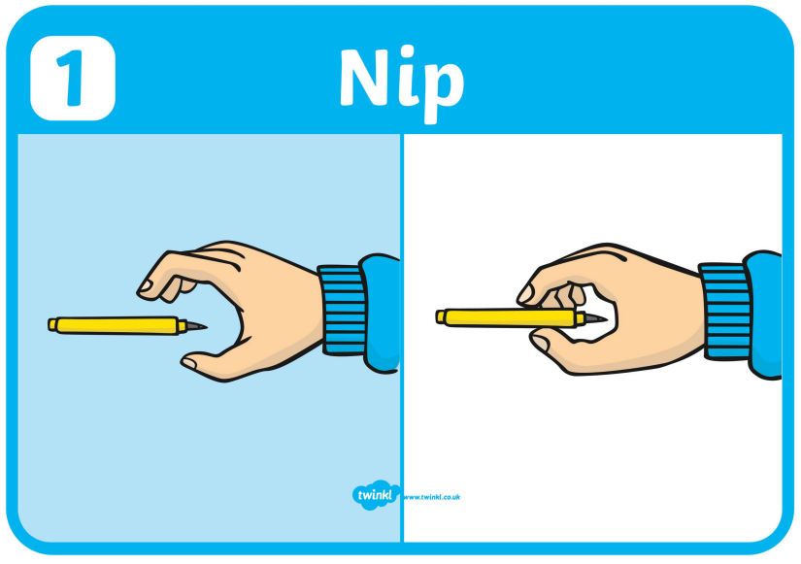
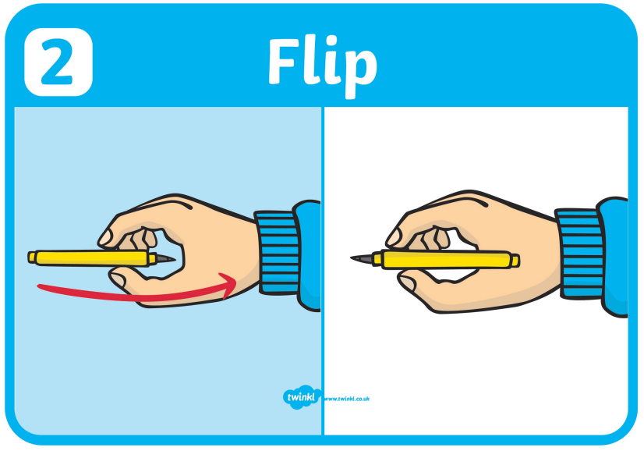
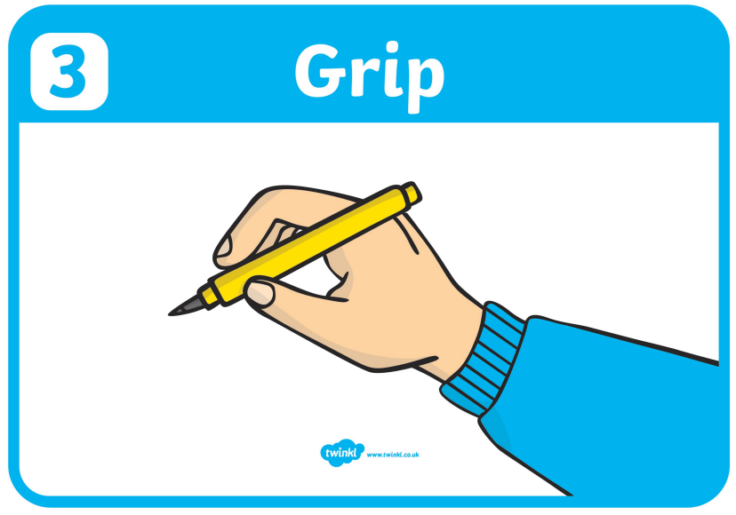
How to hold a pencil
Put the pen or pencil in front of your child with the nib facing them.
Encourage them to pick up the pencil, in their preferred hand, with their fingers.
Flip it back and grip it.
Left handed children will find it helpful to sit slightly at an angle to the table and have their page also at an angle to see their writing.

Slide 44
How to help at home
Get messaging! Leave Secret Symbols around the house, in your child’s bed, in their shoes, in their lunchbox! Send messages from their favourite toys e.g. a teddy, superhero etc. and encourage them to message back.
Look for Secret Symbols whilst you are out and about, what do they mean?
Get creative with mark making – use chalk, paint, mud, water, glitter, shaving foam, the possibilities are endless!
When they are ready encourage them to form letters.
Remember to write words phonetically, this will mean that some words are spelled incorrectly but that is ok! e.g. sinumu (cinema) sosij (sausage)

Slide 45
Thank you for coming, are there any questions?

