Slide 1
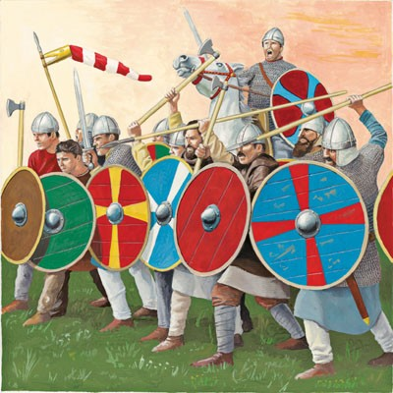
History of the Anglo-Saxons
WALT: understand who the Saxons were.
Understand where they came from.

Slide 2
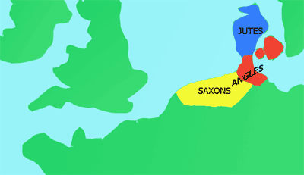
Where did the Anglo-Saxons come from?
Do you know what these places are called today and who lives there?
Click here to view a map
TTYP - Why do you think they came to England?

Slide 3
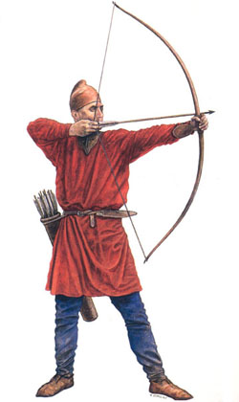
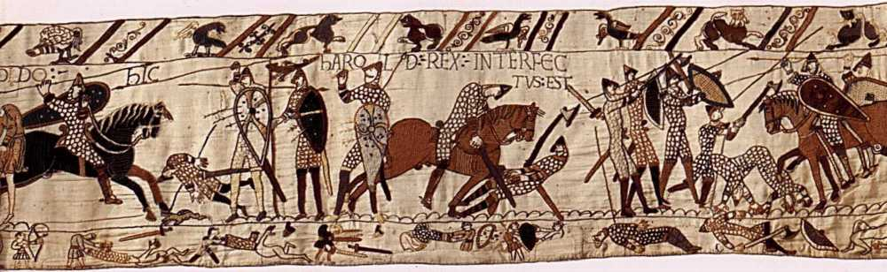
The Anglo-Saxons came from Denmark, Germany and the Netherlands.
These fearsome warriors rowed across the n
North Sea in wooden boats to England and forced the tribes in Britain to flee their homes.
Within a few centuries, the land they had invaded was known as England, after the Angles.

Slide 4
But, who were they..?
Talk to your partner.
Who do you think they were?
Click ahead to find out!!

Slide 5
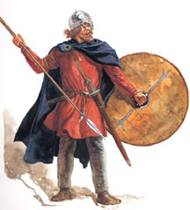
Believe it or not, the Anglo-Saxons were warrior-farmers. They began to invade Britain while the Romans were still in control.
They wanted control and land.
The Anglo-Saxons were tall, fair-haired men, armed with swords and spears and round shields.
Their other skills consisted of hunting, farming, textile (cloth) production and leather working.

Slide 6
There were three groups of people who settled in Britain which together, are called the Anglo-Saxons.
These three groups are called:
Jutes
Angles
Saxons
The Angles and the Saxon tribes were the largest of the three attacking tribes and so we often know them as Anglo-Saxons.

Slide 7
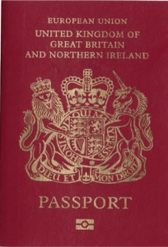
Your Task…
Create an information passport for the Anglo-Saxon Warrior.
Use your imagination from
what you have learnt and
you must include:
Name
Where they were born
How they travelled
What was their job title?
A picture of an Anglo-Saxon
A small description of why they
came to England.

